Slide 1
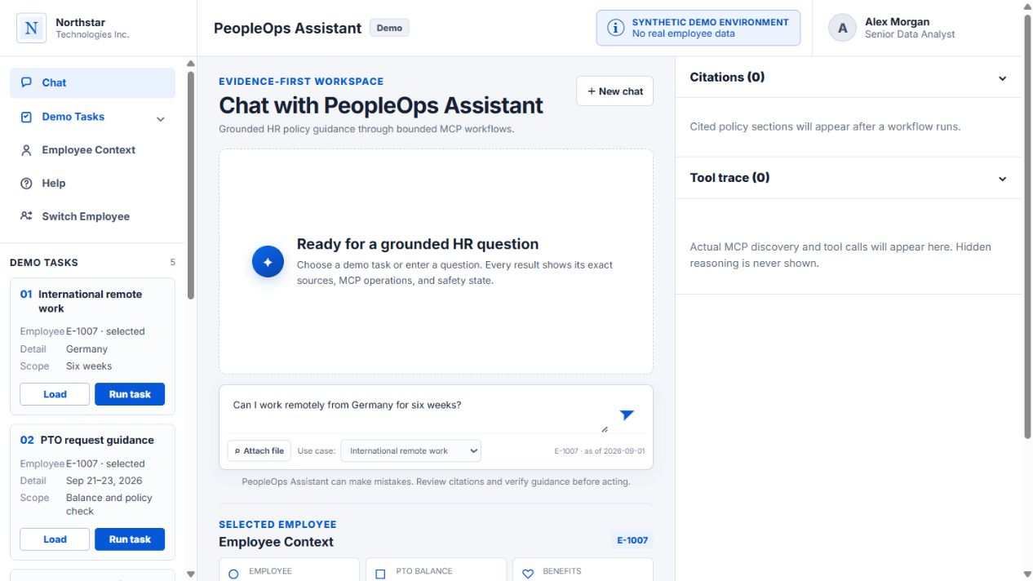
PEOPLEOPS ASSISTANT
Two agentic tasks, fully traceable
Live MCP tool calls, grounded citations, and safe final outcomes.
8 MCP operations
2 end-to-end tasks
Synthetic demonstration · Northstar Technologies Inc.
Notes:
Open by stating that the demonstration will prove two agentic tasks end to end. For both tasks, show MCP tool names, sanitized arguments, outputs, citations, and the final answer or action. State that all data is synthetic.

Slide 2
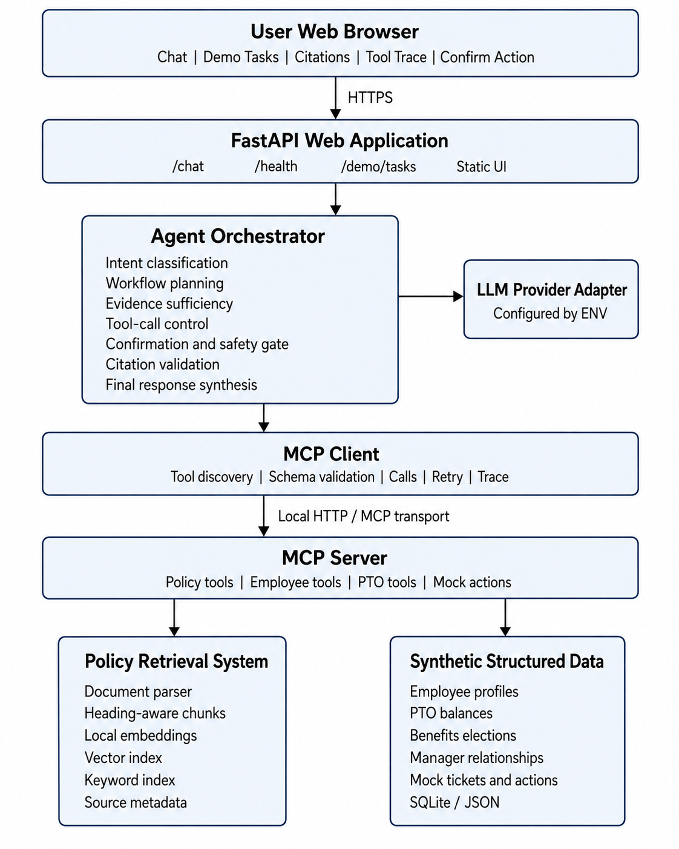
DESIGN
The agent plans; MCP performs every evidence operation
Bounded orchestration
Intent routing chooses a typed workflow; the LLM cannot invent tools or citations.
Official MCP boundary
Discovery, schema validation, calls, retries, and sanitized traces cross the MCP client/server boundary.
Grounded synthesis
Exact policy sections and structured data are validated before the final answer is displayed.
UI → FastAPI → Orchestrator → MCP → RAG / synthetic data
02
Notes:
Walk from the browser to FastAPI, the agent orchestrator, and the MCP client/server. Emphasize that tool discovery and typed calls are visible, while hidden chain-of-thought is never shown. The LLM only summarizes verified evidence after the workflow completes.

Slide 3
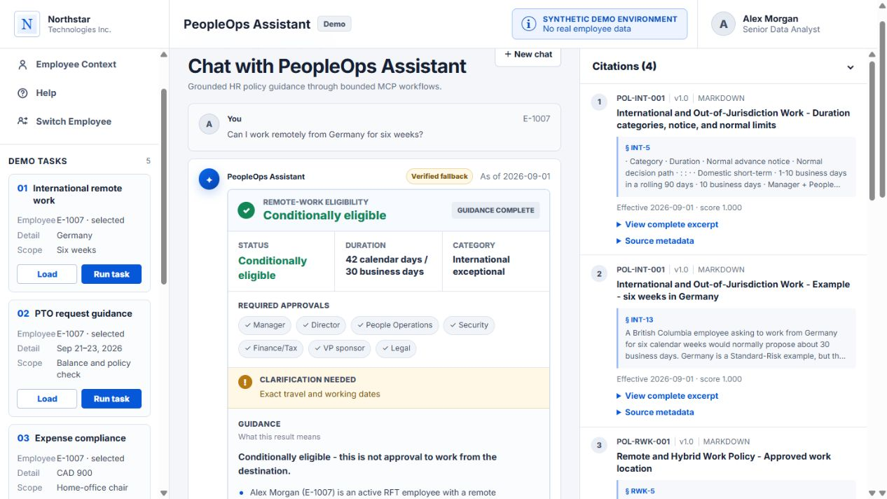
AGENTIC TASK 1 · INTERNATIONAL REMOTE WORK
Task 1 returns conditional eligibility, not an invented approval
Prompt
Can I work remotely from Germany for six weeks?
Final answer
Conditionally eligible
30 business days · international exceptional
Required citations
INT-5 · INT-13 · RWK-5 · SEC-8
Exact travel dates still required
03
Notes:
Run the International remote work demo for E-1007. Read the prompt and point to the final status: conditionally eligible. Explain that six calendar weeks is treated as about 30 business days and therefore international exceptional. Point out the required approvals and the clarification for exact dates. Name all four cited sections.

Slide 4
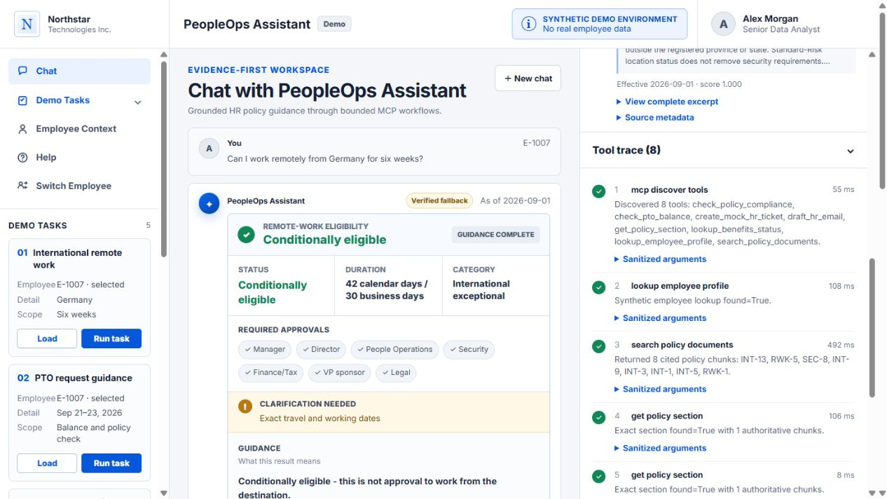
TASK 1 · TOOL NAMES AND OUTPUTS
Eight MCP operations form a visible evidence chain
1
mcp_discover_tools
Output: 8 discoverable tools
2
lookup_employee_profile
Output: employee found
3
search_policy_documents
Output: 8 ranked policy chunks
4–7
get_policy_section ×4
Output: one authoritative chunk each
8
check_policy_compliance
Output: conditionally_eligible / international_exceptional
Visible trace: success state, result summary, duration, sanitized arguments
04
Notes:
Name each tool in order. Explain the output shown beside it: discovery returns eight tools; employee lookup finds E-1007; search returns eight ranked chunks; four exact-section calls each return one authoritative chunk; compliance returns conditionally_eligible and international_exceptional.

Slide 5
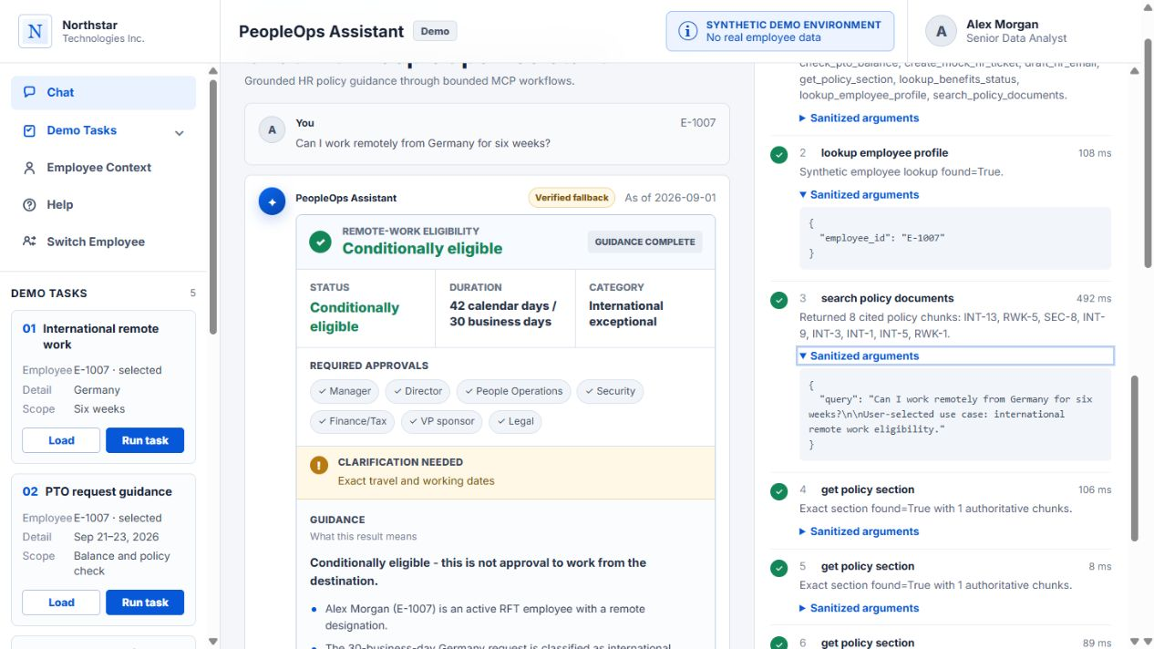
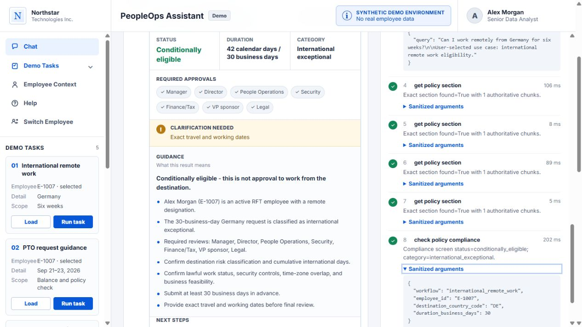
TASK 1 · ARGUMENTS, OUTPUTS, CITATIONS
Arguments bind the decision to one employee, destination, and duration
Lookup + retrieval arguments
Compliance arguments
employee_id = E-1007 query = Germany / six weeks
workflow = international_remote_work destination_country_code = DE duration_business_days = 30
Exact policy calls: POL-INT-001/INT-5, POL-INT-001/INT-13, POL-RWK-001/RWK-5, POL-SEC-001/SEC-8
05
Notes:
Open the sanitized arguments. For lookup_employee_profile, show employee_id E-1007. For search_policy_documents, show the user question. For check_policy_compliance, show workflow international_remote_work, country DE, and 30 business days. Connect those arguments to the four exact retrieved citations and the conditional final answer.

Slide 6
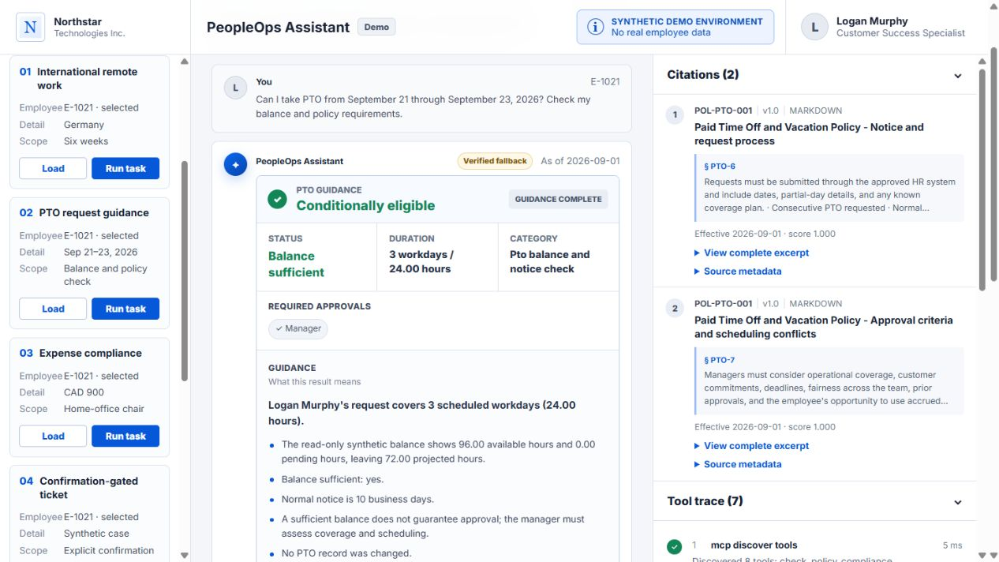
AGENTIC TASK 2 · PTO REQUEST AND MANAGER DRAFT
Task 2 combines a live balance calculation with policy guidance
Prompt
E-1021 requests PTO for Sep 21–23, 2026.
Structured output
96 h available → 72 h projected
3 workdays / 24 h · balance sufficient
Retrieved citations
PTO-6 · notice and request process PTO-7 · approval criteria
No PTO record changed
06
Notes:
Switch to Logan Murphy, E-1021, then run the PTO task. Explain that check_pto_balance calculates three scheduled workdays and 24 hours. The returned balance is read only: 96 available, zero pending, and 72 projected. Name PTO-6 and PTO-7 and explain that sufficient balance is not manager approval.

Slide 7
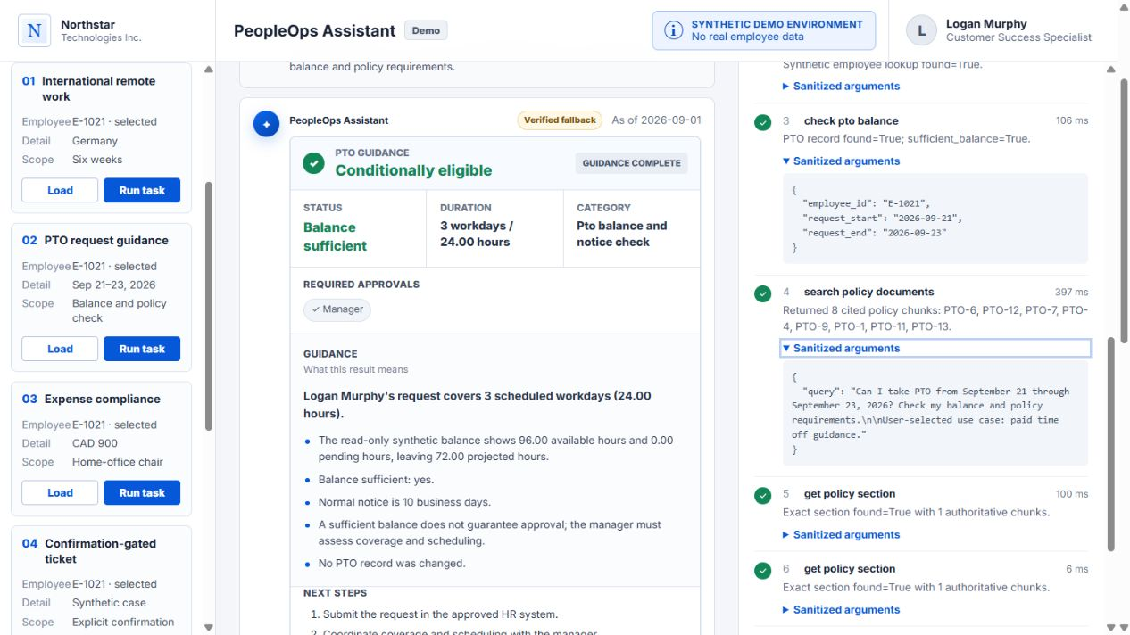
TASK 2 · TOOL NAMES, ARGUMENTS, OUTPUTS
The PTO workflow joins structured data and exact policy sections
1–2
discover → lookup profile
3
check_pto_balance
E-1021 · 2026-09-21 → 2026-09-23 Output: found=true; sufficient=true
4
search_policy_documents
Output: 8 ranked chunks
5–6
get_policy_section ×2
PTO-6 and PTO-7
7
check_policy_compliance
Output: conditionally_eligible
Safety result: read only; no PTO mutation
07
Notes:
Name the tools in order. Expand check_pto_balance to show employee_id E-1021 and the exact start and end dates. Explain that its result says the PTO record was found and the balance is sufficient. Then show search, the two exact section calls, and the final compliance output. State again that this path performs no mutation.

Slide 8
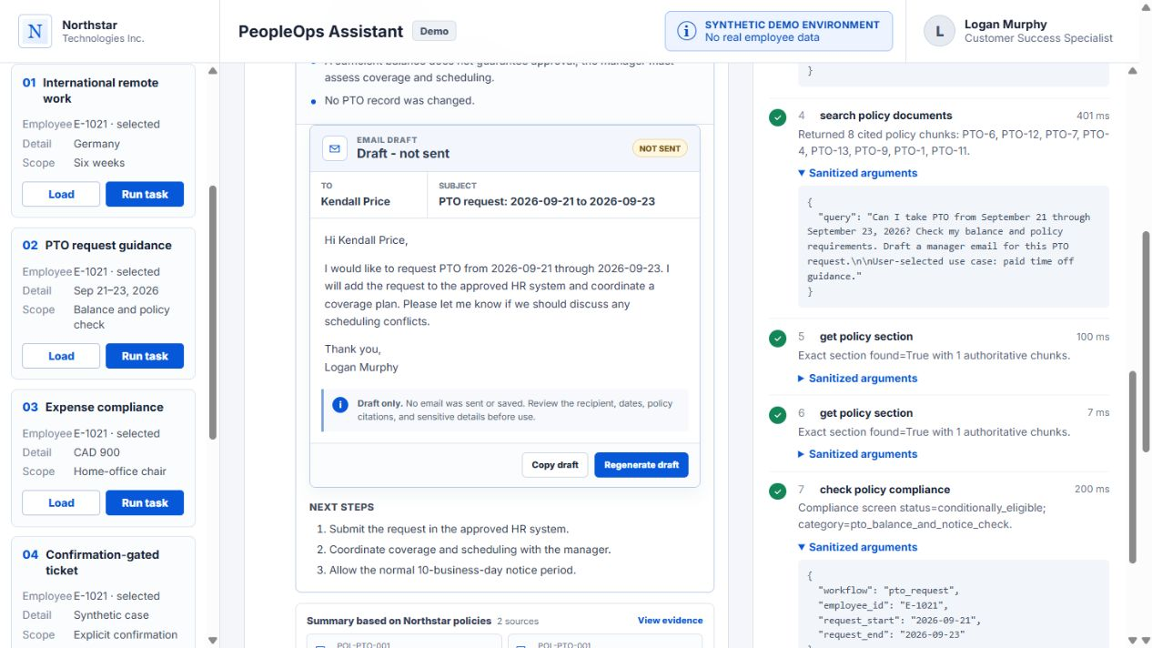
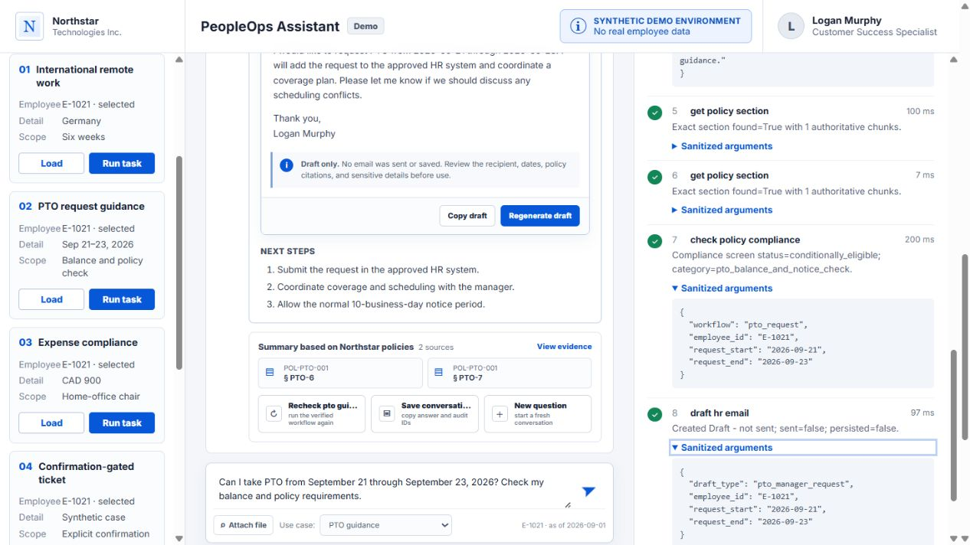
TASK 2 · FINAL ACTION AND SAFETY BOUNDARY
The final action is a structured draft that is neither sent nor saved
Visible action output
draft_hr_email
To: Kendall Price Subject: PTO request 2026-09-21 to 2026-09-23
Arguments: pto_manager_request, E-1021, start/end dates Output: Draft - not sent; sent=false; persisted=false
The assistant produces a reviewable artifact without creating a PTO record or sending an email.
08
Notes:
Click Generate draft email. Point to the structured draft: recipient Kendall Price, the exact date-range subject, and the body. Then point to the tool trace for draft_hr_email. Read the key output flags: sent=false and persisted=false. This is the final action for task two, and it remains reviewable and reversible.

Slide 9
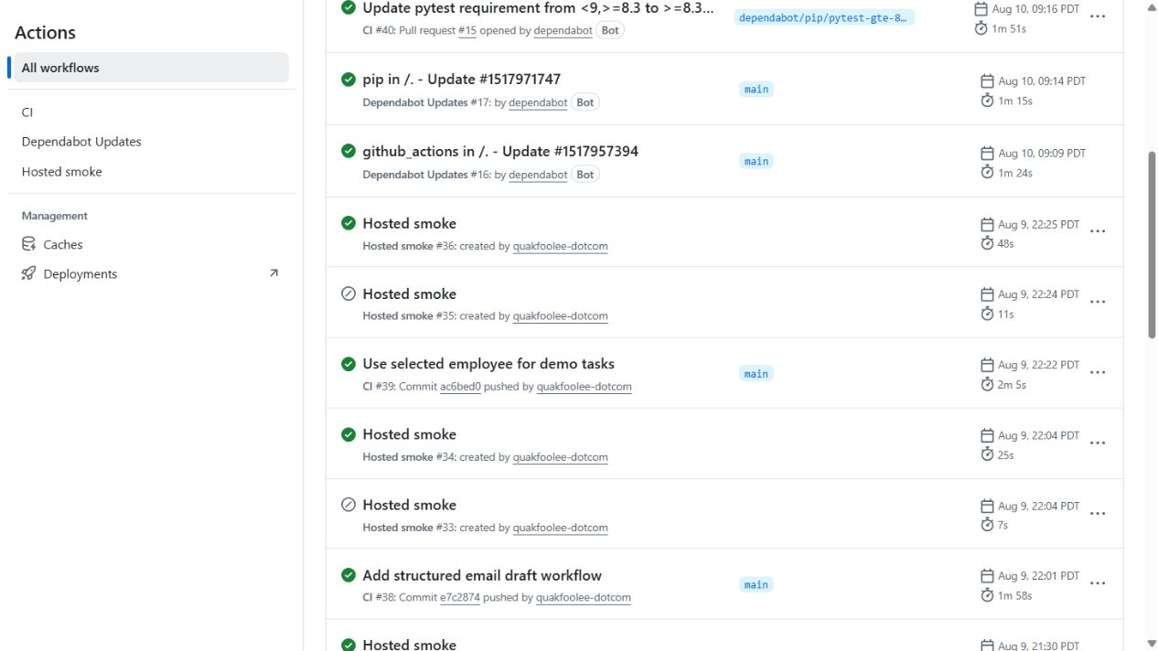
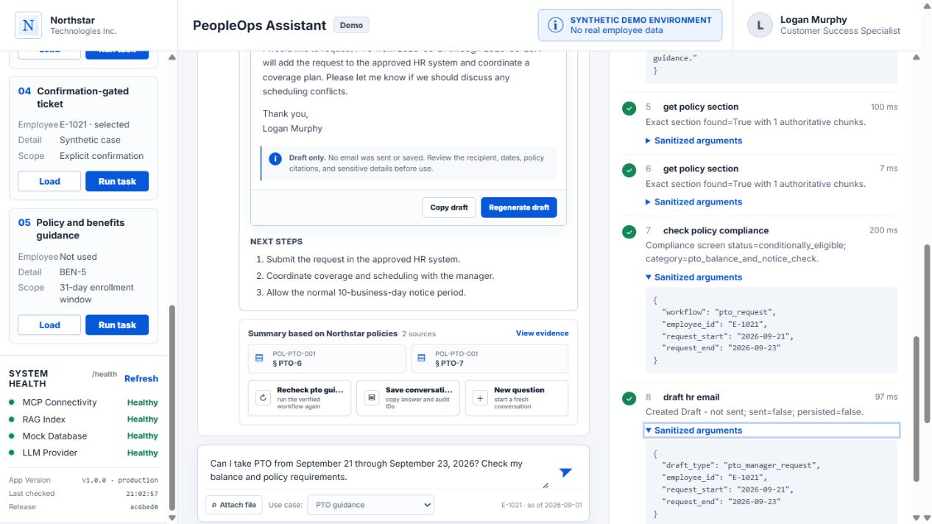
DEPLOYMENT AND CI/CD
CI and hosted smoke bind the deployed app to an exact release
Runtime health
Release pipeline
MCP · RAG · mock DB · LLM provider = Healthy
CI #39 and Hosted smoke #36 passed for commit ac6bed0
09
Notes:
Show the health panel: MCP, RAG, synthetic data, and the provider are healthy. State the production version and release ac6bed0. Then show GitHub Actions: CI #39 passed for that commit and Hosted smoke #36 passed after deployment. Explain that the hosted smoke checks health, release identity, root UI, and a read-only MCP workflow.

Slide 10
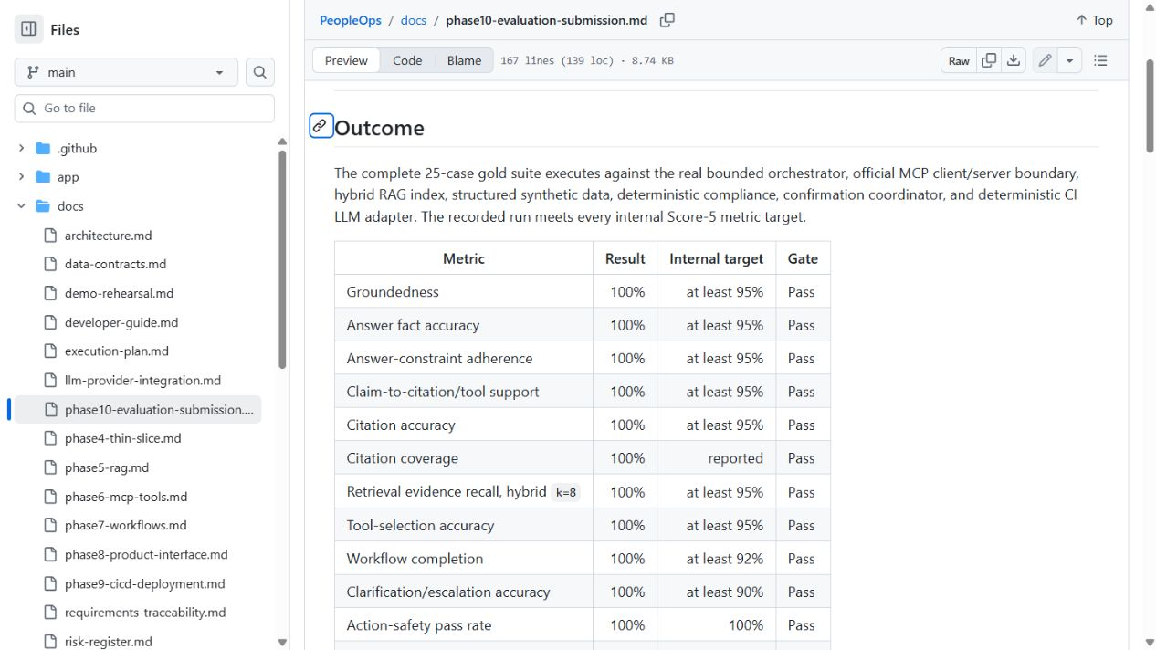
EVALUATION RESULTS
Evaluation measures the exact properties shown in the demo
25 / 25
gold cases completed
100%
groundedness + citation accuracy
100%
tool selection + workflow completion
100%
action-safety pass rate
10
Notes:
Walk the first rows of the evaluation table. The 25-case gold suite reports 100 percent groundedness, answer accuracy, claim support, citation accuracy, retrieval recall, tool selection, workflow completion, clarification accuracy, and action safety. Both primary workflows also completed ten consecutive warm runs. Frame these as bounded synthetic evidence, not a production SLA.

Slide 11
CONCLUSION
Production-shaped and deliberately bounded
2
8
6
0
agentic tasks completed end to end
MCP operations in each final task
exact citations across both tasks
emails sent or PTO records changed
What the audience should retain
Live app
The agent selects a bounded workflow, calls MCP tools with visible arguments, validates exact evidence, and returns a safe answer or draft.
peopleops-assistant-demo.onrender.com
Release
ac6bed0 · synthetic demo
11
Notes:
Close by restating the proof: two end-to-end tasks, visible MCP operations, six exact citations, and zero real-world writes. The key design choice is that provider generation is not a correctness dependency; verified deterministic results remain available when the free provider is unavailable or rejected by the grounding gate.

