Slide 1
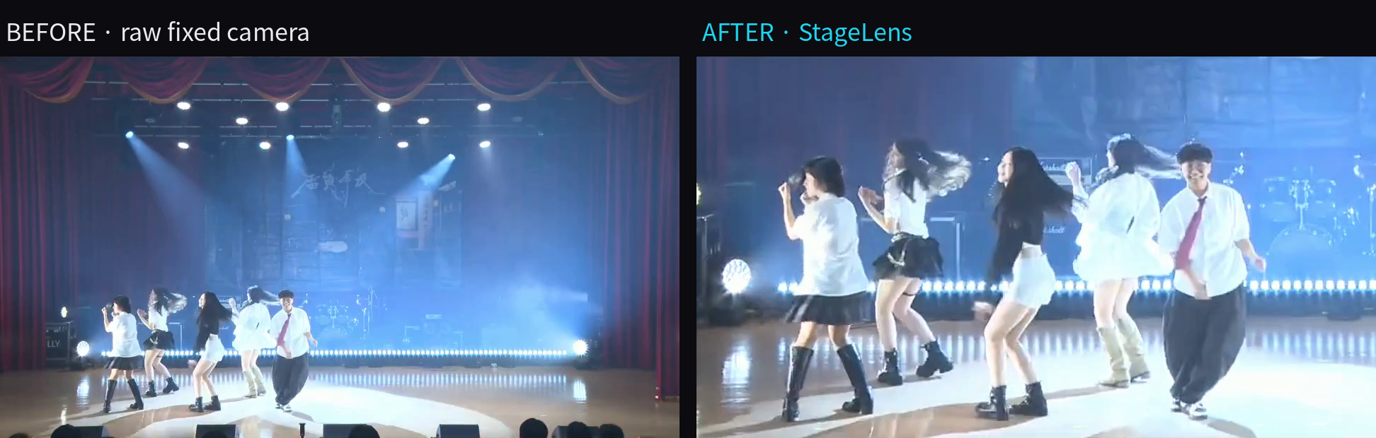
One fixed camera in, a performer-focused shot out
– RESULTS · AUTO-FRAMING –
Left: raw footage. Right: StageLens output. Same clip, no operator.
1.1×–2.3×
virtual zoom, capped at 2.5×
5–6 dancers
kept fully in frame
0 cut heads
in 40 sampled frames
REAL STAGE FOOTAGE · 1080P 60 FPS · CPU PROTOTYPE
Notes:
Clip A (5 dancers, warm/white spotlights), 1080p 60 fps. Zoom range and the 0-cut-heads claim come from sampled frames (20 per clip for clips A and C, checked visually), not a frame-by-frame audit. Footage is from a downloaded video: confirm licence and performer consent before public use.

Slide 2
Works across lighting setups, and we know where it stops
– RESULTS · ROBUSTNESS –
Clip | Content | Dancers | Zoom | FPS (CPU)
A | warm / white spotlights | 5 | 2.14× | 5.8
C | blue light | 6 | 2.15× | 4.6
D | purple backlight, dark outfits | 7 | 1.97× | 5.3
B | 8 → solo + 2 kneeling | 8 → 3 | 1.48× | 5.7
Known limits
Crowds wider than 80% of the stage fall back to a full frame
A lead performer among side performers is not picked yet → Stage II
Lighting restoration needs over-exposed faces; effect is small on wide stage shots
Zoom = median virtual zoom per clip. B is the current limit: side performers keep the crop wide.
TESTED ON 4 CLIPS · WARM SPOTS, BLUE LIGHT, PURPLE BACKLIGHT
Notes:
Clips A, C, D, B: 30 s each from one fixed-camera performance. Clip B is shown on purpose: with a solo dancer and two kneeling performers at the sides the crop stays wide (zoom median 1.48x), which is the lead-performer selection planned for Stage II. Lighting restoration was not quantified on these clips: faces are not over-exposed, so the measured change was about 1% of pixels.

Slide 3
Detection is ~95% of the time: the part UGen300 takes over
– RESULTS · PERFORMANCE –
Throughput
5.7 FPS
CPU prototype, 1080p
target ≥ 30 FPS on UGen300
Latency (frames with detection)
~300 ms
median, CPU
target ≤ 100 ms end-to-end
Auto-framing
1.1×–2.3×
zoom range, 4 test clips
40 sampled frames: 0 cut heads
Stage II target
≥ 30 FPS
≤ 100 ms
measured on UGen300
Pose inference every 2nd frame is the bottleneck. Moving it to the NPU frees the CPU for framing and lighting.
All numbers measured on a CPU prototype; UGen300 results will be added in Stage II.
Notes:
Per-stage medians over all five runs (demo2 plus clips A-D). Detection runs every 2nd frame, so the latency median across all frames is lower (about 144-260 ms depending on the clip); ~300 ms is the cost of a frame that runs detection. FPS: 5.7-5.8 on clips A, B and demo2, 4.6 on C, 5.3 on D. Nothing here is measured on UGen300 yet.

