Slide 1
CLOTHES SHOPPING WEBSITE
Member:
Ta Ngo Quoc Quan
Bien Minh Nghia
TranThi Xuan Xuan
Tran Thi My Duyen
Class: 20IT1

Slide 2
CONTENTS
Reasons for choosing the topic
Website name and logo.
Technologies used in the website
The development directions of the website in the future

Slide 3

1. Reasons for choosing the topic
Information technology develops strongly and modernly
Information technology applications are increasingly developed
The demand for online shopping is increasing day by day
Cheaper, faster, more convenient, more efficient

Slide 4

2. Website name, logo
The Zath

Slide 5
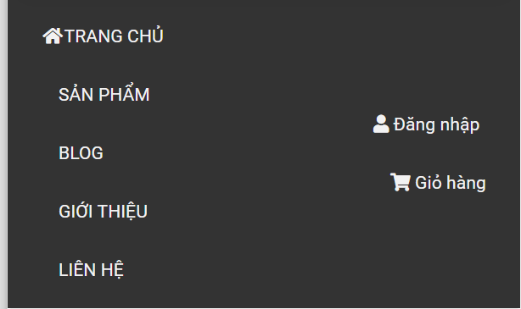
3. Technology used in the website
HTML, CSS, Bootstrap…
Functions:
Homepage, products, searching, blog, introduction, contact, shopping cart
Sign up, sign in, password recovery

Slide 6
4. The development direction of the website in the future
Improved interface: beautiful, easy on the eyes, attractive to users
Database connection to save user information
Constantly updating new products
Update and replace old information
Add some new functions

Slide 7
THANK YOU FOR LISTENING

