Slide 1
DATABASE SYSTEM
ASSIGNMENT 1
Group 9
Class Registration

Slide 2
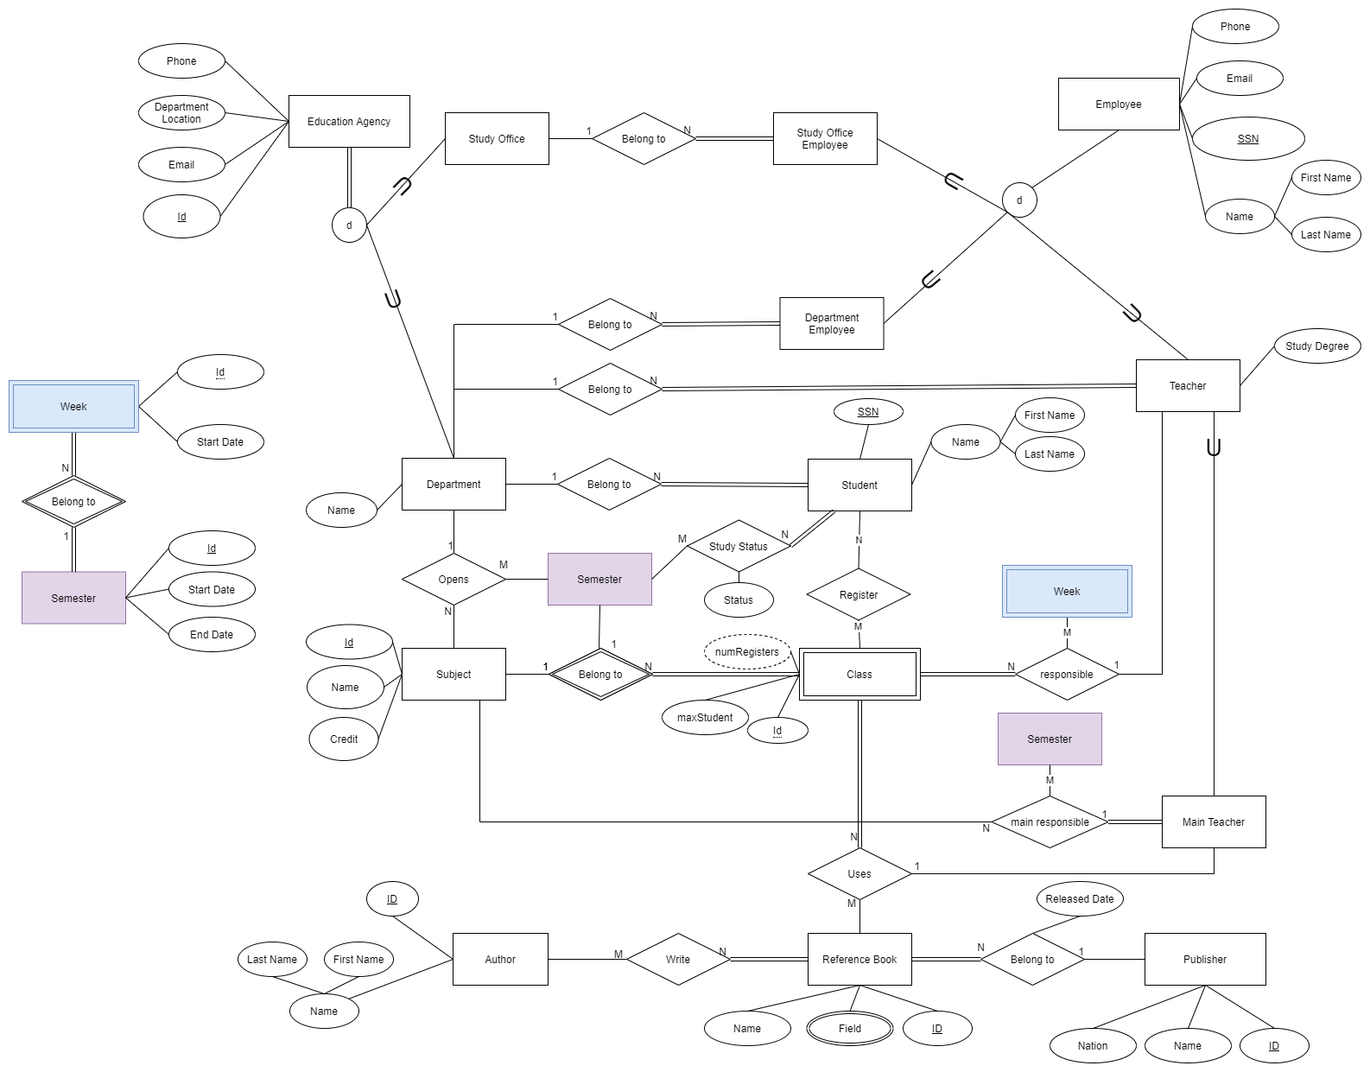
1. ERD

Slide 3
2. Mapping

Slide 4
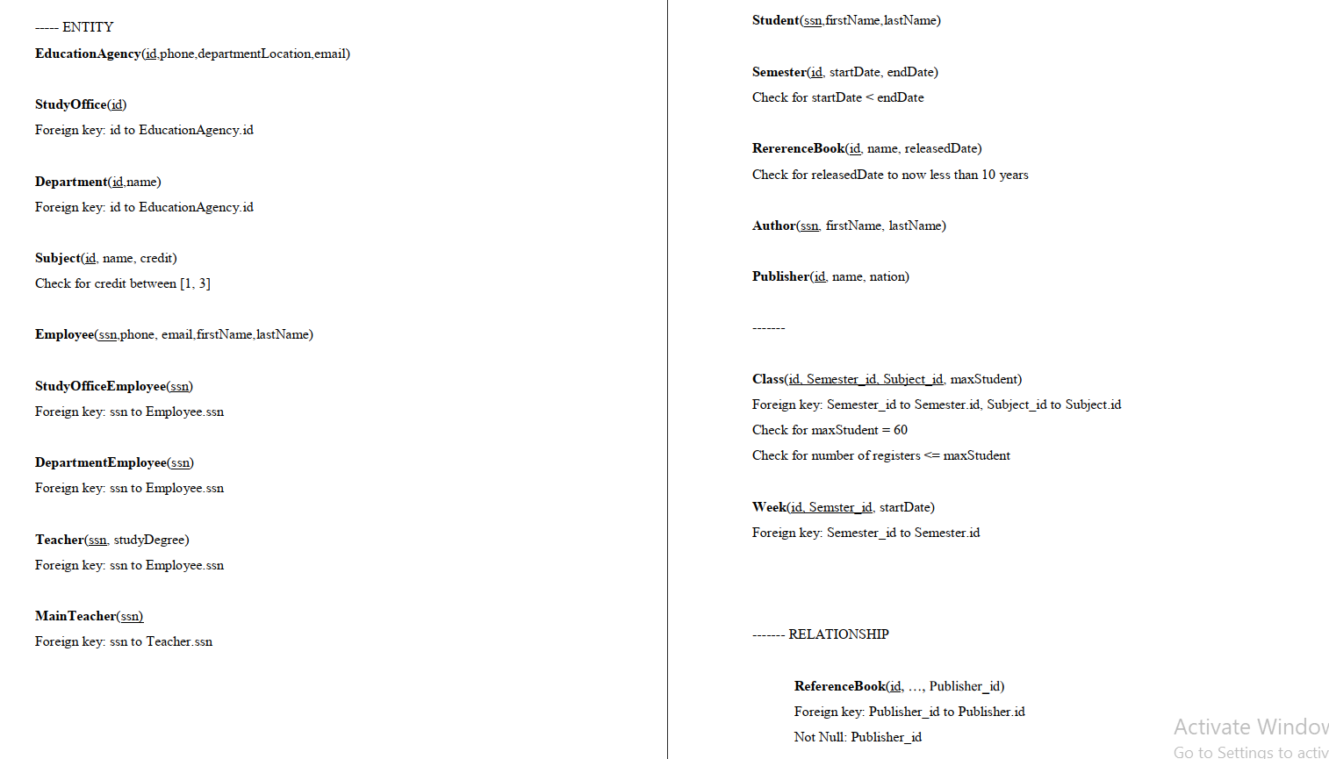
2. Mapping

Slide 5
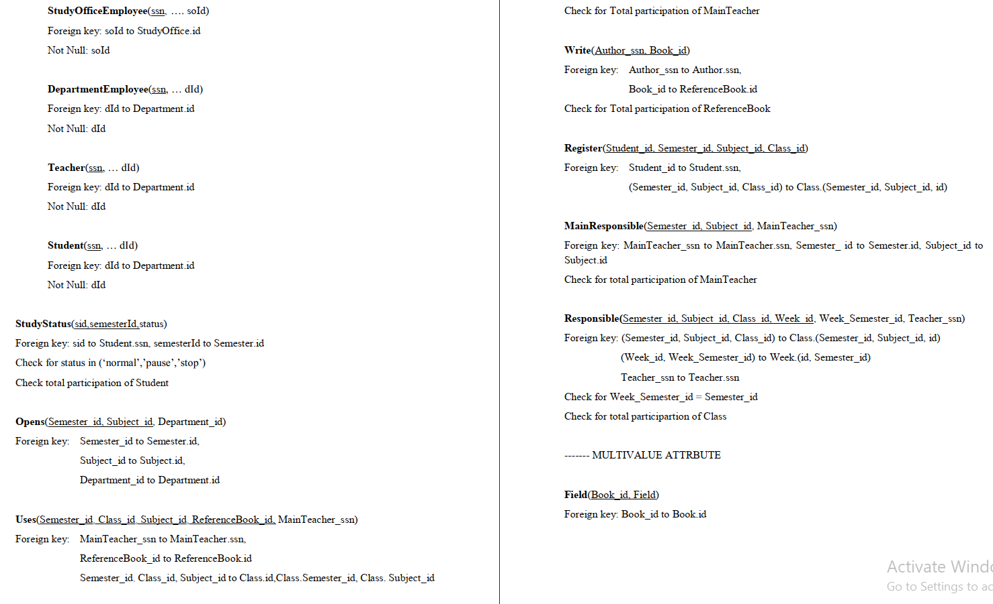

Slide 6


3. User’s Permission
Roles
Students
SOEmployees
DeEmployees
Teachers
Users
Student
SOEmployee
DeEmployee
Teacher

Slide 7

4. FrontEnd
Framework: ReactJS
Dependencies:
  Redux
  ReduxThunk
  AntDesign
  Material Table…

Slide 8
4. FrontEnd
Route → Container → Components
State Management : Redux
Api Call : Redux Thunk
Design Template : AntDesign

Slide 9
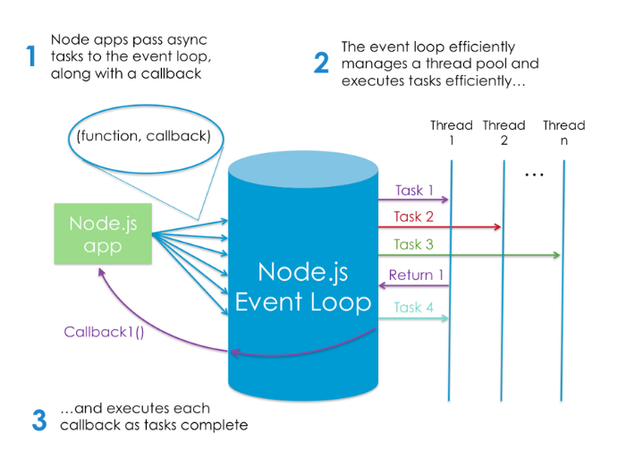
5. BackEnd
NodeJS Platform (JavaScript runtime built on Chrome's V8 JavaScript engine)
Framework: ExpressJs

Slide 10
6. SQL Server Integration Services
ETL Tool
Flow Design
Support Sequence and parallel tasks.
Support data transmit automatically

