Slide 1
In-System Programming(ISP)
Name: Yingchao / YiQuain / ChaoChing
SSPQC0

Slide 2
ISP Flashman

Slide 3
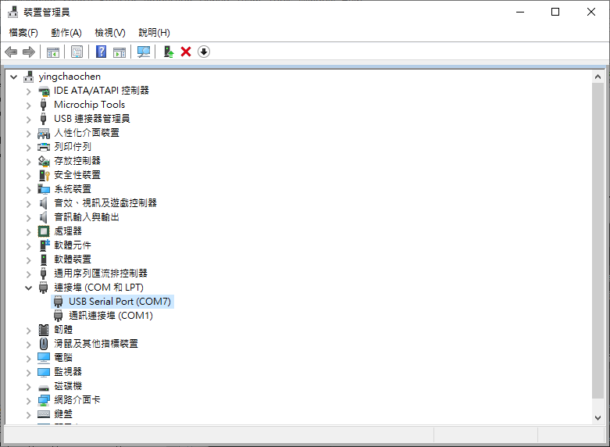

ISP-Application User Interface
Setup the Parameters from the application menu bar.
Device manager check COM Port number.

Slide 4
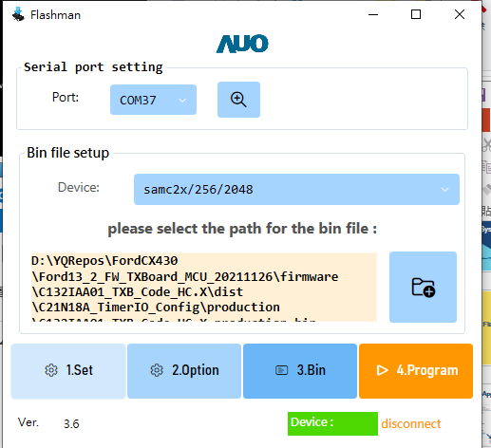
ISP-Application User Interface
Setup the Parameters from the application menu bar.
Select COM Port number.
Select target device. (samc2x )
Select the Bin file
(text-bar able to drag enter)

Slide 5
ISP-Application User Interface
Select the path of bin file
Bin file
(text-bar able to drag enter)

Slide 6
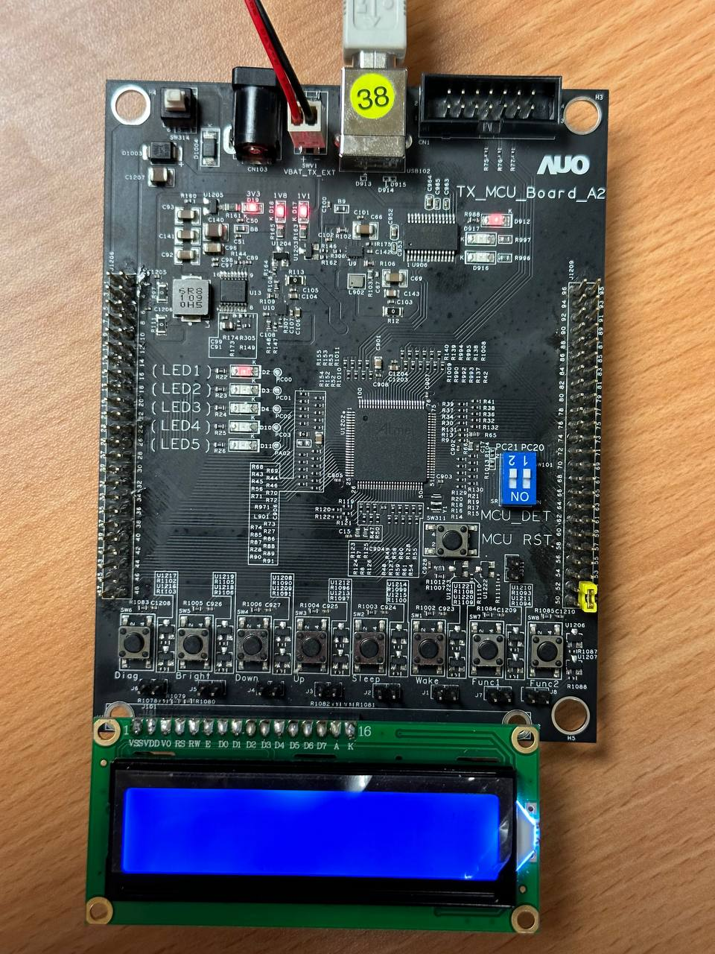
ISP-Application User Interface
SW314
Power Botton
Enter boot mode
Simultaneously press Power Botton and UP botton
Push SW8 (Func2)
Push UP botton
UP

Slide 7
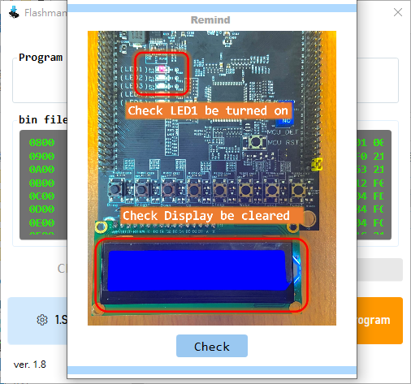
ISP-Application User Interface
Simple diagram of setup device
TX shall turn on the LED 1.
The LCD info shall be cleared.

Slide 8
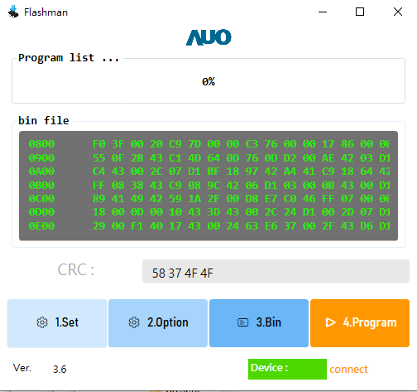
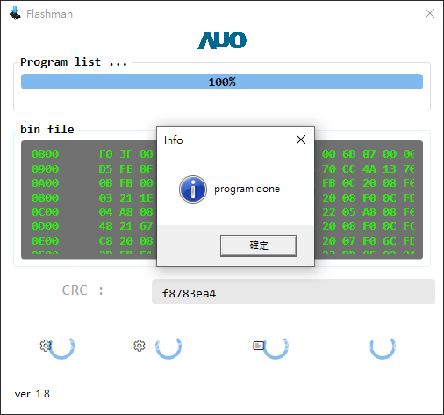
ISP-Application User Interface
Push button to program

Slide 9
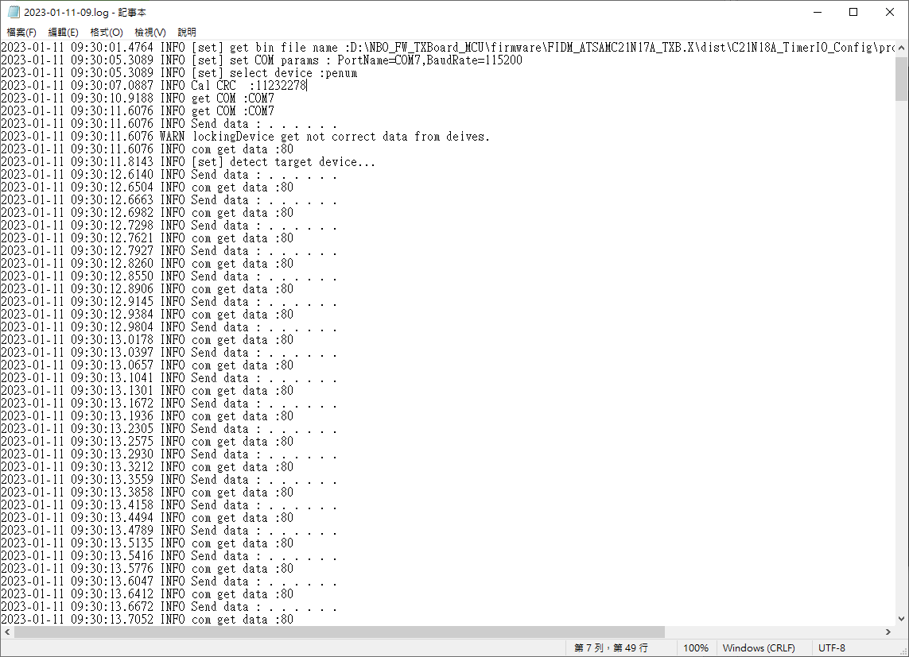
ISP-Application User Interface
Log info.
If user have any question could contact person (Yingchao).

Slide 10
Thanks

