Slide 1
Sports Impact Study: Do New Sports Venues Raise Local House Prices? Evidence from U.S. Metro-Level Housing Data
Quan Nguyen & Michael Zhang
ECON 4200: Senior Seminar
Dr. John Connaughton
November 24, 2025

Slide 2
Research Questions
Do metros that get a new venue (stadium/arena) see higher home values than those that don’t?
Do home prices jump at opening, or build gradually over time?
Do costlier projects have larger effects on home prices?

Slide 3
Why do we care?
Cities spend millions, if not billions on new venues, often with public money and tax breaks. We should know if local residents actually gain or not.
Our study gives evidence for voters and policymakers on whether these big projects show up in the housing market at all, and on what time scale.

Slide 4
Study | Location | Method | Main Finding | Effects
Dehring, Depken & Ward (2006) | Dallas–Fort Worth, USA | Event Study | −1.5% in property value after announcement; tax burden effect | Negative
Ahlfeldt & Maennig (2010) | Berlin, Germany | Hedonic | +3% land value within 3 km radius | Positive
Coates & Humphreys (2008) | U.S. cities (multiple) | Literature Review / Synthesis of Empirical Studies | Most careful studies find little or no net economic gain from stadiums and mega-events | Mixed-Negative
Coates & Humphreys (2012) | Multi-City U.S. | Spatial Hedonic | New facilities do not consistently revitalize nearby neighborhoods | Mixed
Chikish, Humphreys & Nowak (2019) | Oklahoma City, USA | Hedonic + Repeat Sales | Significant gains post-arena and team arrival | Positive
Propheter (2023) | San Francisco, USA | Relocation Analysis | Prices rose near new site, fell near old site | Mixed
Cobb County (2022) | Atlanta, USA | Synthetic Control | No post-opening increase in assessments | Neutral
Funahashi & Cardazzi (2025) | Japan (27 sites) | Difference-in-Differences | Nearby properties gained; strongest for team-based stadiums | Positive
Notes:
Lit Review

Slide 5
Data and Summary Statistics

Slide 6
Raw Data Sources
Zillow Housing Data
US Major-League Sports Stadium and Arena Construction Costs (1909–2026) dataset by Bradbury, Coates, and Humphreys (2025).
Includes the monthly Zillow Home Value Index (ZHVI), which is a “typical home value” measure for metropolitan and micropolitan statistical areas (MSAs & MiSAs)
2000-2025 window
Includes venue (stadiums + arenas) opening information across MLB/NBA/NFL/NHL
Includes opening year and month, venue/team names, and inflation-adjusted cost variables in 2020 $Millions

Slide 7
Cleaning and Merging
Took ZHVI data, dropped MiSAs, keeping only MSAs
Took venue data, matched 2000-2025 window, merged using normalized metro names
For the few metros have >1 venue openings between 2000-2025, kept the earliest opening to avoid duplicating post months
Built a metro–month panel (2000–2025) that pairs Zillow home values with the earliest major-league venue opening and its costs
377 Metros, 309 months, 105,824 total observations
Some metro-months have missing ZHVI, so we remove those before modeling

Slide 8
January 2000 Observation for the Charlotte Metro Area
metro_name | cbsa_code | ym | zhvi | open_year | open_month | open_ym | totalcost2020 | publiccost2020 | pubpct100
Charlotte, NC | 394458 | 2000-01 | 144597.528 | 2005.0 | 10.0 | 2005-10 | 281.960 | 228.7560 | 81.132
The ZHVI in CLT of January 2000 was about $144,600
CLT saw a venue opening (Spectrum Arena) in October 2005
Total construction cost was about $282 Million (2020$)
Public financing for the project was about $229 Million (2020$)
Public share of funding was about 81.1%, which makes private funding 18.9%

Slide 9
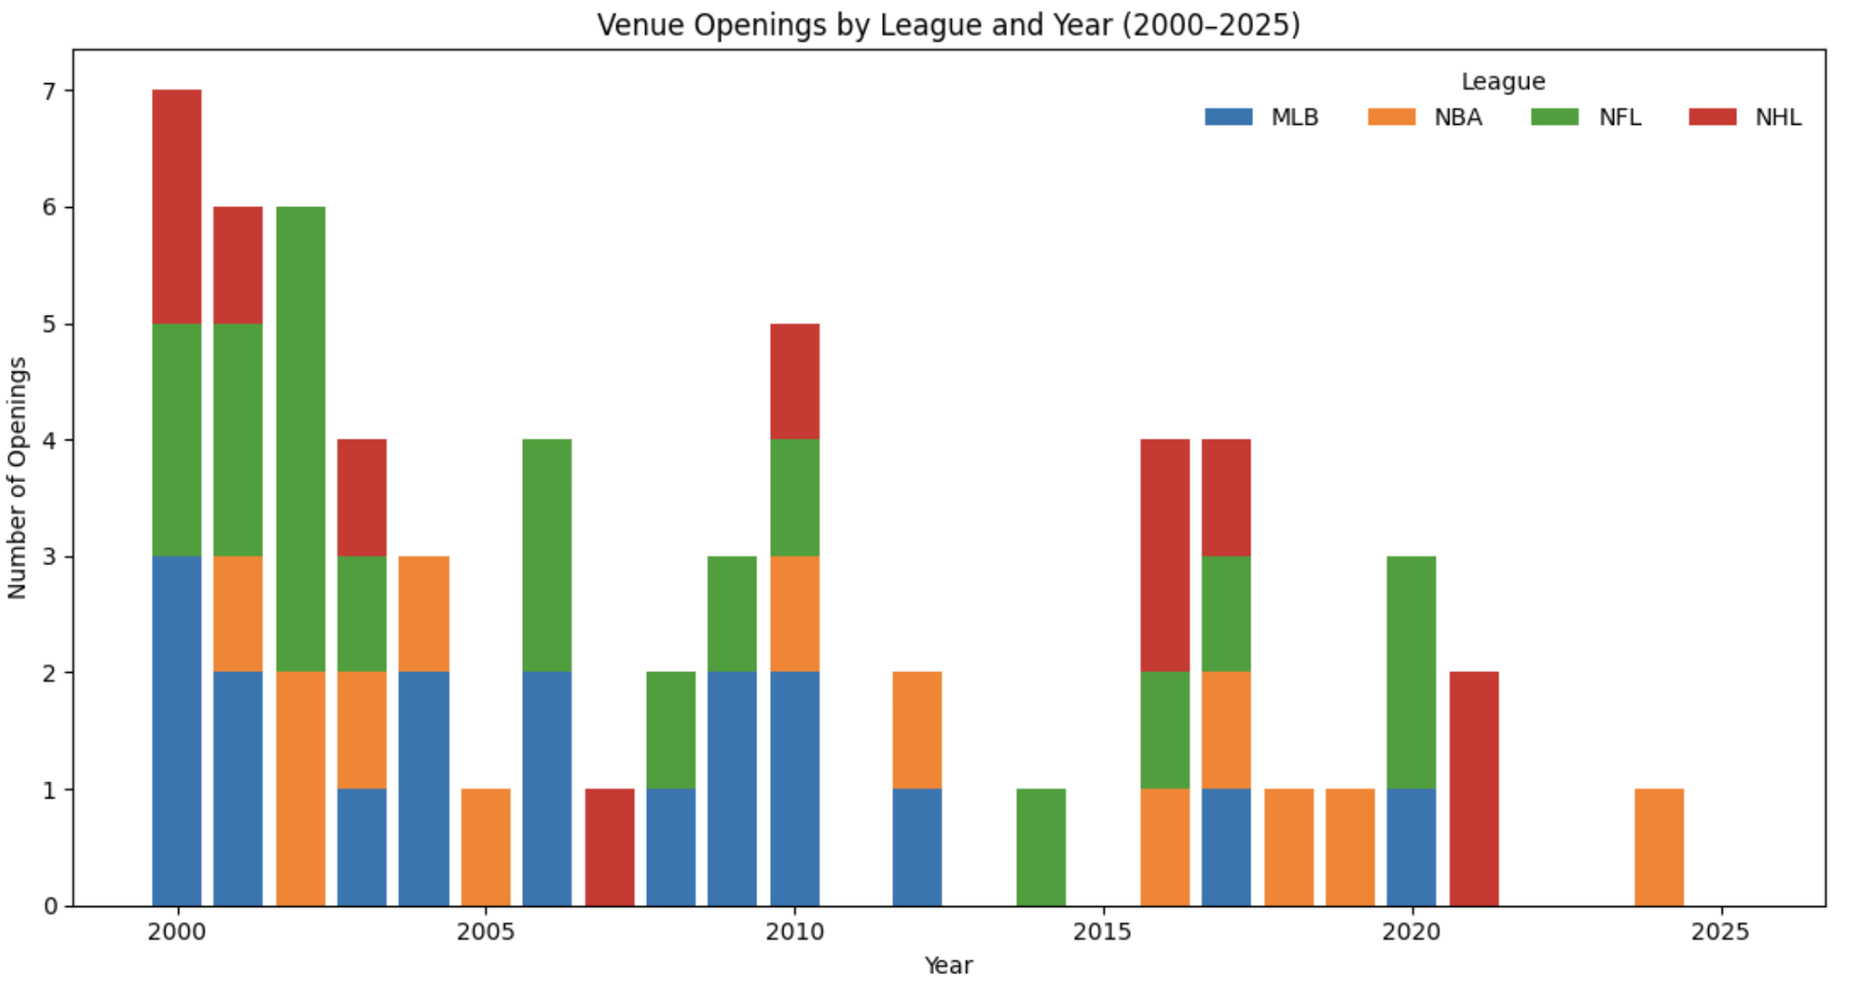

Slide 10
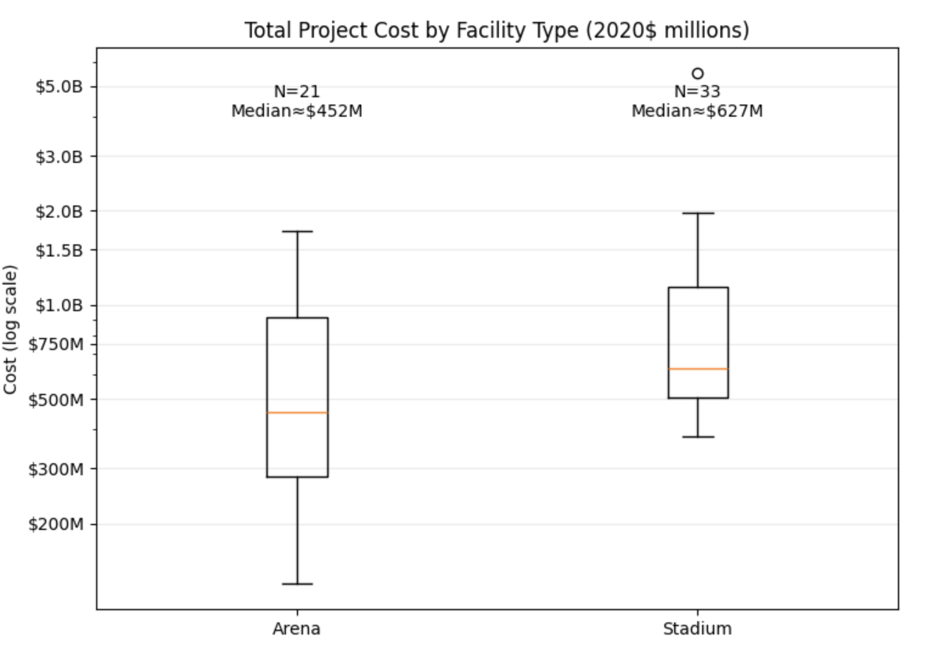
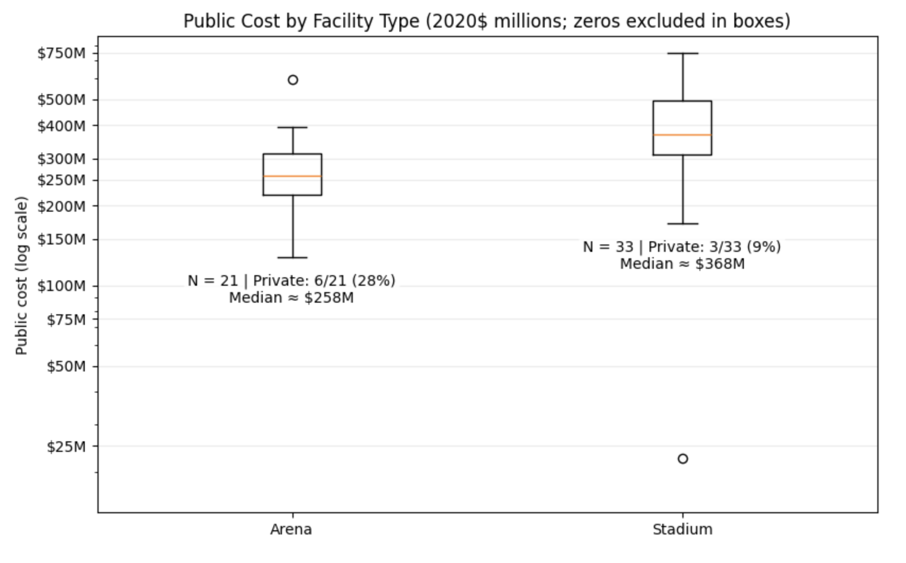
Arenas vs. Stadiums
Notes:
Arenas dominate in count, but stadiums dominate in cost.

Slide 11
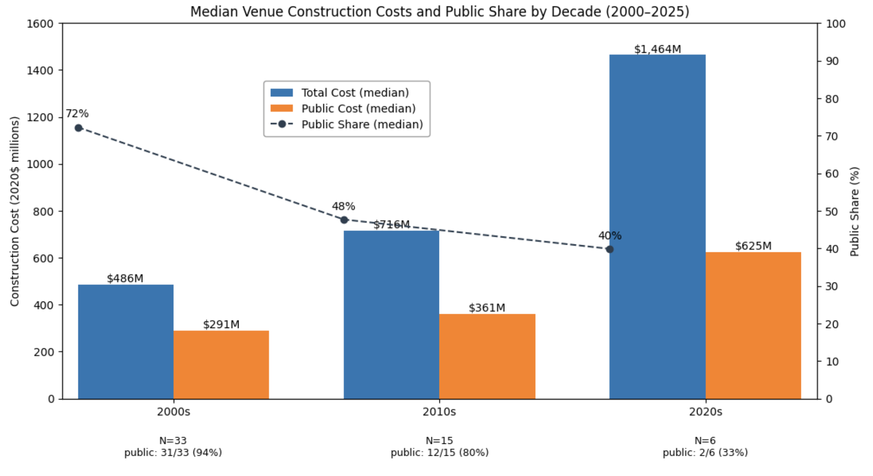
Note: this plot was inspired by Bradbury, Coates and Humphreys (2023)

Slide 12
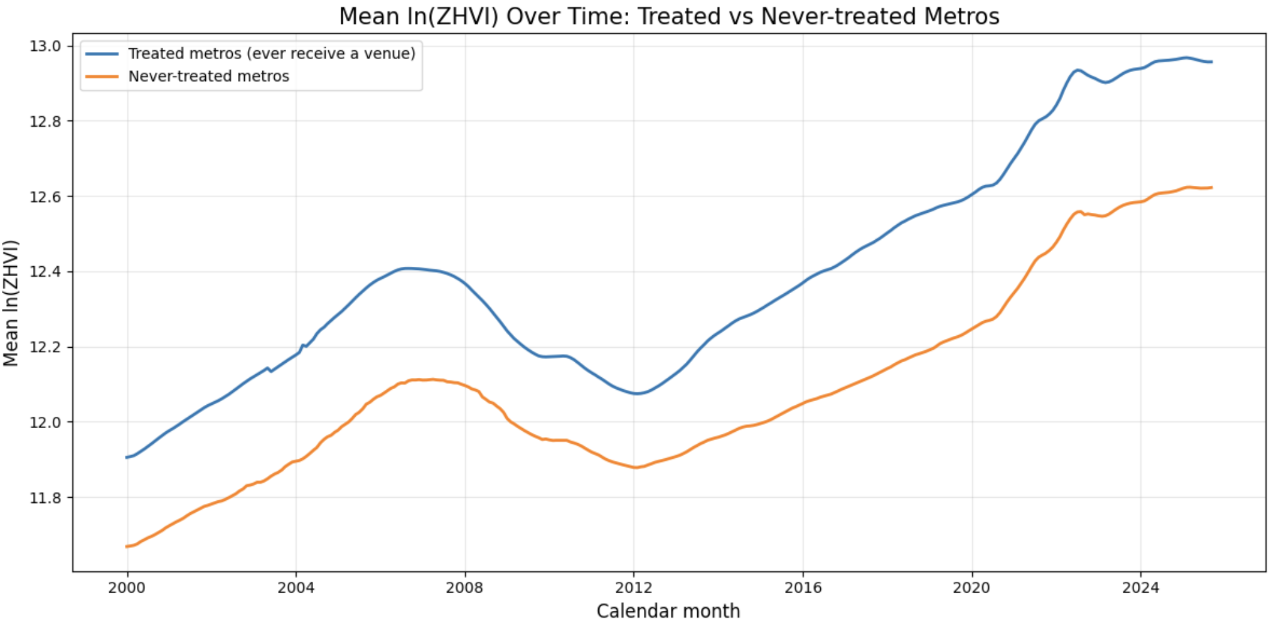

Slide 13
Method 1: Staggered Difference-in-Differences via Two-Way Fixed Effects
Notes:
Classic DiD (the simple 2×2 case)
The textbook DiD setup is:
2 groups: treated vs control
2 periods: before vs after
1 treatment shock that hits the treated group in the second period only:
$Y_{it}$= $β_{1}({Treated}_{i}\text{·}{Post}_{it}$) + ${\text{ϵ}}_{i,t}$, where ${Treated}_{i}\text{·}{Post}_{it}$ is the DiD = Change in treated – Change in control. The DiD compares how much outcomes move over time for treated vs. untreated
TWFE as a generalization: now imagine
Many groups (metros)
Many time periods (months)
Some groups get treated, some never do
Some groups get treated earlier, some later (staggered)
$Y_{it}=β_{1}({Treated}_{i}\text{·}{Post}_{it}$) + $a_{i }+{ \text{ω}}_{t}+{\text{ϵ}}_{i,t}$
TWFE is just the multi-period, multi-group version of DiD:
Group FE absorb treated vs control baseline differences
Time FE absorb common before vs. after shocks
The new ${Treated}_{i}\text{·}{Post}_{it}$ is the DiD interaction, generalized to many groups/times
TWFE is a statistical method used to estimate the causal effect of a treatment in panel data by controlling for unit-specific and time-specific factors. It is a generalization of the difference-in-differences (DiD) model and can be effective when there is a single treatment event, but it can produce biased results when treatments are staggered or effects are heterogeneous over time or across groups. In such cases, alternative estimators are often recommended.
How it works
Unit fixed effects: Accounts for unobservable, time-invariant differences between units (e.g., individual companies, states, or people)
Time fixed effects: Accounts for unobservable factors that change over time and affect all units equally (e.g., macroeconomic shocks).
Estimation: By including both sets of fixed effects, TWFE can isolate the effect of the treatment on the outcome variable by comparing the change in outcomes over time for treated versus untreated units.
-----------------------------------------------------------------------------------------------------
1. DiD = change in treated – change in control
$Y_{it}$= $β_{1}({Treated}_{i}\text{·}{Post}_{it}$) + ${\text{ϵ}}_{i,t}$, where $β_{1}$ is exactly the DiD formula above (also the full regression expands to include the individual Treated and Post variables).
All DiD is doing is comparing how much outcomes move over time for treated vs. untreated
2. TWFE
$Y_{it}=β_{1}({Treated}_{i}\text{·}{Post}_{it}$) + $a_{i }+{ \text{ω}}_{t}+{\text{ϵ}}_{i,t}$
Unit FE subtracts off each unit’s usual level (its LR mean): this is what the first “difference” does in DiD: you’re looking at changes over time within a unit, not its raw level.
Time FE subtracts off each period’s overall mean: this is what the second “difference” does: you remove common shocks that hit everyone in a given period
After removing both, the regression is effectively run on residuals that are “demeaned” by unit and time. On these residuals, the only remaining systematic pattern is: are units that become treated in the post period, above or below what you’d expect, relative to the units that stay untreated?
That is exactly the DiD idea: extra movement for treated units beyond what controls and time trends can explain.
3. Sports example: ${lnZHVI}_{it}=β_{1}({Treated}_{i}\text{·}{Post}_{it}$) + $a_{i }+{ \text{ω}}_{t}+{\text{ϵ}}_{i,t}$
Not all metros are treated and treatment occurs at difference times.
Metro FEs subtracts each metro’s usual level, and month FEs subtract each month’s overall housing market level
On what’s left, $β$ picks up whether treated metros, in the months after their opening (post period), grow more than never-treated metros (and not-yet-treated metros)
Mathematically, $β$ is a weighted average of a bunch of 2x2 DiDs: “early treated vs. never treated,” “late treated vs never treated,” sometimes “early treated vs later treated,” etc.
TWFE Is a generalization of DiD because in the simple case (1 treated, 1 control, 2 periods), TWFE = DiD. However in the big panel case, TWFE = many DiD comparisons stitched together in one regression.
Our example is nice becaue many metros are never treated and we only keep the first opening per metro, so most of the comparisons are clean “treated vs. never-treated” differences In growth, which is very close to the textbook DiD logic.

Slide 14
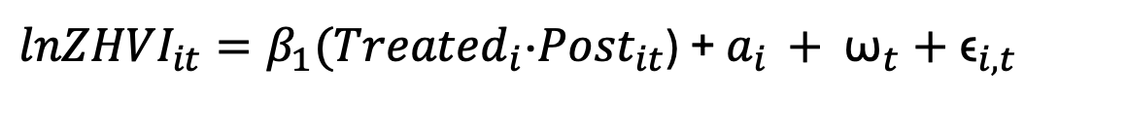
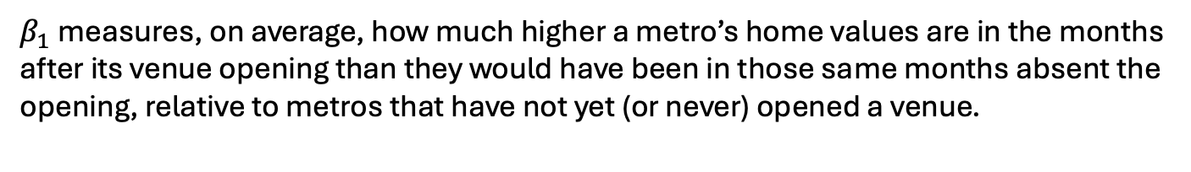
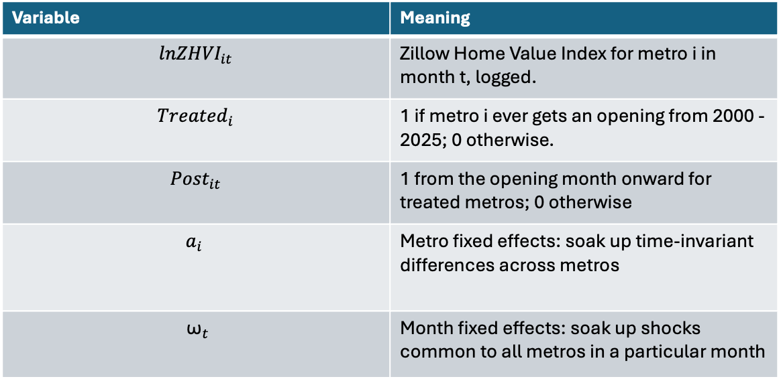
Baseline Model: Staggered DiD with Metro and Month FEs
${lnZHVI}_{it}=β_{1}({Treated}_{i}\text{·}{Post}_{it}$) + $a_{i }+{ \text{ω}}_{t}+{\text{ϵ}}_{i,t}$
Variable | Meaning
$${lnZHVI}_{it}$$ | Zillow Home Value Index for metro i in month t, logged.
$${Treated}_{i}$$ | 1 if metro i ever gets an opening from 2000 - 2025; 0 otherwise.
$${Post}_{it}$$ | 1 from the opening month onward for treated metros; 0 otherwise
$$a_{i }$$ | Metro fixed effects: soak up time-invariant differences across metros
$${ \text{ω}}_{t}$$ | Month fixed effects: soak up shocks common to all metros in a particular month
$β_{1}$measures, on average, how much higher a metro’s home values are in the months after its venue opening than they would have been in those same months absent the opening, relative to metros that have not yet (or never) opened a venue.
Notes:
TWFE takes the DiD idea (“compare changes for treated vs control”) and applies it over and over across many units and many periods, after stripping out unit averages and time averages. That’s why it’s the natural generalization of DiD to panel data.
“On average, by how much did home prices in treated metros change because of the venue opening, beyond what would have happened over time and beyond normal differences between metros?”

Slide 15
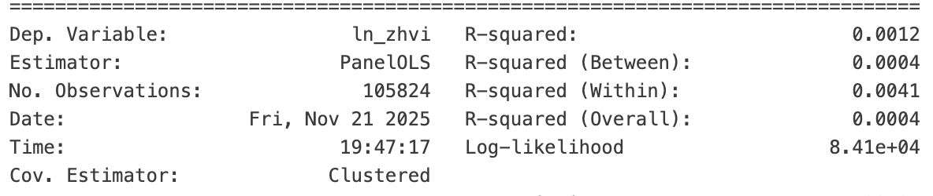
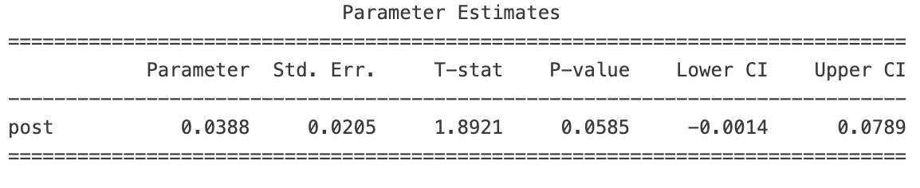
Baseline
${lnZHVI}_{it}=β_{1}({Treated}_{i}\text{·}{Post}_{it}$) + $a_{i }+{ \text{ω}}_{t}+{\text{ϵ}}_{i,t}$
After a metro’s venue opens, its ZHVI is about 3.9% higher on average than it would have been without the opening, relative to metros that haven’t received a new venue in the same months, controlling for metro and month fixed effects
Causality depends on parallel trends
Two way clustered SEs
Notes:
Model
Outcome: ln(ZHVI)_it so coefficients are in approximate percent terms
Treatment indicator: post_it = 1 starting in the opening month (open_ym) for that metro and every month after; 0 beforehand. Metros that never open a new venue in 2000–2025 stay at 0.
Metro FE remove time-invariant differences across metros (size, amenities, long-run level of prices).
Month FE remove nationwide/statewide housing cycles and shocks like interest rates, COVID, etc. that are common to all metros.
Cluster by metro (entity): lets residuals be serially correlated within the same metro over time (very common in housing data).
Cluster by month (time): but even with month fixed effects, residuals can still be correlated across metros within the same month (shared shocks not fully captured). To allow that cross-sectional (same-time) correlation we also cluster by time.
Results:
For a metro once its venue opens, its average ZHVI level in the months after opening is about 3.9% higher than its own pre-opening level relative to the same-month evolution in metros that haven’t opened yet (or never open).
It’s an average over all post-opening months and across treated metros (early openers contribute more post months, so slightly more weight).
Not significant at the 5% level, but yes at the 10% level (p ≈ 0.054).
Entities = 377, Time periods = 309, Obs ≈ 105,824.
R² (within) is tiny. Normal here: with fixed effects and a single step-function regressor, most variation is absorbed by FE and idiosyncratic shocks.
What this result does and does not say
It’s a pooled average “step” effect that treats all post-months the same. If effects phase in (construction/anticipation) or fade out, this spec blends them.
It does not control for any local time-varying confounders (e.g., coincident transit expansions, downtown revitalization). If venue timing is correlated with local booms, B can be biased.
It uses the first opening only per metro (by how we built the panel), and it doesn’t use cost or public share—just a binary “venue opened.”
Caveats: Causality depends on parallel trends: in the absence of a venue opening, do the treated metros follow the same month-to-month pattern as the non-treated metros
Beta is the “Average after-opening shift, pooling all post months”
1. Within each metro, compare “after vs. before.”
Metro fixed effects remove each metro’s average level, so what’s left is how that metro moves relative to its own baseline when the venue switches on.
2. In each month, compare to metros that haven’t opened yet (and never-treated).
Month fixed effects remove nationwide housing shocks that hit everyone (rates, COVID, etc.). That forces the “after vs. before” change to be judged relative to other metros in the same month that are still untreated (plus any never-treated metros).
3. Average those post-opening differences across all post months and metros, with weights.
Every treated post observation contributes to the estimate. Metros that opened earlier simply have more post months, so they get more weight. Also, units with a longer pre+post (i.e., more within-metro variation in the “venue” indicator) get a bit more leverage.
Why timing matters (the weighting intuition)
Early openers: more months with venue=1 ⇒ more post observations ⇒ more weight.
If true effects build over time (small early, larger later), β mixes early and late post months into one number.
If they fade out, β mixes the bigger early impacts with smaller later ones.
That’s why an event study (leads/lags) is the right follow-up: it shows the shape rather than the one-number average.
Takeaway: Beta is a weighted average of after-minus-before changes, with the most weight on treated-metro months where the post indicator is most “unexpected” after removing metro and month averages—typically early post months for adopters, relative to same-month controls.

Slide 16
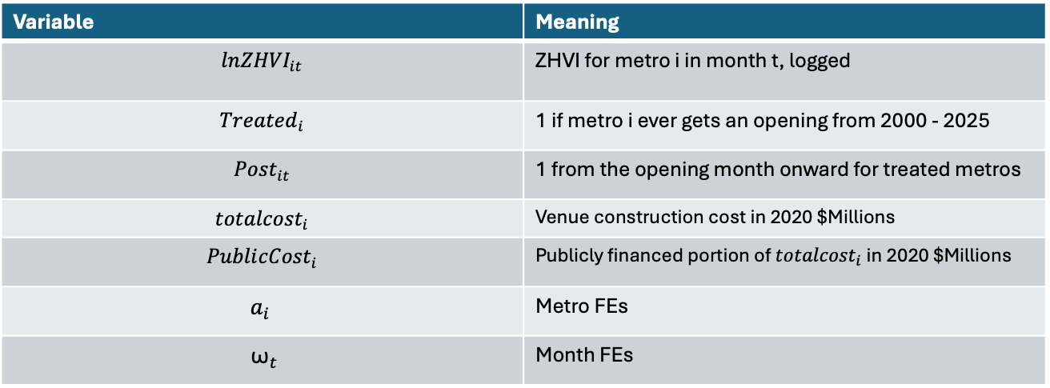
Intensity Model
${ lnZHVI}_{it}=β_{1}\text{(}{Treated}_{i} \text{·} {Post}_{it}$) + $β_{2}({Treated}_{i} \text{· }{Post}_{it}$ $\text{·} {totalcost}_{i}){+ a}_{i }+{ \text{ω}}_{t}+{\text{ϵ}}_{i,t}$
Variable | Meaning
$${lnZHVI}_{it}$$ | ZHVI for metro i in month t, logged
$${Treated}_{i}$$ | 1 if metro i ever gets an opening from 2000 - 2025
$${Post}_{it}$$ | 1 from the opening month onward for treated metros
$${totalcost}_{i}$$ | Venue construction cost in 2020 $Millions
$$Publi{cCost}_{i}$$ | Publicly financed portion of ${totalcost}_{i}$in 2020 $Millions
$$a_{i }$$ | Metro FEs
$${ \text{ω}}_{t}$$ | Month FEs

Slide 17
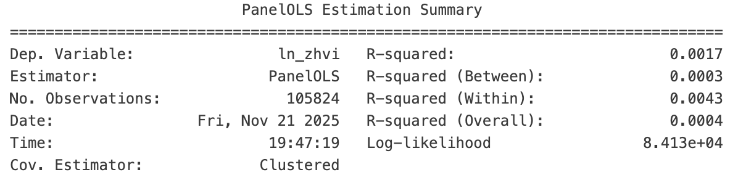
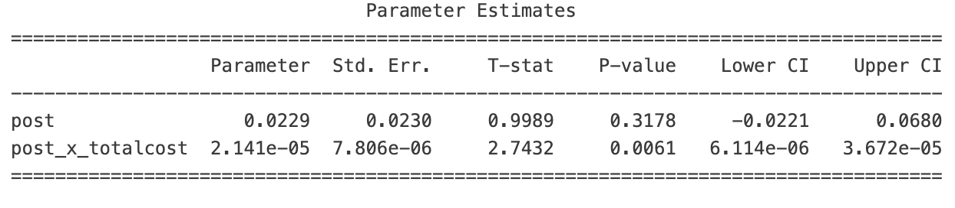
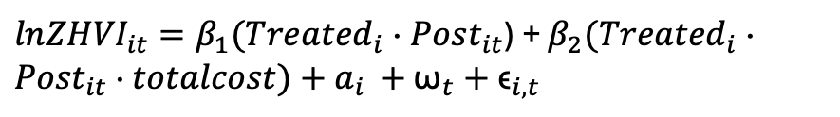
Intensity
${lnZHVI}_{it}=β_{1}\text{(}{Treated}_{i} \text{·} {Post}_{it}$) + $β_{2}({Treated}_{i} \text{·} {Post}_{it}$ $\text{·} totalcost){+ a}_{i }+{ \text{ω}}_{t}+{\text{ϵ}}_{i,t}$
The baseline post term (0.0229) is the effect when cost = $0M (a meaningless baseline). Hence why it isn’t significant and not very interpretable.
With post × totalcost (in $2020M) the post effect rises by 0.21% per $100M of project cost.

Slide 18

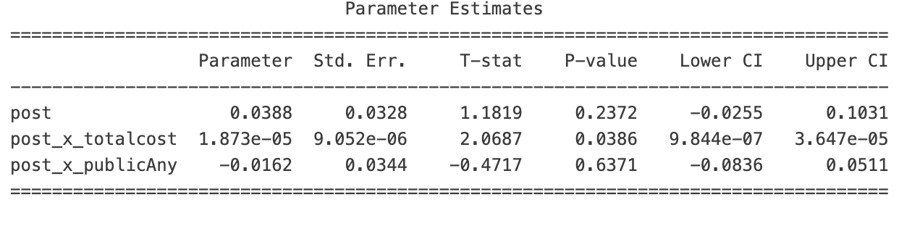
Public vs Private
Baseline post effect when cost = 0 and public = 0 is not meaningful.
Post x totalcost is still statistically significant, only this time an additional $100 million of budget raises the post effect by 0.187%
Post x public: after controlling for total cost, public financing does not measurably change the post effect vs. private projects

Slide 19
Staggered DiD→ Event Study
Staggered DiD
Event Study
Compare metros with openings to those without, before vs. after opening (via TWFE)
Coefficients captured the avg. post opening change in home prices
Interaction told us costlier projects moved prices more
Limitation is that these models collapse all post-opening months into a single “post” effect
Can’t see when prices move before and after
Econometric issues
Bias
Misleading average
Generalizes the TWFE DiD by replacing one “post” dummy with many event-time dummies representing ”k” months before and after opening
Let’s us visualize dynamics (build-ups, peaks, fades)
Let’s us check for any pre-trends (were home prices already moving in a particular path?)
Notes:
Up to now, we’ve been estimating a staggered difference-in-differences regression
The first model tells us the average change in log ZHVI for metros that get a new stadium or arena, comparing the pre- and post-opening periods, after controlling for metro and month fixed effects. The next two models add interactions with total construction cost and whether there’s any public financing, so they tell us whether more expensive or more publicly funded projects are associated with larger price changes.
These are useful, but they have a big limitation: they treat the entire post-opening period as one block. We only get one coefficient that averages together month 1 and month 60. So we don’t learn when prices start to move, how quickly the effect builds, or whether it fades out. And we also can’t clearly see whether treated metros were already on different trends before the opening.
To answer those questions, I move to an event study. Instead of a single post dummy, I create separate indicators for each month or quarter relative to the opening. That lets me trace out a time path of effects and visually check for pre-trends.”
When TWFE DiD can be problematic
Staggered treatment: TWFE is often biased when different units receive the treatment at different times, a situation known as staggered adoption.
Heterogeneous treatment effects: If the effect of the treatment is different for different units or at different points in time, TWFE can produce a misleading average.
Bias: In situations with staggered treatments, TWFE can incorrectly use already-treated groups as a control for other groups, leading to biased estimates.
Alternative: Event-time specification: Using an event-time specification can help avoid some of the bias in TWFE, especially if treatment effects are heterogeneous.

Slide 20
Method 2: Event Study
Notes:
As TWFE DiD generalizes the classic 2x2 DiD, an Event Study generalizes the TWFE DiD specification, by letting the treatment effect vary by event time instead of being one constant post effect.
In fact, if you force all pre coefficients to equal 0 and all post coefficients to be equal, then the event-study collapses back to the simple TWFE DiD with a single $β$.

Slide 21
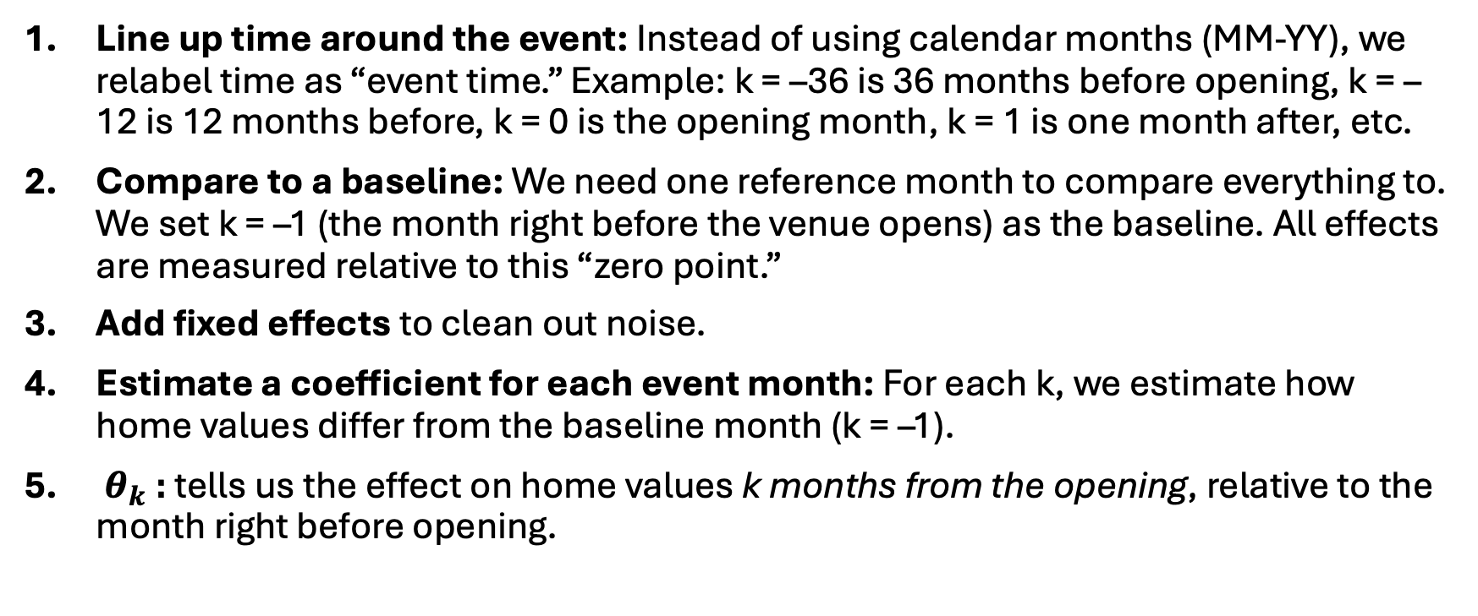
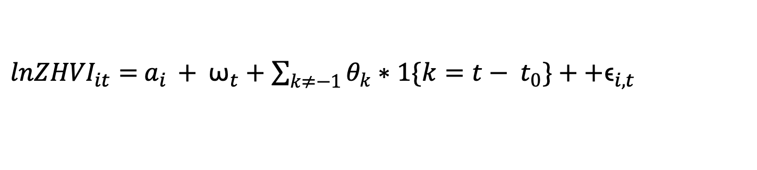
Method
${lnZHVI}_{it}=$ $a_{i }+{ \text{ω}}_{t}+\sum_{k≠−1}{θ_{k}∗1\{k=t− t_{0}\}}++{\text{ϵ}}_{i,t}$
Line up time around the event: Instead of using calendar months (MM-YY), we relabel time as “event time.” Example: k = –36 is 36 months before opening, k = –12 is 12 months before, k = 0 is the opening month, k = 1 is one month after, etc.
Compare to a baseline: We need one reference month to compare everything to. We set k = –1 (the month right before the venue opens) as the baseline. All effects are measured relative to this “zero point.”
Add fixed effects to clean out noise.
Estimate a coefficient for each event month: For each k, we estimate how home values differ from the baseline month (k = –1).
$θ_{k}$: tells us the effect on home values k months from the opening, relative to the month right before opening.
Notes:
What is an event study?
You have panel data (metro × month) and a “big event” that happens at different times for different units: a new stadium opening, a policy change, a merger, etc.
An event study asks: “On average, how does Y (here, log home values) evolve before and after the event, compared to places that haven’t had the event yet (or never have it)?”
2 key features:
Time relative to the event (event time: months or quarters since opening)
Dynamic effects: instead of one “post” dummy, we estimate a separate effect for each lead/lag k time (e.g. 12 months before, 6 months after, 24 months after, etc.).
So it’s like a difference-in-differences with many time dummies around the event.
Variables
i = metro, t = month.
Y_it = ln(ZHVI_it)
Open_month_i be the first opening month in metro I
k_it = t – open_month_i
k = -12: 1 year before opening
k = 0: opening month
K = 24: 2 years after
For each k in some window say -36 to 60, we create a dummy: (D_it)^k = 1 when k_it = k and 0 o.w.
Units that never get a stadium always have these D’s = 0. They still matter as they help pin down the month fixed effects and serve as extra controls.
We choose a reference period e.g. k = -1: the month before opening and do not create a dummy for it as it will get dropped from the regression and be the baseline we compare everything to
Model: TWFE event study (From above)
$a_{i }$metro fixed effects to control for time invariant differences across metros (size, long run price level)
${ \text{ω}}_{t}$ month fixed effects to control for shocks common to all metros in a month (national housing cycle, seasonal cycle, interest rates)
$D_{it}^{k}$ is the set of dummy for being k periods from opening
$β_{k}$ is the dynamic effect at time k relative to the reference period
$β_{k}$ is the average difference in log ZHVI k months from opening vs the reference period (month just before opening), after controlling for metro FE and month FE.
Intuition
Line up time around the event: For each metro, we re-label months not as “Jan 2018, Feb 2018…”, but as “12 months before opening, 11 months before… 0 (opening)… 1 month after, etc.”
Compare to a baseline: We pick one period as our comparison point – here, the k = -1 (one month) right before the stadium opens. We don’t estimate a coefficient for that period; that becomes our “zero” base-line.
Add fixed effects to clean out noise
Estimate a separate effect for each event time: The regression tells us, for each month/quarter relative to the opening, how much higher or lower home values are compared to that pre-period, after controlling for all those fixed effects.
Plot the coefficients as an event-study graph: We plot the $β_{k}$ on the y-axis and event time k on the x-axis.
If the pre-event coefficients (negative k) are all around zero → no pre-trend → supports the idea that treatment and control metros were on parallel paths.
The post-event coefficients show how the effect builds over time: is there an immediate jump? A slow ramp-up? Does it fade?
“Each dot is a regression coefficient for one month or bin of months relative to the opening, and the shaded band is its confidence interval. The zero line is the month right before the stadium opens.”

Slide 22
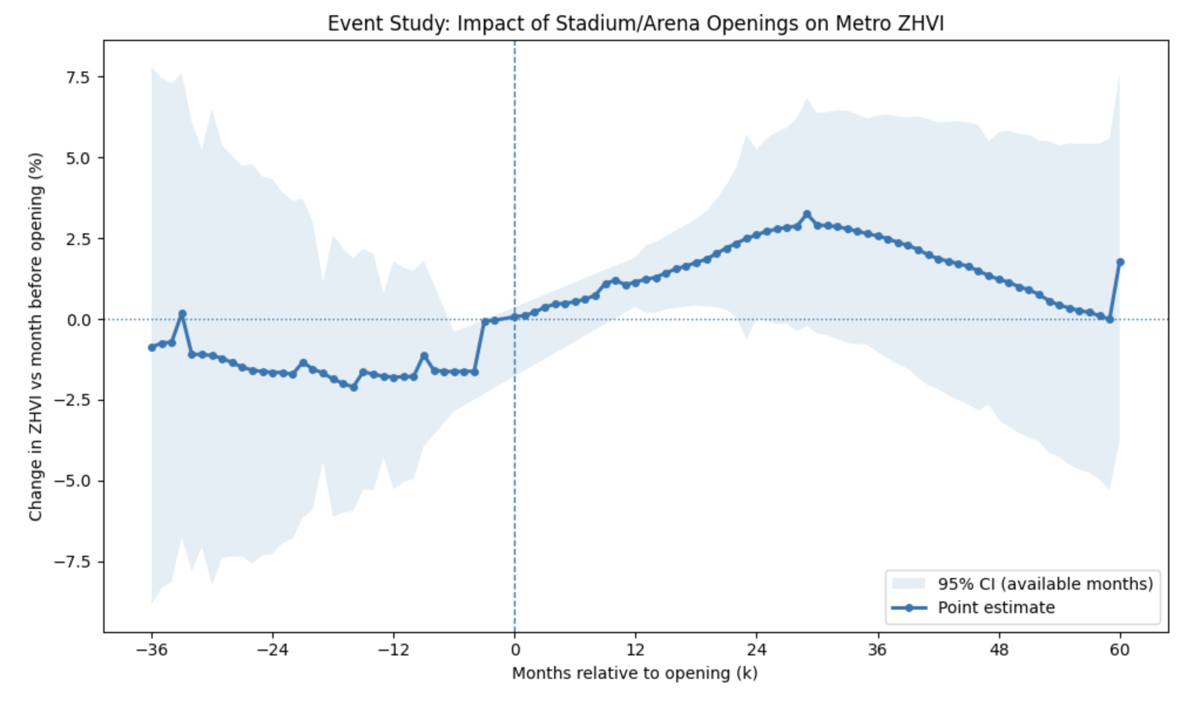
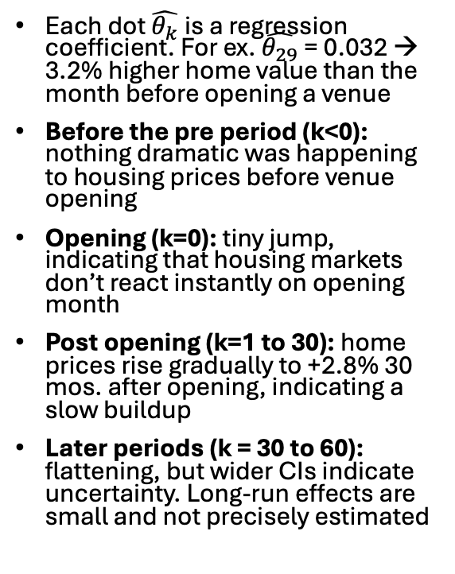
Impact of Venue Openings on Metro Home Value
Each dot $\hat{θ_{k}}$is a regression coefficient. For ex. $\hat{θ_{29}}$= 0.032 → 3.2% higher home value than the month before opening a venue
Before the pre period (k<0): nothing dramatic was happening to housing prices before venue opening
Opening (k=0): tiny jump, indicating that housing markets don’t react instantly on opening month
Post opening (k=1 to 30): home prices rise gradually to +2.8% 30 mos. after opening, indicating a slow buildup
Later periods (k = 30 to 60): flattening, but wider CIs indicate uncertainty. Long-run effects are small and not precisely estimated
Notes:
There is no dot at k = −1 because we never estimate a coefficient for it.
The horizontal 0% line is literally “no change relative to k = −1”.
Every point on the curve is “% change in ln(ZHVI) in month k compared to the month before opening”.
So: k = −1 is the invisible zero that everything else is measured against, and it’s encoded by the fact that the y-axis is “change vs month before opening (%)” and the 0% line is that baseline.

Slide 23
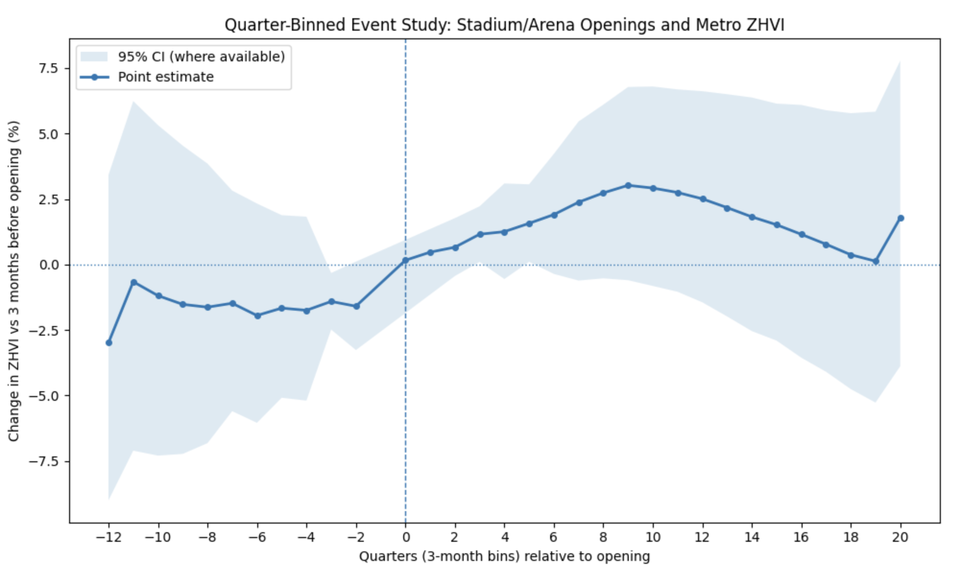
Impact of Venue Openings on Metro Home Value (in quarters)
Monthly event-time dummies can be noisy so by binning it in quarters we get a smoother graph with tighter SEs.
Again, treated metros were not clearly on a different trend before the venue opened. If anything, prices were slightly weaker.
No sharp price jump at opening indicating housing markets respond gradually.
Within 1-3 years of opening, home values in treated metros are roughly 2-3% higher than in the quarter before opening (gradual buildup).
After 3 years, the effects decline and becomes noisy.
Notes:
At −2 (months −6 to −4): estimate is about −1.6% vs the quarter −1.
At 0 (opening quarter): estimate is about +0.2% vs the quarter −1.

Slide 24
Conclusions
New venues modestly increase housing values: average estimated effect is about 3.9% higher home values after opening (compared with metros that have not yet opened in the same month)
More expensive projects produce stronger gains: home values see +0.21% per $100M of construction cost
Home prices do not jump at opening, they rise gradually: within 1-3 years, treated metros experience roughly 2-3% higher home values relative to the time-period before opening
Long run effects fade and become noisy. Effects are real, but may not be permanent, which means they should not be viewed as the core reason for approving public subsidies.
No strong upward trend before opening, so this supports parallel trends assumption. We can say causally, that venue openings decently increase home prices

Slide 25
References
Ahlfeldt, G.M. & Maennig, W. 2010, ‘Impact of sports arenas on land values: Evidence from Berlin’, The Annals of Regional Science, vol. 44, no. 2, pp. 205–227.
Bradbury, J.C., Coates, D. & Humphreys, B.R. 2025, US Major-League Sports Stadium and Arena Construction Costs (1909–2026), research dataset, Bagwell Center for the Study of Markets and Economic Opportunity, Kennesaw State University.
Bradbury, J.C., Coates, D. & Humphreys, B.R. (2023) The Economics of Stadium Subsidies: A Policy Retrospective. Working paper, Kennesaw State University, University of Maryland–Baltimore County, and West Virginia University, 30 January.
Chikish, Y., Humphreys, B.R. & Nowak, A. 2019, ‘Sports facilities and residential property values: Evidence from the construction of new arenas and stadiums’, Regional Science and Urban Economics, vol. 77, pp. 42–59.
Coates, D. & Humphreys, B.R. 2012, ‘Game Attendance and Competitive Balance in Major League Baseball’, Journal of Sports Economics, 13(1), pp. 20–43.
Coates, D. & Humphreys, B.R. 2008, ‘Do economists reach a conclusion on subsidies for sports franchises, stadiums, and mega-events?’, Econ Journal Watch, vol. 5, no. 3, pp. 294–315.
Cobb County Communications 2022, Braves stadium information, Cobb County Government, Marietta, GA.
Dehring, C.A., Depken, C.A. & Ward, M.R. 2007, ‘The impact of stadium announcements on residential property values: Evidence from a natural experiment in Dallas–Fort Worth’, Contemporary Economic Policy, vol. 25, no. 4, pp. 627–638.
Funahashi, H. & Cardazzi, A. 2024, ‘An examination of the externalities of neighborhood stadiums on housing land values’, paper presented at the Japan Society of Sports Industry 33rd Annual Conference, Japan.
Propheter, G. 2023, ‘Sports facilities as a housing amenity: Do prices follow facilities?’, Journal of Sports Economics, vol. 24, no. 4, pp. 443–474.

