Slide 1
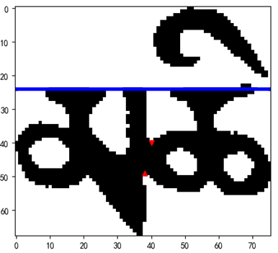
Baseline = 24
P (40,40)
P (38,49)

Slide 2
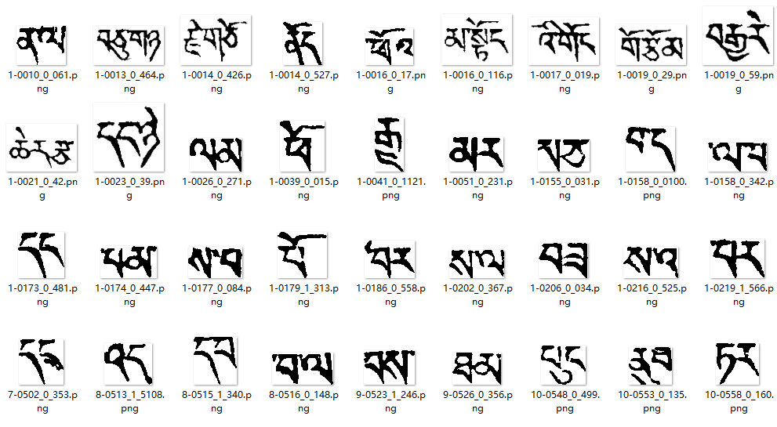

Slide 5







Slide 6
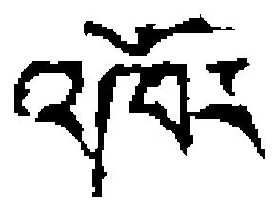


Slide 7
Touching character string images
Detecting foreground profile and skeleton
Extracting feature points and baseline
Base on position of BL
Upper vowels part
Consonants part
Removing useless feature points by the SVM three classifier
Removing useless feature points located near the end points
All candidate segmentation points

Slide 8
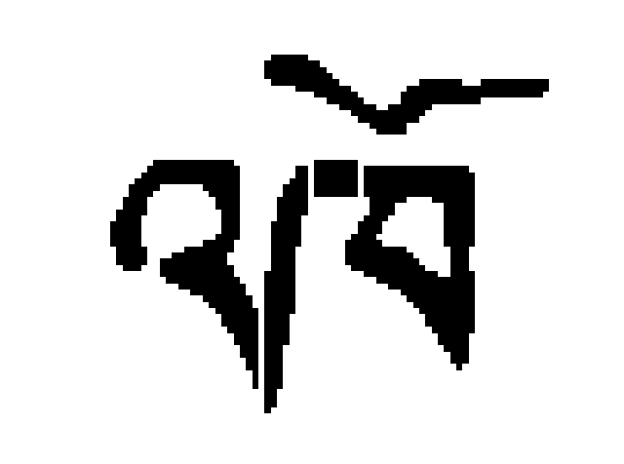


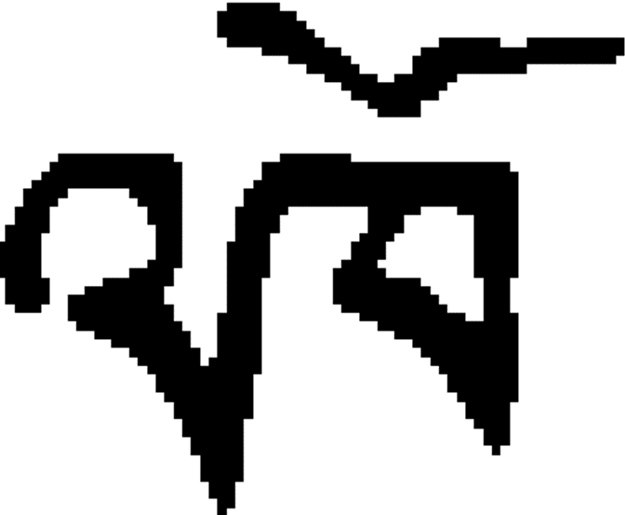

Slide 9
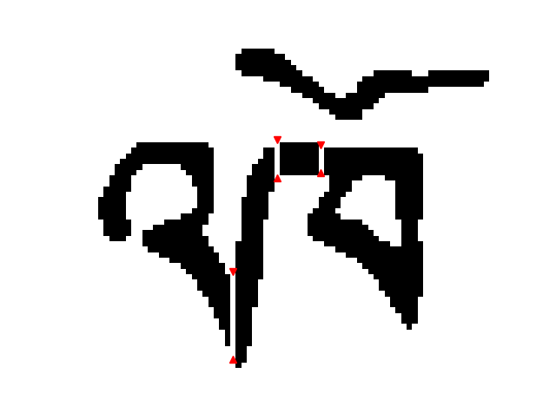






Slide 10





Slide 12
SP₁
SP₂
C₃
C₀
C₂
SP₀
C₁

Slide 14
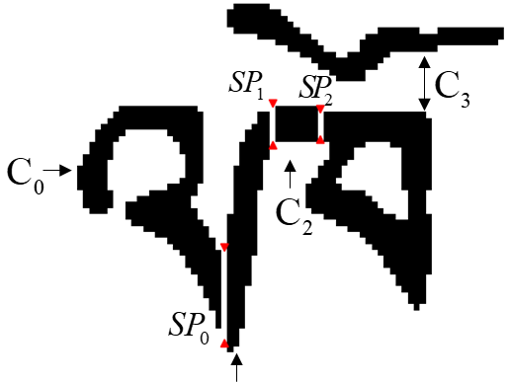

Slide 15
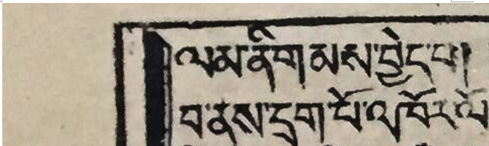
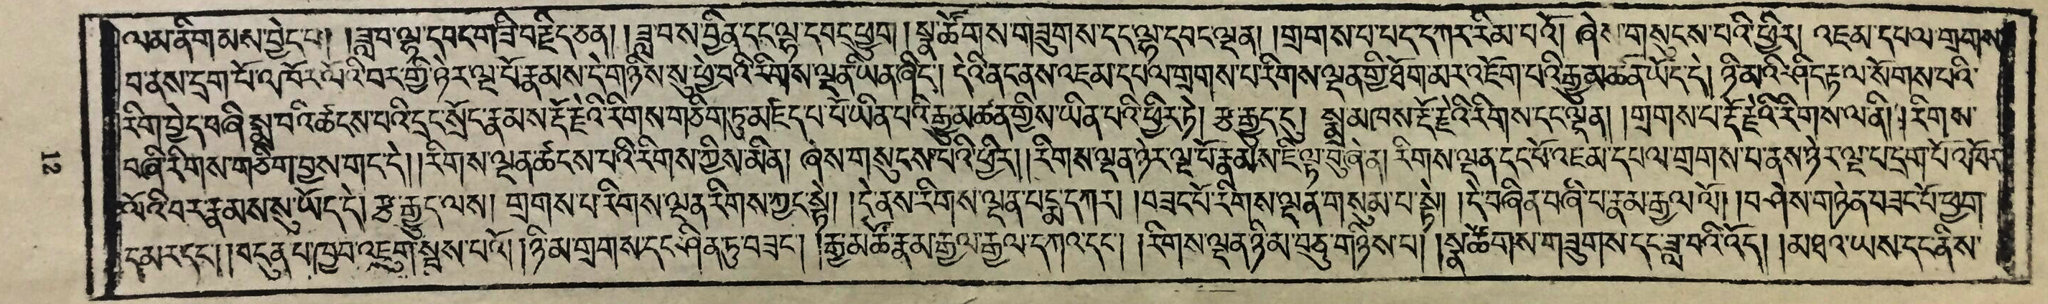
Touching Character String
A Page of Tibetan Historical Documents

Slide 16
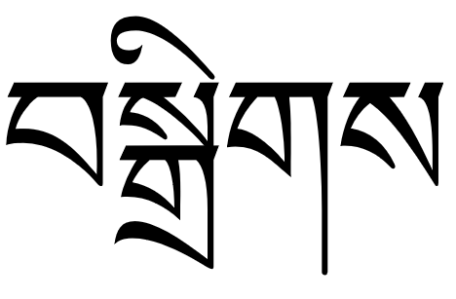
PC
TV
HC
Baseline
བསྒྲིགས
BC
FC
SC1
SC2

Slide 17
span
overlap
dist

Slide 19
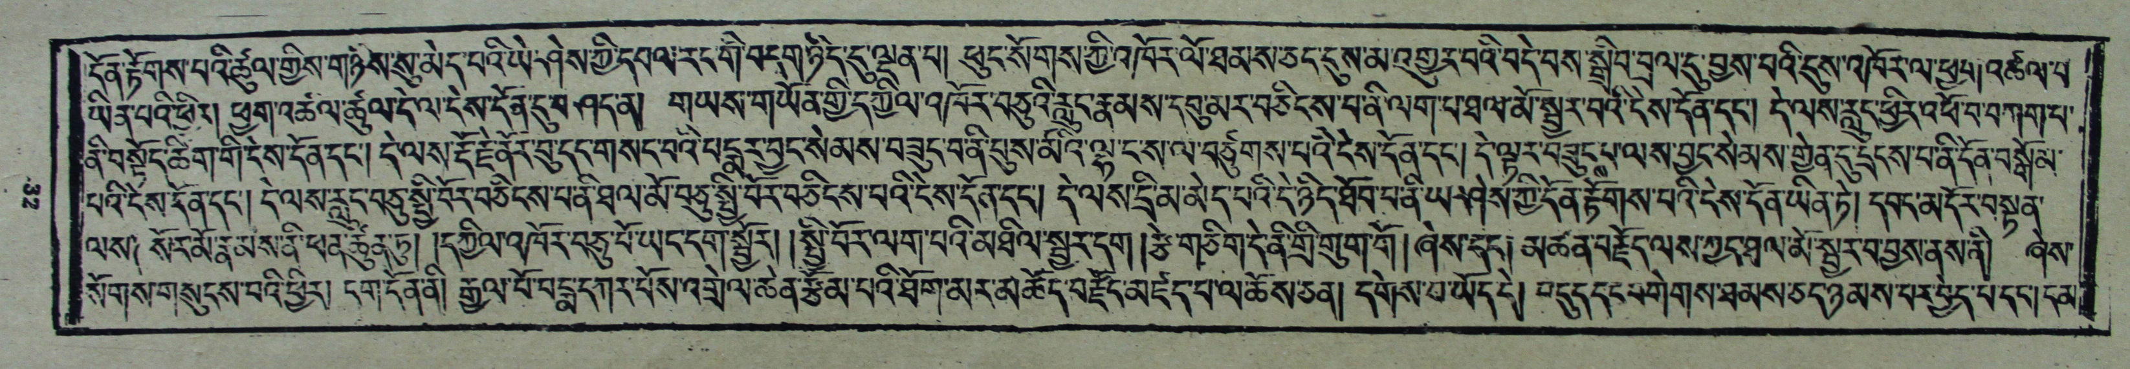
Touching Character String
A Page of Historical Tibetan Documents

Slide 20
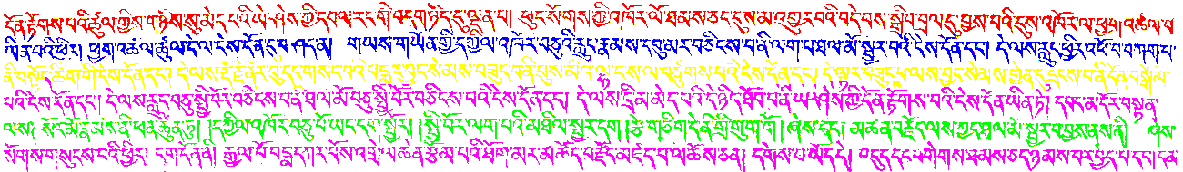

Slide 21
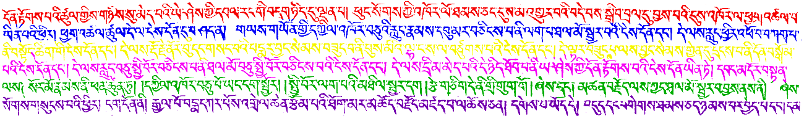

Slide 22
TV
PC
HC
SC1
SC2
BC
FC
BV

