Slide 1
Getting Started with Unity
Basic Concepts

Slide 2
What is Unity?
2D and 3D Game Development Tool
Level Editor & Script Compiler
C#, UnityScript
Very Simple Indie to AAA Commercial
Cross Platform
Win32, WinRT, WP8
Android, iOS, Backberry
Consoles, Vita
Web Browser
Notes:
Unity is a game development tool that allows users to create 3D, 2D or hybrid games. It does this by providing a visual editor and script compiler that when combined allow for a large variety of games to be quickly prototyped, polished and prepared for multiple platforms.
The scripting system allows you to use C#, UnityScript (which is just Javascript with types) and Boo to write “scripts” that define how the game works. These scripts hook together the various components of the Unity engine, from rendering to physics, to allow you to create a diverse set of game types, unlike some other editors that force you into a single genre.
Because of this, Unity has been used in simple indie projects, game prototypes and even commercial AAA games. Many games out there use Unity as their underlying engine, and it has quickly become one of the most popular game development tools.
The major benefit of Unity however, is the cross-platform nature. Unity handles most of the work for you, so you can effectively build your game and then hit compile for each platform you want. Some work is required to take advantage of native features, however all of the tough parts of porting games such as changing the renderer from DirectX to OpenGL and vice versa, or even rewriting the game in a different language, is taken care of for you by Unity. This means that simple games which ignore the native features of a platform can actually achieve the “just hit compile” dream for cross-platform development.
Unity 5 will (or has) enabled development across browsers without a plugin using WebGL.

Slide 3
How Much?
Two Key Versions
Basic (Free)
Pro ($1500 USD)
Editor License + Platform License
Editor License includes Win32/Mac/Linux, Browser
Platform Licenses come in Basic and Pro versions
Pro features require Pro licenses throughout
Notes:
You can sell games for free, but there are limits before you require a pro license (many thousands). If you want to use Pro features or exceed the free license limits, you need to purchase a Pro license. If you want to ship on a platform other than Win32 (Desktop Windows), Linux, Mac, or the Web, you need a pro license for the platform as well.
The exception here is the Windows Store and Windows Phone 8, where the platform license is included with Unity Pro.
Therefore, if you wanted to ship your game with Pro features on Windows 8, WP8, iOS and Android, you need to pay $4500:
$1500 – Unity Pro
$1500 – iOS Pro
$1500 – Android Pro

Slide 4
Agenda
Unity Interface
Scripting
GameObjects and Components
Prefabs
3D Rendering
Input
Physics
Windows Store Specifics

Slide 5
The User Interface
Key Parts

Slide 6
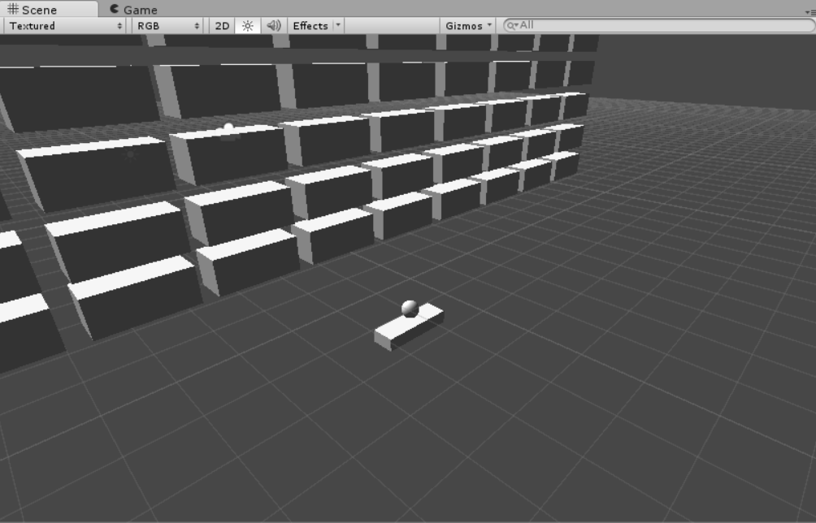
Scene and Game
Scene = Editor
Game = WYSIWYG
Direct Interact with scene and WSAD/RMB to move
Game specific input for Game view
Notes:
Demonstrate scene view, different view modes (Textured/Wireframe etc) Gizmos control and 2D vs 3D view.
Indicate Game mode is for in-editor previews of the game, can Play/Pause with controls at the top of the Unity window and view current state in the Scene view.

Slide 7
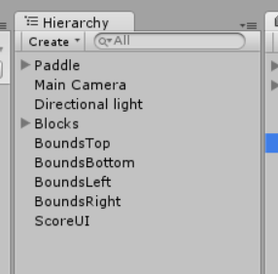
Heirarchy
Everything in the scene
Can be expanded to show GameObjects with other GameObjects as their parents

Slide 8
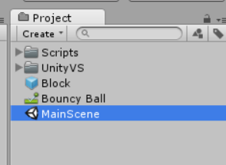
Project
Files in the Project
Create/Rename/Delete
Use this view to delete
Search at top
Notes:
The project view is your standard file explorer for the solution. It contains a structured view of all of the files that Unity has imported and knows about within your Assets folder. Within this view you can create new assets, search, tag, rename, open or delete.
One important note is that you should use this view to delete folders rather than your normal file manager. The reason for this is because Unity assigns metadata to each file through an associated file called a meta file. These files live in the same directory as their associated file and are hidden or visible depending on your editor preferences.
If you delete a file from here, Unity will delete the meta file. If you do not, then in the case of folders, Unity will re-create the folder until you delete the meta file.

Slide 9
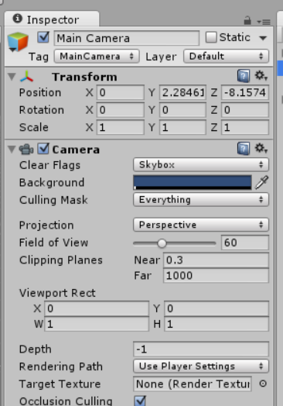
Inspector
Edit object parameters
Inspect and edit while playing
Dynamically generated
Can use custom editors
Notes:
The inspector is the most powerful tool Unity offers within the editor. The Inspector is a dynamically generated property sheet for any selected object and its components. You can use the editor to tweak values, and in the case of scripts, any public fields that the script may have (assuming it has an editor). This allows you to create scripts and then edit per-instance data for the script once it is assigned to a GameObject.
Advanced users can extend the editor for custom or pre-defined types to allow for some powerful editor scripting and functionality. For more information on this, take a look at the Unity documentation.

Slide 10
Coding for Unity

Slide 11
Scripting
C#, UnityScript
Classes that inherit from MonoBehaviour
Can have other code, but these directly link to GameObjects as Components
Uses MonoDevelop by default
Visual Studio if you don’t need debugging
UnityVS (paid plugin) fixes this

Slide 12
MonoBehaviour
Start() – Runs on creation
Initialise data
Awake() – Runs after all components are created, before Update
Cache references to other components
Update() – Runs once per “Tick” (frame)
Gameplay logic
Many others

Slide 13
Unity GameObjects
GameObjects represent “things” within the game
Objects that can be seen (or represented to the user)
Logical objects
GameObjects only come with a Transform
Can be parented to create a Transform hierarchy
Move parent and every child moves relative to parent
Has Components, which define the object

Slide 14
Components
Building blocks for GameObjects
AddComponent<T>
GetComponent<T>
Or build in Editor
Scripts, Physics, Rendering, anything

Slide 15
Transform
Position (Vector3)
Rotation (Quaternion)
Scale (Vector3)
LocalPosition
LocalRotation
LocalScale
Can be Parent of another Transform
Notes:
The transform is the way Unity describes the object’s position, rotation and scale (size) in the game world. There are two variants of each of these, the global position, rotation and scale, and the local position, rotation and scale.
The local is usually equal to the global unless the object has a parent Transform. When the object has a parent, the Local variants are relative to the parent transform, and accessing/editing the global variants will operate relative to the world rather than the parent. <give or show examples in editor>
ADD A DIAGRAM TO THIS SLIDE

Slide 16
Scenes
Stores a GameObject hierarchy
Filetype is <name>.unity
Application.LoadLevel
Application.LoadLevelAdditive
[Pro] Asynchronous Loading

Slide 17
Putting It Together

Slide 18
Prefabs
Save GameObjects as templates for quick creation at Runtime
Re-use object designs
Drag object to Project view to create

Slide 19
Assets
Unity handles many formats
Images
Models
Audio
Place in project folder and boom
Configure in editor depending on file type

Slide 20
Sub-Systems
What goes into a game?

Slide 21
3D Rendering
Mesh Filter
The Mesh Data
Material
What the mesh looks like (Shader + Texture(s))
Mesh Renderer
Binds Filter + Material and Draws
Unity generates a prefab from an imported model
Notes:
Change this to a diagram and split into multiple slides

Slide 22
Input
Hardcoded
Check individual keys in code
You handle configuration or multiple input types
Configurable
Check if a named input has been triggered
Define these inputs in the Unity Editor
Allows for multiple input types

Slide 23
Input - Hardcoded
Input.GetKey()
GetKeyDown/Up()
Input.GetMouseButton()
GetMouseButtonDown/Up()
Input.mousePosition
Input.GetTouch()
Input.touchCount
deviceOrientation, gyro, compass, acceleration
(http://docs.unity3d.com/Documentation/ScriptReference/Input.html)

Slide 24
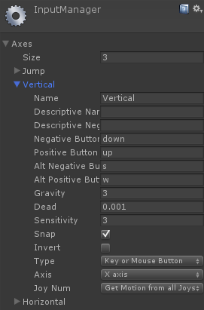
Input - Configurable
“Joystick” Axis or Button
Cleaner Code
Positive/Negative “Directions”
Primary/Secondary Options

Slide 25
Input - Configurable
Input.GetAxis(string name)
Input.GetButton(string name)
GetButtonDown(string name) – Single shot on press
if (Input.GetAxis("Vertical") > 0)
{
// …
}
Notes:
Details about accessing input axis from code

Slide 26
Physics
3D & 2D
Rigid Body + Colliders
Many different collider shapes
Add Rigid Body & Collider to GameObject, set parameters
Gravity Setting in Player Physics Settings
Everything “works”
Can provide custom collision handling

Slide 27
Collision
Collider + RigidBody
MonoBehaviour for custom response
OnCollisionEnter(Collision)
OnCollisionExit(Collision)
void OnCollisionEnter(Collision c)
{
// …
}

Slide 28
Let’s Make a Game
Demo Part 1

Slide 29
Asset Store
Art, Audio and Code Plugins
Useful sub-systems and tools
Purchases tied to Unity account
Use across multiple projects
http://assetstore.unity3d.com
Notes:
Talk about the asset store, feel free to suggest useful plugins. Demonstrate the asset store in client or at http://assetstore.unity3d.com

Slide 30
The Windows Store
Building and Certification

Slide 31
XAML
XML based UI definition
Used for WPF/Silverlight, Windows 8, WP8
Can be edited visually in Visual Studio or Expression Blend
Can be used for Video Playback, Extended Splash or ignored
Unity generates the base XAML required

Slide 32
WinRT and Compiling for the Store
Build Settings > Windows Store Apps
SDK: 8.1
Type: XAML C#
Click Build, select destination for output solution
Generates a Visual Studio 2013 Solution (2012 for an SDK 8.0 build)
Open and press F5 to run and test locally
Unity will skip existing files (except asset data files)

Slide 33
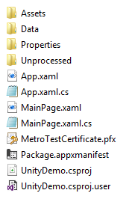

Anatomy of a Build
App icons & splash
Unity generated assets
Assembly properties
Processed script assemblies
Entry point/resume/suspend
Main XAML UI & game container
Test signing certificate
App Manifest
C# Project File
Project file settings
Unity engine code
Your project
Location of Unity Install
Project solution file
Red = Can be excluded from source control
Notes:
Explain the different files generated by Unity. Red items indicate which files can be excluded from source control if you wan to commit this solution. These excluded items can be easily re-generated by unity when building over the top of this solution.
For example, I may make edits to this solution that I want to keep. If I omit these files I save a lot of space in my source repository, and all I need to do to restore them and fix the build is run another build from Unity, over the top of these files. Unity will not overwrite your changes, only the Data, Players and Unprocessed folders.
Unity generates the .props file, which holds the current location of the Unity executable. This is required to process the code during compile and should be omitted from the repository to allow for Unity installs in different locations. This is required to perform a final build. This is not generated or required if you do NOT tick “Generate C# Projects”, as outlined in “Editing Scripts Without Rebuilding”.

Slide 34
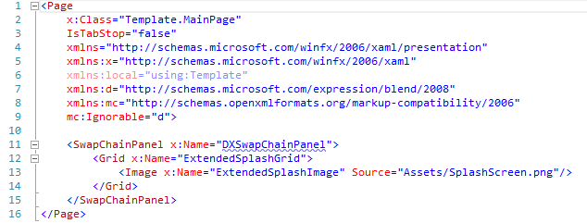
MainPage.xaml
Notes:
Explain the different parts of MainPage.xaml, including the SwapChainPanel where Unity displays its visuals, and the extended splash screen.
A mini overview of XAML is useful here, including the hierarchy structure it uses for layout (as shown by the grid).
Indicate that if you want to display videos, you need to make use of the MediaElement control and interface with your game to display/hide and play the video.
All of the controls here are surfaced in the code behind (MainPage.xaml.cs) using the names defined in the x:Name attributes here.
Custom UI as well as settings can be defined in XAML and can interact with your game using the code-behind C#.

Slide 35
Debugging Scripts with WinRT
Unity uses WinRT instead of Mono for Windows 8
Unity:
Edit > Sync Monodevelop Project(s)
Close MonoDevelop or Visual Studio
Visual Studio (Built Solution):
Add Existing Project > Select the generated .csproj file
firstpass = plugins folder
F5/Debug

Slide 36
Editing Scripts Without Rebuilding
Windows Store Apps only
When building, select Unity C# Projects
Output solution has script projects
Edit, F5, Profit
Caveat:
Do not change any serialized properties
Public
[Serializable]

Slide 37
UnityEngine.WSA
Namespace for Windows Store App integration points
More being added all the time by Unity
Can use this or your own plugin
UnityEngine.WSA.Tile
UnityEngine.WSA.SecondaryTile
UnityEngine.WSA.Toast
UnityEngine.Windows.LicenseInformation
.IsOnAppTrial
PurchaseApp()
Notes:
Look into things like resizing and other hooks that can be used, hint at things for sharing and other APIs that won’t be covered in detail

Slide 38
Cert – Privacy and Settings
When you need a Privacy Policy:
When you collect personal information
When you connect to the internet
IP Addresses are considered personally identifiable
Place this online at a URL that does not change
Add link to the store dashboard
Add link to app settings

Slide 39
Cert – Icons
Icons
Store Icon (50x50)
Medium Tile (150x150)
Small Tile (70x70)
Wide (310x150)
Large (310x310)
Square (30x30)
Splash Screen (620x300)
Rest of screen is filled with a specified colour
DPI Scaled Variants

Slide 40
Platform Macros
Conditional compilation based on chosen platform
Platform specific macros exist in the editor
Windows 8: UNITY_METRO
Windows Phone 8: UNITY_WP8
Combined: UNITY_WINRT
Editor: UNITY_EDITOR
Notes:
Note that macros exist to allow conditional compilation of scripts based on the chosen platform. They are used with the #if directive.
Make special note of the fact that these platform macros apply as soon as the platform is chosen, so even when running in the editor. The only way to exclude code from running in the editor is to combine with the UNITY_EDITOR macro, for example (UNITY_METRO && !UNITY_EDITOR) will avoid the code when running in the editor, while just using UNITY_METRO will not. This is important because the editor runs with Mono, while the built Windows 8 application uses Microsoft’s .NET (.NET Core/WinRT specifically).

Slide 41
Let’s Finish a Game
Demo Part 2

Slide 42
Further Reading
http://unity3d.com/learn
http://unity3d.com/pages/windows

