Slide 1
CSE 577 VLSI System Design Spring 2016 Lecture 3: Physical Implementations
Vijay Narayanan
Xueqing Li
Kevin Irick
With Thanks to Srivatsa Rangachar, Zhibo Wang, and Moon Seok Kim

Slide 2
Lecture Overview
Target
Understanding the ASIC design flow using STD cells and Synopsys/Cadence/Mentor Graphics tools
Understanding design optimization trade-offs in the design synthesis
Content
Design flow overview
DC synthesis
ICC layout
Standard Cell Libraries
Lecture on Tuesday, Feb 2nd is cancelled due to ISSCC;
Lecture/Tutorial/Demo uploaded to Angel;
Exercise: synthesize Homework 1 for lowest power/area. Due Feb 4, 2016

Slide 3
Digital Design Flow
Previous lectures
Verilog/VHDL Design
Modelsim
Simulation
This lecture
DC Synthesis
VCS
Simulation
ICC Physical Design
Future lectures
VCS/PrimeTime
Simulation
DRC/LVS
Finish

Slide 4
DC Synthesis
Standard cell library, IP, I/O, SRAM
HDL design files
Technology library
Design constraints
Input
Area, power, speed, etc.
DC Synthesis
Verilog
Netlist
+
Output Reports
Output

Slide 5
DC Synthesis Step 1: Preparation
}
Synopsys environment setup: source .cshrc
Set path for design and libraries
set project_path "/home/YourName/project/CSE577"
set output_dir "./result”
if {![file exists result]} { file mkdir result}
if {![file exists "$output_dir"]} { file mkdir "$output_dir"}
set path "$project_path/DC"
set search_path "$path $project_path/HDLCode"
set lib_path "/home/synopsys/lib"
set stdlib_path "$lib_path/synopsys_dc”
set target_library "$stdlib_path/tt_0v5.db"
set link_library " * $stdlib_path/tt_0v5.db"
set symbol_library "$stdlib_path/synopsys.sdb”
Set other options
set verilogout_no_tri true
Projects
}
Libraries
Tool command language for configurations (.tcl).

Slide 6
DC Synthesis Step 2: Read/Analyze the Design
Read_file command
read_file -format vhdl {mc8051_p.vhd}
read_file -format vhdl {addsub_core_.vhd}
read_file -format verilog {ntcmcu.v RAM128B.v RAM1K.v}
read_file -format verilog {ntcchip.v}
Analyze command with more check on the syntax
analyze –work work –format verilog ntcchip.v
Link
Will link the verilog files to libraries.

Slide 7
DC Synthesis Step 3: Set Design Constraints
}
Driving, clock, delay/load, area, and other options
set all_input_but_clock [remove_from_collection [all_inputs] {clk1 clk2}]
set_driving_cell -lib_cell BUFX16 -pin Y $all_input_but_clock
create_clock -period 200 [get_ports clk]
set_clock_uncertainty -setup 0.4 [get_ports clk]
set_clock_uncertainty -hold 3 [get_ports clk]
set_clock_transition 0.2 [get_clocks clk]
set_input_delay -max 2 -clock clk $all_input_but_clock
set_input_delay -min 0 -clock clk $all_input_but_clock
set_wire_load_model -name smic13_wl20
set_wire_load_mode top
set_load 0.1 [all_outputs]
set_max_area 0
set verilogout_show_unconnected_pins true
set verilogout_no_tri true
set_fix_multiple_port_nets -all -buffer_constants
set_svf myfile.svf
CLK
}
Delay and load model
}
Others

Slide 8
DC Synthesis Step 4: Compile and Generate Outputs
Compile
define_name_rules verilog -case_insensitive
change_names -hierarchy -rules verilog
write -h -format verilog -output "$output_dir/code_gate.v”
write -format ddc -hierarchy -output "$output_dir/code_gate.ddc”
write_sdc "$output_dir/code_gate.sdc"
write_sdf "$output_dir/code_gate.sdf"
redirect -append -tee "$output_dir/01_Report_area.txt" {report_area -nosplit -hierarchy}
redirect -append -tee "$output_dir/01_Report_power.txt" {report_power -hier -hier_level 100 -analysis_effort high}
redirect -append -tee "$output_dir/01_Report_power_netcell.txt" {report_power -net -cell -analysis_effort high -sort_mode dynamic_power}
redirect -append -tee "$output_dir/01_Report_clock.txt" {report_clock -nosplit}
redirect -append -tee "$output_dir/01_Report_timing.txt" {report_timing -path full -delay max -nworst 1 -max_paths 3 -significant_digits 3 -sort_by group}
Gate level netlist
Clock & IO constraints
binary project file
{
Timing file for Verilog simulation
Reports
Notes:
*.sdc: timing constraint file for P&R
*.vg: gate-level netlist for Place & Route
*.sdf: timing file for Verilog simulation
*.ddc: binary file (i.e. all the constraints and synthesis results are recorded)
*.spf: test protocol file for ATPG tools (i.e. TetraMax)

Slide 9
DC Synthesis Discussions
Functional verification before synthesis!
General discussions – What determines the power, speed, and area specs of your synthesized ASIC?
Process characteristics
Operating voltage
Temperature
Coding style and EDA tools
Timing and area trade-off
Gate, architecture, algorithm level optimizations

Slide 10
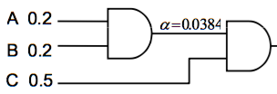
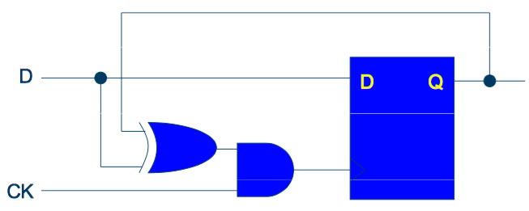
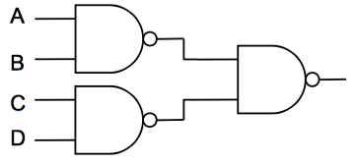
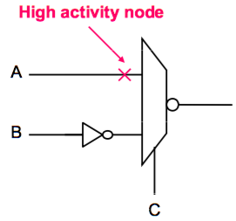
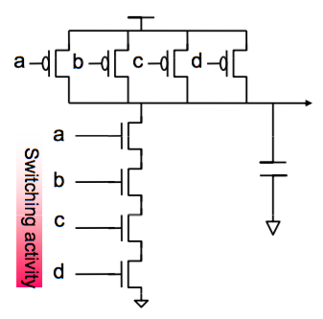
Optimizations
Gate level
STD cell mapping: delay, area, power
Architecture level
Pipelining, parallelism, retiming,
low-activity gray coding
Algorithm level
o(N^m), o(logN)
L
H
System | 10x
RTL | 2-5x
Transistor | 0.2-2x

Slide 11
Coding Checklist
Blocking and non-blocking assignment
Complete sensitivity list in sequential always block
Mixed clock triggering edges? Gated clock? Synchronous vs nonsynchronous?
Readable, reusable, modifiable, scalable
Naming convention, Version control
System definition, function partition, interface specification
Top-bottom hierarchy design
Group working
Using n-Lint for coding style check

Slide 12
HW1/2 - Comments
North – South | East – West | Duration cycles
Left-turn & Red | Red | 5
Green | Red | 10
Yellow | Red | 3
Red | Left-turn & Red | 5
Red | Green | 10
Red | Yellow | 3
How to optimize the trade-offs
FSM minimization & Logic minimization
States coding: binary, gray, one-hot
Typical redundancy in HW2
Power
Speed
Area

Slide 13
HW1/2 – FSM Minimization
North – South | East – West | Duration cycles
Left-turn & Red | Red | 5
Green | Red | 10
Yellow | Red | 3
Red | Left-turn & Red | 5
Red | Green | 10
Red | Yellow | 3
Red | Red | 1 (Emergency)
5+10+3+5+10+3=36→6b
Q: How many states are there? Minimum bits to store them?
LT & Red; Red; 0-4
Green; Red; 0-9
Yellow; Red; 0-2
Red; Yellow; 0-2
Red; Green; 0-9
Red; LT & Red; 0-4
Previous State
Red; Yellow; 0
Red; Yellow; 1
Red; Yellow; 2
Next State
Em
Em
Em
Output=(Em?)Red:Func{States}

Slide 14
HW1/2 – FSM Minimization
LT & Red; Red; 0-4
Green; Red; 0-9
Yellow; Red; 0-2
Red; Yellow; 0-2
Red; Green; 0-9
Red; LT & Red; 0-4
Previous State
Red; Yellow; 0
Red; Yellow; 1
Red; Yellow; 2
Next State
Em
Em
Em
5+10+3+5+10+3=36→6b
Output=(Em?)Red:Func{States}
External Em
DFF
Em
7b
Clock
Output=Func{States}

Slide 15
HW1/2 – FSM Minimization – Moore
North – South | East – West | Duration cycles
Left-turn & Red | Red | 5
Green | Red | 10
Yellow | Red | 3
Red | Left-turn & Red | 5
Red | Green | 10
Red | Yellow | 3
Red | Red | 1 (Emergency)
LT & Red; Red; 0-4
Green; Red; 0-9
Yellow; Red; 0-2
Red; Yellow; 0-2
Red; Green; 0-9
Red; LT & Red; 0-4
Previous State
Red; Yellow; 0
Red; Yellow; 1
Red; Yellow; 2
Next State
Em=1
Em=0
Em=1
Em=0
Em=1
Em=0
Red; Red;
Red; Red;
Red; Red;
{5+10+3+5+10+3=36}x2→7b
Output=Func{States}

Slide 16
Digital Design Flow
Previous lectures
Verilog/VHDL Design
Check
Previous lecture
DC Synthesis
Check
ICC Physical Design
This lecture
Check
DRC/LVS
Finish

Slide 17
ICC Layout Design Overview
PREVIOUS: Synthesis
Design Setup
Floorplanning
Place options
Clock options
Route options
Finishing
NEXT: DRC/LVS
IC Complier

Slide 18
IC Compiler Process
Standard cell library, IP, I/O, SRAM
DC Synthesis Output
Technology library
Design constraints
Input
Area, shape, clock, I/O, etc.
IC Compiler
Verilog
Netlist
+
Layout GDS
+
Output Reports
Output

Slide 19
ICC Layout Design Step 1: Building Projects
Set up software tools
Source .cshrc
Set up the libraries
Create the project
Read the design
Link and check correctness

Slide 20


ICC Layout Design Step 2: Floor planning
Add physical only cells (CORNER), set pad locations
Pre-place macro cells
Preset an outline
IO PAD
Bonding/ soldering pad
Chip Core
Corner
ESD, Supply,
Driver, etc.
Filler
Memory Macro/IP
Image from http://www.ece.umd.edu

Slide 21


IO Pads Introduction
interface to core
What do they do?
What’s inside?
What types?
Power
Analog/RF
Digital
Filler
How to use?
VSS
Circuitry
Circuitry
VDD
www.armge.com
PAD
Printed circuit board
die
Flip-chip substrate
Flip-chip substrate
Printed circuit board
Printed circuit board

Slide 22

IO Pads Introduction
A few examples
VDD
VDD
Analog
Digital Output
VSS
VSS
VDD
VDD or VSS
Power Supply
Digital Input
VSS

Slide 23
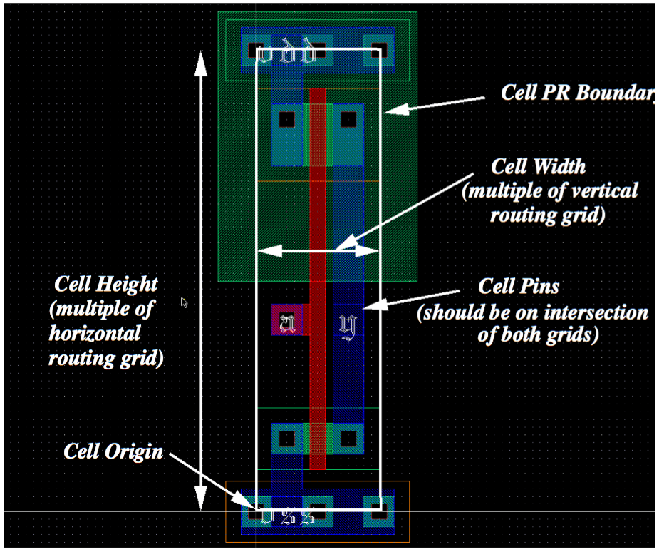
ICC Step 2: Floorplanning/Power
Add physical only cells (CORNER), set pad locations
Pre-place macro cells, preset chip outline
Connect power nets
Floorplanning & placement
VDD
Standard cells array
GND
VDD
Standard cells array
Source:
UMBC CMPE 641 Course
GND

Slide 24
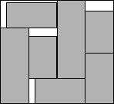
Floorplanning and Placement
Shared Targets
Chip area
Total wire length
Critical path delay
Routability
Others, e.g. noise, heat, etc
Difference in block shape constraints, I/O positions, etc.
Floorplanning: not yet fixed, soft blocks
Placement: fixed as hard blocks
Major CAD algorithms
Simulated Annealing
Partition-based methods
Heuristic algorithms, etc.

Slide 25
ICC Layout Design Step 3: Clocking
Set constraints (re-set)
* like in DC synthesis
Set clock routing rules and cells used in the clock tree
define_routing_rule clock_rule -spacings {METAL2 0.56 METAL3 0.56 METAL4 0.56 METAL5 0.56 METAL6 0.56 METAL7 0.56}
set_clock_tree_options -target_skew 0.1 -max_transition 0.5 -max_fanout 15 -routing_rule clock_rule -layer_list {METAL3 METAL4 METAL5}
Build clock tree and route clock nets
set_clock_tree_references -references {CLKBUFX2 … CLKINVX20}
clock_opt

Slide 26
Major Clocking Concerns and Techniques
Concerns
Clock skew
Power
Noise/jitter
Slew rate
Others
Techniques
Clock distribution tree
Buffer insertion
Wire sizing
Shielding
Distance

Slide 27
Power/Ground Grid
Main concern: current density
Example of 2-layer pg routing
Bottom level
Top layer
Top View

Slide 28
ICC Layout Design Step 4: Route and Finishing
Route all nets
route_opt
Routing problem is not easy…
Given a network, find the routing tree with the minimum length
NP-complete! Also Not all regions allows routing
Finishing
Check antenna errors, Insert standard cell fillers, Insert metal and poly fillers, Check DRC errors, LVS
Report Output
set_write_stream_options -map_layer $my_lib_path/gds2OutLayer.map -child_depth 20 -output_filling {fill} -output_pin {text geometry}
write_stream -cells {ntcchip_top} ./result/ntcchip_phy.gds
define_name_rules verilog -case_insensitive
remove_unconnected_ports [get_cells -hier {*}]
write_verilog -o ./result/ntcchip_phy.v
write_sdf ./result/ntcchip_phy.sdf (timing file)
Notes:
In DC:
*.sdc: timing constraint file for P&R
*.vg: gate-level netlist for Place & Route
*.sdf: timing file for Verilog simulation
*.ddc: binary file (i.e. all the constraints and synthesis results are recorded)
*.spf: test protocol file for ATPG tools (i.e. TetraMax)

Slide 29
References and Homework
References
Synopsys/Cadence user manual
Standard cell library data book
I/O library book
Lab

Slide 30
Homework #5
Due March 1st, 2016
Target:
understand the icc process, go through IIC process for the traffic light system, get the output reports (timing, area, power, etc.) and physical layout (gds).
What to submit:
A report (with snapshots in each ICC step) describing each icc step and the discussions on the icc results;
A zip file containing: verilog design file, synthesized netlist, icc constraints and settings, icc output reports and results.
System I/O specifications (see the next slide)

Slide 31
System specifications of the homework design
Input ports
clock, reset, emergency; //Boolean bit
Output ports:
LeftTurn_EW, Red_EW, Green_EW, Yellow_EW, LeftTurn_NS, Red_NS, Green_NS, Yellow_NS; //Boolean bit
‘0’ for a disabled light; ‘1’ for an enabled light
Functionality
Synchronized FSM by the rising clock edge
If emergency is sampled as ‘1’, red lights will be triggered;
If reset is sampled as ‘1’, the system enters an initial state with the EW red traffic lights and NS green lights on (other lights off).

Slide 32
Appendix – Standard Cell Libraries
Library Database (db file)
Logical View (verilog description or TLF or LIB). Verilog is required for dynamic simulation. Place and route tools usually can use TLF.
Abstract View (Cadence Abstract Generator, LEF). Information about each cell & technology information
Physical Layout (gdsII, Virtuoso Layout Editor) or Synopsys Milkyway format, following specific design standards rules.
Timing, power and parasitics (TLF or LIB)
Transistor and interconnect parasitics are extracted using Cadence or other extraction tools.
Spice or Spectre netlist is generated and detailed timing simulations are performed. Power information can also be generated during these simulations.
Data is formatted into a TLF or LIB file including process, temperature and supply voltage variations.
Logical information for each cell is also contained in this file.

Slide 33
Appendix - .cshrc
#synopsys tools
setenv PATH /home/software/synopsys-2013/syn_vG-G-2012.06-SP5-2/bin:${PATH}
setenv PATH /home/software/synopsys-2013/pts-H-2012.12-SP3-1-x86/bin:${PATH}
setenv PATH /home/software/synopsys-2013/vcs-mx-vH2013.06/bin:${PATH}
setenv VCS_HOME /home/software/synopsys-2013/vcs-mx-vH2013.06
setenv PATH
/home/software/synopsys-2013/customdesigner-H-2013.03-SP2-1/bin:${PATH}
setenv PATH
/home/software/synopsys-2013/icvalidator-I-2013.12-SP2-HF1/bin:${PATH}
setenv PATH /home/software/synopsys-2013/syn_vH-2013.03-SP5-2/bin:${PATH}
setenv PATH /home/software/synopsys-2013/starrc-H-2013.06-SP2-1/bin:${PATH}
setenv PATH
/home/software/synopsys-2013/hercules-vB-2008.09-SP5-1/bin/linux:${PATH}
setenv PATH /home/software/synopsys-2013/icc-H-2013.03-SP2/bin:${PATH}
#synopsys memory compiler
setenv MC_HOME /home/software/synopsys-2013/saed_mc
setenv SAED_MC_32_28_PDK $MC_HOME/etc/techs/SAED_PDK_32/
setenv PERL5LIB $MC_HOME/lib
set path= ($path $MC_HOME/bin )
alias ise '/home/software/xilinx-13.2/ISE_DS/ISE/bin/lin64/ise'
alias matlab '/home/software/matlab_R2012b/bin/matlab’
setenv LM_LICENSE_FILE 1700@telperion.cse.psu.edu
setenv LM_LICENSE_FILE 1711@lm2.rcc.psu.edu:${LM_LICENSE_FILE}
setenv PATH
/home/software/mentorgraphics/modeltech-10.0c/modeltech/linux_x86_64:${PATH}

