Slide 1
CSE 577 VLSI System Design Spring 2016 Lecture 1: Introduction
Vijay Narayanan
Xueqing Li
Kevin Irick

Slide 2
Course Administration
Instructors: Vijay Narayanan vijay@cse.psu.edu Xueqing Li
Guest Instructor: Dr. Kevin Irick
Labs: IST 218/220
Text/Slides: Check for reading material in Angel
Notes:
computer accounts are automatic, if have never had an account in CSE I will have (or soon have) a listing of userids/passwords.
seating chart – assignment for Thursday – xerox copy of your photo ID
pick a seat for the semester and sit there (or nearby) for rest of semester
room size -

Slide 3
Course Contents
Introduction to ASIC/FPGA Design Flow
System Design Project
Course goals
Ability to design and implement digital circuits using standard cell design flow
Prototype and functionally emulate the chip functionality using modern FPGA architectures using synthesizable HDL and exploiting various features of state-of-the-art FPGA design flow

Slide 4
Grading Information
Grade determinates
Homeworks/Lab Assignments ~40%
Course Projects ~ 50%
Class Participation/Individual Assessments ~10%
Many of the projects/homework may require group effort. The Individual assessment will be designed to check individual contributions.
Notes:
Note: evening midterm exam
Design intensive class – with semester design project

Slide 5
Course Structure
Design and tool intensive class
Xilinx ISE and EDK and IBM CAPI
Online documentation and tutorials
Cadence/Mentor Graphics ASIC Design Flow
Lectures:
First 8 weeks mostly to get you upto to pace with design flow
Once Project starts, we will get to more theoretical underpinnings.
Notes:
if you have never used a Unix system - you have that to learn as well!

Slide 6
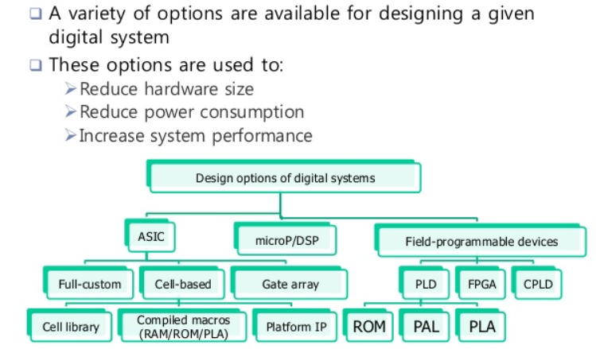
Design Options

Slide 7
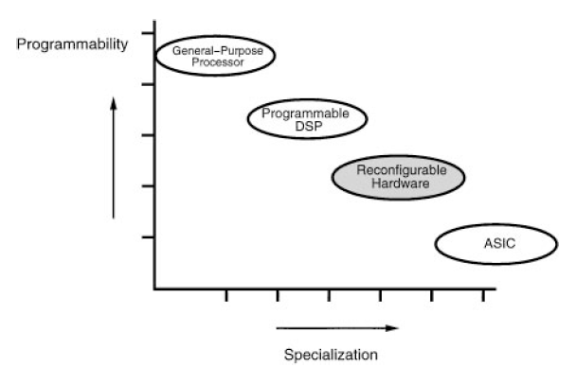
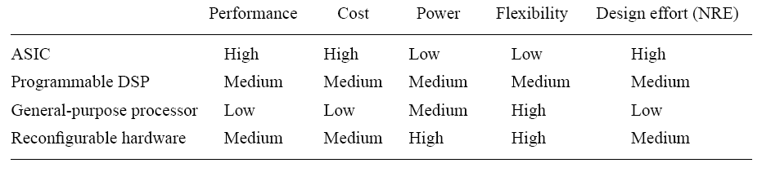
Design Spectrum
Source: RUSSELL TESSIER AND WAYNE BURLESON
Reconfigurable Computing for Digital Signal Processing: A Survey, JVLSISP, 2001

Slide 8
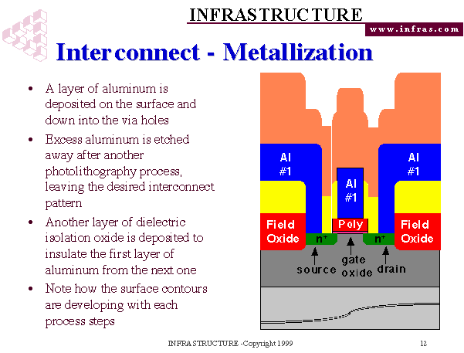
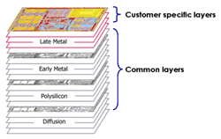
Chip Fabrication

Slide 9
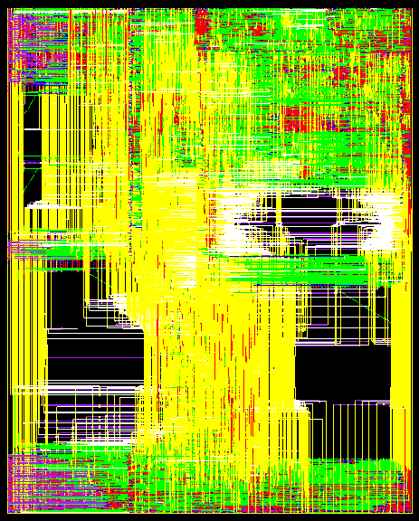
Design Alternatives
Decreasing performance; Increasing flexibility
ASIC – Application Specific Integrated Circuits
Custom Design
Cell Based Design
Mask Programmable Gate Arrays
Structured ASICs
FPGA/FPLD
ASIC type Custom mask layers Custom logic cells
Full-custom All Some
Semicustom/Cell-based All None
MPGA Some None
Structured ASIC Some None
FPGA None None
Further Reading: Online Textbook ASICs by Smith - Chapter 1

Slide 10
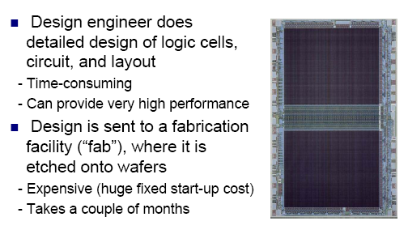
Custom ASIC

Slide 11
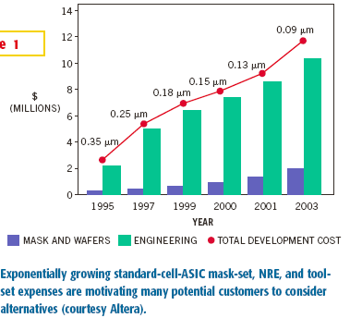
Disadvantage of ASICs

Slide 12
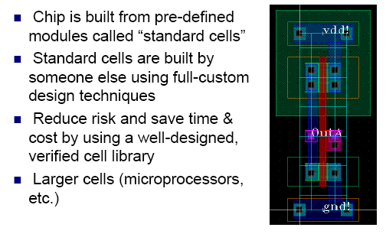
Standard Cell ASICs

Slide 13
Standard Cell Design

Slide 14
Standard Cell ASIC
All mask layers are customized: transistors and interconnect
Fabrication is still costly and slow

Slide 15
Programmable Logic Devices
Standard ICs, available in standard configurations, sold in high volume
No customized cells or masks, just a single large block of programmable interconnect
Can be configured/programmed to create a specialized device

Slide 16
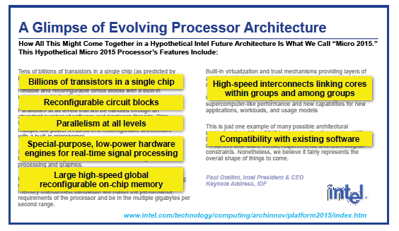
System on Chip

Slide 17
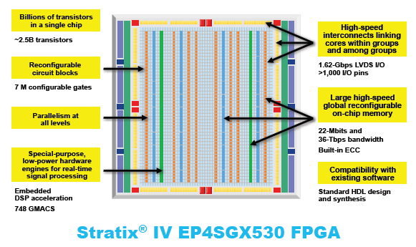
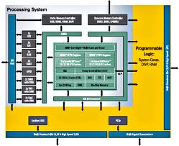
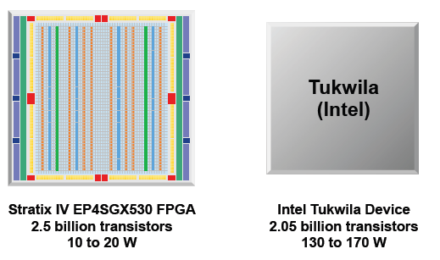
FPGAs
ZYNQ 7000

Slide 18
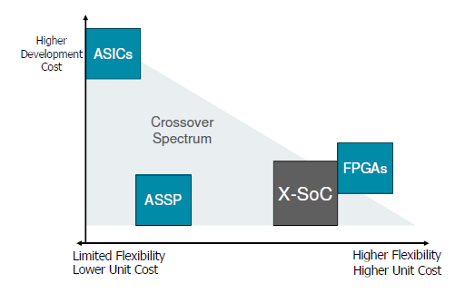
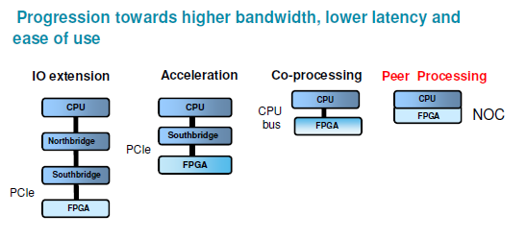
New System on Chips
The integration of (nearly) all necessary electronic functions of a
system in one package
Characterized by high bandwidth and low latency integration of
– Programmable processors
– Accelerator units
– Memories
– IO functions
Software programmable

Slide 19
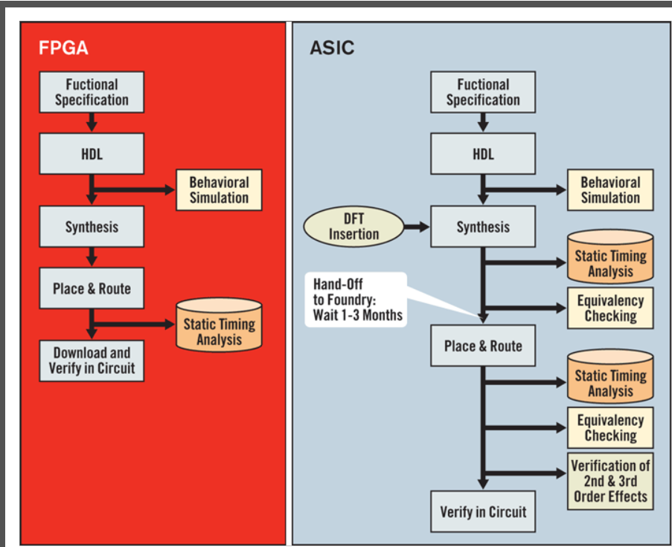
FPGA vs ASIC Design Flow

Slide 20
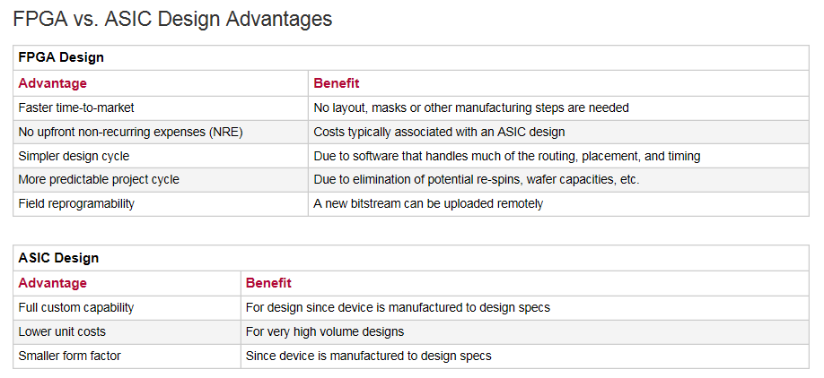
FPGA vs ASIC

Slide 21
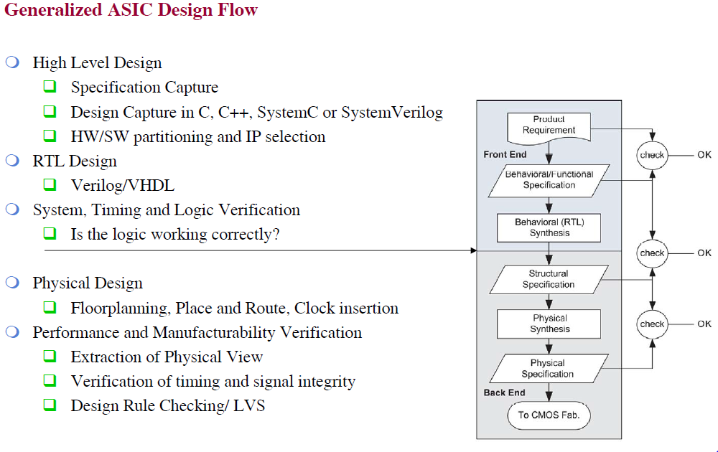
ASIC Design FLow

Slide 22
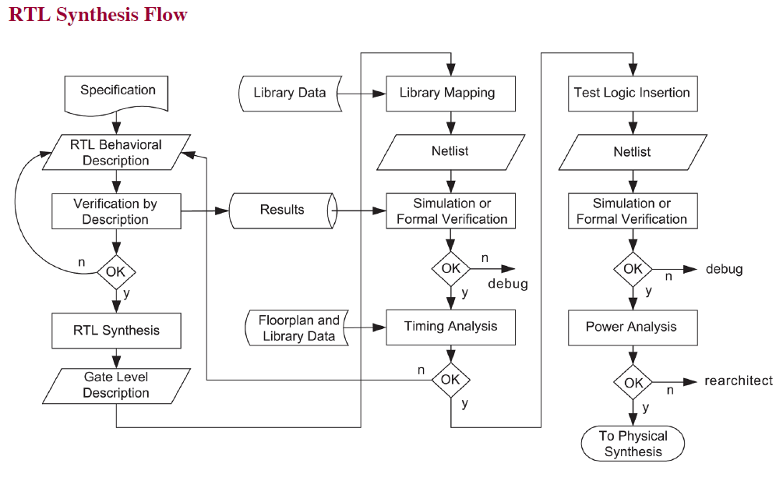
RTL Synthesis FLow

Slide 23
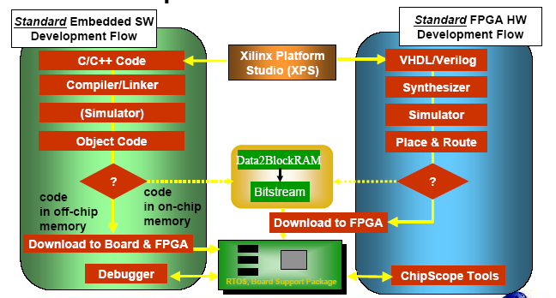
FPGA Toolflow
Source: Xilinx

Slide 24
From Verilog to Bitstream

Slide 25
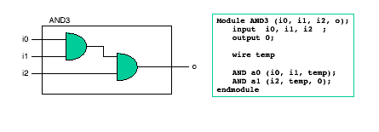
Design Synthesis
Interpret RTL code and translate it to produce synthesized circuit netlist in a standard EDIF format
Some can display circuit schematics corresponding to EDIF netlist
module d_register (CLK, DATA, Q);
input CLK;
input DATA;
output Q;
reg Q;
always @ (posedge CLK)
begin: My_D_Reg
Q <= DATA;
end
endmodule
D
Reg

Slide 26
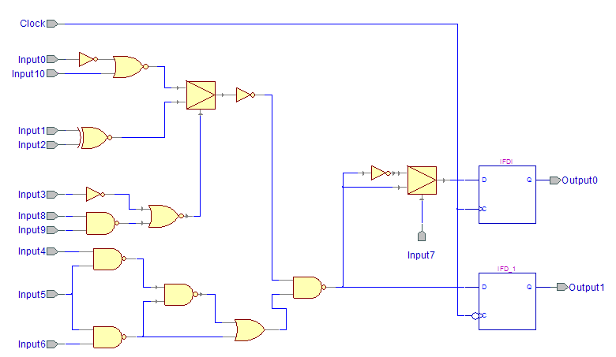
Circuit netlist

Slide 27
Technology Mapping
Process of binding technology-dependent circuits of target technology to
technology-independent circuits
LUT0
LUT4
LUT1
FF1
LUT5
LUT2
FF2
LUT3

Slide 28
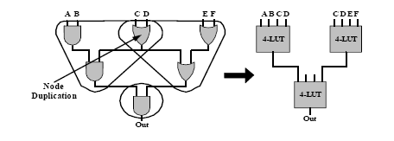
Mapping a Design into LUTs

Slide 29
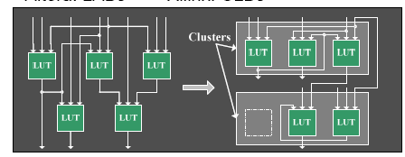
Clustering LUTs into a CLB/LAB
Clustering groups LUTs into CLB-sized clusters
- Connecting LUTs within a CLB is cheap (speed/power/area)

Slide 30
Placement
Finding physical locations in the FPGA to implement the Clustered logic.

Slide 31
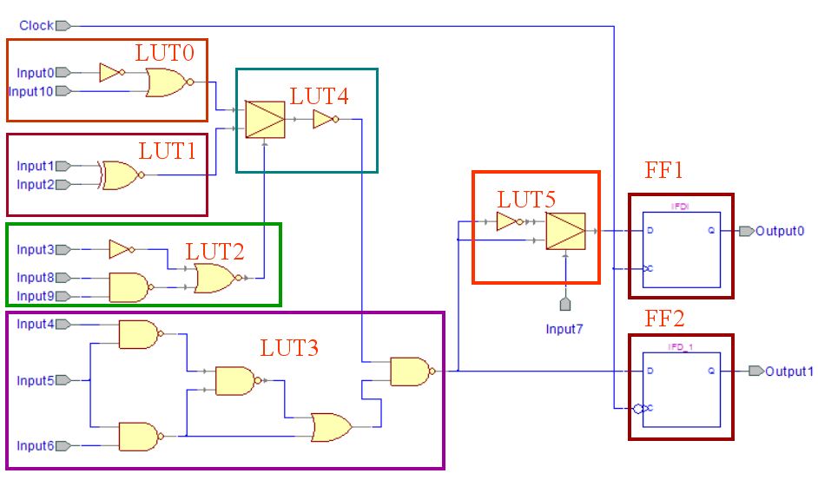
Placement
FPGA
CLB SLICES

Slide 32
Routing
FPGA
Connecting the clusters
Programmable Connections

Slide 33
Static Timing Analyzer
Performs static analysis of the circuit performance
Reports critical paths with all sources of delays
Determines maximum clock frequency

Slide 34
Static Timing Analysis
Critical Path – The Longest Path From Outputs of Registers to Inputs of Registers
t_{P logic}
in
out
D
Q
D
Q
clk
t_{Critical} = t_{P FF} + t_{P} _{logic} + t_{S FF}

Slide 35
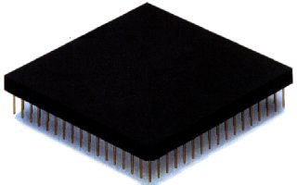
Configuration
Once a design is implemented, you must create a file that the FPGA can understand
This file is called a bit stream: a BIT file (.bit extension)
The BIT file can be downloaded directly to the FPGA, or can be converted into a PROM file which stores the programming information

Slide 36
Timing Metrics
In
D
Q
Out
clock
clock
t_{su}
t_{hold}
time
In
data
stable
t_{c-q}
time
Out
output
stable
output
stable
time
Notes:
tsetup – time that the data inputs (D) must be valid before the clock transition (0 ti 1 transition for a positive edge-triggered device)
thold is the time that the data inputs must remain valid after the clock edge
Tc-q is the worst case propagation delay (with reference to the clock edge) – time to copy D to Q

Slide 37
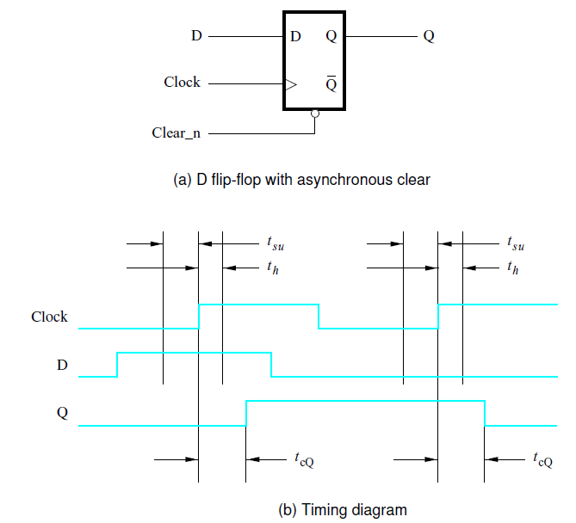
Figure 5.14. Timing for a flip-flop.

Slide 38
How fast can a circuit operate?
D
Q
D
Q
C
Q'
C
Q'
D
Q
D
Q
C
Q'
C
Q'
D
Q
D
Q
C
Q'
C
Q'
D
Q
D
Q
C
Q'
C
Q'
D
Q
D
Q
C
Q'
C
Q'
CLOCK
CLOCK

Slide 39
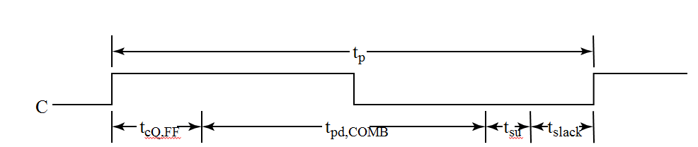
Circuit and System Level Timing
If the clock period is too short, some data changes will not propagate through the circuit to flip-flop inputs before the setup time interval begins
D
Q
D
Q
C
Q'
C
Q'
D
Q
D
Q
C
Q'
C
Q'
D
Q
D
Q
C
Q'
C
Q'
D
Q
D
Q
C
Q'
C
Q'
D
Q
D
Q
C
Q'
C
Q'
CLOCK
CLOCK

Slide 40
Circuit and System Level Timing (continued)
New Timing Components
t_{p} - clock period - The interval between occurrences of a specific clock edge in a periodic clock
t_{pd,COMB} – longest total delay of combinational logic along the path from flip-flop output to flip-flop input
t_{slack} - extra time in the clock period in addition to the sum of the delays and setup time on a path
Can be either positive or negative
Must be greater than or equal to zero on all paths for correct operation

Slide 41
Circuit and System Level Timing (continued)
Timing Equations t_{p} = t_{slack} + (t_{cQ,FF} + t_{pd,COMB} + t_{s})
For t_{slack} greater than or equal to zero, t_{p} ≥ max (t_{cQ,FF} + t_{pd,COMB} + t_{s}) for all paths from flip-flop output to flip-flop input

Slide 42
How fast can you clock this?
Consider a FF with following characteristics
Setup time = 0.6ns
Hold time = 0.4ns
T_{cQ} = (0.8ns to 1.0ns) -- range not a single value
Delay of transistors vary with temperature, sizing etc.
t_{pd,inv =} 1.1 ns (1 + 0.1k) where K is the number of gate inputs

Slide 43
How fast can you clock this?
Consider a FF with following characteristics
Setup time = 0.6ns
Hold time = 0.4ns
T_{cQ} = (0.8ns to 1.0ns) -- range not a single value
Delay of transistors vary with temperature, sizing etc.
t_{pd,inv =} 1.1 ns (1 + 0.1k) where K is the number of gate inputs
1.0 (delay of flip flop) + 1.1 (inverter) + 0.6 (set-up time) = 2.7ns
1/2.7 = 370.37 MHz

Slide 44
Short paths and hold time
Consider a FF with following characteristics
Setup time = 0.6ns
Hold time = 0.4ns
T_{cQ} = (0.8ns to 1.0ns) -- range not a single value
Delay of transistors vary with temperature, sizing etc.
t_{pd,inv =} 1.1 ns (1 + 0.1k) where K is the number of gate inputs
Shortest path back to input is 0.8 + 1.1 = 1.9ns > hold time

Slide 45
Short paths and hold time
Consider a FF with following characteristics
Setup time = 0.6ns
Hold time = 0.4ns
T_{cQ} = (0.8ns to 1.0ns) -- range not a single value
Delay of transistors vary with temperature, sizing etc.
t_{pd,inv =} 1.1 ns (1 + 0.1k) where K is the number of gate inputs
Shortest path back to input is 0.8 + 1.1 = 1.9ns > hold time

Slide 46
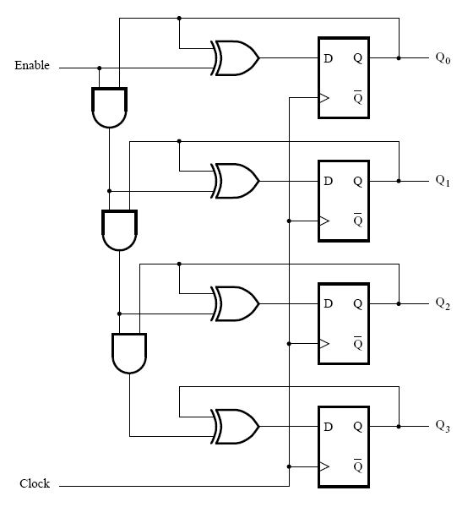
How fast can you clock this?
Longest path between flip-flop to
flip-flop
t_{pd,comb} = 3 And gates + 1 XOR
= 3 (1 +.1*2) + 1 (1 + .1*2)
(remember 1+ .1*K assumption)
T_{p} = 1.0 (T_{cQ max)} + t_{pd,comb} + 0.6 (t_{su})
= 6.4ns
Max frequency = 1/6.4ns
= 156.25 MHz

Slide 47
Short paths and hold time
shortest path between flip-flop to
flip-flop
t_{pd,comb-shortest} = 1 xor
= 1 (1 + .1*2)
(remember 1+ .1*K assumption)
T_{p,shortest} = 0.8 (T_{cQ min)} + t_{pd,comb}
= 2.0ns
< t_{hold} = 0.4ns

Slide 48
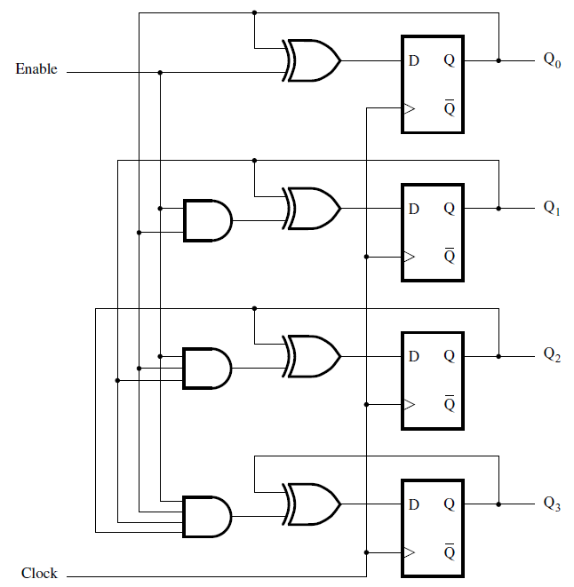
Redesigned faster circuit ?
T_{p} = 1.0 (T_{cQ max)} + t_{pd,comb} + 0.6 (t_{su})
= 1 + 1.2 * 4 + 0.6 = 6.4ns
Max frequency = 1/6.4ns
= 156.25 MHz
T_{p} = 1.0 (T_{cQ max)} + t_{pd,comb} + 0.6 (t_{su})
= 1 + 1.4 + 1.2 + 0.6 = 4.2ns
Max frequency = 1/4.2
= 238.1 MHz

Slide 49
Synchronous Timing Basics
R1
R2
In
Combinational
logic
D
Q
D
Q
t_{clk1}
t_{clk2}
clk
t_{c-q}, t_{su},t_{hold}
t_{plogic}, t_{cdlogic} (t_{plogic, shortest})
Under ideal conditions (i.e., when t_{clk1} = t_{clk2})
T ≥ t_{c-q} + t_{plogic} + t_{su}
t_{hold} ≤ t_{c-q, shortest} +t_{plogic, shortest}
Under real conditions, the clock signal can have both spatial (clock skew) and temporal (clock jitter) variations
skew is constant from cycle to cycle (by definition); skew can be positive (clock and data flowing in the same direction) or negative (clock and data flowing in opposite directions)
jitter causes T to change on a cycle-by-cycle basis
Notes:
Skew delta is tphi’’ – tphi’ where tphi’s are the local clock times. Skew can be positive or negative depending on the routing direction of the clock.
tmin’s are the best case delays of the logic, tmax are the worst case delays (assume register set up time is included in the combinational logic time). ti is the propagation delay of the interconnect.
Clock skew is due to spatial variations in the arrival time of a clock transition
skew is constant from cycle to cycle (by definition)
can be positive (clock and data flowing in the same direction) or negative (clock and data flowing in the opposite direction)
Clock jitter is due to temporal variations in the clock period (T changes on a cycle-by-cycle basis)

Slide 50
Sources of Clock Skew and Jitter in Clock Network
4
power supply
3
interconnect
clock generation
6
capacitive load
1
PLL
7
capacitive coupling
2
clock drivers
5
temperature
Skew
manufacturing device variations in clock drivers
interconnect variations
environmental variations (power supply and temperature)
Jitter
clock generation
capacitive loading and coupling
environmental variations (power supply and temperature)
Notes:
clock is distributed using multiple matched paths to the sequential elements. The clock path includes the wiring and the associated distributed buffers required to drive the interconnect and loads.
What matters is the relative arrival time at the register points at the end of each path – not the absolute delay through the clock distribution path.
Both systematic (nominally identical from chip to chip and predictable – so easy to model and correct for at design time) and random (due to manufacturing variations – so are difficult to model and eliminate)

Slide 51
Positive Clock Skew
Clock and data flow in the same direction
R1
R2
In
Combinational
logic
D
Q
D
Q
t_{clk1}
t_{clk2}
clk
delay
T
T + δ
1
δ > 0
3
2
4
δ + t_{hold}
T :
t_{hold} :
Notes:
For class handout

Slide 52
Positive Clock Skew
Clock and data flow in the same direction
R1
R2
In
Combinational
logic
D
Q
D
Q
t_{clk1}
t_{clk2}
clk
delay
T
T + δ
1
δ > 0
3
2
4
δ + t_{hold}
T + δ ≥ t_{c-q} + t_{plogic} + t_{su} so T ≥ t_{c-q} + t_{plogic} + t_{su} - δ
t_{hold} + δ ≤ t_{cdlogic} + t_{cdreg} so t_{hold} ≤ t_{cdlogic} + t_{cdreg} - δ
T :
t_{hold} :
δ > 0: Improves performance, but makes t_{hold} harder to meet. If t_{hold} is not met (race conditions), the circuit malfunctions independent of the clock period!
Notes:
For lecture
clock skew has the potential to improve the performance of the circuit.
Unfortunately, increasing skew makes the circuit more susceptible to race conditions! If the minimum delay of the combinational logic block is small, the inputs to R2 may change before R2’s first rising edge. To avoid races, we must ensure that the minimum delay through the register and logic must e long enough that the inputs to R2 are valid for a hold time after that edge. Reducing the clock frequency can’t fix it!

Slide 53
Negative Clock Skew
Clock and data flow in opposite directions
R1
R2
In
Combinational
logic
D
Q
D
Q
t_{clk1}
t_{clk2}
clk
delay
T
T + δ
1
3
2
δ < 0
4
T :
t_{hold} :
Notes:
For class handout

Slide 54
Negative Clock Skew
Clock and data flow in opposite directions
R1
R2
In
Combinational
logic
D
Q
D
Q
t_{clk1}
t_{clk2}
clk
delay
T
T + δ
1
3
2
δ < 0
4
T + δ ≥ t_{c-q} + t_{plogic} + t_{su} so T ≥ t_{c-q} + t_{plogic} + t_{su} - δ
t_{hold} + δ ≤ t_{cdlogic} + t_{cdreg} so t_{hold} ≤ t_{cdlogic} + t_{cdreg} - δ
T :
t_{hold} :
δ < 0: Degrades performance, but t_{hold} is easier to meet (eliminating race conditions)
Notes:
For lecture
a negative skew adversely impacts the performance of the system.
However, assuming thold + delta < tcdreg + tcdlogic, a negative skew implies that the system never fails since edge 2 happens before edge 1 – i.e., there is never a race condition.
Unfortunately, for general logic signals flow in both directions so skew can be both positive and negative in the same circuit

Slide 55
Clock Jitter
Jitter causes T to vary on a cycle-by-cycle basis
R1
Combinational
logic
In
t_{clk}
clk
T
-t_{jitter}
+t_{jitter}
T :
T - 2t_{jitter} ≥ t_{c-q} + t_{plogic} + t_{su} so T ≥ t_{c-q} + t_{plogic} + t_{su} + 2t_{jitter}
Jitter directly reduces the performance of a sequential circuit
Notes:
for lecture

Slide 56
Combined Impact of Skew and Jitter
Constraints on the minimum clock period (δ > 0)
R1
R2
In
Combinational
logic
D
Q
D
Q
t_{clk1}
t_{clk2}
T
T + δ
1
δ > 0
6
12
-t_{jitter}
T ≥ t_{c-q} + t_{plogic} + t_{su} - δ + 2t_{jitter} t_{hold} ≤ t_{cdlogic} + t_{cdreg} – δ – 2t_{jitter}
δ > 0 with jitter: Degrades performance, and makes t_{hold} even harder to meet. (The acceptable skew is reduced by jitter.)

Slide 57
Repeat with Clock Skew (1.5ns)
CLOCK
Longest path between flip-flop to
flip-flop (clock at FF3 arrives later
1.5ns than at FF0-FF2
t_{pd,comb} = 3 And gates + 1 XOR - skew
= 3 (1 +.1*2) + 1 (1 + .1*2) – 1.5
(remember 1+ .1*K assumption)
T_{p} = 1.0 (T_{cQ max)} + t_{pd,comb} + 0.6 (t_{su})
= 4.9ns
Max frequency = 1/4.9ns = 204 MHz
Note: Can Change critical path
FF0
FF1
FF2
1.5ns
FF3

Slide 58
Repeat with Clock Skew (1.5ns)
CLOCK
Longest path between flip-flop to
flip-flop (clock at Q3 arrives later
0.6ns than at Q1
T_{p} = 1.0 (T_{cQ max)} + 3.6 + 0.6 (t_{su})
= 5.2ns
Q0 to Q2 delay is 5.2ns
Q0 to Q3 was
FF0
FF1
FF2
1.5ns
FF3

Slide 59
Repeat with Clock Skew (1.5ns)
CLOCK
Q0 to Q2 delay is 5.2ns (with no
skew between Q0 and Q2)
Hold time for shortest path that start
Elsewhere and end at Q3
0.8 + 1.2 + 1.2 = 3.2 ns
< t_{hold} (0.4) + t _{skew} (1.5)
If skew becomes greater than 2.8 ..
We will have hold problem.
FF0
FF1
FF2
1.5ns
FF3

Slide 60
Xilinx Design Flow

Slide 61
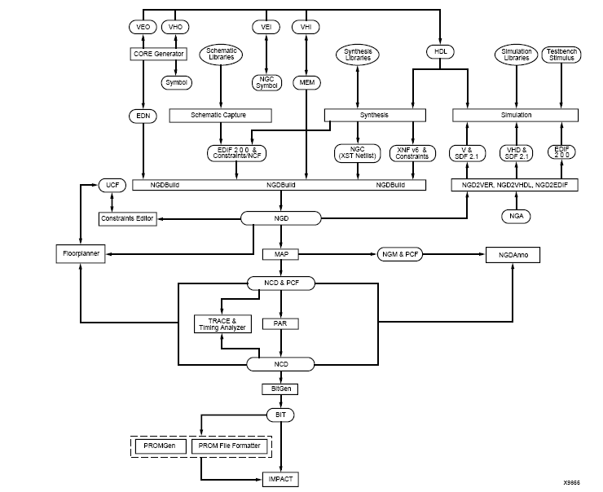

Slide 62
Design Entry and Synthesis

Slide 63
Design Implementation
Translate: The Translate process merges all of the input netlists and design constraints and outputs a Xilinx native generic database (NGD) file, which describes the logical design reduced to Xilinx primitives. (NGDBUILD)
Map: The Map process maps the logic defined by an NGD file into FPGA elements, such as CLBs and IOBs. The output design is a native circuit description (NCD) file that physically represents the design mapped to the components in the Xilinx FPGA. (MAP)
Place and Route: The Place and Route process takes a mapped NCD file, places and routes the design, and produces an NCD file that is used as input for bitstream generation. (PAR)
Programming File Generation: The Generate Programming File process produces a bitstream for Xilinx device configuration. After the design is completely routed, you must configure the device so it can execute the desired function. (Bitgen)

Slide 64
Design Implementation

Slide 65
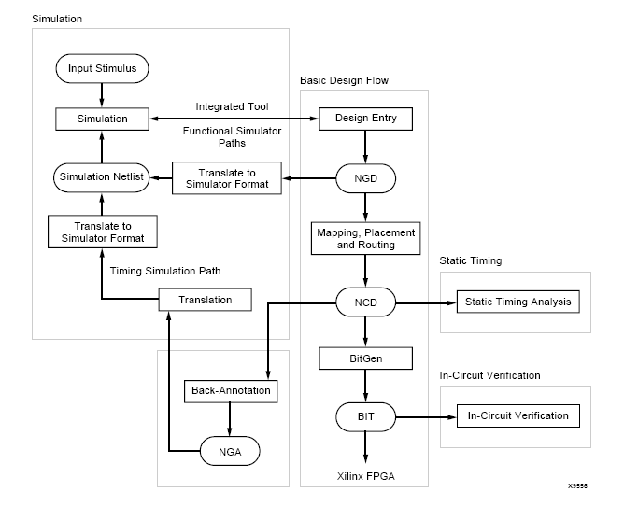
Design Verification

Slide 66
Design Verification Tools
TRACE: Timing Reporter and Circuit Evaluator
Chipscope: inbuilt logic Analyzer

