Slide 2
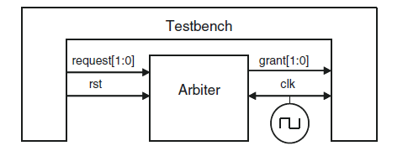

Slide 3
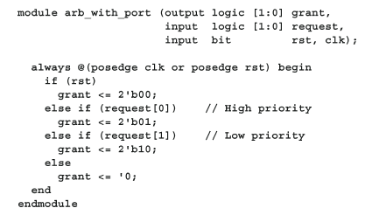
Design

Slide 4
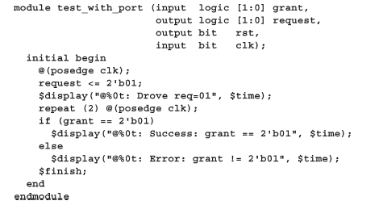
Test bench

Slide 5
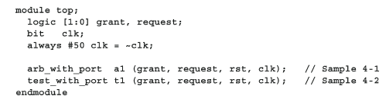
Top Module

Slide 6
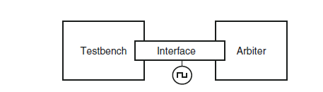

Interface

Slide 7
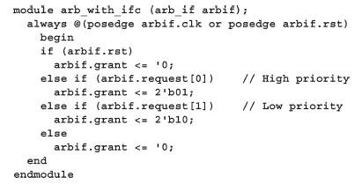
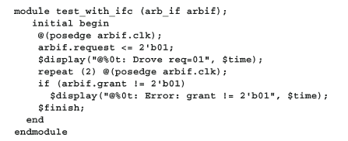
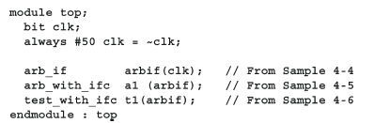
Using Interfaces

Slide 8
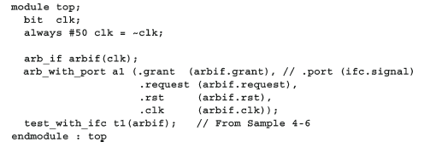
Dealing with legacy code

Slide 9
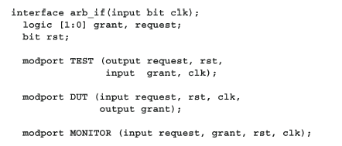
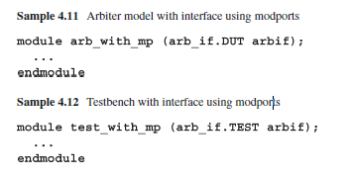
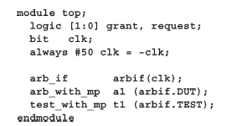
Grouping Signals

Slide 10
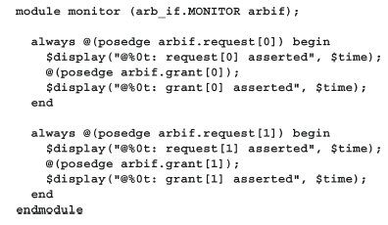
Monitors

Slide 11
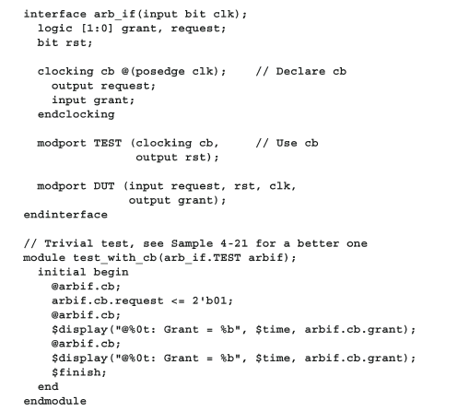
Orchestrate Test and Design

Slide 12
Verilog Test Challenges
So a hardware tester needs to drive the chip’s inputs at the clock edge, and read the
outputs just before the following edge.
A testbench has to mimic this tester behavior. It should drive on or after the
active clock edge, and should sample as late as possible as allowed by the protocol
timing specification, just before the active clock edge.
If the DUT and testbench are made of Verilog modules only, this outcome is
nearly impossible to achieve.
If the testbench drives the DUT at the clock edge, there could be race conditions.
What if the clock propagates to some DUT inputs before the testbench stimulus, but is a little later to other inputs?
From the outside, the clock edges all arrive at the same simulation time, but in the design, some inputs get the value driven during the last cycle, whereas other inputs get values from the current cycle.

Slide 13
Verilog Test Challenges
One way around this problem is to add small delays to the system, such as #0.
This forces the thread of Verilog code to stop and be rescheduled after all other
code. Invariably though, a large design has several sections that all want to execute last.
Whose #0 wins out? It could vary from run to run and be unpredictable between simulators. Multiple threads using #0 delays cause indeterministic behavior.
Avoid using #0 as it will make your code unstable and not portable.
The next solution is to use a larger delay, #1. RTL code has no timing, other than
clock edges, so one time unit after the clock, the logic has settled. However, what if one module uses a time precision of 1ns, whereas another used a resolution of just 10ps? Does that #1 mean 1ns, 10ps, or something else? You want to drive as soon as possible after the clock cycle with the active clock edge, but not during that time, and before anything else can happen. Worse yet, your DUT may contain a mix of RTL code with no delays and gate code with delays. Just as you should avoid using #0, stay away from #1 delays to fix timing problems

Slide 14
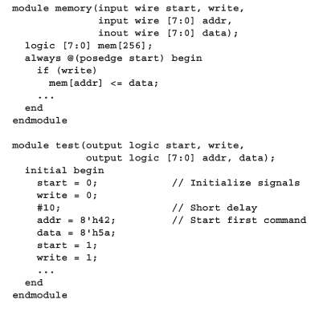
Example of Race

