Slide 1
CSE 577 VLSI Systems Design Spring 2016
Verilog Examples
Vijaykrishnan (Vijay) Narayanan (cse.psu.edu/~vijay)
Xueqing Li and Kevin Irick
Course material on ANGEL: cms.psu.edu
Includes material from: - Brown, et al. Fundamentals of Digital Logic with Verilog Design

Slide 2
Hardware Description Language
Examples: VHDL and Verilog
C-like syntax
Amenable to software engineering techniques
Programming language to describe hardware
Assumed concurrency vs. assumed serialization
Explicit spatial parallelism, resource utilization
Timing dependent behavior
Need to describe HW, its interactions with the outside world, and the testing/verification of HW all in one language!
On the one hand, HDLs are rich languages
On the other hand, NOT ALL HDL CODE DESCRIBES ACTUAL HARDWARE!
(See Appendix A)

Slide 3
The Verilog language
Verilog is a case sensitive language (with a few exceptions)
Identifiers (space-free sequence of symbols)
upper and lower case letters from the alphabet
digits (0, 1, ..., 9)
underscore ( _ )
$ symbol (only for system tasks and functions)
Max length of 1024 symbols
Terminate lines with semicolon
Single line comments: // A single-line comment goes here
Multi-line comments: /* Do not /* nest multi-line comments*/ like this */

Slide 4
Verilog Datatype Categories
type [range] signal_name1{, signal_name2, … signal_n};
Types
Net
Represents a physical wire
Describes structural connectivity
wire and tri (tristate) keywords
wire x; // scalar net x – 1 four-valued bit {0, 1, z, x}
wire Cin, AddSub; // 2 scalar nets
wire [3:0] S; // 4-bit (bus/vector) value can use S[3] to refer to 4th bit
Variables
Used to describe behavior or logic function
reg and integer keywords
reg [2:0] count; // can be sequential or combinational
Integer k; // does not correspond directly to circuit element

Slide 5
Arrays
reg [7:0] R[3:0];
R as four 8-bit variables assigned as R[3], R[2], R[1] and R[0]
Can also access them as R[3][7];

Slide 6
Hardware Description Language - Verilog
Programming Language to describe hardware
// Anything that starts with this is a comment
// SPACE, TAB are ignored by Verilog Compiler
// Verilog signals can take 0, 1, z (tri-state) or x (unknown)
// z or Z are equivalent
// [size][‘radix]constant 3’b001 3 bits long Binary 001
// 2’d21 2 digit long decimal number 21
// h – hex and o – octal
// 8’b0000_1111 _ is only for readability and permitted
wire [3:0] S;
S = 4’b0011; // S[3]=0; S[2]=0; S[1]=1; S[0]=1;
Notes:
Add examples from page 15 – ciletti

Slide 7
Primitives
Common combinational logic gates
and, nand, or, nor, xor, xnor, buf, not
or(x,a,b,c); // instance name is optional
or name_it_my_or(x,a,b,c) // or(output,in1,in2,in3)
Appendix A.9

Slide 8
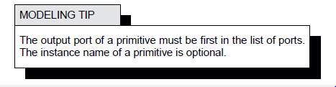
Primitives
and name_it_my_and(x,a,b,c);

Slide 9
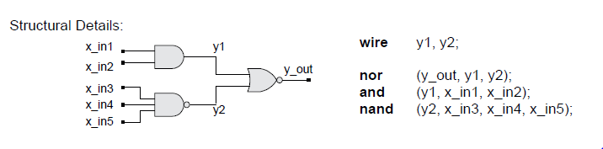
Bigger Circuit

Slide 10
Verilog Operators
Arithmetic
+, -, *, /, **, %
Logical
!, &&, ||, >, >=, <, <=, ==, ===, !=, !==
Bitwise
~, &, |, ^, ~^
Replicate/Concatenate
{a,b,c}
{3{a}}
{{5{a}},b}
Shift
<<, <<<, >>, >>>
Unary Reduction
&, ~&, |, ~|, ^, ~^

Slide 11
Bitwise Operations
~ negation; // example ~1000 = 0001
& And; // example 1010 & 1000 = 1000
^ Exclusive or; // example 1010 ^ 1000 = 0010
| inclusive or; // example 1010 | 1000 = 1010
~^ exclusive nor // example 1010 ~^ 1000 = 1101
y[2:0] = a[2:0] | b[2:0];
/* is equivalent to
or(y[2],a[2],b[2]);
or(y[1],a[1],b[1]);
or(y[0],a[0],b[0]);
*/

Slide 12
Table A.1 from Brown and Vranesic
Category | Examples | Bit Length [L = length function]
Bitwise | ~A, +A, -A A&B, A|B, A~^B, A^B | L(A) Max(L(A),L(B))
Logical | !A, A&&B, A||B | 1 bit
Reduction | &A, ~&A, |A, ~|A, ^~A, ^A | 1 bit
Relational | A==B, A!=B, A>B, A<B, A>=B, A<=B, A===B, A!==B | 1 bit
Arithmetic | A+B, A-B, A*B, A/B, A%B | Max(L(A), L(B))
Shift | A<<B, A >>B | L(A)
Concatenate | {A,…,B} | L(A)+…+L(B)
Replication | {B{A}} | B*L(A)
Condition | A?B:C | Max(L(B),L(C))

Slide 13
Logical operations
Used for taking Boolean expression and returns True or False
! – negation
&& - logical and
|| - logical or
A===B // A identical to B including x and z
A == B // not including x and z

Slide 14
Logical Shift Operation
A = 8’b1010_0001;
A >> 1; // logical shift right
// A becomes 0101_0000;
A = 8’b1010_0001;
A << 1; // logical shift left
// A becomes 0100_0010;

Slide 15
Arithmetic Shift Operation (will revisit again)
A = 8’b1010_0001;
A >>> 1; // arithmetic shift right
// A becomes 1101_0000; //NOTE: leftmost bit retained
A = 8’b1010_0001;
A <<<1; // arithmetic shift left (same effect as logical)
// A becomes 0100_0010;

Slide 16
Modular Design
module
module
name [(port
name{,
port
name})];
[parameter
declarations]
[input
declarations]
[output
declarations]
[inout
declarations]
[wire
or
tri
declarations]
[reg
or
integer
declarations]
[function
or
task
declarations]
[assign
continuous assignmen
ts]
[initial
block]
[always
blocks]
[gate instantiations]
[module
instantiations]
endmo
dule
Appendix A in textbook

Slide 17
Modules
The module is the basic building block in Verilog
Modules can be interconnected to describe the structure of your digital system
Modules start with keyword module and end with keyword endmodule

Slide 18
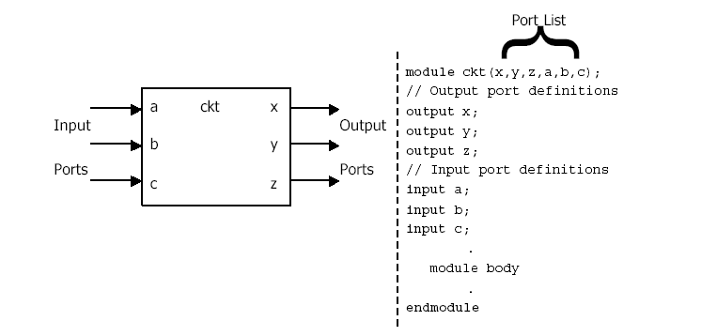
Modeling Structure: Modules
The module is the basic building block in Verilog
Modules can be interconnected to describe the structure of your digital system
Modules start with keyword module and end with keyword endmodule

Slide 19
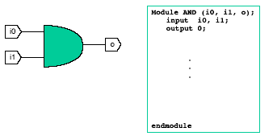
Modeling Structure: Ports
Module Ports
Similar to pins on a chip
Provide a way to communicate with outside world
Ports can be input, output or inout

Slide 20
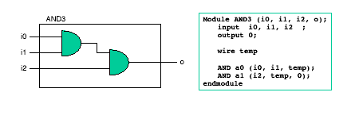
Modeling Structure: instances
Module instances
Verilog models consist of a hierarchy of module instances

Slide 21
How to Build and Test a Module
Construct a “test bench” for your design
Develop your hierarchical system within a module that has input and output ports (called “design” here)
Develop a separate module to generate tests for the module (“test”)
Connect these together within another module (“testbench”)
module design (a, b, c);
input a, b;
output c;
…
module testbench ();
wire l, m, n;
design d (l, m, n);
test t (l, m);
initial begin
//monitor and display
…
module test (q, r);
output q, r;
initial begin
//drive the outputs with signals
…
Adapted from Slides of Prof. Don Thomas, CMU

Slide 22
Another View of This
3 chunks of Verilog, one for each of:
TESTBENCH is the final piece of hardware which
connects DESIGN with TEST so the inputs generated
go to the thing you want to test...
Another module, called TEST, to generate interesting inputs
Your hardware
called
DESIGN
Adapted from Slides of Prof. Don Thomas, CMU

Slide 23
An Example
Module testAdd generated inputs for module halfAdd and displayed changes. Module halfAdd was the design
module tBench;
wire su, co, a, b;
halfAdd ad (su, co, a, b);
testAdd tb (a, b, su, co);
endmodule
module testAdd (a, b, sum, cOut);
input sum, cOut;
output a, b;
reg a, b;
initial begin
$monitor ($time,,
“a=%b, b=%b, sum=%b, cOut=%b”,
a, b, sum, cOut);
a = 0; b = 0;
#10 b = 1;
#10 a = 1;
#10 b = 0;
#10 $finish;
end
endmodule
module halfAdd (sum, cOut, a, b); output sum, cOut;
input a, b;
xor #2 (sum, a, b);
and #2 (cOut, a, b);
endmodule
Adapted from Slides of Prof. Don Thomas, CMU

Slide 24
The Test Module
$monitor
prints its string when executed.
after that, the string is printed when one of the listed values changes.
only one monitor can be active at any time
prints at end of current simulation time
Function of this tester
at time zero, print values and set a=b=0
after 10 time units, set b=1
after another 10, set a=1
after another 10 set b=0
then another 10 and finish
module testAdd(a, b, sum, cOut);
input sum, cOut;
output a, b;
reg a, b;
initial begin
$monitor ($time,,
“a=%b, b=%b, sum=%b,
cOut=%b”,
a, b, sum, cOut);
a = 0; b = 0;
#10 b = 1;
#10 a = 1;
#10 b = 0;
#10 $finish;
end
endmodule
Adapted from Slides of Prof. Don Thomas, CMU

Slide 25
Another Version of a Test Module
module testAdd (test, sum, cOut);
input sum, cOut;
output [1:0] test;
reg [1:0] test;
initial begin
$monitor ($time,,
"test=%b, sum=%b, cOut=%b",
test, sum, cOut);
test = 0;
#10 test = test + 1;
#10 test = test + 1;
#10 test = test + 1;
#10 $finish;
end
endmodule
Multi-bit “thingies”
test is a two-bit register and output
It acts as a two-bit number (counts 00-01-10-11-00…)
Module tBench needs to connect it correctly — mod halfAdd has 1-bit ports.
module tBench;
wire su, co;
wire [1:0] t;
halfAdd ad (su, co, t[1], t[0]);
testAdd tb (t, su, co);
endmodule
Connects bit 0 or wire t to this port (b of the module halfAdder)
Adapted from Slides of Prof. Don Thomas, CMU

Slide 26
Another Version of testAdd
Other procedural statements
You can use “for”, “while”, “if-then-else” and others here.
This makes it easier to write if you have lots of input bits.
module testAdd (test, sum, cOut);
input sum, cOut;
output [1:0] test;
reg [1:0] test;
initial begin
$monitor ($time,,
"test=%b, sum=%b, cOut=%b",
test, sum, cOut);
for (test = 0; test < 3; test = test + 1)
#10;
#10 $finish;
end
endmodule
module tBench;
wire su, co;
wire [1:0] t;
halfAdd ad (su, co, t[1], t[0]);
testAdd tb (t, su, co);
endmodule
Adapted from Slides of Prof. Don Thomas, CMU

Slide 27
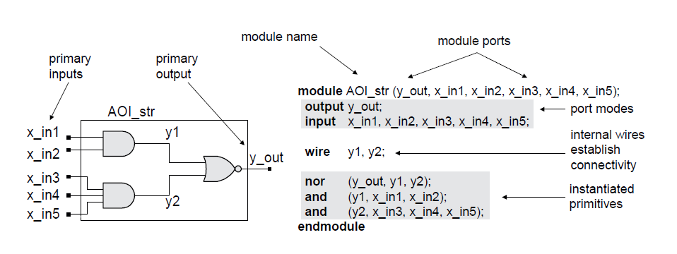
Modules

Slide 28
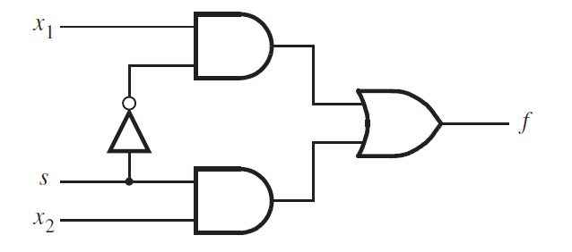
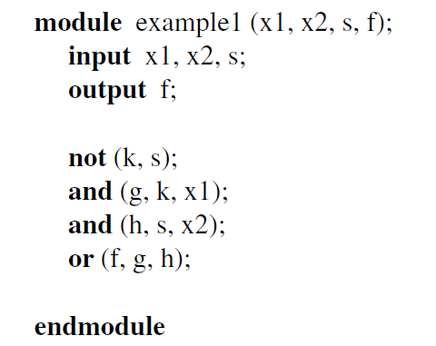
Example logic circuit – Hardware Description

Slide 29
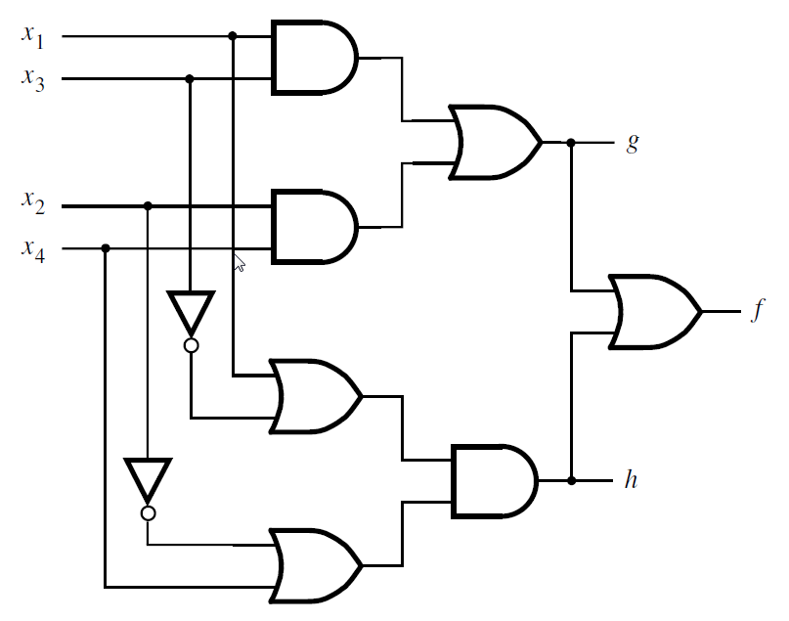
Example logic circuit – Hardware Description
module example2 (x1, x2, x3, x4, f, g, h);
input x1, x2, x3, x4;
output f, g, h;
and (z1, x1, x3);
and (z2, x2, x4);
or (g, z1, z2);
or (z3, x1, ~x3);
or (z4, ~x2, x4);
and (h, z3, z4);
or (f, g, h);
endmodule

Slide 30
Module Ports
What and why of ports
Similar to pins on a chip
Provide a way to communication with outside world
Ports can be input, output, or inout
inout used to describe bidirectional pins
Mostly only used at highest level of design hierarchy
It is not necessary for a module to have ports
Common when describing a testbench

Slide 31
Ports
module circuit
(
//Input Port Definitions
input a,
input b,
input c,
input s,
//Output Port Definitions
output x,
output y,
output z,
//Inout Port Definitions
inout h
);
//Module Body
assign x = a | b | c;
assign y = a & b & c & h;
assign z = ~(a & b & c & h);
assign h = (s == 1'b1) ? x : 1'bz;
endmodule

Slide 32
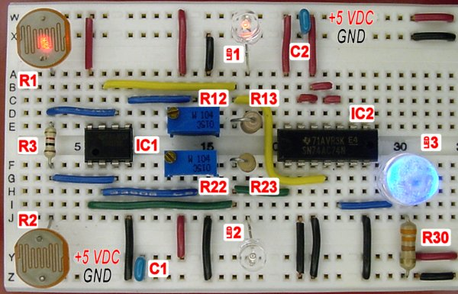
Instantiation
Module Instances
Verilog models consist of a hierarchy of module instances
These instances are interconnected using nets
Verilog “wires”
Think “wiring up a circuit board”
instances are specific components
We use wires to interconnect the components

Slide 33
Instantiation
module AND2
(
//Input Port Definitions
input i0,
input i1,
//Output Port Definitions
output o
);
assign o = i0 & i1;
endmodule
module circuit
(
//Input Port Definitions
input a,
input b,
input c,
//Output Port Definitions
output x
);
//Declare a net
wire temp;
//Instantiate a 2-Input AND Gate and call it A0
AND2 A0
(
.i0 (a ),
.i1 (b ),
.o (temp )
);
//Instantiate a 2-Input AND Gate and call it A1
AND2 A1
(
.i0 (temp ),
.i1 (c ),
.o (x )
);
endmodule

Slide 34
Instantiation
module AND2
(
//Input Port Definitions
input i0,
input i1,
//Output Port Definitions
output o
);
assign o = i0 & i1;
endmodule
module circuit
(
//Input Port Definitions
input a,
input b,
input c,
//Output Port Definitions
output x
);
//Declare a net
wire temp;
//Instantiate a 2-Input AND Gate and call it A0
AND2 A0
(
.i0 (a ),
.i1 (b ),
.o (temp )
);
//Instantiate a 2-Input AND Gate and call it A1
AND2 A1
(
.i0 (temp ),
.i1 (c ),
.o (x )
);
endmodule
Instance Type is “AND2”
Instance Name is “A0”
Port belonging to “this” module
Port belonging to “AND2” module

Slide 35
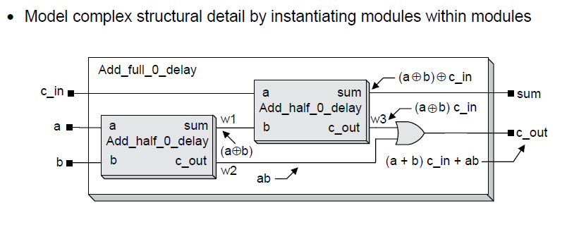
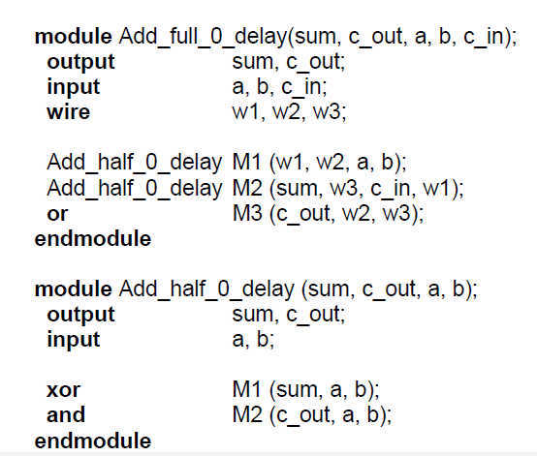
Modular Design

Slide 36
Structural Vs. Behavioral Models
Structural model
Just specifies primitive gates and wires
i.e., the structure of a logical netlist
You basically know how to do this now.
Behavioral model
More like a procedure in a programming language
Still specify a module in Verilog with inputs and outputs...
...but inside the module you write code to tell what you want to have happen, NOT what gates to connect to make it happen
i.e., you specify the behavior you want, not the structure to do it
Why use behavioral models
For testbench modules to test structural designs
For high-level specs to drive logic synthesis tools

Slide 37
Structural vs. Behavioral Verilog Code
Structural Verilog
Behavioral Verilog
module MUX (f, a, b, sel);
output f;
input a, b, sel;
and #5 g1 (f1, a, nsel),
g2 (f2, b, sel);
or #5 g3 (f, f1, f2);
not g4 (nsel, sel);
endmodule
module MUX
(f, sel, b, c);
output reg f;
input sel, b, c;
always @ (sel or b or c)
begin
if (sel == 1)
f = b;
else
f = c;
end
endmodule
a
f1
a
nsel
f
f
b
f2
b
sel
sel
f =
a • sel’ + b • sel
Adapted from Slides of Prof. Don Thomas, CMU

Slide 38
Structural Verilog: 4:1 Mux

Slide 39
Behavioral Verilog

Slide 40
Verilog: 4-to-1 mux via cascaded ternary operator
module mux4to1 (w0, w1, w2, w3, S, f);
input w0, w1, w2, w3;
input [1:0] S;
output f;
assign f = S[1] ? (S[0] ? w3 : w2) : (S[0] ? w1 : w0);
endmodule

Slide 41
Verilog: 2-to-1 mux via “if-else”
module mux2to1 (w0, w1, s, f);
input w0, w1, s;
output reg f;
always @(w0, w1, s)
if (s==0)
f = w0;
else
f = w1;
endmodule

Slide 42
Verilog: 4-to-1 mux via case statement
module mux4to1 (W, S, f);
input [3:0] W;
input [1:0] S;
output reg f;
always @(W, S)
case (S)
0: f = W[0];
1: f = W[1];
2: f = W[2];
3: f = W[3];
endcase
endmodule

Slide 43
Sensitivity Lists
Explicit Sensitivity List
Implicit Sensitivity List Using @(*)
module circuit
(
//Input Port Definitions
input a,
input b,
input c,
//Output Port Definitions
output reg x,
output reg y,
output reg z
);
// Module Body
always @ (a, b, c)
begin
x = a | b | c;
y = a & b & c;
z = ~(a & b & c);
end
endmodule
module circuit
(
//Input Port Definitions
input a,
input b,
input c,
//Output Port Definitions
output reg x,
output reg y,
output reg z
);
// Module Body
always @ (*)
begin
x = a | b | c;
y = a & b & c;
z = ~(a & b & c);
end
endmodule

Slide 44
Edge Triggering
A Verilog signal can take on the following values
0
1
X (unknown)
Z (high-impedance)
An edge is a signal transition
A NEGEDGE is on the transitions
1 -> x, 1 -> z, 1 -> 0
x -> 0, z -> 0
A POSEDGE is on the transitions
0 -> x, 0 -> z, 0 -> 1
x -> 1, z -> 1
Used to describe “clocked” (synchronous) logic
D
Q
clk
D Flip Flop

Slide 45
D Flip-Flop Positive Clock Edge Triggered
// Module Body
always @ (posedge clk)
begin
Q <= D;
end
D
Q
clk
D Flip Flop

Slide 46
D Flip-Flop Negative Clock Edge Triggered
// Module Body
always @ (negedge clk)
begin
Q <= D;
end
D
Q
clk
D Flip Flop

Slide 47
D Flip-Flop Positive Clock Edge Triggered, Asynchronous Active High Reset
// Module Body
always @ (posedge clk, posedge reset)
begin
//Was it clk or reset that got us here?
if (reset == 1’b1)
begin
Q <= 1’b0;
end
else
begin
Q <= D;
end
end
reset
D
Q
clk
D Flip Flop

Slide 48
D Flip-Flop Positive Clock Edge Triggered, Asynchronous Active Low Reset
// Module Body
always @ (posedge clk, negedge reset)
begin
if (reset == 1’b0)
begin
Q <= 1’b0;
end
else
begin
Q <= D;
end
end
reset
D
Q
clk
D Flip Flop

Slide 49
D Flip-Flop Positive Clock Edge Triggered, Synchronous Active High Reset
// Module Body
always @ (posedge clk)
begin
if (reset == 1’b1)
begin
Q <= 1’b0;
end
else
begin
Q <= D;
end
end
reset
0
1
D
Q
D
0
clk
D Flip Flop

Slide 50
What is Procedural Code?
Code of the type
is referred to as Procedural Code because the statements between the begin and the end are executed procedurally, or in order.
The Block is executed when triggered by a change in any signal in the sensitivity list
Then the statements in the body of the always block are executed once
always @ (input1 or input2 or …)
begin
if-then-else or case statement
end

Slide 51
Procedural Block Examples
reg Q;
always @ (W or E or D)
begin
if (E == 1)
begin
Q = D;
end
else
Q = W;
end
end
E
D
1
Q
W
0
2-to-1 Mux
Here ‘Q’ will be updated if any of ‘W’ or ‘E’ or ‘D’ change

Slide 52
Procedural Block Examples
reg Q;
always @ (E or D)
begin
if (E == 1)
begin
Q = D;
end
end
D
Q
E
Transparent
Latch
Whats the value of ‘Q’ when ‘D’ changes but ‘E’ is 0?
Incomplete conditional assignments are a common bug.
Here ‘Q’ will hold on to its previous value if ‘E’ is 0!!!

Slide 53
Procedural Block Examples
Whats the value of ‘Q’ when ‘Y’ changes?
reg Q;
always @ (E or D)
begin
if (E == 1)
begin
Q = Y;
end
else
begin
Q = D;
end
end
Incomplete sensitivity lists is a common bug in designs.
Here ‘Q’ will not follow the value of ‘Y’!!!

Slide 54
Procedural Assignments
Used within behavioral blocks (initial, always)
Two types of assignments
= //Blocking Assignment
<= //Non-Blocking Assignment
Can be used to assign to verilog variable types
reg
integer
real

Slide 55
Blocking Assignments
Blocking Assignments: Uses the “=“ assignment operator
Blocking Assignments: Are evaluated sequentially
Blocking Assignments: Used to describe combinatorial logic

Slide 56
Non-Blocking Assignments
Non-Blocking Assignments: Uses the <= assignment operator
Non-Blocking Assignments: Are updated simultaneously
Non-Blocking Assignments: Used to describe sequential logic

Slide 57
Non-Blocking Rules
Execution of Non-Blocking assigments can be thought of as a two-step process:
Evaluate the RHS of all Non-Blocking statements at the beginning of the time step.
Update the LHS of all Non-Blocking statements at the end of the time step.

Slide 58
Blocking Rules
Execution of Blocking assignments can be viewed as a one-step process:
Evaluate the RHS and update the LHS of the blocking assignment without interrupt from any other Verilog statement

Slide 59
Implement this in Verilog
d
q1
q2
q3
D
Q
D
Q
D
Q
clk
clk
clk
D Flip Flop
D Flip Flop
D Flip Flop
clk

Slide 60
Design 1
Q1: Does this work?
Q2: Is this good Verilog style?
module pipe
(
input [7:0] d,
input clk,
output reg [7:0] q3
);
reg [7:0] q2, q1;
always @ (posedge clk)
begin
q1 = d;
q2 = q1;
q3 = q2;
end
endmodule
Q1: NO (what does this actually become?) Q2: NO (see Q1 above)
(Blocking vs. Non-Blocking: Brown & Vranesic Section 5.12.3)

Slide 61
Design 2
Q1: Does this work?
Q2: Is this good Verilog style?
module pipe
(
input [7:0] d,
input clk,
output reg [7:0] q3
);
reg [7:0] q2, q1;
always @ (posedge clk)
begin
q3 = q2;
q2 = q1;
q1 = d;
end
endmodule
Q1: Yes (Why does this work when design one does not?) Q2: Not really – it works, but you shouldn’t have to be this careful with the ordering
(Blocking vs. Non-Blocking: Brown & Vranesic Section 5.12.3)

Slide 62
Design 3
Q1: Does this work?
Q2: Is this good Verilog style?
module pipe
(
input [7:0] d,
input clk,
output reg [7:0] q3
);
reg [7:0] q2, q1;
always @ (posedge clk)
q1 = d;
always @ (posedge clk)
q2 = q1;
always @ (posedge clk)
q3 = q2;
endmodule
Q1: Unknown! (Order of evaluation is undefined. Could work like Design 2 or fail like Design 1 or fail differently than Design 1.) Q2: NO (see Q1 above)
(Blocking vs. Non-Blocking: Brown & Vranesic Section 5.12.3)

Slide 63
Design 4 (Non-Blocking)
Works? YES! Good style? YES!
module pipe
(
input [7:0] d,
input clk,
output reg [7:0] q3
);
reg [7:0] q2, q1;
always @ (posedge clk)
begin
q1 <= d;
q2 <= q1;
q3 <= q2;
end
endmodule
module pipe
(
input [7:0] d,
input clk,
output reg [7:0] q3
);
reg [7:0] q2, q1;
always @ (posedge clk)
begin
q3 <= q2;
q2 <= q1;
q1 <= d;
end
endmodule
(Blocking vs. Non-Blocking: Brown & Vranesic Section 5.12.3)

Slide 64
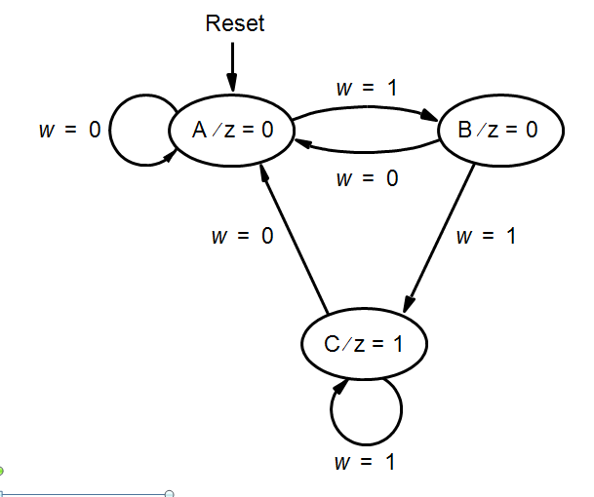
Present
Next state
Output
state
w
=
0
w
=
1
z
A
A
B
0
B
A
C
0
C
A
C
1
Figure 6.4. State table for the sequential circuit in Figure 6.3.

Slide 65
module simple (Clock, Resetn, w, z);
input Clock, Resetn, w;
output z;
reg [2:1] y, Y;
parameter [2:1] A = 2'b00, B = 2'b01, C = 2'b10;
// Define the next state combinational circuit
always @(w, y)
case (y)
A: if (w) Y = B;
else Y = A;
B: if (w) Y = C;
else Y = A;
C: if (w) Y = C;
else Y = A;
default: Y = 2'bxx;
endcase
// Define the sequential block
always @(negedge Resetn, posedge Clock)
if (Resetn = = 0) y <= A;
else y <= Y;
// Define output
assign z = (y = = C);
endmodule
Figure 6.29. Verilog code for the FSM in Figure 6.3.

Slide 66
module simple (Clock, Resetn, w, z);
input Clock, Resetn, w;
output reg z;
reg [2:1] y, Y;
parameter [2:1] A = 2'b00, B = 2'b01, C = 2'b10;
// Define the next state combinational circuit
always @(w, y)
begin
case (y)
A: if (w) Y = B;
else Y = A;
B: if (w) Y = C;
else Y = A;
C: if (w) Y = C;
else Y = A;
default: Y = 2'bxx;
endcase
z = (y = = C); //Define output
end
// Define the sequential block
always @(negedge Resetn, posedge Clock)
if (Resetn = = 0) y <= A;
else y <= Y;
endmodule
Figure 6.33. Second version of code for the FSM in Figure 6.3.

Slide 67
module simple (Clock, Resetn, w, z);
input Clock, Resetn, w;
output z;
reg [2:1] y;
parameter [2:1] A = 2'b00, B = 2'b01, C = 2'b10;
// Define the sequential block
always @(negedge Resetn, posedge Clock)
if (Resetn = = 0) y <= A;
else
case (y)
A: if (w) y <= B;
else y <= A;
B: if (w) y <= C;
else y <= A;
C: if (w) y <= C;
else y <= A;
default: y <= 2'bxx;
endcase
// Define output
assign z = (y = = C);
endmodule
Figure 6.34. Third version of code for the FSM in Figure 6.3.

Slide 68
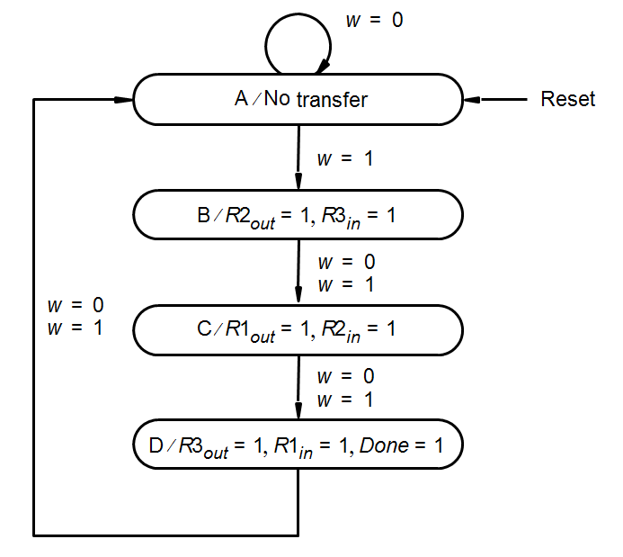
Figure 6.35. Verilog code for the FSM in Figure 6.11.
module control (Clock, Resetn, w, R1in, R1out, R2in, R2out, R3in, R3out,Done);
input Clock, Resetn, w;
output R1in, R1out, R2in, R2out, R3in, R3out, Done;
reg [2:1] y, Y;
parameter [2:1] A = 2'b00, B = 2'b01, C = 2'b10, D = 2'b11;
// Define the next state combinational circuit
always @(w, y)
case (y)
A: if (w) Y = B;
else Y = A;
B: Y = C;
C: Y = D;
D: Y = A;
endcase
// Define the sequential block
always @(negedge Resetn, posedge Clock)
if (Resetn = = 0) y <= A;
else y <= Y;
// Define outputs
assign R2out = (y = = B);
assign R3in = (y = = B);
assign R1out = (y = = C);
assign R2in = (y = = C);
assign R3out = (y = = D);
assign R1in = (y = = D);
assign Done = (y = = D);
endmodule

Slide 69
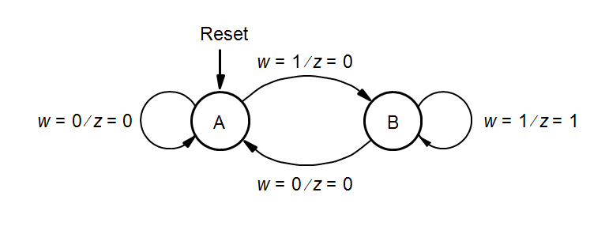
Figure 6.36. Verilog code for the Mealy machine of Figure 6.23.
module mealy (Clock, Resetn, w, z);
input Clock, Resetn, w;
output reg z;
reg y, Y;
parameter A = 1’b0, B = 1’b1;
// Define the sequential block
always @(negedge Resetn, posedge Clock)
if (Resetn = = 0) y <= A;
else y <= Y;
// Define the next state and output combinational circuits
always @(w, y)
case (y)
A: if (w)
begin
z = 0;
Y = B;
end
else
begin
z = 0;
Y = A;
end
B: if (w)
begin
z = 1;
Y = B;
end
else
begin
z = 0;
Y = A;
end
endcase
endmodule

