Slide 1

DeCoR: A Delayed Commit and Rollback Mechanism for Handling Inductive Noise in Processors
Meeta S. Gupta, Krishna K. Rangan,
Michael D. Smith, Gu-Yeon Wei
David Brooks
Harvard University
School of Engineering and Applied Sciences

Slide 2
Parameter Variations
With technology scaling, parameter variations are becoming a major concern
Impacts maximum clock frequency and/or power
  Worst-case delay effected by variations
  POWER6: 17% timing variations due to voltage noise
Variations
Process
Runtime
Voltage
Temperature
DeCoR: A Delayed Commit and Rollback Mechanism for Handling Inductive Noise in Processors
Notes:
With Technology scaling, especially beyond 90nm feature sizes, parameter variations has become an important design constraint. The worst-case delay in the circuits is affected by variations and hence impacting the clock frequency which is set by the worst-case circuit delay
Parameter variations can be broadly classified as process variations and runtime variations. Process variations is caused by the inability to control fabrication process at small feature sizes. The other class of variations, namely voltage and temperature variation is caused by the variations in activity levels across the processor at runtime.

Slide 3
Voltage Noise
Current
Voltage
Voltage Emergency
Traditional designs set conservative margins
DeCoR: A Delayed Commit and Rollback Mechanism for Handling Inductive Noise in Processors

Slide 4
Avoiding Voltage Noise
Current
Sensor Delay
Voltage
Soft threshold
Start throttle
Inability to react in time can lead to violations

Slide 5
DeCoR
Current
Voltage
Rollback
DeCoR: A Delayed Commit and Rollback Mechanism for Handling Inductive Noise in Processors

Slide 6
Solution Space
High
ROBUSTNESS
Low
More
L2 Cache
T
I
MI
N
G
MA
R
G
I
N
S
Traditional
Design
L1 Cache
RRF
Processor Core
L2 Cache
L2 Cache
DeCoR
L1 Cache
L1 Cache
Emergency
Avoidance
RRF
RRF
Less
Processor Core
Processor Core
DeCoR: A Delayed Commit and Rollback Mechanism for Handling Inductive Noise in Processors

Slide 7
Outline
Background on voltage noise
DeCoR
  Implementation details
  Performance
Comparison
  Avoidance schemes
  Explicit checkpointing
Conclusions
DeCoR: A Delayed Commit and Rollback Mechanism for Handling Inductive Noise in Processors

Slide 8
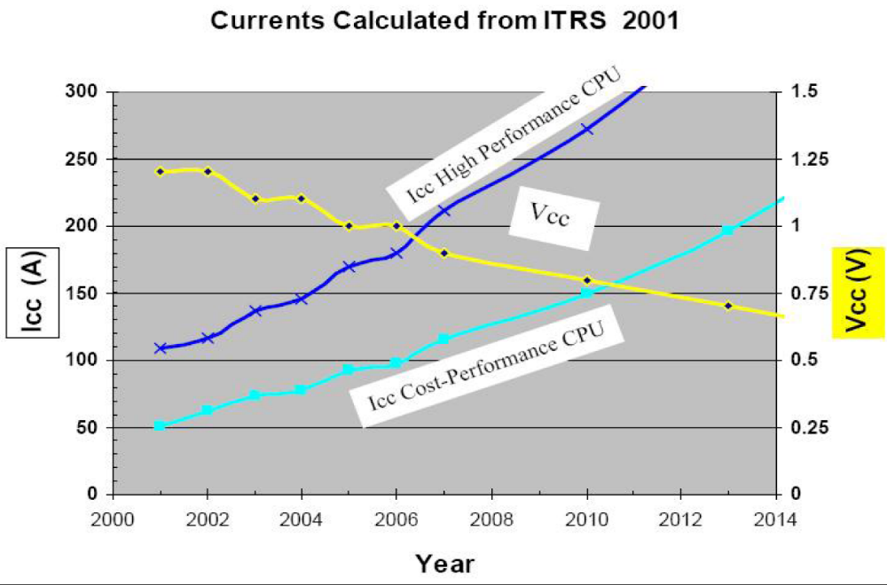
Vcc and Icc Trends
Z_{target} ~ 1 mΩ
Ed Sanders, “Power Technology Roadmap for Microprocessor Voltage Regulators”, APEC-2004
DeCoR: A Delayed Commit and Rollback Mechanism for Handling Inductive Noise in Processors
Notes:
Decrease in feature sizes has led to constant decrease in the operating voltage of the processors. But at the same time the current consumption has been rapidly increasing, leading to a decrease in the target impedance, which is nothing but V/I. The target impedance of today’s processors is already in the submilliohm range.
Alongwith this trend in impedance, the parasitics in the system have started becoming more dominant. This figure shows the different inductance and resitive components present on the motherboard,package, package-chip connections and on the chip.
The presence of these inductive and capacitive components has lead to a peak at around 50-100Mhz, which is know as the mid-frequency response of the system. Power-saving techniques like clock-gating have lead to an increase variation in the activity of the processors, leading to a large fluctuation in currents. These fluctuations in current coupled with the inductance, leads to voltage variations in the power supply, also known as inductive noise, or

Slide 9
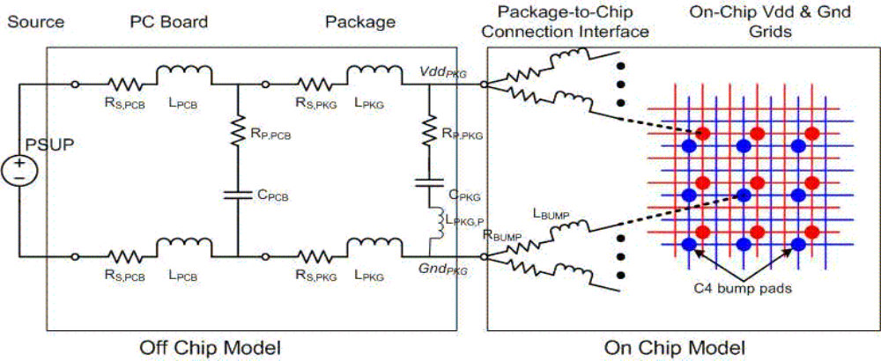
What causes voltage noise?
DeCoR: A Delayed Commit and Rollback Mechanism for Handling Inductive Noise in Processors
Notes:
Decrease in feature sizes has led to constant decrease in the operating voltage of the processors. But at the same time the current consumption has been rapidly increasing, leading to a decrease in the target impedance, which is nothing but V/I. The target impedance of today’s processors is already in the submilliohm range.
Alongwith this trend in impedance, the parasitics in the system have started becoming more dominant. This figure shows the different inductance and resitive components present on the motherboard,package, package-chip connections and on the chip.
The presence of these inductive and capacitive components has lead to a peak at around 50-100Mhz, which is know as the mid-frequency response of the system. Power-saving techniques like clock-gating have lead to an increase variation in the activity of the processors, leading to a large fluctuation in currents. These fluctuations in current coupled with the inductance, leads to voltage variations in the power supply, also known as inductive noise, or

Slide 10
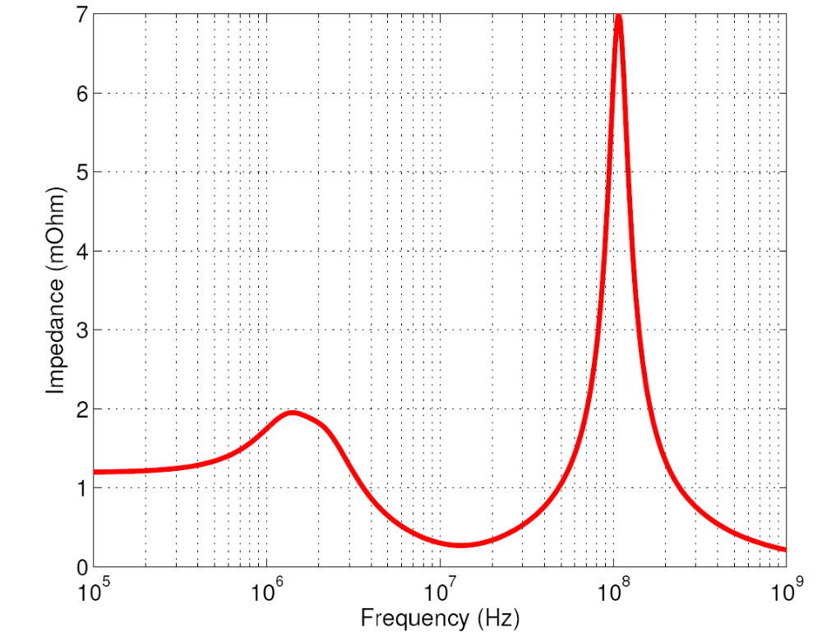
What causes voltage noise?
Mid-Frequency Response
Processor activity leads to fluctuation in currents
Fluctuations in currents leads to voltage variations
  V = Ldi/dt
DeCoR: A Delayed Commit and Rollback Mechanism for Handling Inductive Noise in Processors

Slide 11
Outline
Background on voltage noise
DeCoR
  Implementation details
  Performance
Comparison
  Avoidance schemes
  Explicit checkpointing
Conclusions
DeCoR: A Delayed Commit and Rollback Mechanism for Handling Inductive Noise in Processors

Slide 12
Philosophy of DeCoR
Takes a reactive approach for handling violations
  Allows violations to occur
  Has the ability to rollback to a guaranteed correct state
Divides the machine into two zones
  Timing Margin-protected (TM-protected)
  Rollback-protected (RB-protected)
Makes no assumption about the underlying power delivery subsystem
  Package choice affects the performance but not correctness
DeCoR: A Delayed Commit and Rollback Mechanism for Handling Inductive Noise in Processors

Slide 13
How Does DeCoR Work?
Committed
state
Committed
state
Processor
State
Noise-speculative
Noise-verified
Noise-verified
Noise-speculative
Noise-verified
Noise-speculative
Violation Occurs
Violation detected
Sliding window based on sensor delay
Delayed-commit: completed results buffered in the buffers until verified to be correct
  Noise-speculative
  Noise-verified
Rollback to a previous noise-verified state when a violation is detected
DeCoR: A Delayed Commit and Rollback Mechanism for Handling Inductive Noise in Processors

Slide 14
Key Features of DeCoR
Divide the processor state into noise-verified and noise-speculative state
A noise-violation causes the processor to start from a noise-verified state
Ensures correct data transition between the TM-Protected and RB-Protected zones
DeCoR: A Delayed Commit and Rollback Mechanism for Handling Inductive Noise in Processors

Slide 15
Modifications Required for DeCoR
ICache
Fetch Unit
Decode Unit
Floating-Point
Execution
Units
Integer
Execution
Units
Memory
Management
Unit
ROB/LSQ
RRF
Commit Logic
DCache
DeCoR: A Delayed Commit and Rollback Mechanism for Handling Inductive Noise in Processors

Slide 16
Architecture of DeCoR
L1 Cache
RRF
TM-Protected Zone
Relies on standard circuit-based techniques to guarantee timing-margins
L2 cache, register file, L1 write port, PC chain
c
Instr
Commit Logic
c
Instr
Protected by delayed-commit and rollback mechanism
Can have more aggressive timing margins
Instruction fetch unit, Icache, issue logic, execution units, commit logic
LSQ
ROB
Flush Logic
RB-Protected Zone
Sensor
DeCoR: A Delayed Commit and Rollback Mechanism for Handling Inductive Noise in Processors

Slide 17
Architecture of DeCoR
L1 Cache
RRF
c
Instr
Commit Logic
c
Instr
Noise-speculative
LSQ
Noise-verified
ROB
Flush Logic
Sensor
DeCoR: A Delayed Commit and Rollback Mechanism for Handling Inductive Noise in Processors

Slide 18
Factors Contributing to the Performance Impact
Delayed commit
  Leads to pressure on the reorder buffer and load/store queue
Rollback penalty
  Have to re-execute certain part of the application
Throttle penalty
  Slow restart of the machine after rollback
DeCoR: A Delayed Commit and Rollback Mechanism for Handling Inductive Noise in Processors

Slide 19
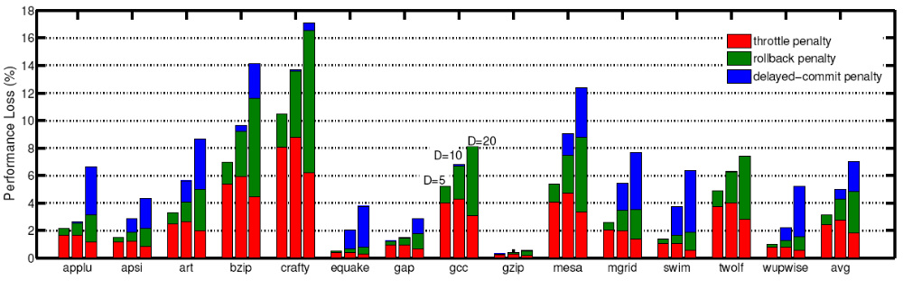
Performance of DeCoR

Slide 20
Outline
Background on voltage noise
DeCoR
  Implementation details
  Performance
Comparisons
  Avoidance schemes
  Explicit checkpointing
Conclusions
DeCoR: A Delayed Commit and Rollback Mechanism for Handling Inductive Noise in Processors

Slide 21
Emergency Avoidance Schemes
Proactive in nature
  Aim to reduce the sudden build-up of current in processors
Dependence on detection mechanism
Application
Feedback Loop
Actuator
Processor Core
throttle on/off
Current/ voltage
Sensor
DeCoR: A Delayed Commit and Rollback Mechanism for Handling Inductive Noise in Processors
Notes:
The main philosophy behind the emergency avoidance techniques is to reduce the sudden build up of current, aiming to provide a smooth current profile. These mechanisms have a strong dependance on the detection mechanim used for detecting the onset of current buildup, which governs the delay associated with the feedback loop
These mechanisms also have a dependance on the underlying power-delivery subsystem characteristics or package characteristics. The 3 main factors that influence the voltage variations are:
The Qfactor of the package: this represents the resonance band of the system
The resonance cycles: which represent the processor cycles corresponding to the resonance frequency of the system. For a resonance frequency of 100MHz, a 3 GHz processor would have a 30 cycle resonance frequency compared to a 100 cycle for a 10GHz processor
-peak impedance : represents the maximum impedance of the system, which we would like to be as low as possible:
All the proposed emergency avoidance techniques have a strong dependance on the assumptions made of thepackage.

Slide 22
Different Emergency-Avoidance Techniques
Voltage based throttling¹
  If the voltage exceeds certain soft-threshold then throttle the system
  Choice of soft-threshold depends on the sensor delay and accuracy
Resonance-detector²
  Based on the assumption that only resonating currents cause noise-margin violations
  Detects low-high transition patterns of currents
  If number of such transitions exceeds a threshold then throttle the system
1 R. Joseph et al, HPCA2003
2 Powell et al, ISCA2004
DeCoR: A Delayed Commit and Rollback Mechanism for Handling Inductive Noise in Processors
Notes:
Emergency avoidance techniques can be broadly divided into voltage-based throttling mechanism, where a voltage sensor detects the voltage variation and if the voltage exceeds a certain threshold (called the soft threshold) a throttling mechanism is triggered. The throtting mechanism can range from a simple frequency throttling to pipeline throttling, each having a different rate of reduction of the current. Again the choice of threshold is strongly dependant on the delay associated in the feedback loop, a overly conservative threshold is required for slow sensors.
The second class of techniques are based on current detection and make the assumption that only periodic currents lying in the resonance band of the system are the cause of violations. These mechanisms detect a pattern of high-low or low-high transitions and based on a certain threshold trigger the throttling mechanism. Large voltage droops are mostly attributed to resonating current, however our experiments have shown that sudden increase in current or isolated current waves can also cause large voltage drops.

Slide 23
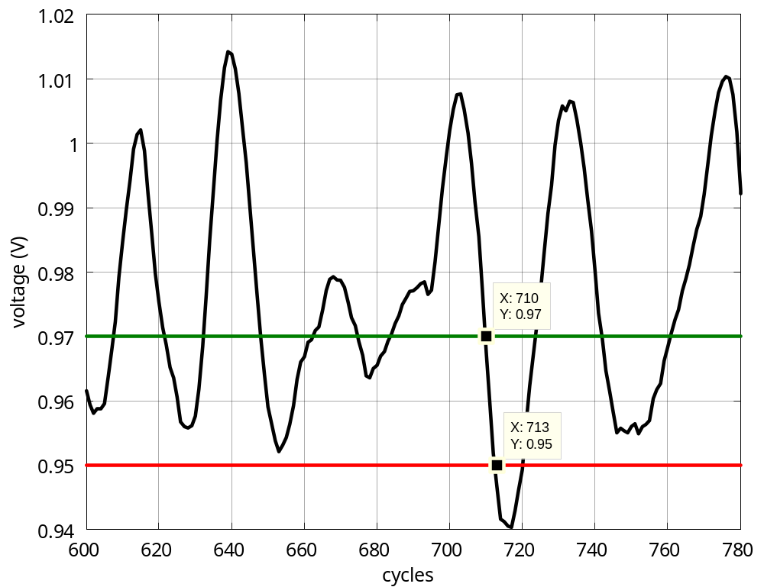
Robustness Guarantee of Emergency Avoidance Mechanism
Soft threshold
Need Fast Sensors
Noise-margin
3 cycles!
DeCoR: A Delayed Commit and Rollback Mechanism for Handling Inductive Noise in Processors
Notes:
As mentioned earlier, all these schemes have a feedback loop and the delay associated with the loop is largely determined by the detection mechanism or the sensors. The maximum allowable sensor delay for ensuring the correctness of the solution is determined the cycles between the crossing of the two thresholds. Which in this case we can see to be only 3 cycles!
The voltage variations are also tightly coupled to the underlying power-delivery network and hence for these mechanisms to be robust, it is necessary to ensure correctness for different packages. This graph here shows the violations across different package characteristics. We chose to sweep two of the three factors—resonance cycles and qfactor, as changing either one effects the peak impedance
We assume an aggressive throttling mechanism
We can see that even with packages with low-Q have violations, and the packages assumed in the prior work are limited to the lower left corner.

Slide 24
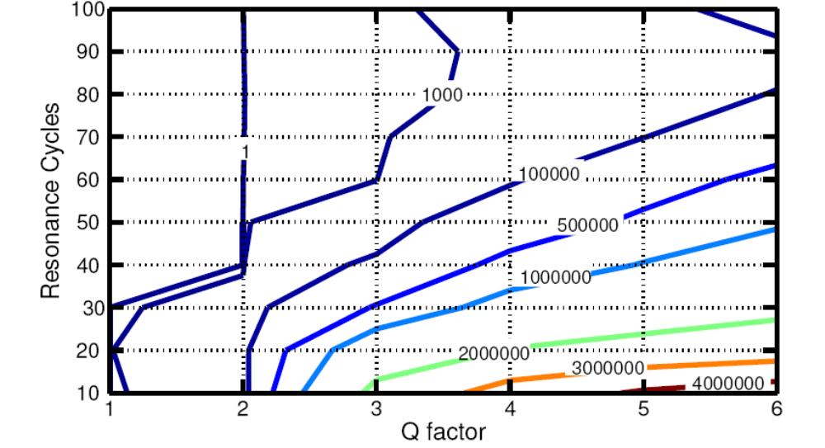
Robustness Guarantee of Emergency Avoidance Mechanism
Sensitiveness to package
Sensor Delay=5 cycles
Pentium IV
Alpha 21264
DeCoR: A Delayed Commit and Rollback Mechanism for Handling Inductive Noise in Processors
Notes:
As mentioned earlier, all these schemes have a feedback loop and the delay associated with the loop is largely determined by the detection mechanism or the sensors. The maximum allowable sensor delay for ensuring the correctness of the solution is determined the cycles between the crossing of the two thresholds. Which in this case we can see to be only 3 cycles!
The voltage variations are also tightly coupled to the underlying power-delivery network and hence for these mechanisms to be robust, it is necessary to ensure correctness for different packages. This graph here shows the violations across different package characteristics. We chose to sweep two of the three factors—resonance cycles and qfactor, as changing either one effects the peak impedance
We assume an aggressive throttling mechanism
We can see that even with packages with low-Q have violations, and the packages assumed in the prior work are limited to the lower left corner.

Slide 25
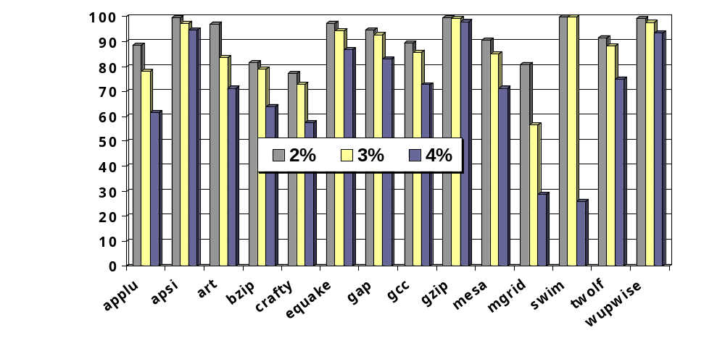
Choice of Detection Threshold
False Alarms (%)
Conservative thresholds can lead to large penalty due to false alarms
DeCoR: A Delayed Commit and Rollback Mechanism for Handling Inductive Noise in Processors

Slide 26
Drawbacks of Emergency Avoidance Mechanisms
Performance impact depends on the choice of the threshold
Not robust across different package solutions
Dependence on assumptions about the underlying system
  Cannot easily retarget to different processor architectures or package solutions
DeCoR: A Delayed Commit and Rollback Mechanism for Handling Inductive Noise in Processors

Slide 27
Explicit Checkpointing
Explicit checkpoint mechanisms have been employed to tackle
  Soft-error
  Fault detection
  Boost performance
Checkpoints are taken at very coarse granularities
  100 to 1000 cycles
Requires explicit saving and restoring of architectural state
  Updated memory state, registers
DeCoR: A Delayed Commit and Rollback Mechanism for Handling Inductive Noise in Processors

Slide 28
Comparison to Existing Checkpoint Restart Mechanisms
DeCoR is an implicit checkpoint restart scheme
  No explicit saving of state is required
Explicit checkpoint-restart methods have huge overheads
Explicit checkpoint mechanisms require two checkpoints for correctness
Checkpoint
(C_{I} )
Checkpoint
(C_{I+1} )
Rollback to C_{I}
Checkpoint interval
Violation Occurs
Violation Detected
Sensor Delay
DeCoR: A Delayed Commit and Rollback Mechanism for Handling Inductive Noise in Processors

Slide 29
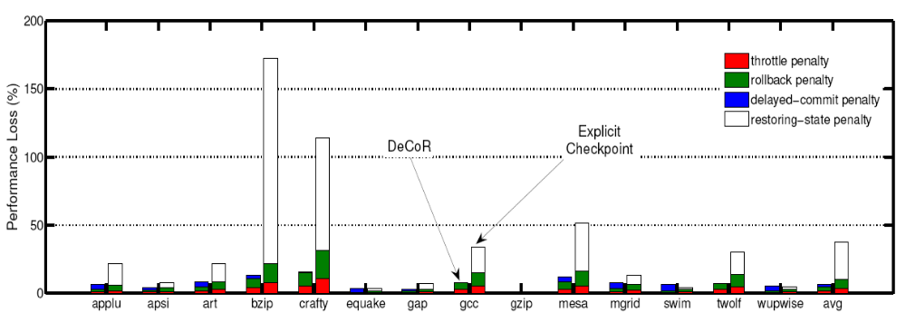
DeCoR vs Explicit Checkpoint
7% vs 39%

Slide 30
Conclusions and Future Work
DeCoR provides a low-cost and robust solution for handling voltage variations
  Relies on existing buffering and flush mechanism
  Performance loss much lower than explicit checkpoint-restart schemes
Exploring mechanisms to limit the rollbacks and replays
  Study the tradeoff between code-rescheduling and hardware techniques
DeCoR: A Delayed Commit and Rollback Mechanism for Handling Inductive Noise in Processors

Slide 31
    Questions?
DeCoR: A Delayed Commit and Rollback Mechanism for Handling Inductive Noise in Processors

Slide 32
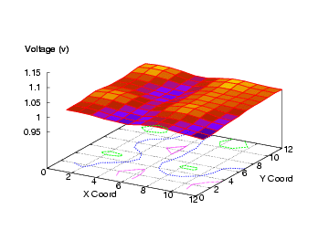
CMP
bzip running on 3 cores,
4th core is idle
DeCoR: A Delayed Commit and Rollback Mechanism for Handling Inductive Noise in Processors

Slide 33
Comparison to DIVA
Relies on a checker processor that runs in parallel with the main core
Assumes all reads and writes to all registers and memories will complete without error
  Extensive TM-protected zones
Duplicates functional units
  Additional power and area overhead
DeCoR: A Delayed Commit and Rollback Mechanism for Handling Inductive Noise in Processors

Slide 34
Comparison to Razor
Razor requires Razor latches – potentially high overhead
Similar recovery scheme to RazorII [ISSCC Feb 2008]
DeCoR: A Delayed Commit and Rollback Mechanism for Handling Inductive Noise in Processors

Slide 35
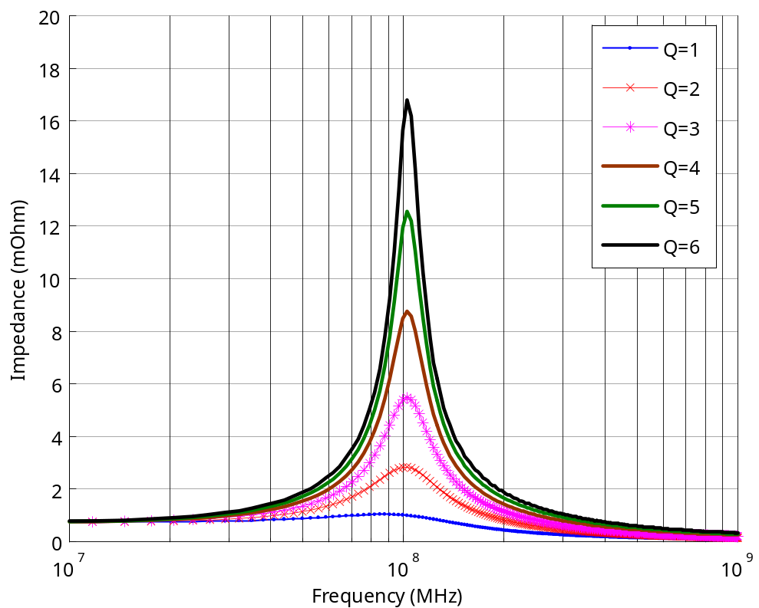
Power-Delivery Subsystem Characteristics
Qfactor
  Higher Q means higher impedance at resonance
Resonance cycles
  100 MHz = 30 cycles for 3GHz machine and 100 cycles for 10GHz machine
Peak impedance
DeCoR: A Delayed Commit and Rollback Mechanism for Handling Inductive Noise in Processors

