Slide 1
BubbaGun Gameloft C++ Project

Slide 2
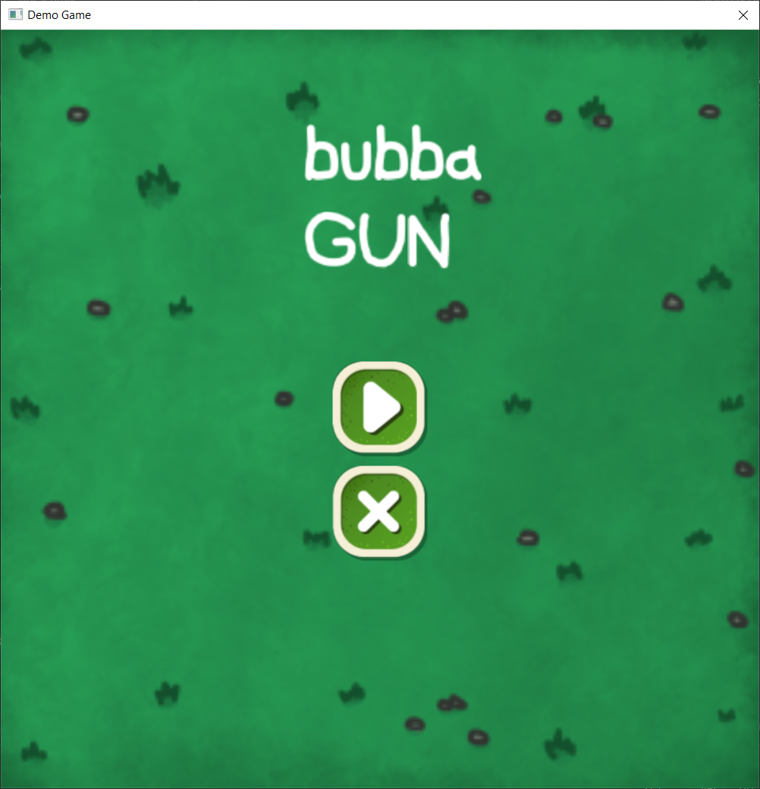
About the Game
An overview of my game

Slide 3
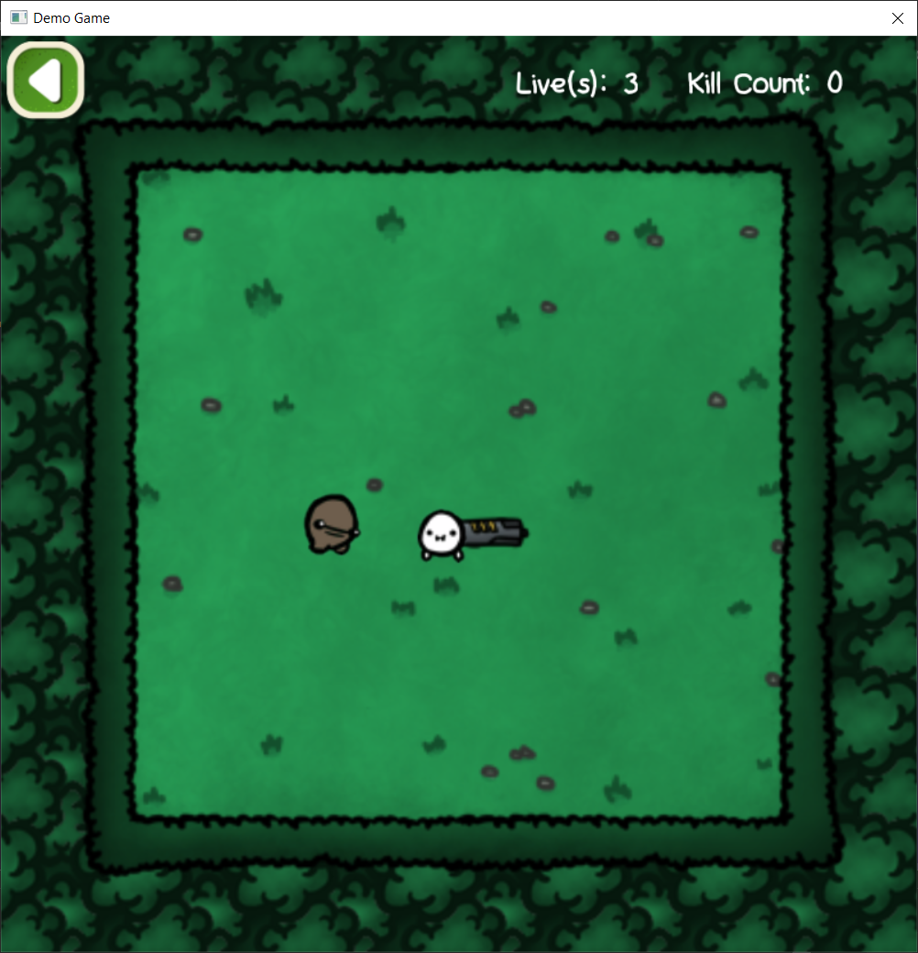
About the Game
Idea:
Generic Top-down shooter
Dynamic Difficulty
Basic Mechanics

Slide 4
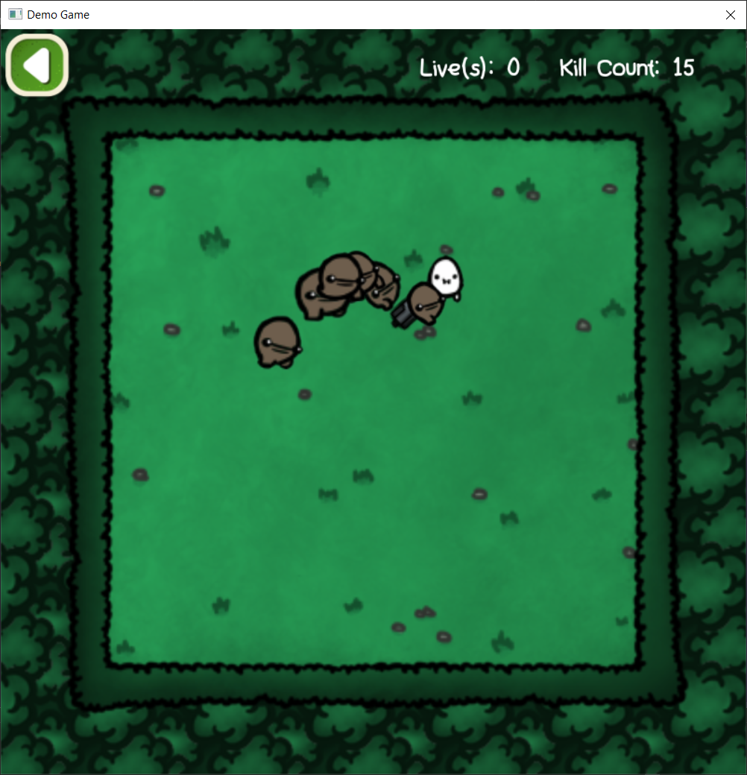
About the Game
Genre:
Top-down shooter
Hyper-casual
Easy to learn, hard to master

Slide 5
About the Game
Genre:
Top-down shooter
Hyper-casual
Easy to learn, hard to master

Slide 6

External Tools used
Software that were use during the game’s production

Slide 7



External Tools used
Paint.net:
Handle .tga files properly
Stitch separate files into one
Photoshop:
Edited some sprites
+
=

Slide 8

The Game in details

Slide 9
Main Game States
Intro & Menu
Logo
Name
Buttons
Play
Touch events
Key events

Slide 10

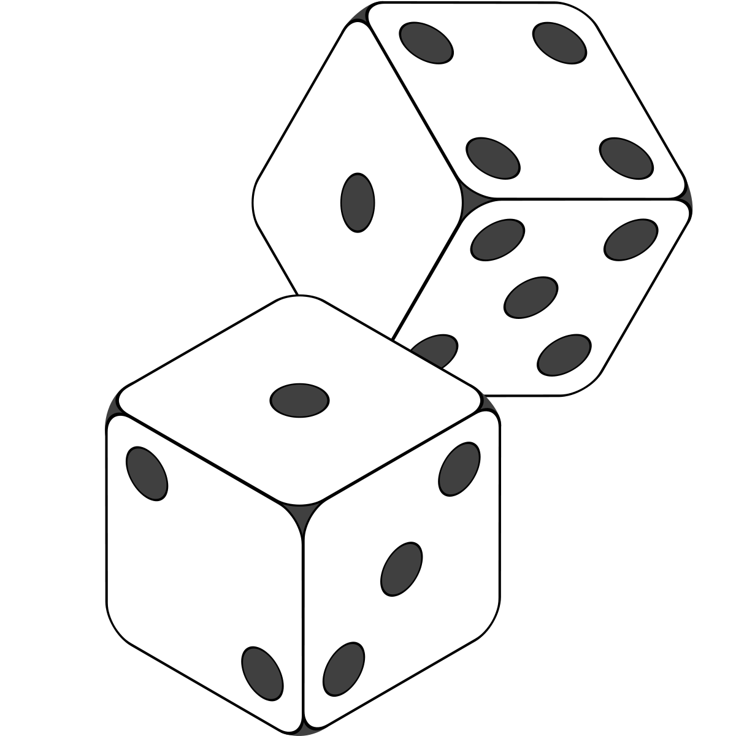
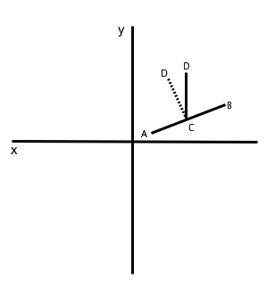

Main Gameplay
Player
Moves freely
Has 3 lives
Owns powerful gun
Unlimited ammo
Recoil
Enemies
Dynamic Stats:
Health
Speed
States:
Closing in
Chase
Rest
Spawning
Interval:
Random
Dynamic
Position:
Suitable Distance

Slide 11

Problem solution pairs
Problems I encountered and how I fixed them

Slide 12
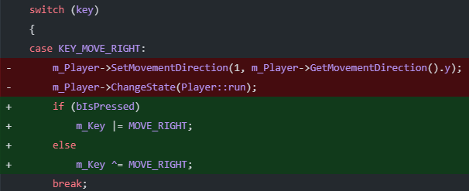

Unresponsive Movement controls
GSPlay.cpp
Problem:
Sticky controls
2 buttons at a time
Solution:
Using bitwise operators
Player.cpp

Slide 13
Make a shared_ptr of this
Problem:
Function required a shared_ptr
Want to use *this pointer
Solution:
Pass *this as a parameter

Slide 14
Bad difficulty curve
Problem:
Could not find the right balance
Games were either easy or hard
Solution:
Brute force analysis
Nerfing player -> Too hard/overwhelming
Buffing player -> Too easy/relaxing

Slide 15
Bad difficulty curve
Problem:
Could not find the right balance
Games were either easy or hard
Solution:
Brute force analysis
Buffing monsters -> Just right
Re-calibrate player (speed, fire-rate) -> Just right

Slide 16
Future Development
If I have more time to work on

Slide 17
More mechanics
Powerups
Random
Fire-rate
Speed
Health
Frenzy
Group Spawn
Random
Amount
Same Types
Dynamic
Dash Roll
Move quickly
Invulnerable
Kill enemies with Frenzy

Slide 18
Code Refactoring and Optimizations
Object Pooling
Useable with different classes
More Game states
Credits
Instructions
Game Over
Refactoring:
OOP
Singleton
Common functions
Easy access

