Slide 2
Spring Cloud, Spring Cloud Sleuth will be used to collect trace information
the tracing information from a complete workflow is called a trace or a trace tree, and sub-parts of the tree, for example, the basic units of work, are called spans. Spans can consist of sub-spans forming the trace tree. The Zipkin UI can visualize a trace tree and its spans as follows:

Slide 3
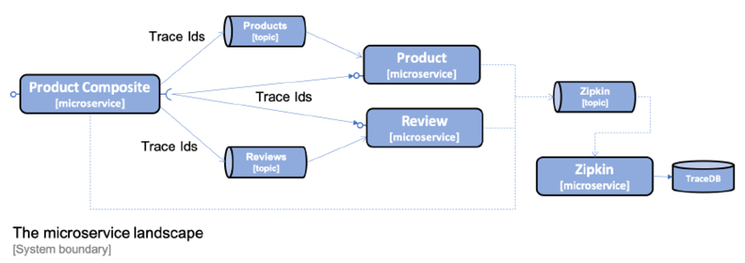
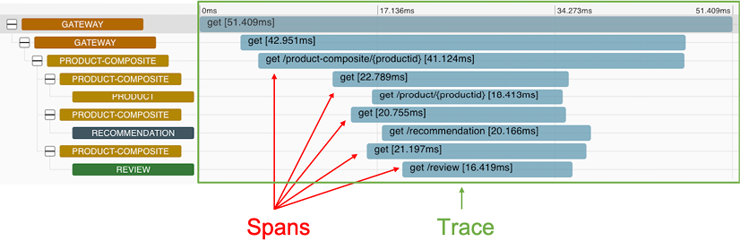

Slide 4
Zipkin comes with native support for storing trace information either in memory, or in a database such as Apache Cassandra, Elasticsearch, or MySQL. Added to this, a number of extensions are available. For details, refer to https://zipkin.io/pages/extensions_choices.html
Spring Cloud Sleuth can send trace information to Zipkin either synchronously over HTTP, or asynchronously using a message broker such as RabbitMQ or Kafka. To avoid creating runtime dependencies on the Zipkin server from the microservices, it is preferable to send trace information to Zipkin asynchronously using either RabbitMQ or Kafka. This is illustrated in the following diagram:

Slide 5
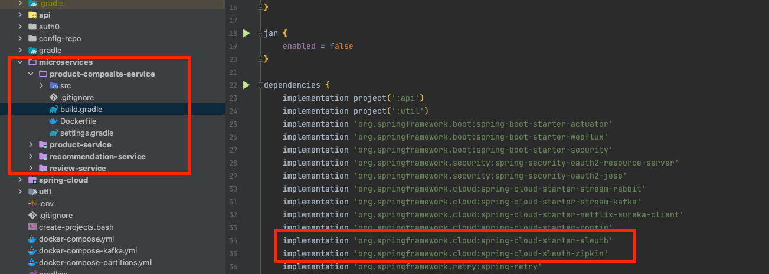
Add dependencies to the build files to bring in Spring Cloud Sleuth and the capability of sending trace information to Zipkin

Slide 6
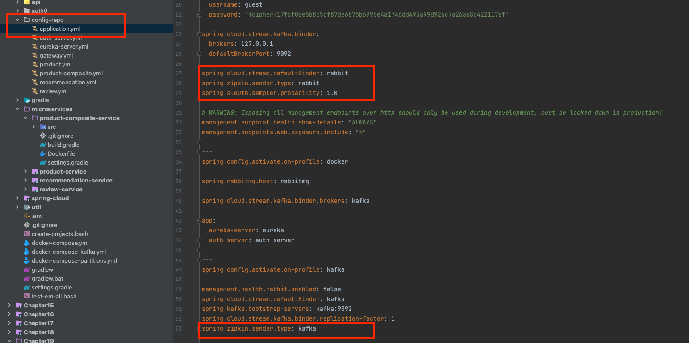
Adding configuration for Spring Cloud Sleuth and Zipkin
By default, Spring Cloud Sleuth only sends 10% of the traces to Zipkin. To ensure that all traces are sent to Zipkin, the following property is added in the default profile:
When sending traces to Zipkin using Kafka, the Spring profile kafka will be used. In the kafka profile, we override the setting in the default profile so that trace information is sent to Zipkin using Kafka:

Slide 7
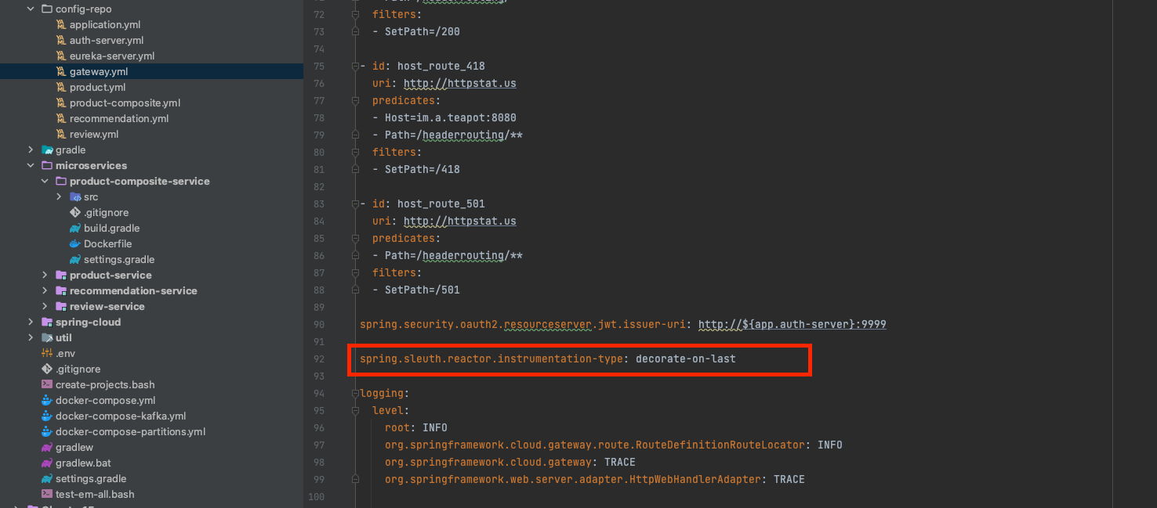
the Gateway service needs a parameter in the configuration file config-repo/gateway.yml to enable Sleuth to track trace IDs correctly:
For details, see: https://docs.spring.io/spring-cloud-sleuth/docs/3.0.1/reference/html/integrations.html#sleuth-reactor-integration.

Slide 8
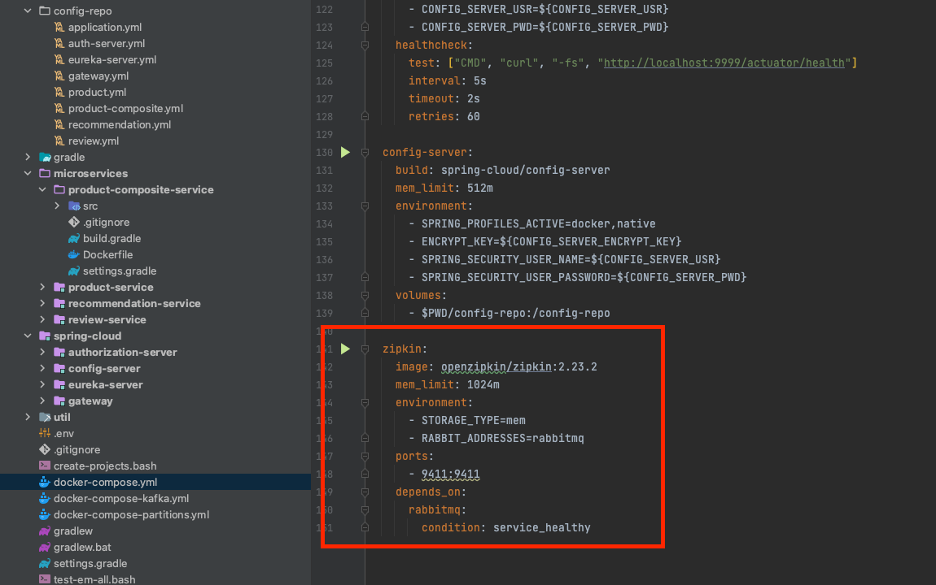
Adding Zipkin to the Docker Compose files
the Zipkin server is added to the Docker Compose files using an already existing Docker image, openzipkin/zipkin, published by the Zipkin project. In docker-compose.yml and docker-compose-partitions.yml, where RabbitMQ is used, the definition of the Zipkin server appears as follows:
The version of the Docker image, openzipkin/zipkin, is specified to be version 2.23.2.
The RABBIT_ADDRESSES=rabbitmq environment variable is used to specify that Zipkin will receive trace information using RabbitMQ and that Zipkin will connect to RabbitMQ using the hostname rabbitmq.
The STORAGE_TYPE=mem environment variable is used to specify that Zipkin will keep all trace information in memory.
The memory limit for Zipkin is increased to 1,024 MB, compared to 512 MB for all other containers. The reason for this is that since Zipkin is configured to keep all trace information in memory, it will consume more memory than the other containers after a while.
Zipkin exposes the HTTP port 9411 for web browsers to access its web user interface.
Docker will wait to start up the Zipkin server until the RabbitMQ service reports being healthy to Docker.
While it is OK to store the trace information in Zipkin in memory for development and test activities, Zipkin should be configured to store trace information in a database such as Apache Cassandra, Elasticsearch, or MySQL in a production environment.

Slide 9
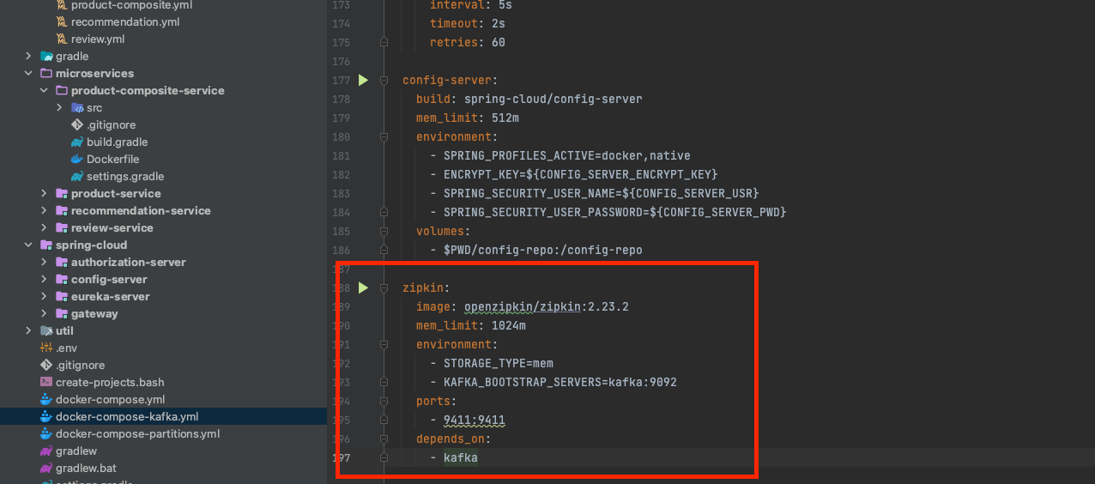
In docker-compose-kafka.yml, where Kafka is used, the definition of the Zipkin server appears as follows:
The configuration for using Zipkin together with Kafka is similar to the configuration we just saw for using Zipkin with RabbitMQ.
The main difference is the use of the KAFKA_BOOTSTRAP_SERVERS=kafka:9092 environment variable, which is used to specify that Zipkin will use Kafka to receive trace information and that Zipkin will connect to Kafka using the hostname kafka and the port 9092.
Docker will wait to start up the Zipkin server until the Kafka service has been started.

