Slide 1
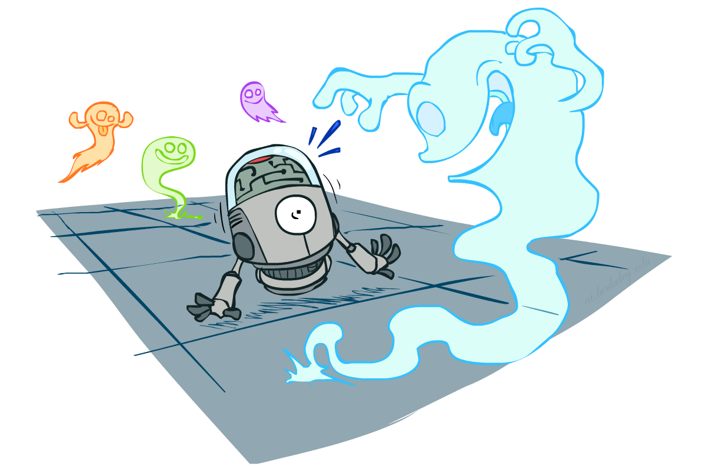
CS 115: Maths for Computer Science
Probability
Instructor: Ngoc-Hoang LUONG
[These slides were created by Dan Klein and Pieter Abbeel for CS188 Intro to AI at UC Berkeley. All CS188 materials are available at http://ai.berkeley.edu.]
Notes:
Please retain proper attribution, including the reference to ai.berkeley.edu. Thanks!

Slide 2

Today
Probability
Random Variables
Joint and Marginal Distributions
Conditional Distribution
Product Rule, Chain Rule, Bayes’ Rule
Inference
Independence
Notes:
Like “sort this list” or “add these two numbers”

Slide 3
Random Variables
A random variable is some aspect of the world about which we (may) have uncertainty
R = Is it raining?
T = Is it hot or cold?
D = How long will it take to drive to work?
L = Where is the ghost?
We denote random variables with capital letters
Random variables have domains
R in {true, false}
T in {hot, cold}
D in [0, ∞)
L in possible locations, maybe {(0,0), (0,1), …}

Slide 4
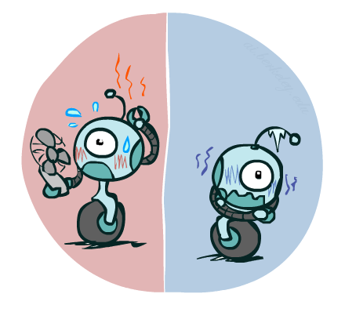

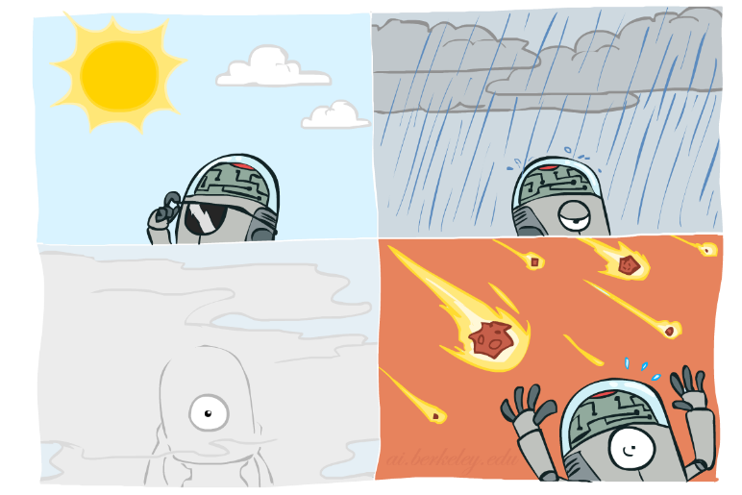

Probability Distributions
Associate a probability with each value
Temperature:
Weather:
W | P
sun | 0.6
rain | 0.1
fog | 0.3
meteor | 0.0
T | P
hot | 0.5
cold | 0.5

Slide 5


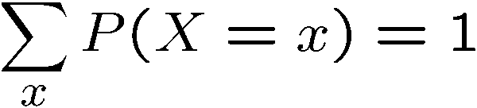
Probability Distributions
Unobserved random variables have distributions
A distribution is a TABLE of probabilities of values
A probability (lower case value) is a single number
Must have: and
Shorthand notation:
OK if all domain entries are unique
T | P
hot | 0.5
cold | 0.5
W | P
sun | 0.6
rain | 0.1
fog | 0.3
meteor | 0.0

Slide 6




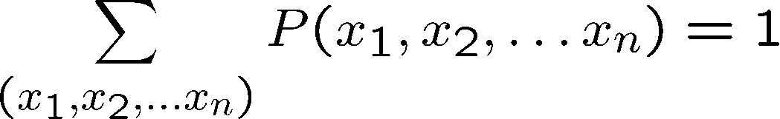
Joint Distributions
A joint distribution over a set of random variables:
specifies a real number for each assignment (or outcome):
Must obey:
Size of distribution if n variables with domain sizes d?
For all but the smallest distributions, impractical to write out!
T | W | P
hot | sun | 0.4
hot | rain | 0.1
cold | sun | 0.2
cold | rain | 0.3

Slide 7
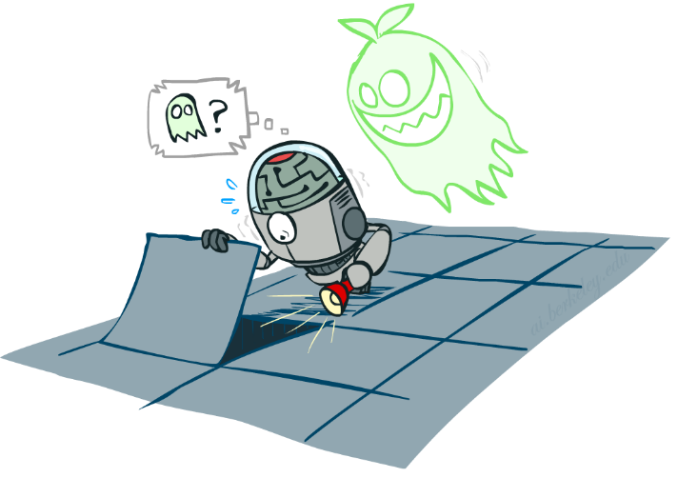

Probabilistic Models
Distribution over T,W
A probabilistic model is a joint distribution over a set of random variables
Probabilistic models:
(Random) variables with domains
Assignments are called outcomes
Joint distributions: say whether assignments (outcomes) are likely
Normalized: sum to 1.0
Ideally: only certain variables directly interact
Constraint satisfaction problems:
Variables with domains
Constraints: state whether assignments are possible
Ideally: only certain variables directly interact
T | W | P
hot | sun | 0.4
hot | rain | 0.1
cold | sun | 0.2
cold | rain | 0.3
Constraint over T,W
T | W | P
hot | sun | T
hot | rain | F
cold | sun | F
cold | rain | T

Slide 8
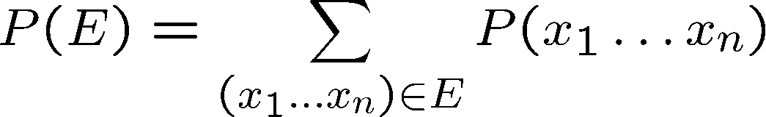
Events
An event is a set E of outcomes
From a joint distribution, we can calculate the probability of any event
Probability that it’s hot AND sunny?
Probability that it’s hot?
Probability that it’s hot OR sunny?
Typically, the events we care about are partial assignments, like P(T=hot)
T | W | P
hot | sun | 0.4
hot | rain | 0.1
cold | sun | 0.2
cold | rain | 0.3

Slide 9

Quiz: Events
P(+x, +y) ?
P(+x) ?
P(-y OR +x) ?
X | Y | P
+x | +y | 0.2
+x | -y | 0.3
-x | +y | 0.4
-x | -y | 0.1

Slide 10
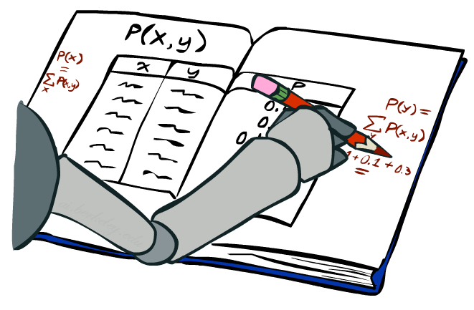
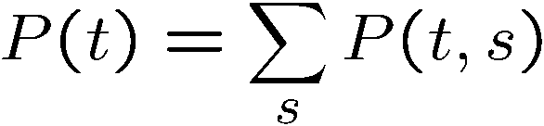
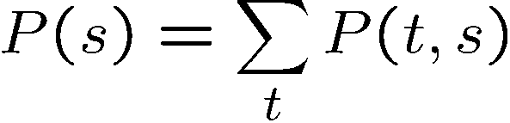
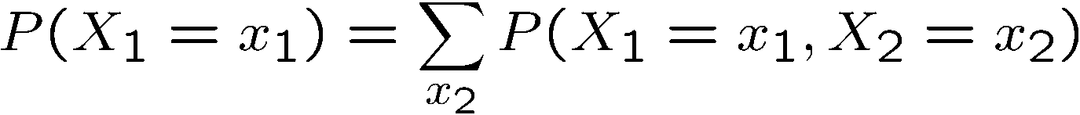
Marginal Distributions
Marginal distributions are sub-tables which eliminate variables
Marginalization (summing out): Combine collapsed rows by adding
T | P
hot | 0.5
cold | 0.5
T | W | P
hot | sun | 0.4
hot | rain | 0.1
cold | sun | 0.2
cold | rain | 0.3
W | P
sun | 0.6
rain | 0.4

Slide 11


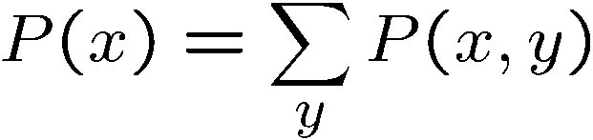

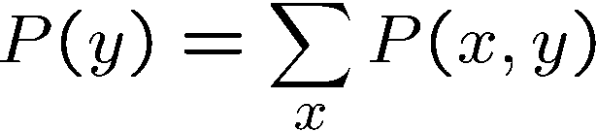
Quiz: Marginal Distributions
X | P
+x
-x
X | Y | P
+x | +y | 0.2
+x | -y | 0.3
-x | +y | 0.4
-x | -y | 0.1
Y | P
+y
-y

Slide 12
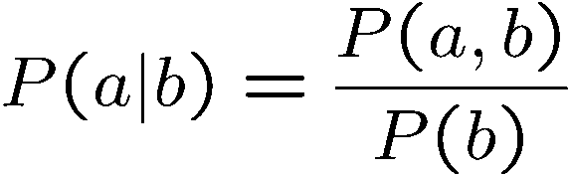
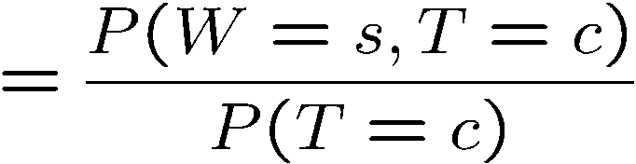
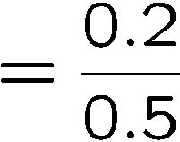



Conditional Probabilities
A simple relation between joint and conditional probabilities
In fact, this is taken as the definition of a conditional probability
P(a,b)
P(a)
P(b)
T | W | P
hot | sun | 0.4
hot | rain | 0.1
cold | sun | 0.2
cold | rain | 0.3

Slide 13
Quiz: Conditional Probabilities
P(+x | +y) ?
P(-x | +y) ?
P(-y | +x) ?
X | Y | P
+x | +y | 0.2
+x | -y | 0.3
-x | +y | 0.4
-x | -y | 0.1

Slide 14



Conditional Distributions
Conditional distributions are probability distributions over some variables given fixed values of others
Conditional Distributions
Joint Distribution
W | P
sun | 0.8
rain | 0.2
T | W | P
hot | sun | 0.4
hot | rain | 0.1
cold | sun | 0.2
cold | rain | 0.3
W | P
sun | 0.4
rain | 0.6

Slide 15
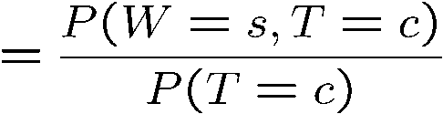

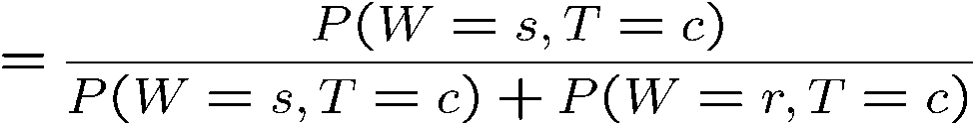
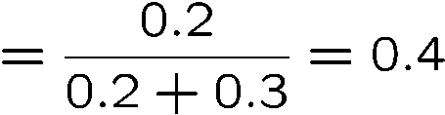

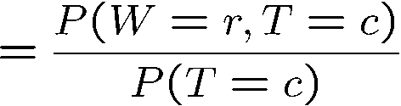

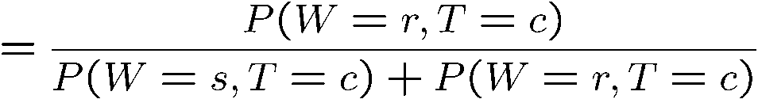
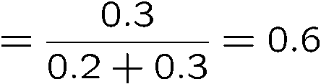
Normalization Trick
T | W | P
hot | sun | 0.4
hot | rain | 0.1
cold | sun | 0.2
cold | rain | 0.3
W | P
sun | 0.4
rain | 0.6

Slide 16








Normalization Trick
SELECT the joint probabilities matching the evidence
NORMALIZE the selection
(make it sum to one)
T | W | P
hot | sun | 0.4
hot | rain | 0.1
cold | sun | 0.2
cold | rain | 0.3
T | W | P
cold | sun | 0.2
cold | rain | 0.3
W | P
sun | 0.4
rain | 0.6

Slide 17
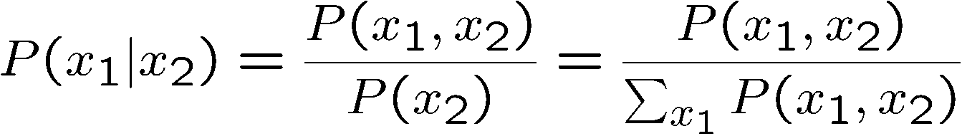
Normalization Trick
SELECT the joint probabilities matching the evidence
NORMALIZE the selection
(make it sum to one)
T | W | P
hot | sun | 0.4
hot | rain | 0.1
cold | sun | 0.2
cold | rain | 0.3
T | W | P
cold | sun | 0.2
cold | rain | 0.3
W | P
sun | 0.4
rain | 0.6
Why does this work? Sum of selection is P(evidence)! (P(T=c), here)

Slide 18

Quiz: Normalization Trick
P(X | Y=-y) ?
SELECT the joint probabilities matching the evidence
NORMALIZE the selection
(make it sum to one)
X | Y | P
+x | +y | 0.2
+x | -y | 0.3
-x | +y | 0.4
-x | -y | 0.1

Slide 19
To Normalize
(Dictionary) To bring or restore to a normal condition
Procedure:
Step 1: Compute Z = sum over all entries
Step 2: Divide every entry by Z
Example 1
All entries sum to ONE
Example 2
W | P
sun | 0.2
rain | 0.3
Normalize
W | P
sun | 0.4
rain | 0.6
T | W | P
hot | sun | 20
hot | rain | 5
cold | sun | 10
cold | rain | 15
T | W | P
hot | sun | 0.4
hot | rain | 0.1
cold | sun | 0.2
cold | rain | 0.3
Normalize
Z = 0.5
Z = 50

Slide 20


Normalization Trick
A trick to get a whole conditional distribution at once:
Select the joint probabilities matching the evidence
Normalize the selection (make it sum to one)
Why does this work? Sum of selection is P(evidence)! (P(r), here)
T | W | P
hot | sun | 0.4
hot | rain | 0.1
cold | sun | 0.2
cold | rain | 0.3
T | R | P
hot | rain | 0.1
cold | rain | 0.3
T | P
hot | 0.25
cold | 0.75
Select
Normalize

Slide 21
Conditional Distributions
Conditional distributions are probability distributions over some variables given fixed values of others
Conditional Distributions
Joint Distribution
W | P
sun | 0.8
rain | 0.2
T | W | P
hot | sun | 0.4
hot | rain | 0.1
cold | sun | 0.2
cold | rain | 0.3
W | P
sun | 0.4
rain | 0.6

Slide 22
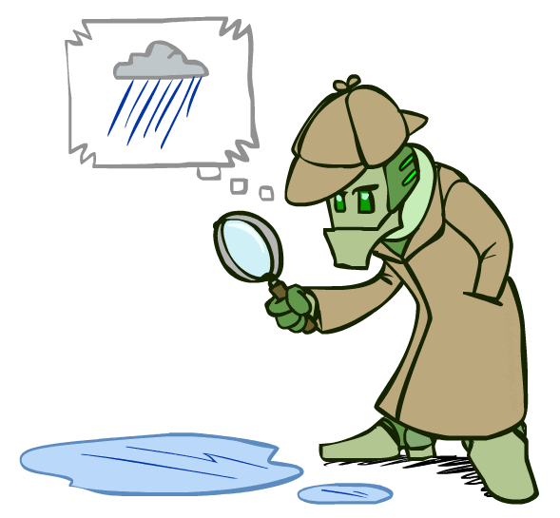
Probabilistic Inference
Probabilistic inference: compute a desired probability from other known probabilities (e.g. conditional from joint)
We generally compute conditional probabilities
P(on time | no reported accidents) = 0.90
These represent the agent’s beliefs given the evidence
Probabilities change with new evidence:
P(on time | no accidents, 5 a.m.) = 0.95
P(on time | no accidents, 5 a.m., raining) = 0.80
Observing new evidence causes beliefs to be updated

Slide 23





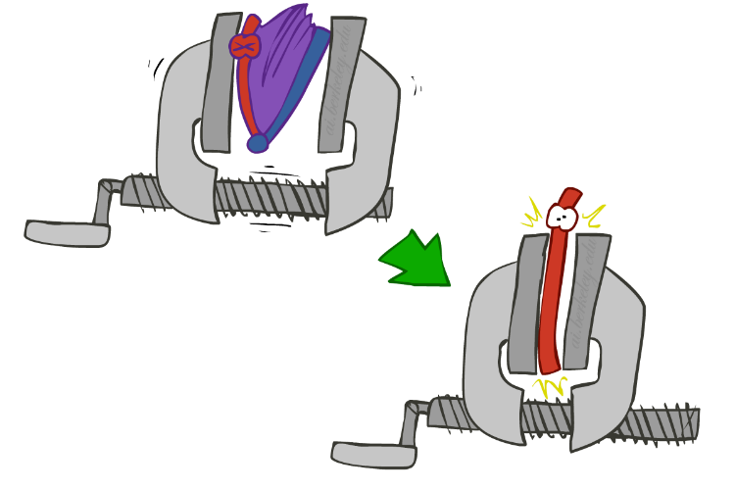
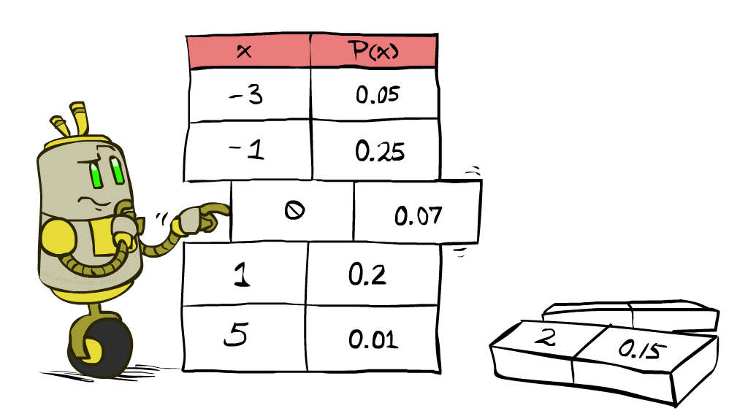


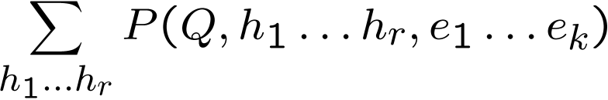
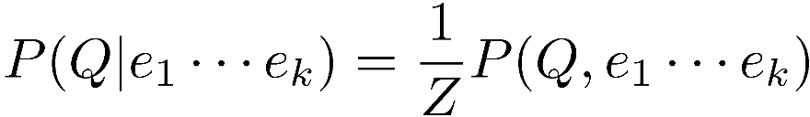
Inference by Enumeration
* Works fine with multiple query variables, too
General case:
Evidence variables:
Query* variable:
Hidden variables:
We want:
All variables
Step 1: Select the entries consistent with the evidence
Step 2: Sum out H to get joint of Query and evidence
Step 3: Normalize

Slide 24
Inference by Enumeration
P(W)?
P(W | winter)?
P(W | winter, hot)?
S | T | W | P
summer | hot | sun | 0.30
summer | hot | rain | 0.05
summer | cold | sun | 0.10
summer | cold | rain | 0.05
winter | hot | sun | 0.10
winter | hot | rain | 0.05
winter | cold | sun | 0.15
winter | cold | rain | 0.20

Slide 25
Inference by Enumeration
Obvious problems:
Worst-case time complexity O(d^{n})
Space complexity O(d^{n}) to store the joint distribution

Slide 26
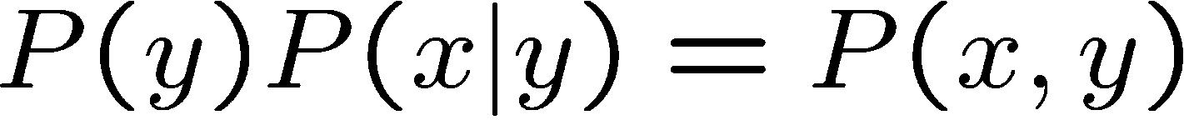
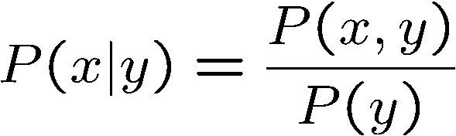
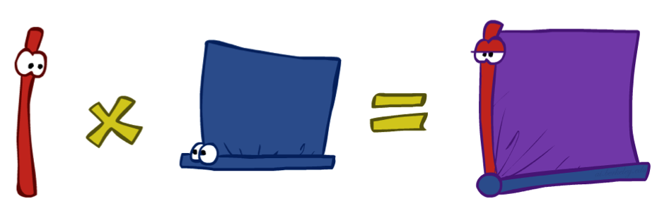
The Product Rule
Sometimes have conditional distributions but want the joint

Slide 27


The Product Rule
Example:
D | W | P
wet | sun | 0.1
dry | sun | 0.9
wet | rain | 0.7
dry | rain | 0.3
D | W | P
wet | sun | 0.08
dry | sun | 0.72
wet | rain | 0.14
dry | rain | 0.06
R | P
sun | 0.8
rain | 0.2

Slide 28
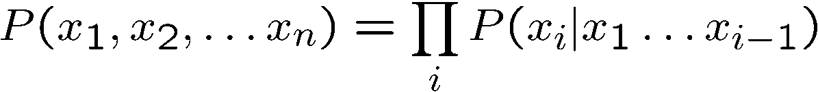
The Chain Rule
More generally, can always write any joint distribution as an incremental product of conditional distributions
Why is this always true?

Slide 29
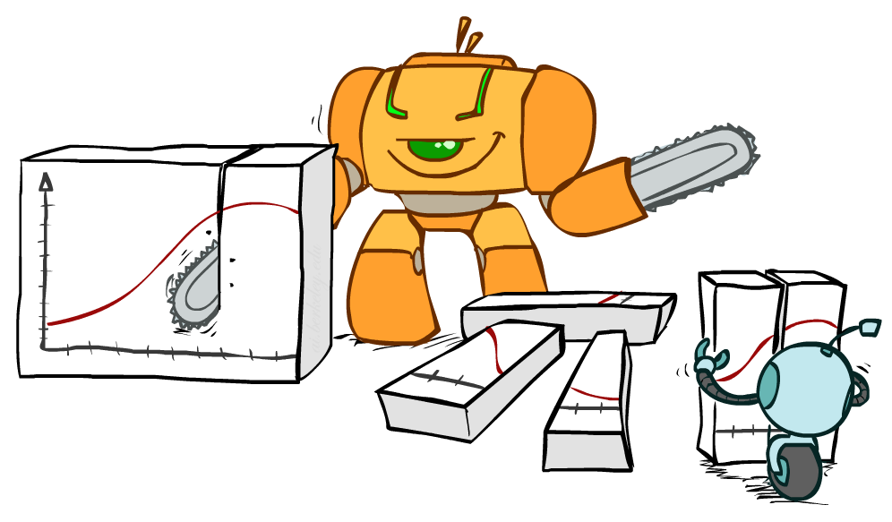
Bayes Rule

Slide 30


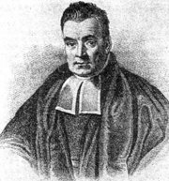
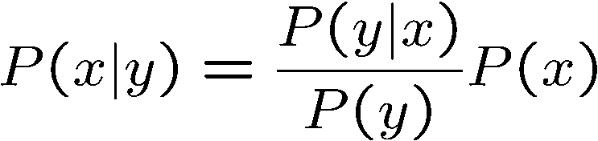
Bayes’ Rule
Two ways to factor a joint distribution over two variables:
Dividing, we get:
Why is this at all helpful?
Lets us build one conditional from its reverse
Often one conditional is tricky but the other one is simple
Foundation of many systems we’ll see later (e.g. ASR, MT)
In the running for most important AI equation!
That’s my rule!

Slide 31
Inference with Bayes’ Rule
Example: Diagnostic probability from causal probability:
Example:
M: meningitis, S: stiff neck
Note: posterior probability of meningitis still very small
Note: you should still get stiff necks checked out! Why?
Example
givens

Slide 32
Inference with Bayes’ Rule
Example:
I am 90% confident that I’m a good singer. P(good singer) = 0.9
If I’m a good singer, then 99% of people will like my singing. P(like | good singer) = 0.99
If I’m a bad singer, then 10% of people will like my singing. P(like | bad singer) = 0.10
I sing in my living room and my roommate covers his ears.
I need to update my beliefs to account for what I’ve learned.
I need to calculate: P(good singer | roommate doesn’t like my singing) = ?

Slide 33
Quiz: Bayes’ Rule
Given:
What is P(W | dry) ?
D | W | P
wet | sun | 0.1
dry | sun | 0.9
wet | rain | 0.7
dry | rain | 0.3
R | P
sun | 0.8
rain | 0.2

Slide 34

Probabilistic Models
Models describe how (a portion of) the world works
Models are always simplifications
May not account for every variable
May not account for all interactions between variables
“All models are wrong; but some are useful.” – George E. P. Box
What do we do with probabilistic models?
We (or our agents) need to reason about unknown variables, given evidence
Example: explanation (diagnostic reasoning)
Example: prediction (causal reasoning)
Example: value of information
Notes:
George Box: All models are wrong; some of them are useful

Slide 35
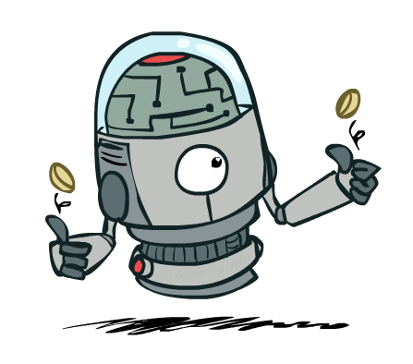
Independence

Slide 36


Independence
Two variables are independent if:
This says that their joint distribution factors into a product two simpler distributions
Another form:
We write:
Independence is a simplifying modeling assumption
Empirical joint distributions: at best “close” to independent
What could we assume for {Weather, Traffic, Cavity, Toothache}?

Slide 37




Example: Independence?
T | P
hot | 0.5
cold | 0.5
T | W | P
hot | sun | 0.4
hot | rain | 0.1
cold | sun | 0.2
cold | rain | 0.3
T | W | P
hot | sun | 0.3
hot | rain | 0.2
cold | sun | 0.3
cold | rain | 0.2
W | P
sun | 0.6
rain | 0.4

Slide 38


Example: Independence
N fair, independent coin flips:
H | 0.5
T | 0.5
H | 0.5
T | 0.5
H | 0.5
T | 0.5

Slide 39
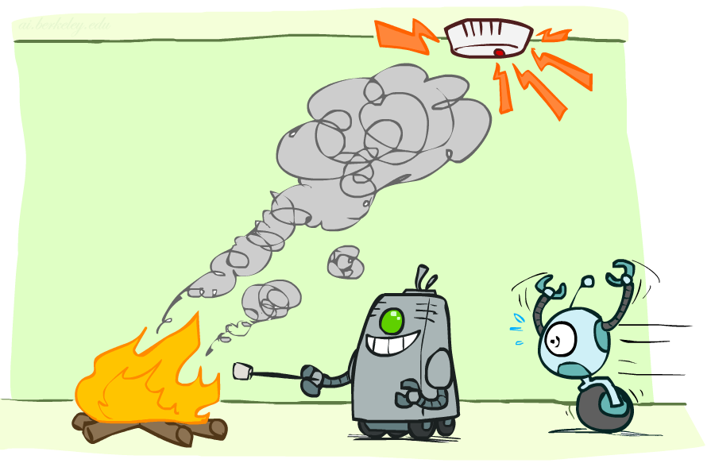
Conditional Independence

Slide 40
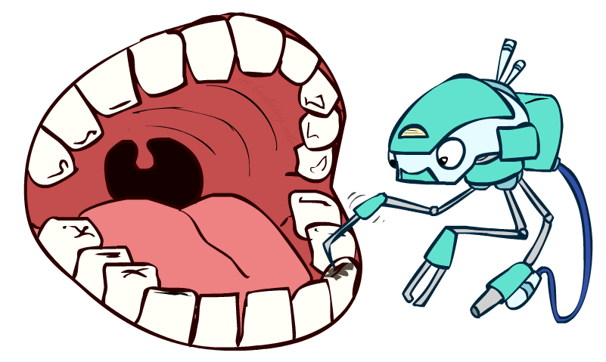
Conditional Independence
P(Toothache, Cavity, Catch)
If I have a cavity, the probability that the probe catches in it doesn't depend on whether I have a toothache:
P(+catch | +toothache, +cavity) = P(+catch | +cavity)
The same independence holds if I don’t have a cavity:
P(+catch | +toothache, -cavity) = P(+catch| -cavity)
Catch is conditionally independent of Toothache given Cavity:
P(Catch | Toothache, Cavity) = P(Catch | Cavity)
Equivalent statements:
P(Toothache | Catch , Cavity) = P(Toothache | Cavity)
P(Toothache, Catch | Cavity) = P(Toothache | Cavity) P(Catch | Cavity)
One can be derived from the other easily

Slide 41

Conditional Independence
Unconditional (absolute) independence very rare (why?)
Conditional independence is our most basic and robust form of knowledge about uncertain environments.
X is conditionally independent of Y given Z
if and only if:
or, equivalently, if and only if

Slide 42
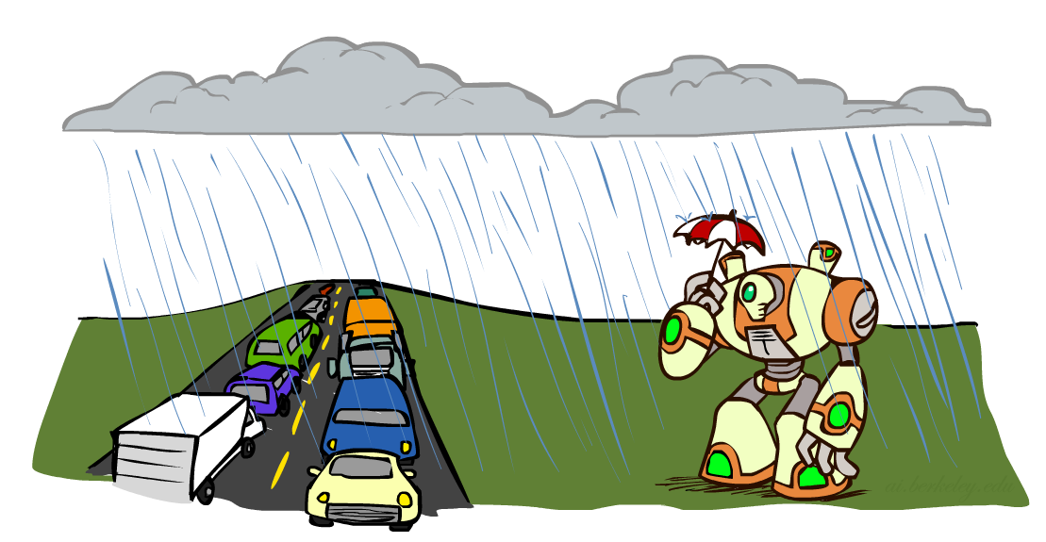
Conditional Independence
What about this domain:
Traffic
Umbrella
Raining

Slide 43

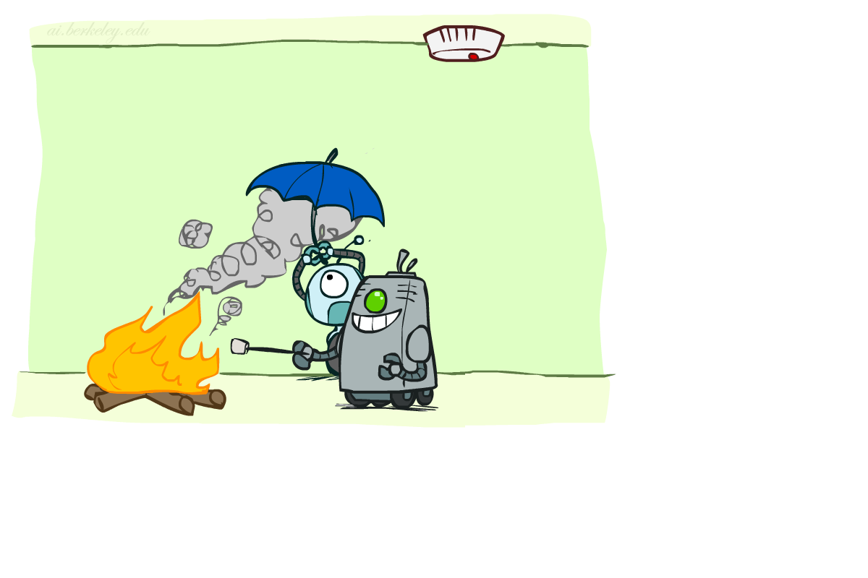
Conditional Independence
What about this domain:
Fire
Smoke
Alarm

Slide 44

Conditional Independence and the Chain Rule
Chain rule:
Trivial decomposition:
With assumption of conditional independence:
Bayes’nets / graphical models help us express conditional independence assumptions

