Slide 1
PCA – Principal components analysis
GROUP 1

Slide 2
Overview
What is Principal Component Analysis (PCA)?
Computing PCA
Example in PCA
Application

Slide 3
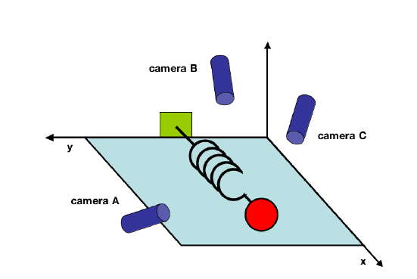
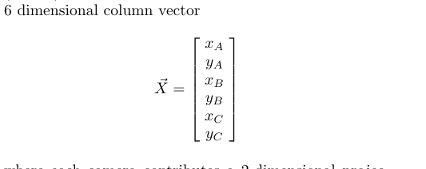
Toy example

Slide 4
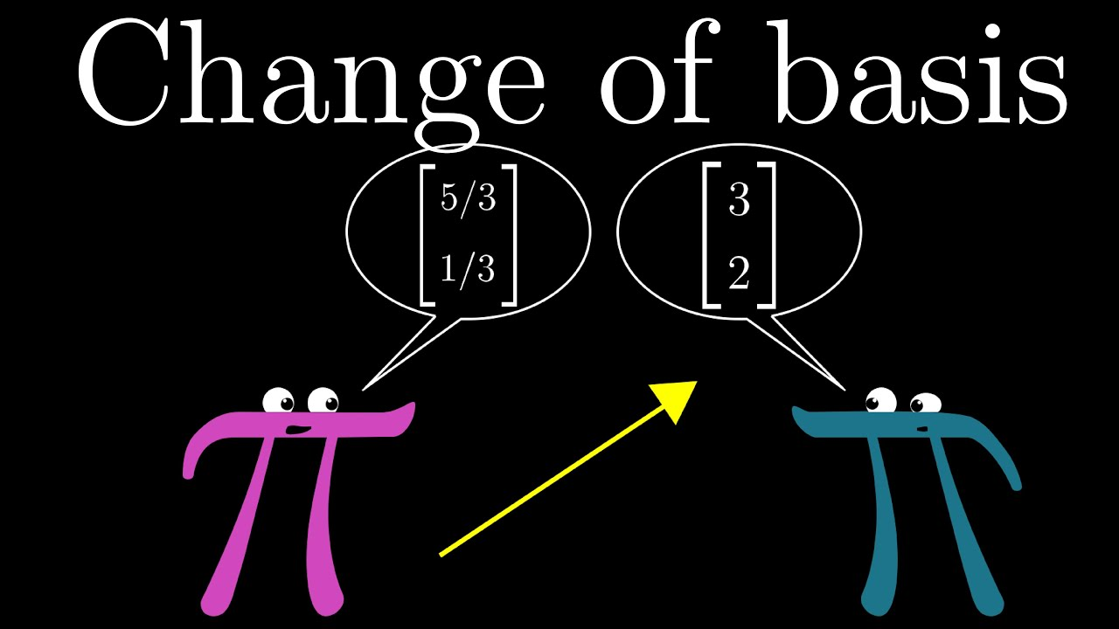
Change of basis

Slide 5
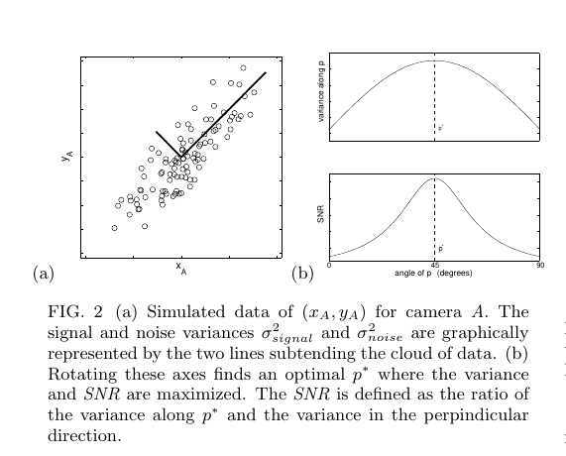
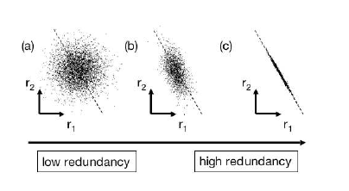
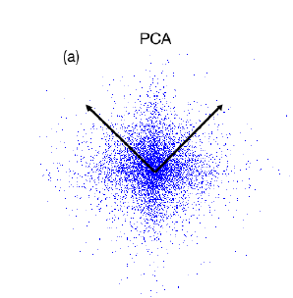
45 dregree 2 bold line along the spread of data

Slide 6
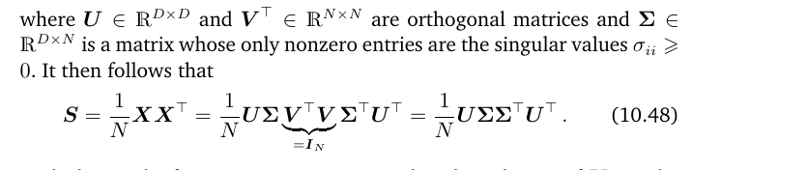
PCA AND SVD

Slide 7
What is Principal component analysis (pca)?
Problem:
Working directly with high-dimensional data (such as images) come with difficulties
-> Hard to analyze, expensive storage data vector
Example: A 640 × 480 pixel color image is a data point in a million-dimensional space, where every pixel responds to three dimensions, one for each color channel (red, green, blue).

Slide 8
What is Principal component analysis (pca)?
PRINCIPLE COMPONENT ANALYSIS
Most common form of factor analysis
Linear dimensionality reduction algorithm
Describe the variation of multiple correlated variables by a group of new uncorrelated variables (components)

Slide 9
What is Principal component analysis (pca)?
If 2 variables are (highly) correlated
They may reflect an underlying unobserved factor (latent factor)
-> Only need 1 variable
-> Latent variables can be known as ‘factors’ or ‘principal components’

Slide 10
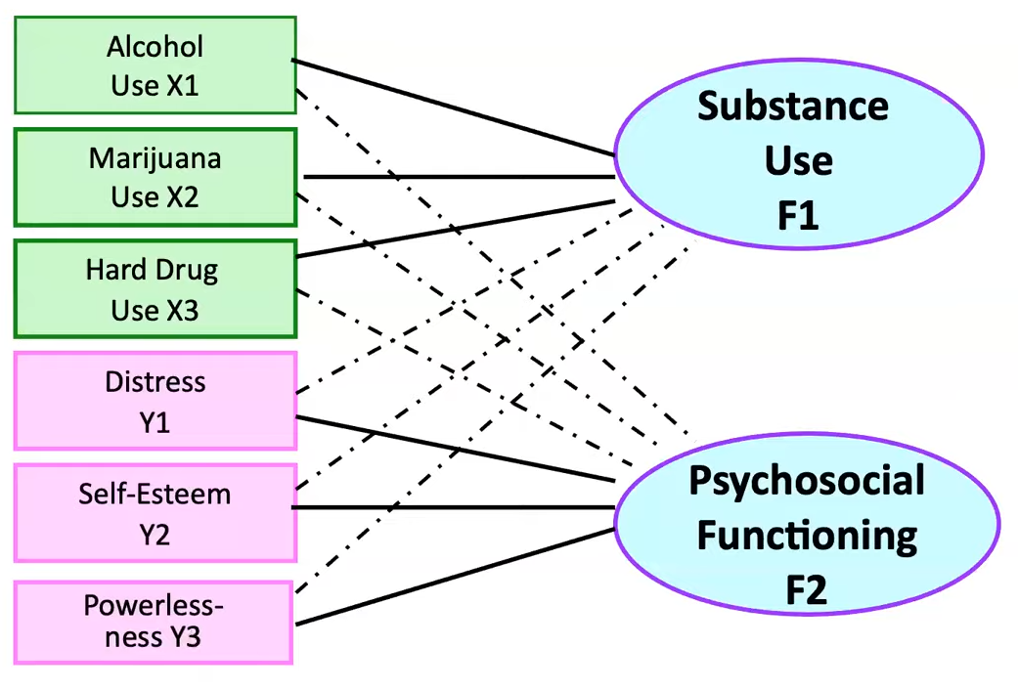
What is Principal component analysis (pca)?
Example

Slide 11
Computing pca
Mean subtraction
Standardization
Eigendecomposition of the covariance matrix
projection

Slide 12
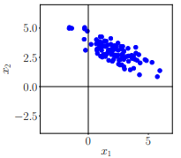
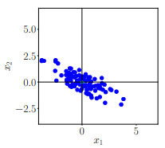


Computing pca
MEAN SUBTRACTION
Centering the data by computing the mean $μ$ of the dataset and subtracting it from every single data point
The mean $μ:$
$$μ=\frac{1}{N}\sum_{i=1}^{N}{x_{i}}$$
S$ubtracting data points to μ:$
$$x_{i}=x_{i}−μ$$
where${ x}_{i}∈R^{D}$

Slide 13
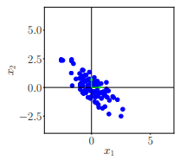


Computing pca
STANDARDIZATION
Divide the data points by the standard deviation $σ_{d}$ of the dataset for every dimension d = 1, . . . , D. Data has variance 1 along each axis.
The standard deviation$:$
$$σ_{d}=\sqrt{\frac{\sum_{i=1}^{N}{{\left(x_{i}−μ\right)}^{2}}}{N}}$$
Standardization of the dataset$:$
$$x_{i}=\frac{x_{i}}{σ_{d}}$$
where${ x}_{i}∈R^{D}$

Slide 14
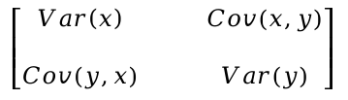
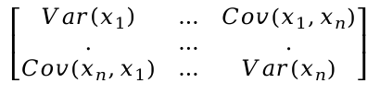

Computing pca
EIGENDECOMPOSITION OF THE COVARIANCE MATRIX
Compute the data covariance matrix and its eigenvalues and corresponding eigenvectors
The covariance(X, Y)$:$
$$cov\left(X,Y\right)=\frac{\sum_{i=1}^{N}{\left(X_{i}−\overline{X}\right)\left(y_{i}−\overline{Y}\right)}}{N}$$
The covariance matrix:
$$\left[\begin{matrix}Var\left(x_{1}\right) & … & Cov(x_{1},x_{n}) \\ . & … & . \\ Cov(x_{n},x_{1}) & … & Var(x_{n})\end{matrix}\right]$$
Example: The covariance matrix of a 2 x 2 will be:
$$\left[\begin{matrix}Var\left(x\right) & & Cov(x,y) \\ & & \\ Cov(y,x) & & Var(y)\end{matrix}\right]$$

Slide 15
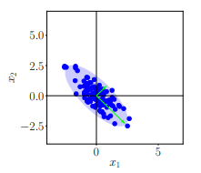

Computing pca
EIGENDECOMPOSITION OF THE COVARIANCE MATRIX
Compute the data covariance matrix and its eigenvalues and corresponding eigenvectors
Eigenvectors and eigenvalues:
$$A\vec{x}=λ\vec{x} where \vec{x} :eigenvector$$
$λ$ : eigenvalue
A : covariance matrix
Using eigenvalues and eigenvectors, we can find the main axes of our data. The first main axis (also called “first principal component”) is the axis in which the data varies the most. The second main axis (also called “second principal component”)
Second principal component axis (PC2)
First principal component axis (PC1)
Notes:
Why eigenvectors and eigenvalues?
To reduce the dimension of the A matrix (a.k.a covariance matrix), which will lead to n-reduction dimension in data later when multiply projection matrix with data.
- The greater eigenvalue the more eigenvector span to vary most variance respectively

Slide 16
Computing pca
PROJECTION
Project the data points to the new axes (PC1, PC2, …) and put it back to the original data space by undo standardization
We obtain the projection as$:$
$${\tilde{x}}_{∗}=BB^{T}x_{∗}$$
With coordinate:
$${\tilde{z}}_{∗}=B^{T}x_{∗}$$
$$where B is the matrix that contains eigenvectors that are associated$$
$$with the largest eigenvalues of the data covariance matrix as column$$
Undo standardization:
$${\tilde{x}}_{∗}^{(d)}={\tilde{x}}_{∗}^{(d)}σ_{d}+μ_{d} with d=1,2,…,D$$

Slide 17
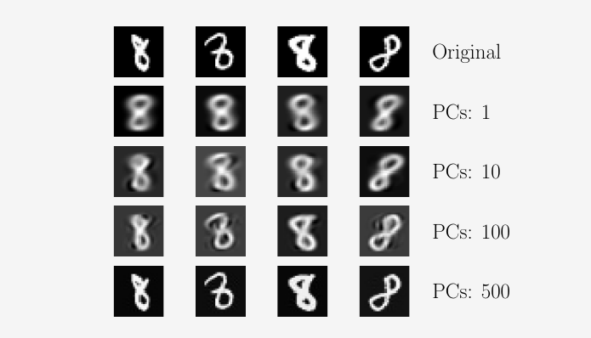
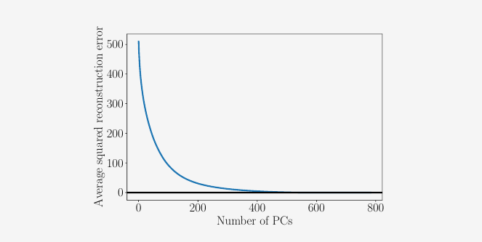
DEmo

Slide 18
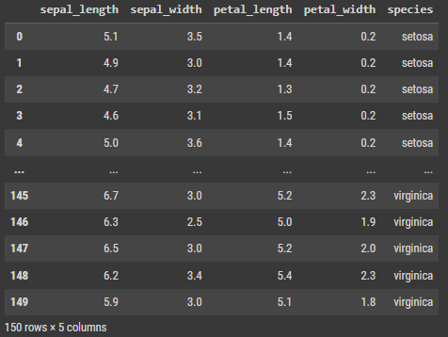
EXAMPLE
We do experiment on Iris Dataset

