Slide 1
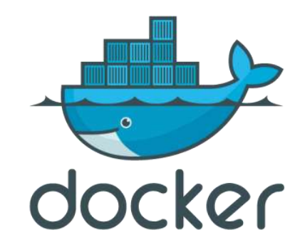
Introduction to Docker

Slide 2

Agenda
What is docker ?
Compare Docker and Hypervisors.
Install Docker.
Docker structor.
Docker images.
DockerFile.
Docker container.
Docker Compose.

Slide 3
What is Docker ?
Docker is “a platform for developers and sysadmins to develop, ship, and run applications”, based on containers.
Docker allows you to package an application with all of its dependencies into a standardized unit for software development.

Slide 4
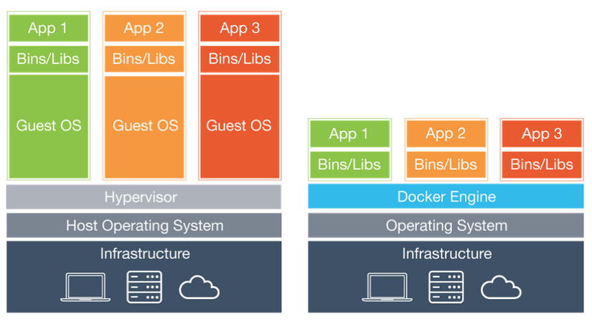
Docker vs Hypervisors

Slide 5
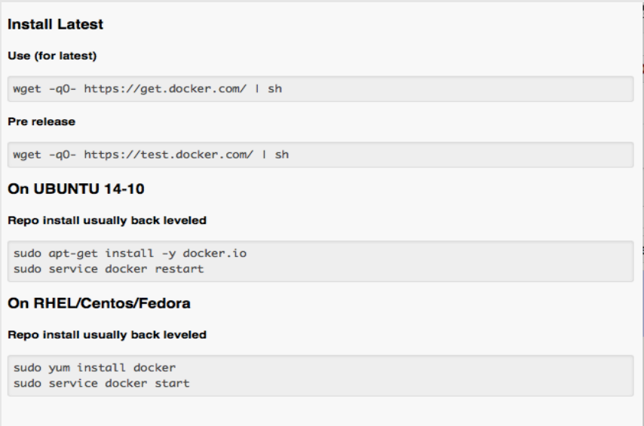
Docker installation
On Linux

Slide 6
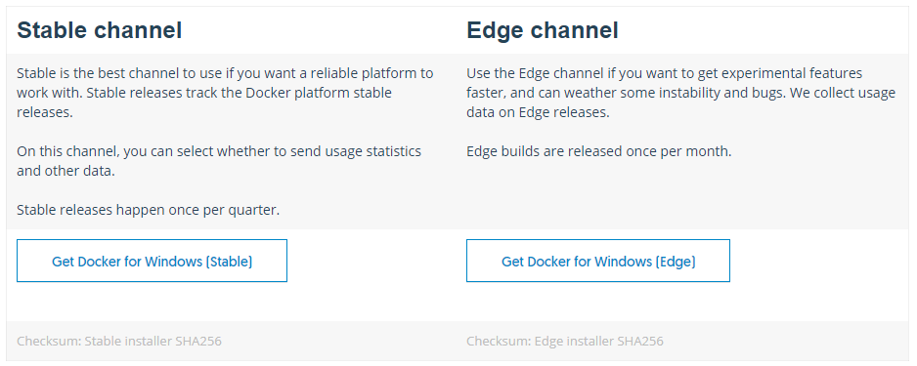
Docker installation
On Window

Slide 7
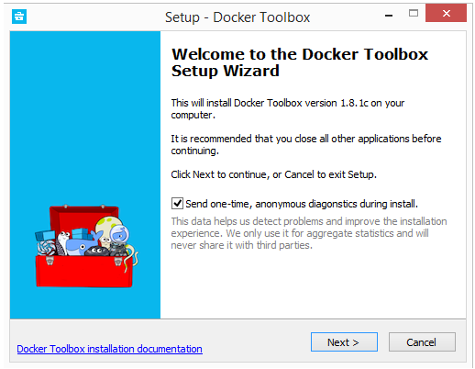
Docker installation
On Window

Slide 8
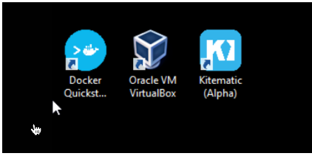
Docker installation
On Window

Slide 9
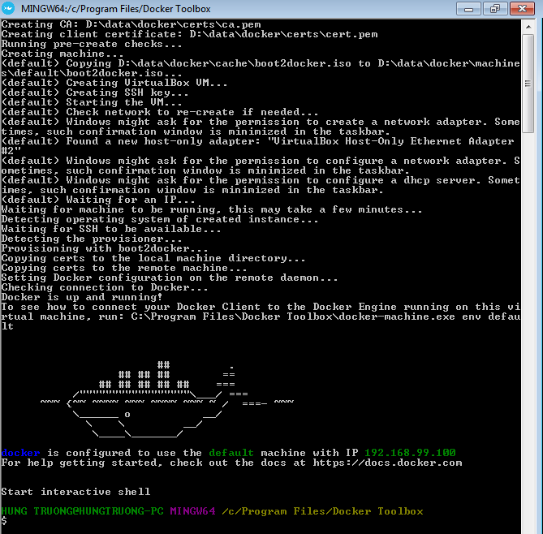
Docker installation
On Window

Slide 10
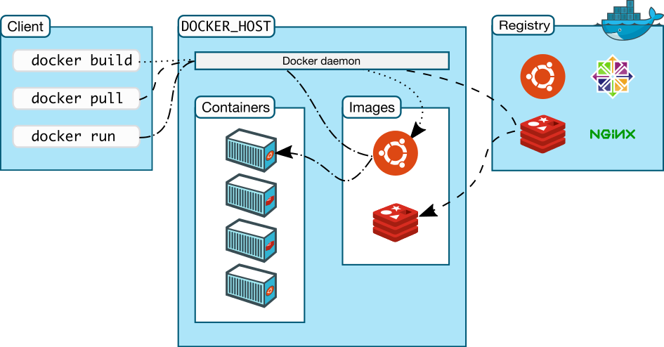
Docker structor

Slide 11
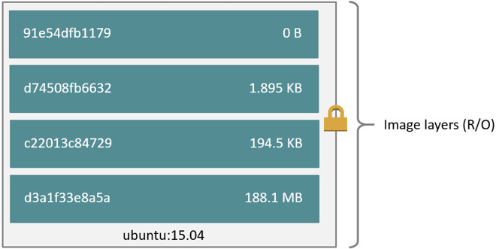
Docker Images
Define
- An image is a read-only template with instructions for creating a Docker container. Often, an image is based on another image, with some additional customization.
- A Docker image is built up from a series of layers.

Slide 12
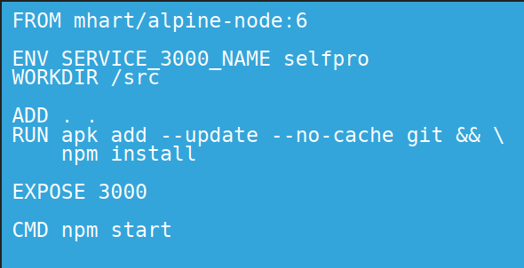
Docker Images
Dockerfile
- A Dockerfile is a text document that contains all the commands a user could call on the command line to assemble an image.

Slide 13
Docker Images
Dockerfile Systax
# Comment
INSTRUCTION arguments
Dockerfile commands
+ FROM
+ ENV
+ ADD
+ COPY
+ RUN
+ VOLUME
+ WORKDIR
+ CMD
+ EXPOSE

Slide 14
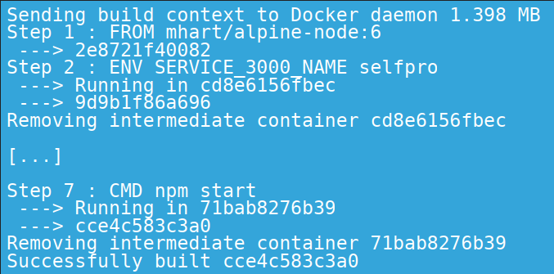
Docker Images
Dockerfile Usage
$docker build –t imagename:tag –f path/.dockerfile .

Slide 15
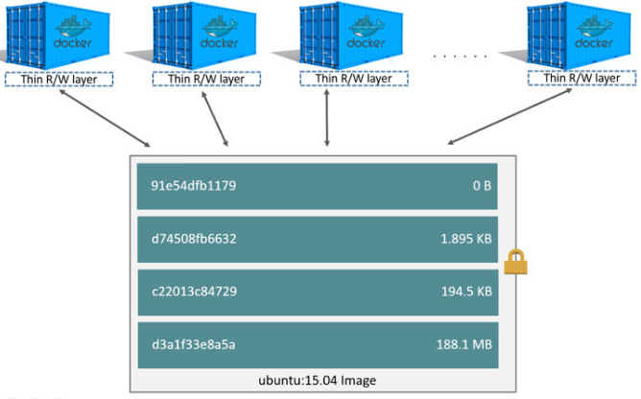
Docker Container
Define
- A container is a runnable instance of an image.
- The major difference between a container and an image is the top writable layer.

Slide 16
Docker Container
Create container
$docker create
$docker run
Useful parameters of the docker run command are:
--name {container_name}
-p {host_port}:{container_port}
-v {/host_path}:{/container_path}
-it
-d
--link
Further parameters can be discovered via docker run –help.

Slide 17
Docker Container
Container commands
- Docker ps
- Docker ps –a
- Docker rm $(docker ps -qa)
- Docker start
- Docker stop
- Docker exec
- Docker log

Slide 18
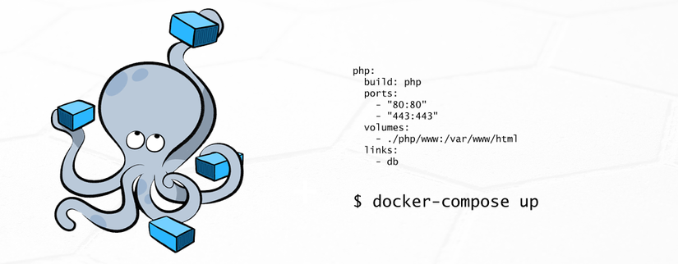
Docker Compose
Define
- Compose is a tool for defining and running multi-container Docker applications.
- With Compose, you use a YAML file to configure your application’s services.

Slide 19
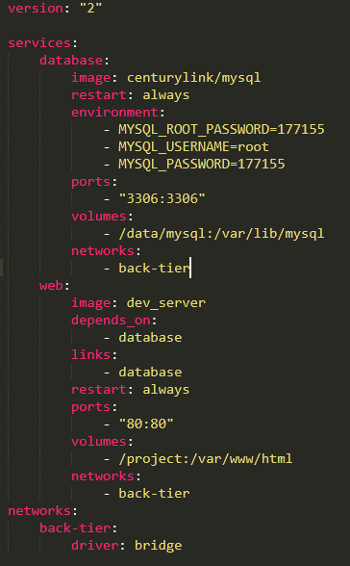
Docker Compose
Docker compose yml file
- Version
- Services
- Image
- Volumes
- Ports
- Links
- restart
- environment
- depends_on

Slide 20
Docker Compose
Docker compose commands
- Docker compose up
- Docker compose down
- Docker compose stop

Slide 21
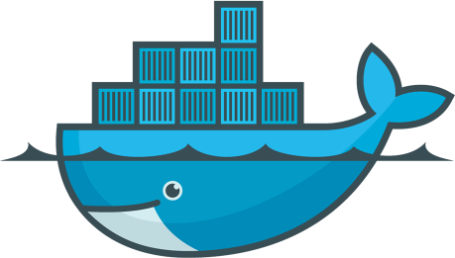
The end

