Slide 1
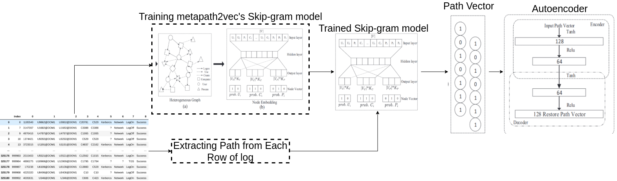
LMTracker pipeline model

Slide 2
LMTracker original result
AUC | Recall | Precision | Accuraccy
0.95 | 0.93 | 0.86 | 0.91

Slide 3
Test 1
Train: Use metapath2vec sampling mechanism (Random Walk in heterogeneous graph) to sample training path
Validation and Test: Path are sampled from the log file. Random split apply for the malicious data. Validation is used to define threshold for autoencoder.
Train (Normal-malicious) | Validation (Normal-malicious) | Test (Normal-malicious)
10000 - 0 | 5000 - 158 | 5000 - 159
Seed | AUC | F1 macro | Recall | Precision | Accuracy
10 | 0.85 | 0.51 | 0.73 | 1 | 0.74
20 | 0.91 | 0.63 | 0.87 | 1 | 0.88
30 | 0.86 | 0.49 | 1 | 0.97 | 0.97
40 | 0.92 | 0.67 | 0.91 | 1 | 0.91
50 | 0.88 | 0.71 | 0.94 | 0.99 | 0.94
Average | 0.884 | 0.59 | 0.89 | 0.992 | 0.887

Slide 4
Test 2
Train: Path are sampled from the log file (generate a path from each row of data)
Validation and Test: Path are sampled from the log file (generate a path from each row of data). Random split apply for the malicious data
Train (Normal-malicious) | Validation (Normal-malicious) | Test (Normal-malicious)
10000 - 0 | 5000 - 158 | 5000 - 159
Seed | AUC | F1 macro | Recall | Precision | Accuracy
10 | 0.82 | 0.70 | 0.95 | 0.99 | 0.94
20 | 0.93 | 0.7 | 0.93 | 1 | 0.93
30 | 0.86 | 0.49 | 1 | 0.97 | 0.97
40 | 0.92 | 0.67 | 0.91 | 1 | 0.91
50 | 0.88 | 0.71 | 0.94 | 0.99 | 0.94
Ave | 0.882 | 0.654 | 0.946 | 0.99 | 0.938

Slide 5
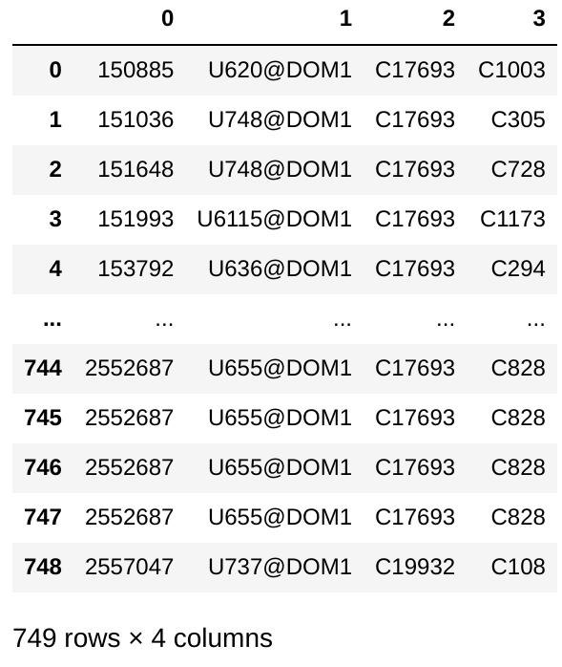
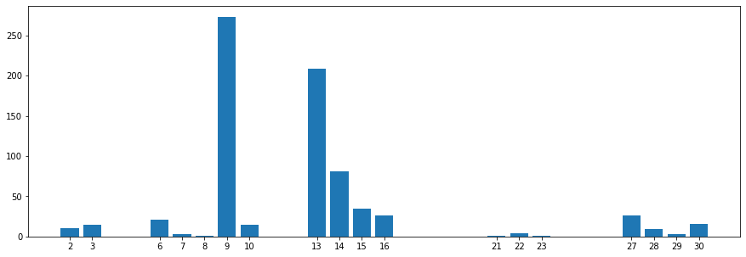
Test 3
- 748 malicious activities in red_team.txt file
- Malicious event spanning in first 30 days
- Use malicious sample of first 10 day for validation, next 20 day for testing

Slide 6
- Train: Path are sampled from the log file (generate a path from each row of data)
- Validation and Test: Path are sampled from the log file (generate a path from each row of data). Malicious event from first 10 days are used for the validation (define threshold). Testing set contain malicious event from the next 20 days
Train (Normal-malicious) | Validation (Normal-malicious) | Test (Normal-malicious)
10000 - 0 | 5000 - 198 | 5000 - 168
Seed | Threshold (normalised) | AUC | F1 macro | Recall | Precision | Accuracy
10 | 0.292650 | 0.91 | 0.71 | 0.93 | 1 | 0.93
20 | 0.263195 | 0.88 | 0.57 | 0.81 | 1 | 0.82
30 | 0.354501 | 0.86 | 0.68 | 0.92 | 0.99 | 0.92
40 | 0.330291 | 0.83 | 0.61 | 0.88 | 0.99 | 0.88
50 | 0.368204 | 0.92 | 0.70 | 0.92 | 1 | 0.92
Ave |  | 0.88 | 0.654 | 0.892 | 1 | 0.894

Slide 7
Varying Threshold
This slide will show how importance of choosing the threshold impact the result:
(1) Threshold is chosen such that model produce the best result on the validation set
(2)
Seed=60 | AUC | F1 macro | Recall | Precision | Accuracy
(1) | 0.632 | 0.63 | 0.98 | 0.68 | 0.95
(2) | 0.93 | 0.70 | 0.92 | 1 | 0.92

