Slide 1
Introduction to Reinforcement Learning A mini course @ HCMUS, Vietnam Lectures 1-3 (cont’d)
Long Tran-Thanh
Long.tran-thanh@warwick.ac.uk

Slide 2
Model-free approaches

Slide 3

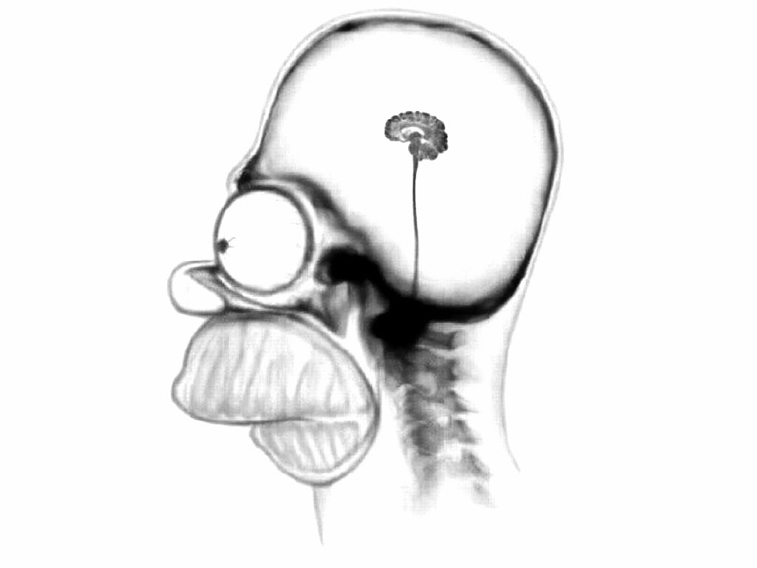

Agent + environment
Perception
Environment
Action
Abstract model:
Agent
Environment

Slide 4
Environment model
Perception
Environment
Environment
model
Action
Environment model:
Having access to this model gives us P and R
Using DP + Bellman operator would work very well

Slide 5
Environment model
Perception
Environment
Environment
model
Action
Environment model:
Knowing this model gives us full information about P and R
Using DP + Bellman operator would work very well
What happens if we don’t know P and/or R?

Slide 6
Unknown environment model
Perception
Environment
Environment
model
Action
Environment model:
We don’t know the model
But we have access to it through interactions
We can observe what happens if we make actions

Slide 7
Unknown environment model
Perception
Environment
Environment
model
Action
Environment model:
We don’t know the model
But we have access to it through interactions
We can observe what happens if we make actions
MDP: we assume full observability (received reward, new state)
POMDP: partially observable MDP (some feedback is missing)
In this course we only focus on MDPs

Slide 8
Covered methods in this lecture
Monte Carlo policy
Temporal Difference: TD[0], TD[lambda]
SARSA
Q-learning

Slide 9
Monte Carlo (MC) method
Main question: how to evaluate a policy’s value if we don’t know the MDP model
Idea:
Just follow the policy, let the randomness of the model and policy guide us
Observe the trajectory T of the policy starting from certain state s
Repeat this many times, and take the average total returns -> estimate for the value of s

Slide 10
Monte Carlo (MC) method
Main question: how to evaluate a policy’s value if we don’t know the MDP model
Idea:
Just follow the policy, let the randomness of the model and policy guide us
Observe the trajectory T of the policy starting from certain state s
Repeat this many times, and take the average total returns -> estimate for the value of s
Justification:

Slide 11
Monte Carlo (MC) method
This is called the MC method:
Follow the policy, let the randomness of the model and policy guide us
Observe the trajectory T of the policy starting from certain state s
Repeat this many times, and take the average total returns -> estimate for the value of s
We need to know when to stop following the policy -> works for finite trajectories only
-> MC method can only be applied to episodic MDPs (finite horizon H)

Slide 12
Monte Carlo (MC) method
Goal: estimate the value of each state s under policy
Observe random state-action sequence by following the policy with episode length H:
Calculate return for each t
Repeat this for multiple episodes
For each s: MC computes the empirical mean of relevant returns

Slide 13
Monte Carlo (MC) method
Goal: estimate the value of each state s under policy
Observe random state-action sequence by following the policy:
Calculate return for each t
For each s: MC computes the empirical mean of relevant returns
What are the relevant return values?

Slide 14
Monte Carlo (MC) method
S_t = s
a_t
S_(t+1)
a_(t+1)
S_(t+2)
a_(t+2)
a_(t+100)
During the process, we may visit s multiple times
Include the corresponding return of every time we visit s?
Include the return of first time visit only?

Slide 15
Monte Carlo (MC) method
S_t = s
a_t
S_(t+1)
a_(t+1)
S_(t+2)
a_(t+2)
a_(t+100)
First-visit MC method:
Aim: to evaluate value of state s
For each episode i: The first time step t that state s is visited in the episode:
Increment counter
Increment total return
Value is estimated by empirical mean return
By law of large numbers, as

Slide 16
Monte Carlo (MC) method
S_t = s
a_t
S_(t+1)
a_(t+1)
S_(t+2)
a_(t+2)
a_(t+100)
Every-visit MC method:
Aim: to evaluate value of state s
For each episode i: for every time step t that state s is visited in the episode:
Increment counter
Increment total return
Value is estimated by empirical mean return
By law of large numbers, as

Slide 17
Monte Carlo (MC) method
S_t = s
a_t
S_(t+1)
a_(t+1)
S_(t+2)
a_(t+2)
a_(t+100)
First-visit MC
Unbiased estimator of true value
Slower convergence (slower updates)
Every-visit MC:
Duplicated rewards (introduce estimation bias)
Faster convergence

Slide 18
Monte Carlo (MC) method
S_t = s
a_t
S_(t+1)
a_(t+1)
S_(t+2)
a_(t+2)
a_(t+100)
Third option - Incremental MC:
Idea: the value update is in fact the same as the following incremental update:

Slide 19
Monte Carlo (MC) method
S_t = s
a_t
S_(t+1)
a_(t+1)
S_(t+2)
a_(t+2)
a_(t+100)
Third option - Incremental MC:
Idea: the value update is in fact the same as the following incremental update:

Slide 20
Monte Carlo (MC) method
S_t = s
a_t
S_(t+1)
a_(t+1)
S_(t+2)
a_(t+2)
a_(t+100)
Third option - Incremental MC:
Idea: the value update is in fact the same as the following incremental update:

Slide 21
Monte Carlo (MC) method
S_t = s
a_t
S_(t+1)
a_(t+1)
S_(t+2)
a_(t+2)
a_(t+100)
Third option - Incremental MC:
Idea: the value update is in fact the same as the following incremental update:
More general update rule:

Slide 22
Monte Carlo (MC) method
S_t = s
a_t
S_(t+1)
a_(t+1)
S_(t+2)
a_(t+2)
a_(t+100)
Third option - Incremental MC:
Every-visit MC + general update rule

Slide 23
Monte Carlo (MC) method
S_t = s
a_t
S_(t+1)
a_(t+1)
S_(t+2)
a_(t+2)
a_(t+100)
Third option - Incremental MC:
Every-visit MC + general update rule
If then incremental MC = every-visit MC
is useful when MDP is not stationary (i.e., we prioritise more recent updates)

Slide 24
Summary of the MC method
S_t = s
a_t
S_(t+1)
a_(t+1)
S_(t+2)
a_(t+2)
a_(t+100)
Simple: Estimates expectation by empirical average (given episodes sampled from policy of interest)
Updates V estimate using sample of return to approximate the expectation
Does not assume Markov property (why?)
Converges to true value under some (generally mild) assumptions
But: works for finite/episodic MDPs only

Slide 25
Temporal difference (TD) learning
Recall:
Dynamic programming: efficient calculations + can handle infinite horizon, but needs to know MDP (i.e., model-based)
MC method/learning: model-free, but requires episodic nature
Idea: Why not combine these 2 and take the best of each?

Slide 26
Temporal difference (TD) learning
Recall:
Dynamic programming: efficient calculations + can handle infinite horizon, but needs to know MDP (i.e., model-based)
MC method/learning: model-free, but requires episodic nature
Idea: Why not combine these 2 and take the best of each? – this is what TD does
“If one had to identify one idea as central and novel to reinforcement learning, it would undoubtedly be temporal-difference (TD) learning." - Sutton and Barto 2017

Slide 27
Temporal difference (TD) learning
TD learning (or more precisely, TD(0) learning)
Bellman operator:
Incremental MC method:

Slide 28
Temporal difference (TD) learning
TD learning (or more precisely, TD(0) learning)
Bellman operator:
Incremental MC method:
From the latter, we can write:
is a 1-step look-ahead estimate of
Note that in MC we only do this update at the end of each epoch (but then we do for each state s)

Slide 29
Temporal difference (TD) learning
TD learning (or more precisely, TD(0) learning)
Bellman operator:
Incremental MC method:
From the latter, we can write:
In TD - do this update, but straight after we visit a state (and don’t wait until the end of the episode):

Slide 30
Temporal difference (TD) learning
TD learning (or more precisely, TD(0) learning):
Can immediately update after each visit of s
Therefore, there’s no need for episodic setting
If we repeat this many times, it resembles the Bellman operator (why?)

Slide 31
Temporal difference (TD) learning
TD learning (or more precisely, TD(0) learning):
Can immediately update after each visit of s
Therefore, there’s no need for episodic setting
If we repeat this many times, it resembles the Bellman operator (why?)
TD target:
TD error:

Slide 32
Temporal difference (TD) learning
TD learning (or more precisely, TD(0) learning):
Input:
Initialisation:
While (interacting with environment):
Sample tuple
Update

Slide 33
From TD(0) to TD(lambda)
Recall that in TD(0):
1-step estimate of return

Slide 34
From TD(0) to TD(lambda)
Recall that in TD(0):
We can use n-step estimates as well
1-step estimate of return
...

Slide 35
From TD(0) to TD(lambda)
Recall that in TD(0):
We can use n-step estimates as well
1-step estimate of return
Which n would be the best?
Small n = worse accuracy but faster update
Large n = the opposite
Idea: why not combine return of different n-steps?
E.g., take the average of n = 2 and n = 5
How to efficiently combine these together?
...

Slide 36
From TD(0) to TD(lambda)
Recall that in TD(0):
We can use n-step estimates as well
1-step estimate of return
Lambda-return :
TD( ):
...

Slide 37
Forward-view TD(lambda)
TD( ):
How to calculate ?
Forward-view:
Look into the future and calculate return for each n
This has restrictions similar to MC: only works for finite episodes

Slide 38
Backward-view TD(lambda)
TD( ):
How to calculate ?
Backward-view:
We update the returns of states visited in the past instead
This sounds good, but how to implement it in practice?

Slide 39
Backward-view TD(lambda)
TD( ):
How to calculate ?
Backward-view:
We update the returns of states visited in the past instead
This sounds good, but how to implement it in practice?
Some heuristics:
Frequency heuristic: assign current value to most frequent states
Recency heuristic: assign current value to most recent states

Slide 40
Backward-view TD(lambda)
TD( ):
How to calculate ?
Backward-view:
We update the returns of states visited in the past instead
This sounds good, but how to implement it in practice?
Some heuristics:
Frequency heuristic: assign current value to most frequent states
Recency heuristic: assign current value to most recent states
Eligibility trace:

Slide 41
Backward-view TD(lambda)
TD( ):
Backward-view:
Eligibility trace:
Recall TD error:
Value update:

Slide 42
Backward-view TD(lambda)
TD( ):
Backward-view:
Eligibility trace:
Recall TD error:
Value update:
Theorem: The sum of the updates is identical for forward-view and backward-view in the offline setting (i.e., episodic/batch)

Slide 43
Backward-view TD(lambda)
TD( ):
Backward-view:
Eligibility trace:
Recall TD error:
Value update:
Theorem: The sum of the updates is identical for forward-view and backward-view in the offline setting (i.e., episodic/batch)
Theorem: With a slightly different eligibility trace, backward = forward-view in online setting (ICML 2014)

Slide 44
From policy evaluation to finding optimal policy
So far what we have done:
Given a policy , we want to compute its value function
DP: relies on Bellman operator, needs knowledge of MDP
MC method: model-free, but episodic
TD learning: model-free, works for both episodic and infinite horizon

Slide 45
From policy evaluation to finding optimal policy
So far what we have done:
Given a policy , we want to compute its value function
DP: relies on Bellman operator, needs knowledge of MDP
MC method: model-free, but episodic
TD learning: model-free, works for both episodic and infinite horizon
Next question: Can we find the optimal policy without the knowledge of the MDP model?

Slide 46
From policy evaluation to finding optimal policy
Recall: in case of known MDP model -> policy iteration
State-action value function + policy improvement
Can we do the same without knowing R and P?
Idea: combine the model-free policy evaluation techniques (MC, TD) with policy iteration -> model-free policy iteration

Slide 47
Model-free policy iteration
Ideal case:
Initialise policy
Repeat:
Policy evaluation: compute
Policy improvement: compute given

Slide 48
Model-free policy iteration
Ideal case:
Initialise policy
Repeat:
Policy evaluation: compute
Policy improvement: compute given
Possible issues:
If is deterministic then we cannot compute for all

Slide 49
Model-free policy iteration
Ideal case:
Initialise policy
Repeat:
Policy evaluation: compute
Policy improvement: compute given
Possible issues:
If is deterministic then we cannot compute for all
How to visit other ?
Idea: add some extra exploration (e.g., add random noise to the action choice)

Slide 50
Epsilon-greedy policy iteration
Initialise policy ,
Repeat:
Policy evaluation: compute (MC or TD)
Policy improvement:
with probability
arbitrary action a with probability (i.e., uniformly randomly pick a)

Slide 51
SARSA: epsilon-greedy policy iteration + TD evaluation
Initialise epsilon-greedy policy , , t = 0, initial state
Choose
Repeat:
Take action , observe
Choose action // note: still using the same policy
Update Q given tuple // note: hence the name

Slide 52
SARSA: epsilon-greedy policy iteration + TD evaluation
Initialise epsilon-greedy policy , , t = 0, initial state
Choose
Repeat:
Take action , observe
Choose action // note: still using the same policy
Update Q given tuple // note: hence the name
Policy improvement:
, t = t + 1
with probability
arbitrary action a with probability (i.e., uniformly randomly pick a)

Slide 53
Q-learning
Initialise epsilon-greedy policy , , t = 0, initial state
Repeat:
Take action , observe
Update Q:
Because of the max operator, we don’t need to sample an additional action

Slide 54
Q-learning
Initialise epsilon-greedy policy , , t = 0, initial state
Repeat:
Take action , observe
Update Q:
Policy improvement:
t = t + 1
with probability
arbitrary action a with probability (i.e., uniformly randomly pick a)

Slide 55
Q-learning vs. SARSA
SARSA:
On-policy learning
Direct experience
Learn to estimate and evaluate a policy from experience obtained from following that policy (here was sampled from the same policy)
Q-learning:
Off-policy learning
Learn to estimate and evaluate a policy using experience gathered from following a different policy (here max_a is not part of the same policy)

