Slide 1
Introduction to Reinforcement Learning A mini course @ HCMUS, Vietnam Lectures 4-6 (cont’d)
Long Tran-Thanh
Long.tran-thanh@warwick.ac.uk

Slide 2
Policy gradient

Slide 3
Last lecture
Function approximation:
In large scale RL, we approximate V(s) and Q(s,a) with v(s, w) and q(s,a,w)
We implicitly derive a policy from there: main goal is to learn the values. Policy is just a helper to do this learning efficiently (e.g., we use epsilon-greedy)
This is called value-based RL

Slide 4
Value-based vs. policy-based RL
Function approximation:
In large scale RL, we approximate V(s) and Q(s,a) with v(s, w) and q(s,a,w)
We implicitly derive a policy from there: main goal is to learn the values. Policy is just a helper to do this learning efficiently (e.g., we use epsilon-greedy)
This is called value-based RL
Question: Can we learn the policy in a more explicit way?
Idea: Remember policy iteration?
Iterate over deterministic policies
Challenge: search on large policy space

Slide 5
Value-based vs. policy-based RL
Function approximation:
In large scale RL, we approximate V(s) and Q(s,a) with v(s, w) and q(s,a,w)
We implicitly derive a policy from there: main goal is to learn the values. Policy is just a helper to do this learning efficiently (e.g., we use epsilon-greedy)
This is called value-based RL
Question: Can we learn the policy in a more explicit way?
Idea: Remember policy iteration?
Iterate over deterministic policies
Challenge: search on large policy space
Idea 2: Why not parametrise the policies as well?
More compact representation
Can do efficient search directly on the policy space (using gradient descent)
This is called policy-based RL

Slide 6
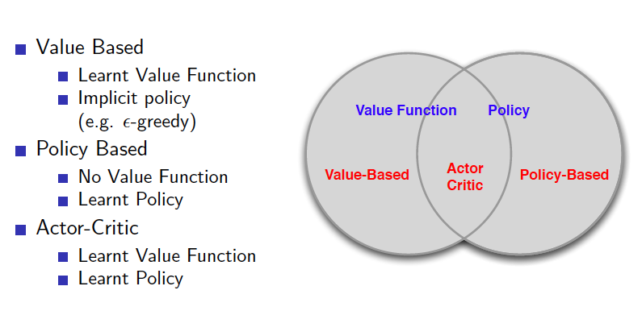
Value-based vs. policy-based RL
Taken from David Silver’s slides

Slide 7
Policy-based RL
Advantages:
Better convergence properties (converges faster)
Effective in high-dimensional or continuous action spaces
Can learn stochastic policies
Can deal with adaptive/adversarial environments where deterministic policies fail
Disadvantages:
Typically converge to a local rather than global optimum (also gets stuck at saddle points in many cases)
Evaluating a policy is typically inefficient and high variance

Slide 8

Stochastic policies vs. deterministic policies
Example: Two-player game of rock-paper-scissors
Scissors beats paper
Rock beats scissors
Paper beats rock
Consider policies for iterated rock-paper-scissors
A deterministic policy is easily exploited
A uniform random policy of choosing each with 1/3 probability is optimal (i.e. Nash equilibrium)

Slide 9
What is the best policy?
We parametrise policies with parameter vector
Goal: Find with best policy
But how do we measure the quality of a policy ? We need to define a utility function

Slide 10
What is the best policy?
We parametrise policies with parameter vector
Goal: Find with best policy
But how do we measure the quality of a policy ? We need to define a utility function
In episodic environments we can use the start value:

Slide 11
What is the best policy?
We parametrise policies with parameter vector
Goal: Find with best policy
But how do we measure the quality of a policy ? We need to define a utility function
In episodic environments we can use the start value:
In continuing environments we can use the average value:
where is the stationary distribution of the underlying Markov chain

Slide 12
What is the best policy?
We parametrise policies with parameter vector
Goal: Find with best policy
But how do we measure the quality of a policy ? We need to define a utility function
In episodic environments we can use the start value:
In continuing environments we can use the average value:
where is the stationary distribution of the underlying Markov chain
Or the average reward per time-step:
where R(s,a) is the expected reward received at (s,a)

Slide 13
How to find the best policy?
Gradient-free solutions:
Hill climbing
Simplex / amoeba / Nelder Mead
Genetic algorithms
Greater efficiency often possible using gradient:
Gradient descent
Conjugate gradient
Quasi-newton
We focus on gradient descent, many extensions possible

Slide 14
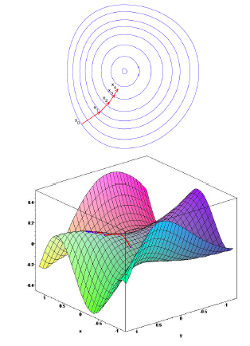
Recall gradient descent
: a differentiable function of parameter vector
Goal: find local (global) maximum of
Gradient of :
Adjust in the negative direction of the gradient
Taken from David Silver’s slides

Slide 15
How to compute the gradient?
Finite differences approach
Score function (with likelihood ratio)

Slide 16
Computing the gradient with finite differences
Idea:
is the kth unit vector (with 1 in the kth component, and 0 elsewhere)

Slide 17
Computing the gradient with finite differences
Idea:
is the kth unit vector (with 1 in the kth component, and 0 elsewhere)
Uses n evaluations to compute policy gradient in n dimensions
Simple, noisy, inefficient - but sometimes effective
Works for arbitrary policies, even if policy is not differentiable

Slide 18
Computing the gradient with score function
Consider a simple one-step MDP (we stop after 1 action)
Starting state follows distribution d(s)

Slide 19
Computing the gradient with score function
Consider a simple one-step MDP (we stop after 1 action)
Starting state follows distribution d(s)
Gradient:

Slide 20
Computing the gradient with score function
Consider a simple one-step MDP (we stop after 1 action)
Starting state follows distribution d(s)
Gradient:
Simple trick:
Using for any :

Slide 21
Computing the gradient with score function
Idea: consider a simple one-step MDP (we stop after 1 action)
Starting state follows distribution d(s)
Gradient:
Simple trick:
Using for any :
score function

Slide 22
Computing the gradient with score function
Idea: consider a simple one-step MDP (we stop after 1 action)
Starting state follows distribution d(s)
Gradient:

Slide 23
Computing the gradient with score function
Idea: consider a simple one-step MDP (we stop after 1 action)
Starting state follows distribution d(s)
Gradient:

Slide 24
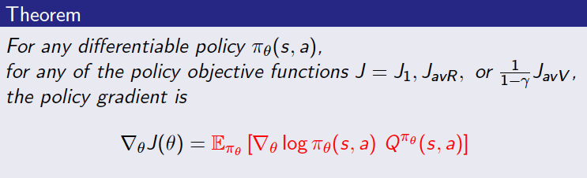
The policy gradient theorem
It generalises the previous idea to general MDPs

Slide 25
The policy gradient theorem
It generalises the previous idea to general MDPs
It replaces R(s,a) with the expected Q-value of the policy

Slide 26
Approximating the gradient
Gradient policy theorem:
Challenge: calculate

Slide 27
Approximating the gradient with MC
Gradient policy theorem:
Challenge: calculate
Solution: use MC method, use return as unbiased estimate of
This solution is called REINFORCE: MC + policy gradient theorem (Williams, 1992)

Slide 28
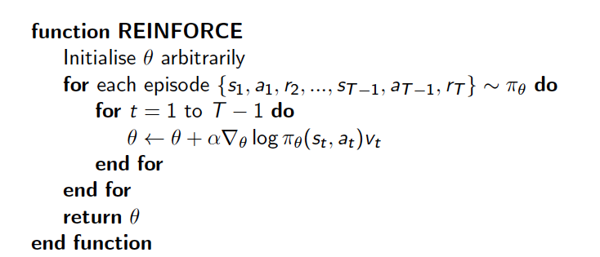
The REINFORCE algorithm

Slide 29
Approximating the gradient with value function approximation
Gradient policy theorem:
Challenge: calculate
Solution: use MC method, use return as unbiased estimate of
This solution is called REINFORCE: MC + policy gradient theorem (Williams, 1992)
Issue: MC has high variance -> requires lots of samples

Slide 30
Approximating the gradient with value function approximation
Gradient policy theorem:
Challenge: calculate
Solution: use MC method, use return as unbiased estimate of
This solution is called REINFORCE: MC + policy gradient theorem (Williams, 1992)
Issue: MC has high variance -> requires lots of samples
Idea 2: use value function approximation:

Slide 31
Actor-critic algorithms
Critic (responsible for the value function approximation part): Updates action-value function parameters w (using e.g., MC, TD(0), TS(lambda))
Actor (responsible for the policy gradient part): Updates policy parameters , in direction suggested by critic

Slide 32
Actor-critic algorithms
Critic (responsible for the value function approximation part): Updates action-value function parameters w (using e.g., MC, TD(0), TS(lambda))
Actor (responsible for the policy gradient part): Updates policy parameters , in direction suggested by critic
Actor-critic algorithms follow an approximate policy gradient:

Slide 33
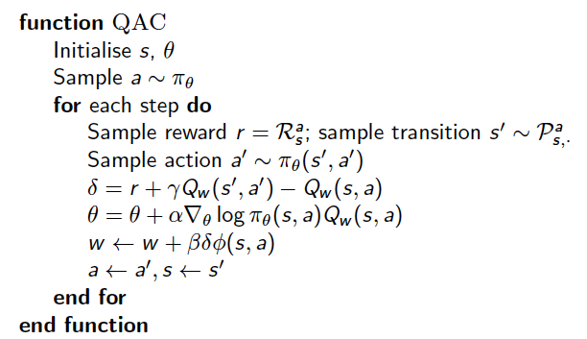
Action-value Actor-critic (QAC – Crites & Barto, 1994)
Critic: linear value function approx using TD(0)
Actor: policy gradient

Slide 34
Other Actor-critic algorithms
A2C (Advantage Actor-Critic, Mnih et al., 2016)
Advantages: lower variance, in-line with theory
A3C (Asynchronous Advantage Actor-Critic, Mnih et al., 2016): multi-agent RL
Deep Deterministic Policy Gradient (DDPG): for continuous action spaces + returns to Q-value (due to the deterministic policy)

