Slide 1
Introduction to Reinforcement Learning A mini course @ HCMUS, Vietnam Lectures 4-6
Long Tran-Thanh
Long.tran-thanh@warwick.ac.uk

Slide 2
Last lectures
Function approximation (Lectures 3&4):
In large scale RL, we approximate V(s) and Q(s,a) with v(s, w) and q(s,a,w)
We implicitly derive a policy from there: main goal is to learn the values. Policy is just a helper to do this learning efficiently (e.g., we use epsilon-greedy)
This is called value-based RL
Direct optimisation on policy space:
More compact representation of policies
Can do efficient search directly on the policy space (using gradient descent)
This is called policy-based RL
Policy gradient (Lecture 5):
REINFORCE (Williams, 1992)
Actor-Critic (Crites & Barto, 1994)
A2C, A3C (Mnih et al., 2016)

Slide 3
Advanced RL methods

Slide 4
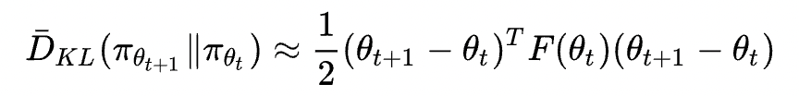

Natural policy gradient (Kakade, 2001)
Standard PG revisited:
Gradient descent is on the parameter space
Depends on the choice of feature vectors. HOW can we get rid of this dependency?
Idea: policy = distribution (independent from choice of parameters)
Would be much more “natural” if we do gradient descent on the probability space of policies
What we need is the “distance” definition for distributions (for parameter space we used e.g., Euclidean)
Solution: KL-divergence:
When KL-divergence is very small:
Fischer information matrix (curvature of J on the distribution space)

Slide 5

Natural policy gradient
Update rule (Kakade, 2001):
Much more robust and natural than PG
BUT: computationally very expensive (inverting F)
Approximation of F inverse is needed (ideas from the optimisation literature)

Slide 6



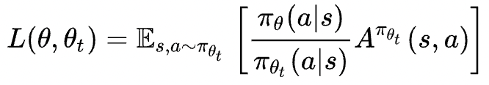
TRPO: Trust Region Policy Optimization (Schulman et al., 2015)
Update rule of PG:
This is in fact a solution of the following optimisation problem
For natural PG, the constraint becomes
TRPO uses a surrogate objective function:

Slide 7
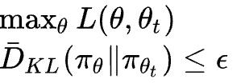
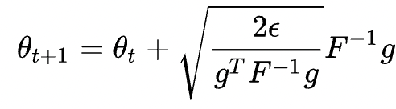

TRPO: Trust Region Policy Optimization (Schulman et al., 2015)
Why this is good?
Answer: Using Taylor expansion as approximator, we can get
(policy gradient)
Issue of inverting F -> use conjugate gradient method for Fx = g (to calculate x)

Slide 8
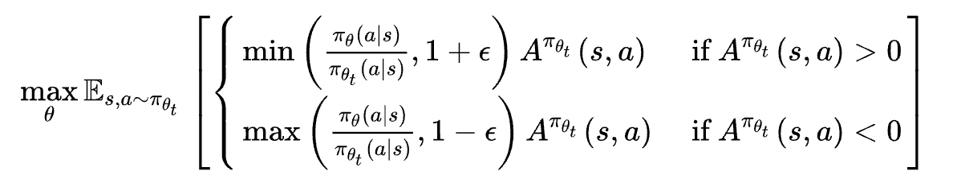
PPO: Proximal Policy Optimization (Schulman et al., 2017)
It’s a challenge to handle the KL divergence constraint
Idea: use clipping
Then use SGD/Adam etc. to optimise this clipped objective function

Slide 9
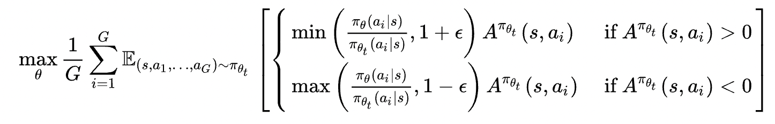
GRPO: Group Relative Policy Optimization (DeepSeek, 2025 – Shao et al., 2025)
Advantage value
Instead of calculating V(s) as PPO does, GRPO uses a relative group advantage estimate:
Samples G actions for each state s:
Calculate:
where is the empirical mean-std of
Use PPO to solve

