Slide 1
Introduction to Reinforcement Learning
A mini course @ HCMUS, Vietnam
Lectures 7-9 (cont’d)
Long Tran-Thanh
long.tran-thanh@warwick.ac.uk
University of Warwick, UK

Slide 2
Adversarial Online Learning

Slide 3
Stochastic vs. Adversarial
Adversarial to stochastic:
Any algorithm with low regret in adversarial setting can also produce low regret in stochastic setting
Claim: regret in stochastic setting is smaller than regret in adversarial setting
Implication 1: if adversarial regret is bounded above by a sub-linear bound -> also the stochastic bound
Implication 2: The other direction is not true

Slide 4
(Adversarial) Online Optimisation
A generalised version of adversarial bandits
Recall the model of classical multi-armed bandit problem:
Time step t: opponent chooses value r(t,i) for each arm i from K arms (indexed by 1..K), player chooses arm i(t)
Stochastic: r(t,i) ~ D(i) (drawn iid); adversarial: r(t,i) arbitrarily chosen

Slide 5
(Adversarial) Online Optimisation
A generalised version of adversarial bandits
Recall the model of classical multi-armed bandit problem:
Time step t: opponent chooses value v(t,i) for each arm i from K arms (indexed by 1..K), player chooses arm i(t)
Stochastic: v(t,i) ~ D(i) (drawn iid); adversarial: v(t,i) arbitrarily chosen
More general model:
X: action space/space of possible arms (e.g., classical bandit as X = {1,2,..K} set of integers)
Time step t: opponent chooses function
Player chooses , and receives
Goal: minimise regret (for expected regret, take the expectation)

Slide 6
Online Optimisation: Formulation
X: action space/space of possible arms (e.g., classical bandit as X = {1,2,..K} set of integers)
Time step t: opponent chooses function
Player chooses , and receives
Goal: minimise regret

Slide 7
Online Optimisation: Formulation
X: action space/space of possible arms (e.g., classical bandit as X = {1,2,..K} set of integers)
Time step t: opponent chooses function
Player chooses , and receives
Goal: minimise regret
How to identify good (i.e., no-regret) A(t)?
Degree of feedback (A(t) depends on this)
Full information feedback: at the end of each round t, we see the whole (we will know its value for each x)
Bandit feedback: at the end of each round t, we can only see the value of chosen x

Slide 8
Can We Always Efficiently Solve These Problems?
Efficiency = computational (i.e., can we solve in polynomial time?)

Slide 9
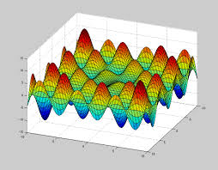
Can We Always Efficiently Solve These Problems?
Efficiency = computational (i.e., can we solve in polynomial time?)
Answer: highly depends on the f functions
When f is highly non-convex/non-linear, even with the full knowledge of f in advance, we cannot solve the problem efficiently (i.e., cannot find the global optimum in polynomial time)

Slide 10
Hopeful Cases
Discrete models:
Small number of arms (trivial - not interesting)
Arms with structures (e.g., combinatorial)
Continuous models:
Linear reward function
Convex
Non-convex unimodal
Non-convex + smoothness conditions (stochastic only)

Slide 11
Combinatorial Bandits
X: action space – subset of binary vectors:
Each arm:
Adversary chooses at the beginning of each time step t (before we choose)
Our reward:
Regret:
Goal: put an efficient bound on the expectation of the regret

Slide 12
Combinatorial Bandits
X: action space – subset of binary vectors:
Each arm:
Adversary chooses at the beginning of each time step t (before we choose)
Our reward:
Regret:
Goal: put an efficient bound on the expectation of the regret
Semi-bandit feedback : modification on feedback - we can see not only f_t(x_t), but all the v_(t,i)*x(t,i) values as well (i.e., each entry of the dot product)

Slide 13
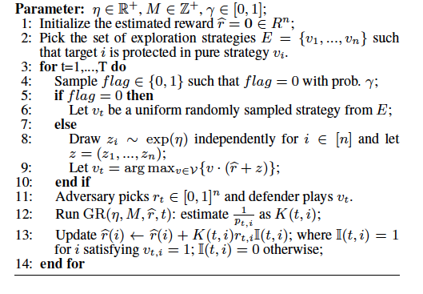
Combinatorial Bandits - Algorithms
Idea: use FPL as a basis
Extra epsilon-greedy style exploration
Extra part: geometric re-sampling

Slide 14
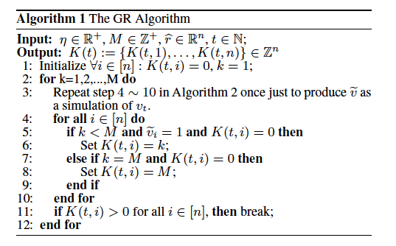
Combinatorial Bandits – Algorithms (cont’d)
Further readings:
Neu & Bartok (2015): http://cs.bme.hu/~gergo/files/NB16.pdf
Xu et al. (2016): https://eprints.soton.ac.uk/387256/1/main.pdf

Slide 15
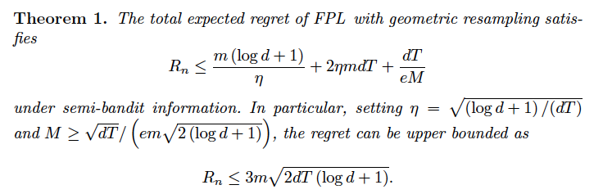
Combinatorial Bandits – Regret Analysis

Slide 16
Special Case: Stochastic Combinatorial Bandits
Stochastic version of the combinatorial bandit
V_{t,i} ~ D_{i} iid

Slide 17
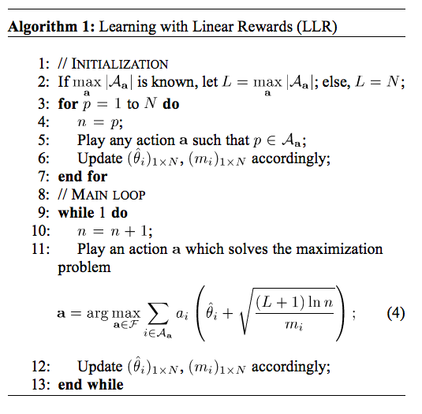
Special Case: Stochastic Combinatorial Bandits
Stochastic version of the combinatorial bandit
V_{t,i} ~ D_{i} iid
Idea: use a combinatorial version of UCB

Slide 18
Special Case: Stochastic Combinatorial Bandits (cont’d)
Theorem: the expected regret of LLR is at most O(N^4 lnT)
Further reading: Gai et al. (2012). Combinatorial Network Optimization With Unknown Variables: Multi-Armed Bandits With Linear Rewards and Individual Observations.
Link: http://anrg.usc.edu/www/papers/TON-Jan2012.pdf

Slide 19
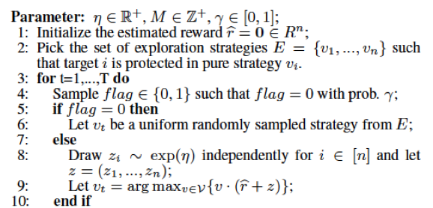
Combinatorial Optimisation with Full Information
Similar to the combinatorial bandit model, but now we see all the v_k values, not just those which have x_{t,k} = 1 (semi-bandit), or only the sum (bandit feedback)
Many good algorithms, but the main idea is to take a good bandit algorithm, and then just update all the reward estimate of ALL the arms /actions.
For example: we don’t need the GR part in FPL
Update every r at each t

Slide 20
Linear Bandits
X: action space – subset of real-number vectors:
Each arm:
Adversary chooses at the beginning of each time step t (before we choose)
Our reward:
Regret:
Goal: put an efficient bound on the expectation of the regret

Slide 21
Linear Bandits – Algorithms
Idea: if X is a finite set of real-numbered vectors -> use Exp3 style algorithms
Pseudo reward:
Probability of pulling x:
Uniform distribution over the (combinatorial) vector space
Exploitation
Exploration

Slide 22
Linear Bandits – Algorithms
Bounded-loss assumption: for any t and action x:
Theorem: expected regret is at most
What if X is continuous?
Idea: discretise the space of X -> use the previous version of Exp3
Extra regret from fineness of discretisation level:
Can we avoid discretisation?

Slide 23
Online Convex Optimisation
X: action space – convex subset of real-numbered vectors:
Each arm:
Adversary chooses convex function at the beginning of each time step t (before we choose)
Our reward:
Regret:
Goal: put an efficient bound on the expectation of the regret

Slide 24
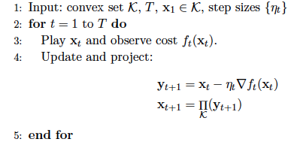
Full Information Feedback – Algorithm
Full information feedback: we see the whole function f_{t} at the end of each t
Online gradient descent algorithm (Zinkevich, 2001)
Projection step: keeps x_(t+1) within the action space X
Note that we choose x_{t+1} solely based on f_t (so we only use the previous function to choose the next action (!!)

Slide 25
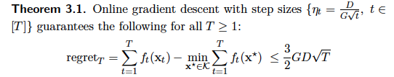
Full Information Feedback – Regret Analysis
D: diameter of X (the largest distance between 2 points in X)
G: upper bound on the norm of any gradients in f_t
Further reading: Elad Hazan (2015). Introduction to Online Convex Optimization
Link: http://ocobook.cs.princeton.edu/OCObook.pdf

Slide 26
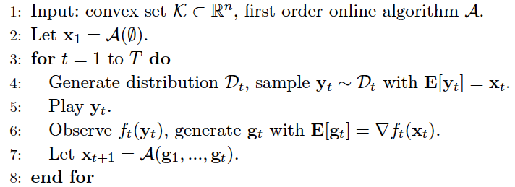
Bandit Feedback – Algorithms
Bandit feedback: we only see the value of f_t(x_t) at the end of each t (i.e., the value of chosen point)
E.g., OGD from Zinkevich
Idea: reduce this problem back to full information case
How?

Slide 27
Bandit Feedback – Algorithms
Bandit feedback: we only see the value of f_t(x_t) at the end of each t (i.e., the value of chosen point)
E.g., OGD from Zinkevich
Idea: reduce this problem back to full information case
How?
Answer: remember finite differences from policy gradient?

