Slide 1
Project report: Blog Application
Group 2:
Pham Quang Huy
Pham Minh Tu
Doan Sy Hung
Thandar Shwe Sin
Aye Myat Thu

Slide 2
Outline
Overview
Software Implementation
Testing and Document
Teamwork
Final result - Live Demo

Slide 3
Overview
People are using blogs to share their ideas and knowledge to the world
With that view, we want to create a platform where people can communicate and exchange their ideas

Slide 4
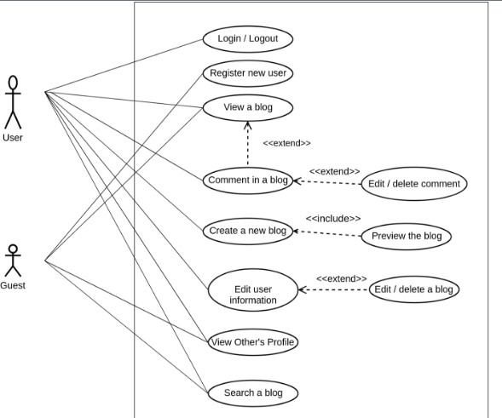
Overview
Basic functions

Slide 5


3. Implementation
Technologies:
Web:
Bootstrap
Angular 4

Slide 6


3. Implementation
Technologies:
Mobile:

Slide 7



3. Implementation
Technologies:
Server:

Slide 8
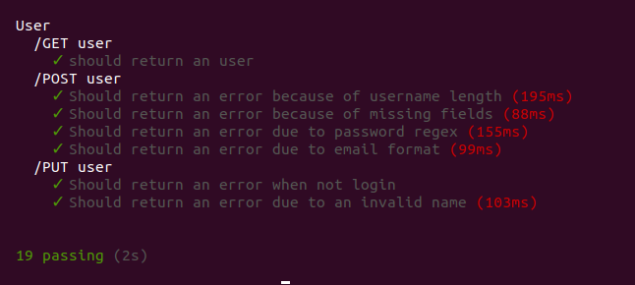
3. Testing
API test using Mocha, Chai
.

Slide 9

4. Teamwork
Communication
Facebook Messenger, Skype
Version control
Git, GitHub

Slide 10
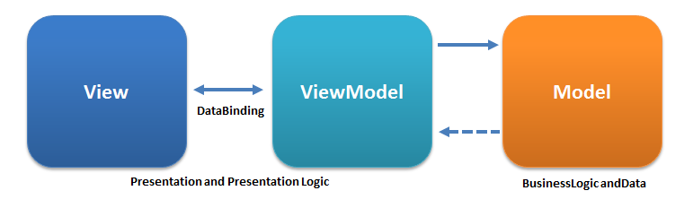
Design pattern - client side
MVVM
html
Component class
Service class

Slide 11
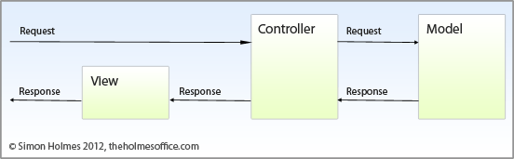
Design pattern - server side

Slide 12
Live Demo

