Slide 1


FPT Aptech Ha Noi
TechWiz 3
Web Application Developmentg
Students perform : Group Tripple Dot
Hà Nội , Ngày 12 Tháng 8 Năm 2022.

Slide 2

Member
Dao Quang Linh (Leader)
Dao Dinh Luyen
Le Xuan Bac
Nguyen Hoang Son
Lam Van Duc
Bui Van Trung
FPT Aptech Ha Noi : Team Tripple Dot

Slide 3
Content :
Overview of the group's topics and products
Technology used
Product Design
FPT Aptech Ha Noi : Team Tripple Dot

Slide 4
Overview of the group's topics and products
Next steps
FPT Aptech Ha Noi : Team Tripple Dot

Slide 5
Why do you need this Web App?
Overview of the group's topics and products
Health is one of the most important factors in modern times today and should be our top priority. With the increase of disease and the large number of urban populations, the placing scheduling or going to the doctor becomes difficult.
There may be a situation where a person wants to check his blood pressure, Scales heavy, etc., and for this purpose they ask to continue to the clinic. Sometimes, even after making an appointment, a person has can forget this or can go to the hospital / doctor's clinic Doctor and doctor are not available.
What individuals seek is an easy means to help them track and monitor their health. They will be able to set reminders for doctor appointments, create dosage schedules daily medication and monitor weight, blood pressure and sugar levels theirs, etc.
FPT Aptech Ha Noi : Team Tripple Dot

Slide 6

Proposed solutions
Overview of the group's topics and products
There needs to be a web app called PersonalHealthAssistant to help people manage their health better health.The app will allow users to register and then, view appointments, receive reminders about their appointment, keep regular records of their health such as Blood Pressure (BP), Glucose, etc medication dosing schedule and more.
FPT Aptech Ha Noi : Team Tripple Dot

Slide 7
Project size
Overview of the group's topics and products
This application will be used by individuals who want to monitor their health their. They can set up reminders for doctor appointments, create calendars Daily medication dosing schedule, monitoring weight, blood pressure and levels blood sugar, etc.
FPT Aptech Ha Noi : Team Tripple Dot

Slide 8
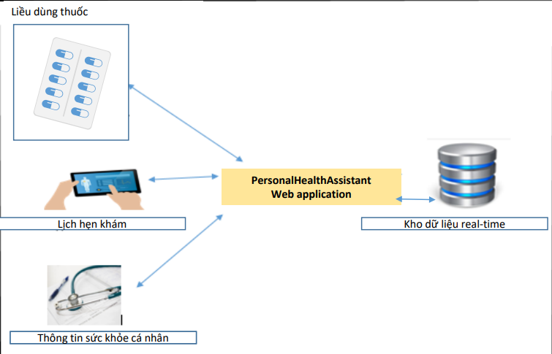
Drug dosage
Appointment schedule
Real-time data warehouse
Personal Health Information
FPT Aptech Ha Noi : Team Tripple Dot

Slide 9
Functional requirements
Application functions for users
Home Page: Includes an interface to introduce medical equipment products and services, menu for many functions various functions, including basic functions like Register or Login. After logging in, users will be able to use more menus
Register: Allow users to sign up for PersonalHealthAssistant web app. User is anyone who wants to use this app page. The information Registration requires email ID, full name, address, gender, etc. User has You can set a username and choose a password.
Login : Allow registered users to log in to the app PersonalHealthAssistant and use many of the app's functions. After When the user logs in, the username will be in the upper right corner of the screen Figure.
Settings: Users can manage their accounts by options such as Create, Update or Delete an account. The account will store the information on medical history, medical conditions the user has had, allergies or other medical conditions other information. The User ID issued at the time of registration will never adjustable.
FPT Aptech Ha Noi : Team Tripple Dot

Slide 10
Appointments: Users will be able to do the following: Add/Modify/Delete/View Appointments
Personal Health Vitals : This menu will have 3 options and the user can do 3 operations: Add/Modify/Delete/View Health Vitals
Medicine Dosage: This menu will have 3 options and the user can do 3 operations: Add/Modify/Delete Dosage
Search: Users can search by appointment, health information, dosage drugs, etc. Search function must first accept items (Category) for search and then enter keywords
Sort: The Sort function allows users to sort appointments by date, or health information by date, etc.
FPT Aptech Ha Noi : Team Tripple Dot

Slide 11
Technology used
Next steps
FPT Aptech Ha Noi : Team Tripple Dot

Slide 12












Cơ sở lí thuyết
FPT Aptech Ha Noi : Team Tripple Dot

Slide 13
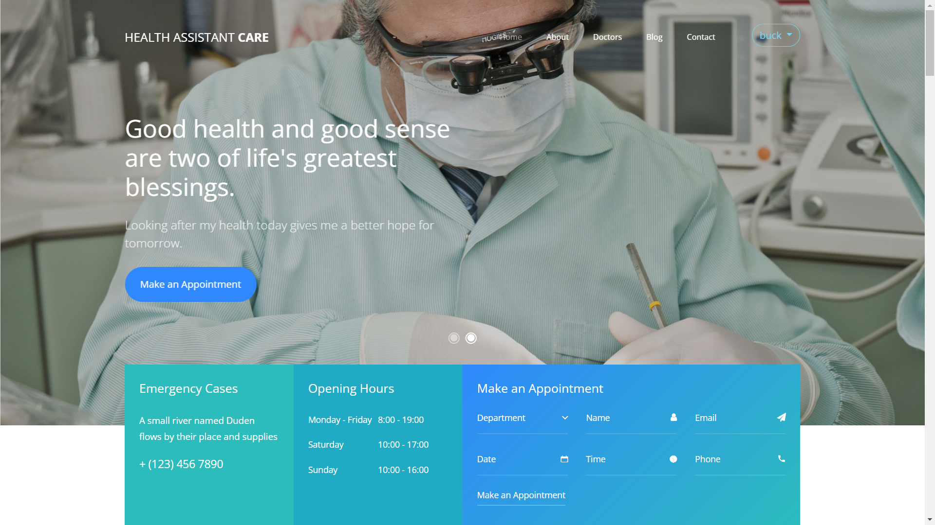
Main Page

Slide 14
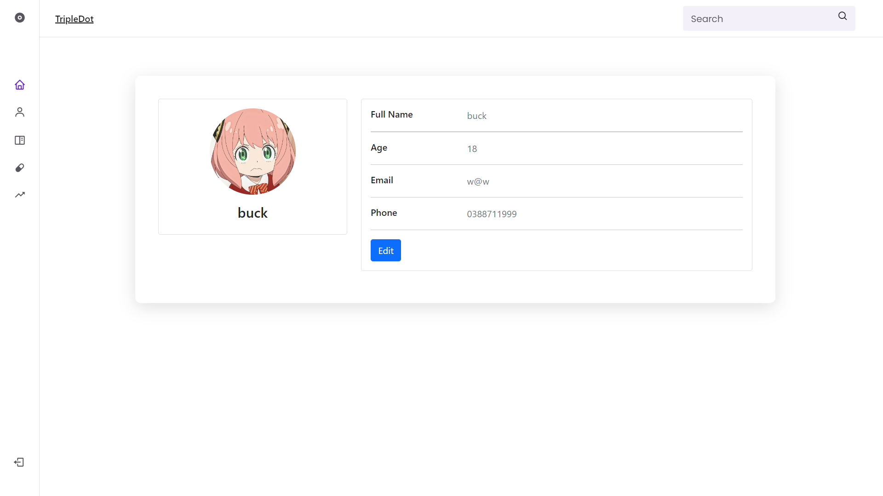
Interface to the user

Slide 15
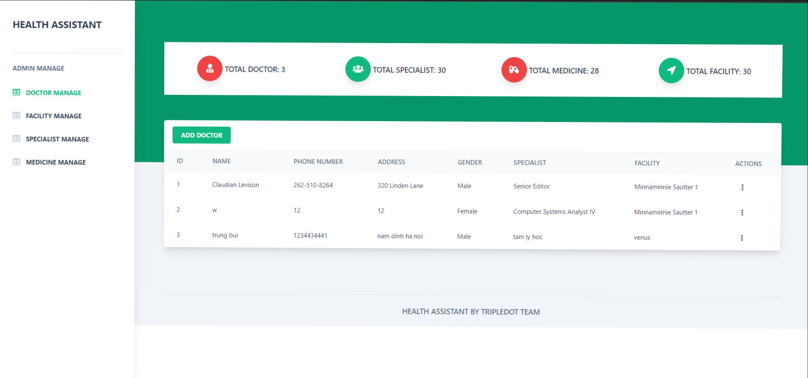
Interface Admin

Slide 16
FPT Aptech Ha Noi
https://github.com/quanglinhh/TechWiz-Project.git
Hà Nội , Ngày 12 Tháng 8 Năm 2022.

