Slide 1
UDP Protocol Specification
University of Calgary – CPSC 441

Slide 2
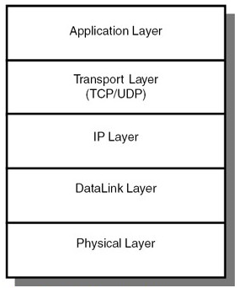
What is UDP?
UDP stands for User Datagram Protocol.
A protocol for the Transport Layer in the protocol Stack.
Alternative to the Transmission Control
Protocol (TCP) and, together with IP,
is also referred to as UDP/IP
Programs on networked computers
can send short messages sometimes
known as datagram (using
datagram sockets) to one another.

Slide 3
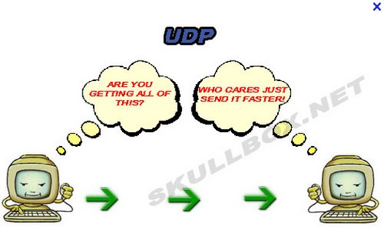
Features of UDP
UDP is a minimal transport layer protocol.
Unreliable and connection-less:
UDP provides no guarantees to the upper layer protocol for message delivery
The UDP protocol retains no state of UDP messages once sent
Messages may be delivered out of order.
Provide integrity verification
(via checksum) of the header
and payload.
UDP provides application
multiplexing (via port numbers)

Slide 4
Encapsulation
From: http://medusa.sdsu.edu/network/CS576/Lectures/ch11_UDP.pdf

Slide 5
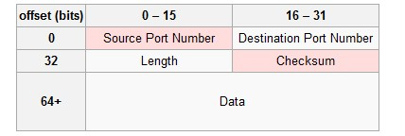
UDP Header (1/3)
The UDP header consists of 4 fields, each of which is 2 bytes.
The use of two of those is optional in IPv4 (pink background in table). In IPv6 only the source port is optional.
Source port number
Identifies the sender's port , should be assumed to be the port to reply to if needed.
If not used, then it should be zero.

Slide 6
UDP Header (2/3)
Destination port number
Identifies the receiver's port and is required
Length
Specifies the length in bytes; considers the entire datagram: header and data
The minimum length is 8 bytes = the length of the header.
The field size sets a theoretical limit of 65,535 bytes (8 byte header + 65,527 bytes of data) for a UDP datagram

Slide 7
UDP Header (3/3)
Checksum
The checksum field is used for error-checking of the header and data. This field is mandatory for IPv6.
If no checksum is generated by the transmitter, the field should be set to all-zeros.
UDP uses pseudo header to define the checksum. It is calculated over the combination of pseudo header and UDP message.
The pseudo header contains: the IP Source Address field, the IP Destination Address field, the IP Protocol field and the UDP Length field.

Slide 8
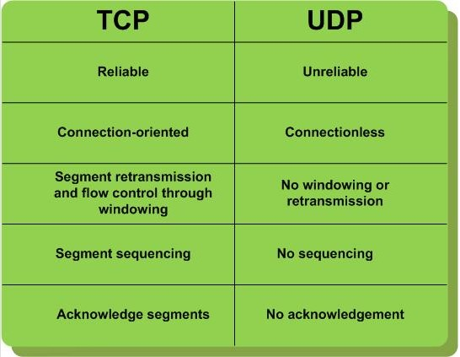
TCP vs. UDP

Slide 9
Why still use UDP?
UDP’s advantages over TCP:
UDP’s header is much smaller than TCP’s. The header is being applied to every segments, and adds up!
Generating a UDP header has much simpler processing steps.
UDP has no connection setup overhead, while TCP requires a 3-way handshake.
UDP is widely used and recommended for cases where:
Speed Is more important than reliability. An application values timely delivery over reliable delivery
Data exchanges are short and the order of reception of datagram does not matter
A best-effort for delivery is enough
Applications require multicast or broadcast transmissions, not supported by TCP.

Slide 10
Popular Applications Using UDP
Domain Name System (DNS)
Simple network management protocol (SNMP)
Dynamic Host Configuration Protocol (DHCP)
Routing Information Protocol (RIP)
Many Multimedia applications like streaming video, VOIP
“Real-time video and audio streaming protocols are designed to handle occasional lost packets, so only slight degradation in quality occurs, rather than large delays if lost packets were retransmitted.” [Wikipedia]

Slide 11
Checksum
“Checksum is the 16-bit one's complement of the one's complement sum of a pseudo header of information from the IP header, the UDP header, and the data, padded with zero octets at the end (if necessary) to make a multiple of two octets.” [RFC 768]
Checksum is calculated for UDP header and data
IP header also has a checksum, but it doesn’t cover data.
UDP checksum test is performed only at the sender and receiver end stations
The IP checksum test is performed in every intermediate node (router).
UDP check sum is performed over a pseudo header.
In addition to UDP header and data + the source and the destination IP address
This prevent misrouting: in case the destination IP address in IP header was corrupted, and it was not discovered by the IP checksum test, the UDP datagram would arrive to the wrong IP address. UDP can detect this and silently drop the datagram.

Slide 12
Pseudo Header
From: http://medusa.sdsu.edu/network/CS576/Lectures/ch11_UDP.pdf

Slide 13
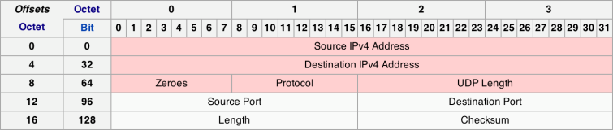
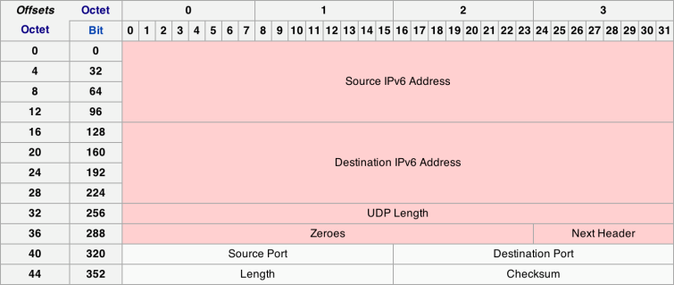
Pseudo Header (IPv4 vs. IPv6)

Slide 14
Sample Checksum Calculation
“Checksum is the 16-bit one's complement of the one's complement sum of a pseudo header of information from the IP header, the UDP header, and the data, padded with zero octets at the end (if necessary) to make a multiple of two octets.” [RFC 768]
Sample from: http://medusa.sdsu.edu/network/CS576/Lectures/ch11_UDP.pdf

Slide 15
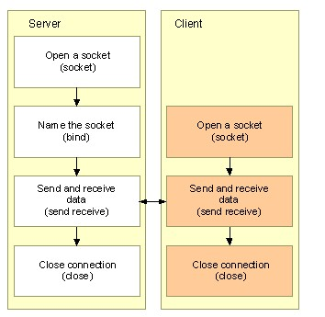
Socket Programming with UDP
A UDP server does not have to listen for and accept client connections
A UDP client does not have to connect to a server.

Slide 16
UDP Server and Client Sockets
Server:
Open a datagram socket with socket()
Name the socket with the bind() function, using a SOCKADDR structure for the address parameter
Exchange data with a client using the sendto() and recvfrom() functions
Close the connection with the closesocket() function
Client:
Open a datagram socket with socket()
Exchange data with server using sendto() and recvfrom()
Close the connection with the closesocket() function

Slide 17
Socket and Bind Functions
int socketid = socket(domain, type, protocl);
socketid: socket descriptor, an integer (like a file-handle)
domain: integer, communication domain
e.g., PF_INET (IPv4 protocol)
type: should be set to SOCK_DGRAM for UDP
protocol: for UDP over IP, should be set to IPPROTO_UDP or just 0
int status = bind(socketid, &addrport, size);
status: error status, -1 if bind failed, zero if successful
sockid: integer, socket descriptor
addrport: struct sockaddr, the (IP) address and port of the machine
size: the size (in bytes) of the addrport structure

Slide 18
Sending and Receiving Data
int sendto(int sockid, const void *sendbuf, int sendlen, int flags, const struct sockaddr *to, int tolen);
sockid: integer, socket descriptor
sendbuf: Buffer containing the data to be transmitted.
sendlen: Size in bytes of the data in the buf buffer.
flags: Indicator specifying the way in which the call is made.
to: struct sockaddr, the address of the target
tolen: the size (in bytes) of the addrport structure
int recvfrom(int sockid, const void *recvbuf, int recvlen, int flags, const struct sockaddr *from, int fromlen);
sockid and flags are same as above
recvbuf and recvlen: Buffer containing the received data and its size
from and fromlen: the address of the source and its size
Return value: If no error occurs, these function returns the total number of bytes sent/recieved, if an error occurs, SOCKET_ERROR (-1) is returned.

Slide 19
Sample Code
Word server and client
SimpleChat

Slide 20
References
http://en.wikipedia.org/wiki/User_Datagram_Protocol
http://www.beej.us/guide/bgnet/output/html/singlepage/bgnet.html
http://medusa.sdsu.edu/network/CS576/Lectures/ch11_UDP.pdf
http://ipv6.com/articles/general/User-Datagram-Protocol.htm
http://msdn.microsoft.com/en-us/library/ms881658.aspx
http://www.youtube.com/watch?v=KSJu5FqwEMM

