Slide 1
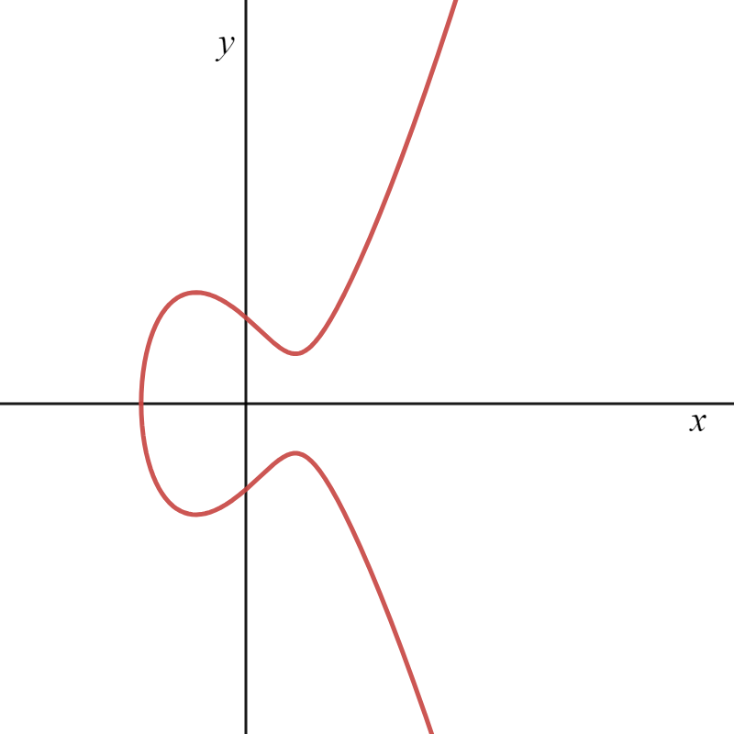

EC addition law
y² = x³ - 3x + 3
P + Q = R
R’
Q
P
R
Created by Hieu T. Nguyen
using Demos & PowerPoint

Slide 2
EC addition law
y² = x³ - 3x + 3
P + Q = R
R
R’
P, Q
(P ≡ Q)
Created by Hieu T. Nguyen
using Demos & PowerPoint

Slide 3
EC addition law
y² = x³ - 3x + 3
P + Q = R
R ≡ O
Q
P
Created by Hieu T. Nguyen
using Demos & PowerPoint

