Slide 1
How did sociology begin?
Sociology emerged in the middle of the nineteen century in Europe
Three factors led to the development of sociology
1.Industrial Revolution
2.Travel
3.Success of Natural Sciences

Slide 2
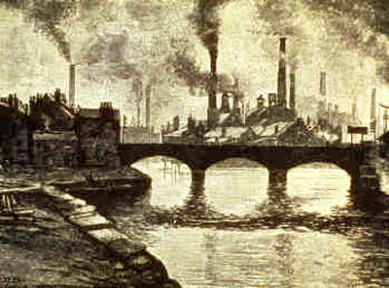
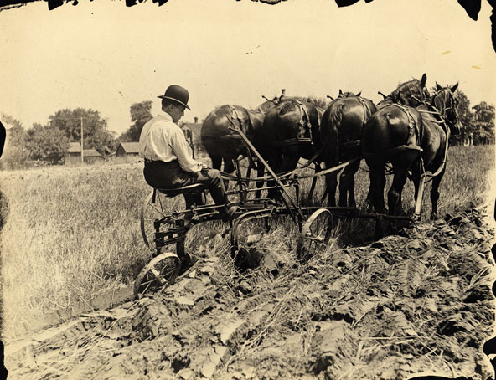
Industrial Revolution
Europe was changing from agriculture to factory production
Masses of people moved to the cities in search of work
In cities people met anonymity, crowding, filth, and poverty
Industrial Revolution challenged the traditional order an opened the door for democratic changes
Social changes undermined the traditional explanations of human existence

Slide 3


Travel
The Europeans had been successful in obtaining colonies
Their colonial empires exposed them to radically different cultures
Startled by these contrasting ways of life, they began to ask questions why cultures differed

Slide 4
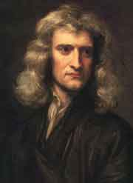
Success in natural sciences
Newton’s laws explained the movement of everything visible in the universe (from planets to buildings)
It seemed logical to discover the laws underlying social phenomena

Slide 5
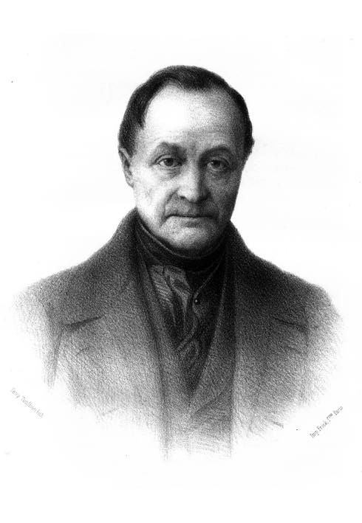
The Father of Sociology
Auguste Comte (1798-1857)
The new social science that Comte sought to establish was first called social physics but he coined the word sociology, a hybrid term compounded of Latin and Greek parts
Comte first used the term sociology in print in 1838

Slide 6

August Comte
Comte hoped that sociologists would use scientific methods to gain knowledge of the social world
Then they would advise people about how life ought to be lived
This would the cure from social chaos

Slide 7
Chart Important People in the History of Sociology
Complete the chart hand out as instructed

Slide 9
Founders of Sociology

Slide 10
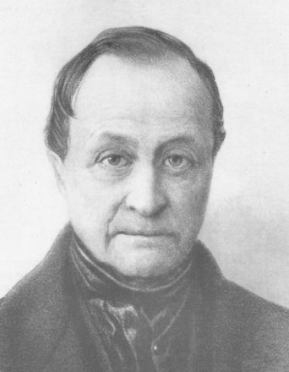
Auguste Comte
• Coined the term “sociology”
• Study social world through scientific method
• Key concepts: positivism
Theories and work has been abandoned.

Slide 11
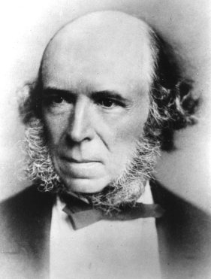
Herbert Spencer
• Structural/Functionalist
• Coined the term “survival of the fittest” in reference to human social arrangements (Social Darwinism)
• Advocated against social reform efforts to poor people because it disrupts the natural selection process of evolution\
Also discredited today.

Slide 12
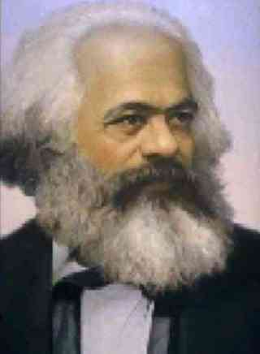
Karl Marx
• Founder of political / economic theory of socialism (communism)
• Considered the founder of the conflict perspective – Class Conflict between wealthy class and working class.
• Key concepts: proletariat, bourgeoisie, capitalists, social class,

Slide 13
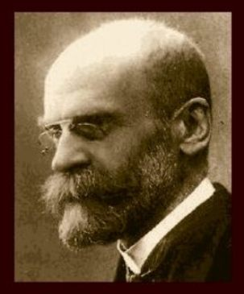
Emile Durkheim
• Founded sociology as an academic discipline
• Famous for his study on suicides (1897)
• Use of statistics in sociology
• Key concepts: social facts, social structure
• Social forces affect peoples’ lives! (Social Integration)

Slide 14
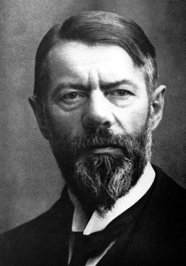
Max Weber
• Weber wanted objectivity- value free. A sociologist should keep all values and beliefs to themselves and should not affect research.
Verstehen – A German word used by Weber that means “to have insight into someone’s situation” to have been there.
Homeless example

Slide 15
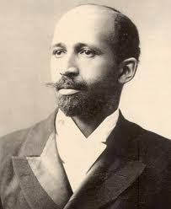
W. E. B. Dubois
• First Afro-American PhD graduate of Harvard University
• Concerned with the social position of African-Americans in US
society.
• Wrote The Philadelphia Negro (1899) on race relations
• Used statistics to examine racial discrimination against blacks

Slide 16
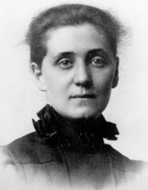
Jane Addams
• Won the first Nobel Peace Prize (1931) given to an
American sociologist
• Founded Hull House for the poor in Chicago
• Influenced the “Chicago School” of applied sociology
(social problems)
• Pioneered the study of social problems

