Slide 1
License Plate Detection Using Image Processing and Pattern Recognition Techiniques
Group 6 : La Quang Huy – Huynh Van Hanh

Slide 2
Table of contents
01.
Problem
02.
Solution
Lincense Plate Detection Problems
Upcoming Ideas and Solutions

Slide 3
01.
Problem

Slide 4
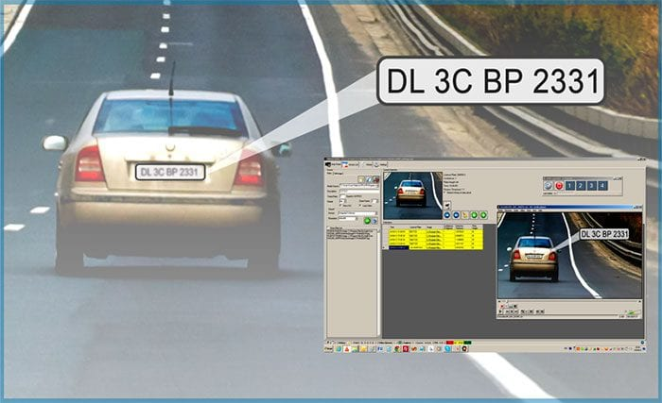
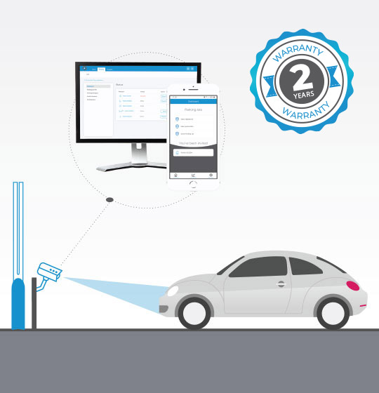
Problem
License Plate Detection or Recognization on stationary to fast-moving vehicles is one of the common intelligent video analytics applications for smart cities.
Some of the common use cases include:
parking assistance systems
automated toll booths
vehicle registration and identification for delivery and logistics at ports.
medical supply transporting warehouses.

Slide 5
Absolute Environment for Image
Requirement
Req. 1
Dynamic lighting conditions
Reduce Reflections, shadows, and blurring
Req. 2
Videos Detection
Hard to detect fast-moving vehicles
Req. 3
Obstructions
No objects block license plates
Req. 4
Weird Font
Cannot detect weird font words

Slide 6
Solution
Blur the Image
Convert to Grayscale
Find vertical edges
Threshold the vertical edged image.
Close Morph the Threshold image.
Step 1: Detect and localize a license plate in an input image/frame
Step 2: Extract the characters from the license plate
Step 3: Apply some form of Optical Character Recognition (OCR) to recognize the extracted characters

Slide 7
We’ll use OpenCV, Tesseract, and PyTesseract.
Process:
Terms: Inputs are the images, videos that get into the program
Step 1: Resize the input
Step 2: Reduce the noise by using Gaussian Blur.
Step 3: Binarize the input using OTSU’s Thresholding and find the vertical edge of input.
Step 4: Apply Closing Morphological Transformation on thresholded input.
Step 5: Find contours in the input by highlighting border of white spots/shapes.
Step 6: Find the minimum area rectangle (cv2. minAreaRect) enclosed by each of the contour and validate their side ratios and area.
Notes:
3. To reveal the plate we have to binarize the image. For this apply Otsu’s Thresholding on the vertical edge image. In other thresholding methods we have to choose a threshold value to binarize the image but Otsu’s Thresholding determines the value automatically.
4.Apply Closing Morphological Transformation on thresholded image. Closing is useful to fill small black regions between white regions in a thresholded image. It reveals the rectangular white box of license plate.
5. To detect the plate we need to find contours in the image. It is important to binarize and morph the image before finding contours so that it can find more relevant and less number of contours in the image

Slide 8
We’ll use OpenCV, Tesseract, and PyTesseract.
Process:
Terms: Inputs are the images, videos that get into the program
Step 7: Validate rectangle shape in right position: horizontal size > vertical size.
Step 8: Recognize the characters on the license plate precisely, we have to apply image segmentation.
Step 9: Apply adaptive thresholding on the plate’s value channel image to binarize it and reveal the characters.
Step 10: Cut the characters into a smaller pieces and bring each characters into a box. (Negative Trans if needed)
Step 11: Use OCR to recognize the character one by one.
Notes:
8: To recognize the characters on license plate precisely, we have to apply image segmentation. For that first step is to extract the value channel from the HSV format of the plate’s image.
9: apply adaptive thresholding on the plate’s value channel image to binarize it and reveal the characters. The image of plate can have different lightning conditions in different areas, in that case adaptive thresholding can be more suitable to binarize because it uses different threshold values for different regions based on the brightness of the pixels in the region around it.
10: Now find all the contours in the character candidate mask and extract those contour areas from the plate’s value thresholded image, you will get all the characters separately.
Can using matplot to cut the characters

Slide 9
Thank you

