Slide 1
Analysis of Michelin restaurants.
Quang Tran Ngoc.

Slide 2
Introduction:
Michelin restaurants is famous with food as well as luxurious.
There are many restaurants around the world.
Problems:
There are many fake Michelin restaurants with low quality.
To group and classify the correct Michelin restaurants.

Slide 3
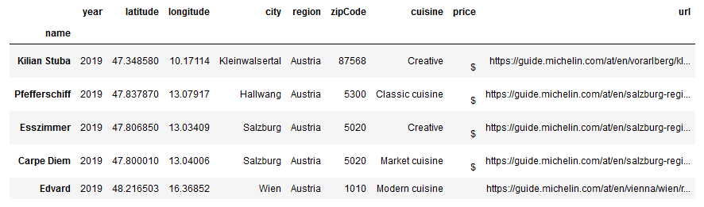
Data acquisition and cleaning.
The data of Michelin restaurant: Link1 and Link2.
Re-organize the data table.

Slide 4
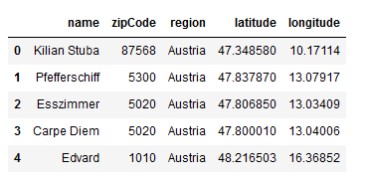
Feature selection:
Only 5 categories are used.

Slide 5
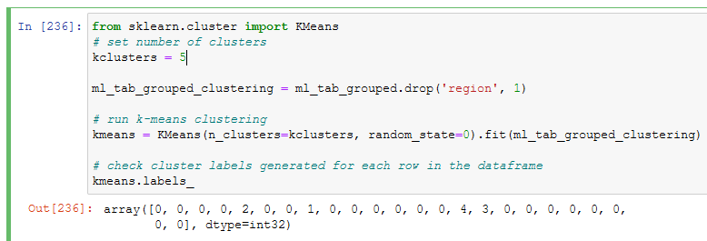
Apply K-means:
Choosing cluster is 5 for my model.

Slide 6
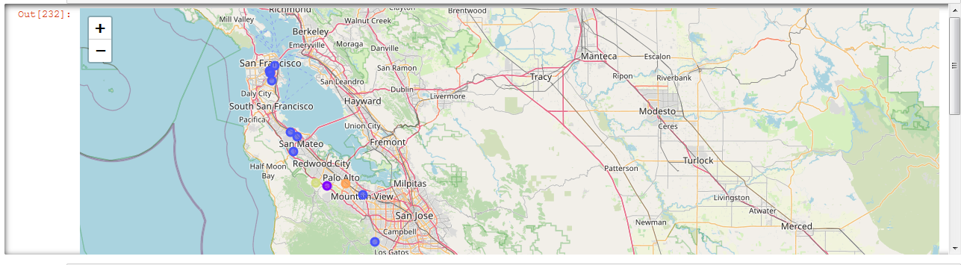
Visualization for the problem(1/2)

Slide 7
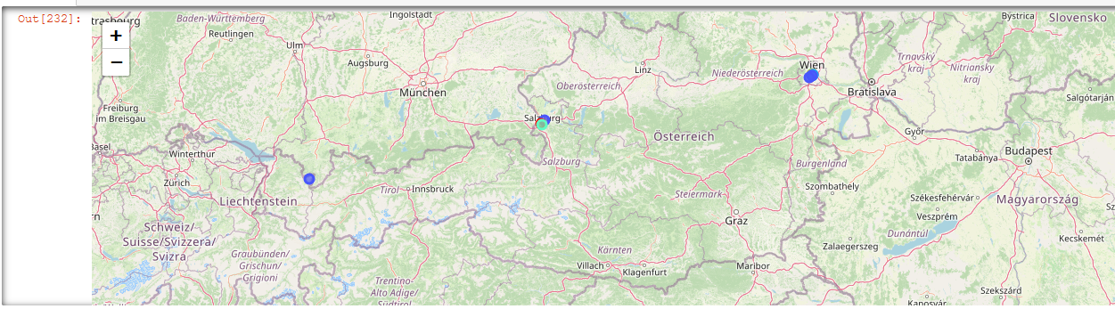
Visualization for the problem(2/2)

Slide 8
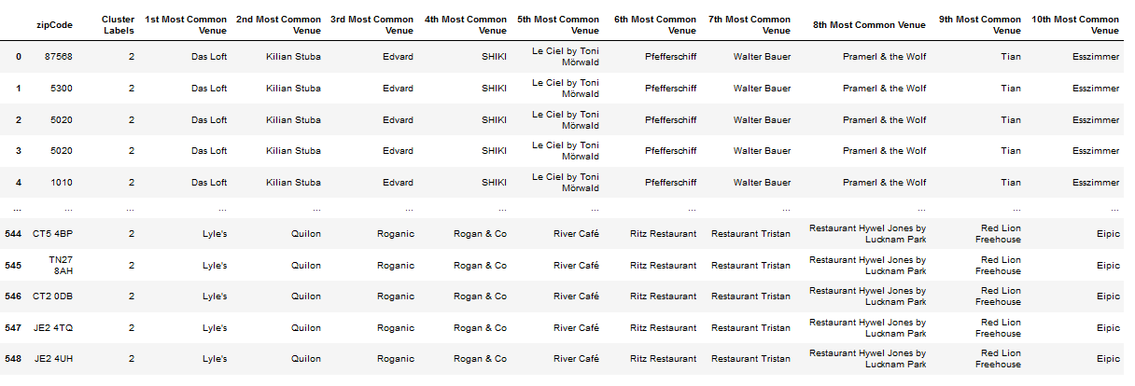
Examination
To check the evaluation, we choose random labels from 0 to 4, we can visualize the name of restaurants in the region.

Slide 9
Thanks for attention.

