Slide 1




Final Assignment: Chrome Extension
Mentor: Huỳnh Bá Thụy
Huỳnh Anh Duy, Trần Nguyễn Vinh Quang

Slide 2



Overview of Chrome Extension
Extensions are small software programs that customize the browsing experience
They are built on web technologies such as HTML, JavaScript, and CSS

Slide 3
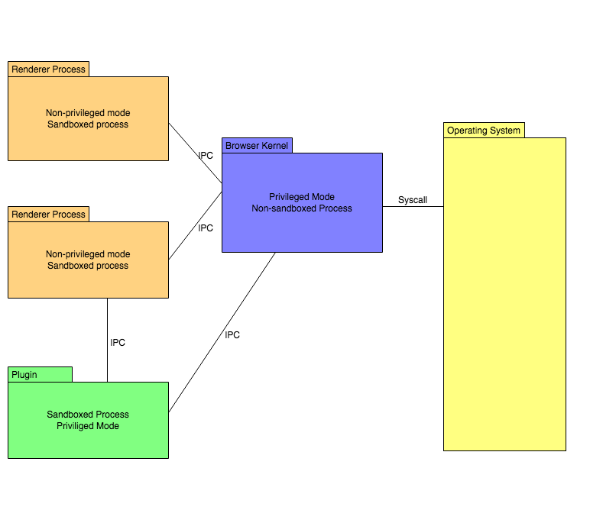
Chrome Architecture
Main Components of Chrome Browser:
Renderer Process
Browser Kernel
Plugin
Notes:
Browser Kernel is the main process that co-ordinates the Renderer processes, which basically are tab processes. So there is a single Browser Kernel process and multiple Renderer processes, each corresponding to a tab. Each of the Renderer process is “sandboxed” so that they have restricted privileges such as limited access to OS system calls, file system etc. The Renderer process proxies the web (untrusted source) and the Browser Process proxies the user.
The Renderer process is responsible for parsing the HTML-CSS, construction of DOM, V8 instance (Javascript execution) for a tab. It does not run with user privilege. This is to prevent a compromised Renderer process from accessing user’s file system. It processes the web page to bitmaps(some intermediate format) and sends it to the kernel which paints the web page to the display.
The Browser Kernel is responsible for all the privileged operations such as network, filesystem, OS system calls etc. For a tab (Renderer Process) to perform any user privileged operation such as file upload (access the file-system), it delegates the operation to the Browser Kernel through IPC (Inter process communication). The Browser Kernel caters the privileged needs and abstracts the OS for the Renderer process. Its also responsible for maintaining Persistent storage objects like cookie storage, local storage, indexedDB etc.
Plugins are not to be mistaken for chrome extensions. For example, Adobe Flash is a plugin. A pdf reader is a plugin. I have not explored the plugin architecture in chrome yet (but stay tuned). They are basically new technologies like Flash player, developed by 3rd parties which might be considered to be merged into the Browser Kernel. They being 3rd party software, run in a different process with user privileges. This is to protect the Kernel from a corrupted plugin.
Key points to remember
Browser Kernel provides API for sandboxed Renderer processes to perform privileged operation. It manages the lifecycle of renderer processes.
A Renderer process takes the HTML,CSS,JS files and prepares them for the Kernel to display them.

Slide 4
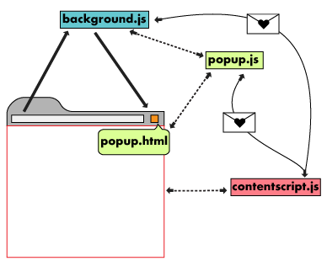
Extension Architecture
An extension’s architecture will depend on its functionality, but many robust extensions will include multiple components:
Manifest
Background Script
UI Elements
Content Script
Options Page
Notes:
The background script is the extension's event handler; it contains listeners for browser events that are important to the extension. It lies dormant until an event is fired then performs the instructed logic. An effective background script is only loaded when it is needed and unloaded when it goes idle.
UI Elements
An extension's user interface should be purposeful and minimal. The UI should customize or enhance the browsing experience without distracting from it. Most extensions have a browser action or page action, but can contain other forms of UI, such as context menus, use of the omnibox, or creation of a keyboard shortcut.
Extension UI pages, such as a popup, can contain ordinary HTML pages with JavaScript logic. Extensions can also call tabs.create or "window.open()" to display additional HTML files present in the extension.
An extension using a page action and a popup can use the declarative content API to set rules in the background script for when the popup is available to users. When the conditions are met, the background script communicates with the popup to make it’s icon clickable to users.
Content scripts
Extensions that read or write to web pages utilize a content script. The content script contains JavaScript that executes in the contexts of a page that has been loaded into the browser. Content scripts read and modify the DOM of web pages the browser visits.
Options Page
Just as extensions allow users to customize the Chrome browser, the options page enables customization of the extension. Options can be used to enable features and allow users to choose what functionality is relevant to their needs.

Slide 5

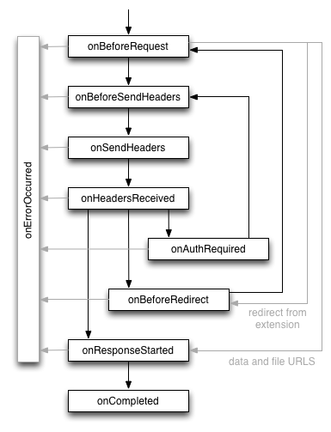

Web Request API
Notes:
The web request API defines a set of events that follow the life cycle of a web request. You can use these events to observe and analyze traffic. Certain synchronous events will allow you to intercept, block, or modify a request.
onBeforeRequest (optionally synchronous)
Fires when a request is about to occur. This event is sent before any TCP connection is made and can be used to cancel or redirect requests.
onBeforeSendHeaders (optionally synchronous)
Fires when a request is about to occur and the initial headers have been prepared. The event is intended to allow extensions to add, modify, and delete request headers (*). The onBeforeSendHeaders event is passed to all subscribers, so different subscribers may attempt to modify the request; see the Implementation details section for how this is handled. This event can be used to cancel the request.
onSendHeaders
Fires after all extensions have had a chance to modify the request headers, and presents the final (*) version. The event is triggered before the headers are sent to the network. This event is informational and handled asynchronously. It does not allow modifying or cancelling the request.
onHeadersReceived (optionally synchronous)
Fires each time that an HTTP(S) response header is received. Due to redirects and authentication requests this can happen multiple times per request. This event is intended to allow extensions to add, modify, and delete response headers, such as incoming Set-Cookie headers. The caching directives are processed before this event is triggered, so modifying headers such as Cache-Control has no influence on the browser's cache. It also allows you to cancel or redirect the request.
onAuthRequired (optionally synchronous)
Fires when a request requires authentication of the user. This event can be handled synchronously to provide authentication credentials. Note that extensions may provide invalid credentials. Take care not to enter an infinite loop by repeatedly providing invalid credentials. This can also be used to cancel the request.
onBeforeRedirect
Fires when a redirect is about to be executed. A redirection can be triggered by an HTTP response code or by an extension. This event is informational and handled asynchronously. It does not allow you to modify or cancel the request.
onResponseStarted
Fires when the first byte of the response body is received. For HTTP requests, this means that the status line and response headers are available. This event is informational and handled asynchronously. It does not allow modifying or cancelling the request.
onCompleted
Fires when a request has been processed successfully.
onErrorOccurred
Fires when a request could not be processed successfully.

Slide 6
Project assignment detail requirement
Allow user to capture HTTP/HTTPS conversation
Allow user to control when to start/stop/download output
Allow user to save output into a JSON format

Slide 7
Demo

Slide 8
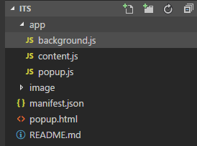
Code walkthrough

Slide 9
Test cases
System Test:
Click Start and access a website, then click save Json data.
Click Stop and access a website, then click save Json data.
Switch to another tab and do the same.

Slide 10
Conclusion
This is a good tool to capture HTTP/S requests, responses.
However, need to improve user interface, need to create test suite.

