Slide 1
Basic Project 1
Thesis name :
Using java language to build a chat application program in the socket method
Student perform : HUYNH VAN HUY – MSV : 23IT100
TRAN QUANG TUAN – MSV : 23IT300
Class : 23IT4
Instructors :Th.s TRINH THI NGOC LINH

Slide 2
Table of Contents
I
III
Theoretical basis
Demo program
II
**
System design analysis
Conclusion and development direction
VIII
X. Q&A

Slide 3
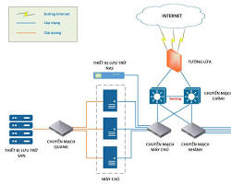
I
Theoretical basis
Brief introduction to LTM :
I.1
-Network programming is an important field in information technology and software development, focusing on establishing, managing and interacting with network connections, sending and receiving data over the network.
- Goal of network programming: Network programming aims to develop applications and services capable of communicating over the network. This includes transmitting data, establishing connections, and handling communication between computers and devices on the network.
-Network protocols: To communicate over the network, network programmers often use network protocols such as TCP/IP, UDP, HTTP, FTP, and many others. These protocols define how data is packaged, sent, and received on the network.
1980
1970
1960
1950

Slide 4
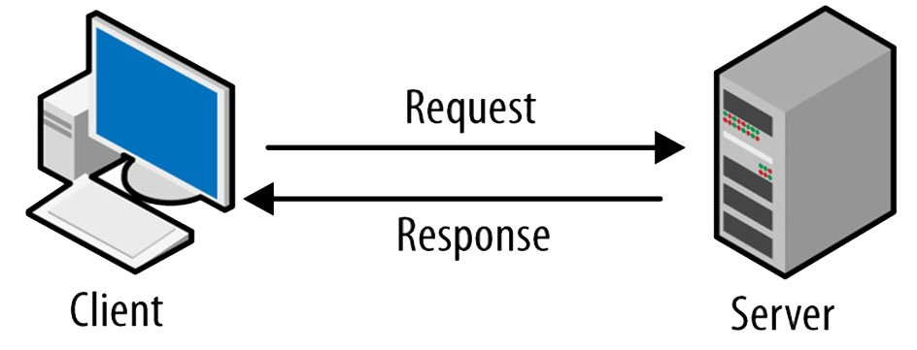
I
Theoretical basis
I.2
Introduction to the client-server model:
-Server is understood as a server, usually a large computer system with a powerful processor. capable of operating reliably, capable of storing large data, it specializes in managing resources (mainly databases), providing network services for client computers to use.
-The operating process of this model is to repeat the following two processes:
+Client sends request to server.
+The server receives the request, it will process and respond to the client.
1980
1970
1960
1950

Slide 5
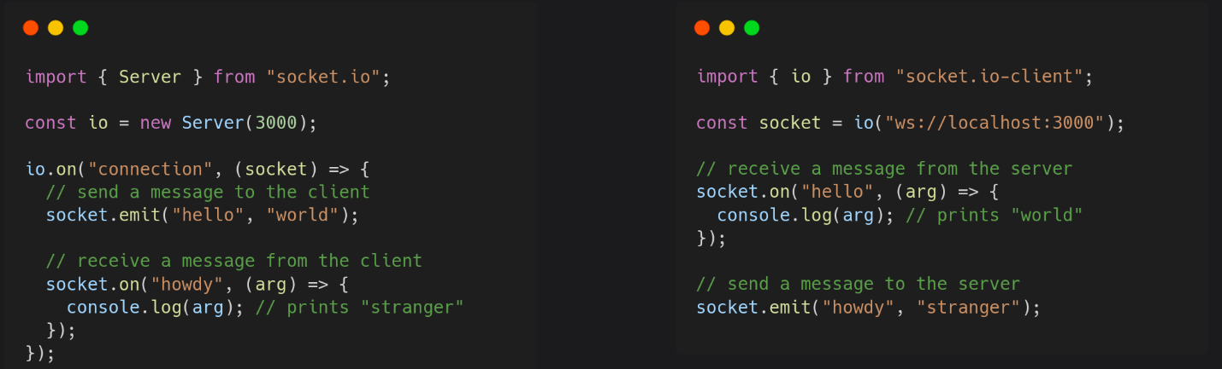
I
Theoretical basis
I.3
Socket.IO protocol :
-Socket.IO is a library and protocol used to develop real-time web applications through data transmission between the server and browser or between servers. Socket.IO provides a way to establish a WebSocket connection or use alternative methods if WebSocket is not available, like long polling.
-Socket.IO supports both server-side and browser-side, allowing you to build real-time web applications such as online games, chat applications, real-time notifications, and other applications that need to send and receive data instantly.
1980
1970
1960
1950

Slide 6


I
Theoretical basis
I.4
Overview of database management systems:
-MySQL is a popular database management system used worldwide. It supports many types of data, including structured and unstructured data, and is used in web applications, enterprise applications, and many other applications.
-HeidiSQL is a free, open source database management tool running on Windows that was launched in 2002 by Ansgar. It allows you to view and edit data and structures from computers running MariaDB, MySQL, Microsoft SQL, PostgreSQL and SQLite database systems.
1980
1970
1960
1950

Slide 7
II
System design analysis
Functional analysis:
II.1
-On the client:
+Create a username registered by the user.
+Log in to the server with the account you created.
+Get a list of nicks online on the server.
+Send a message to an account online on the server.
+Send images to another client on the server.
+Receive messages from other clients.
-On the server:
+Create a connection port ready to receive connections from clients.
+Handle login requests from clients:
_ If you do not have an account, you must request to create an account.
_ If you already have an account, you are only allowed to log in.
+Returns a list of active users for the requesting user.
+Receive messages from another user.
1980
1970
1960
1950

Slide 8
II
System design analysis
Program analysis and design:
II.2
CLIENT
SERVER
Main Form
Login Form
Server Thread
Main Form
Socket Thread
Client Thread
1980
1970
1960
1950

Slide 9
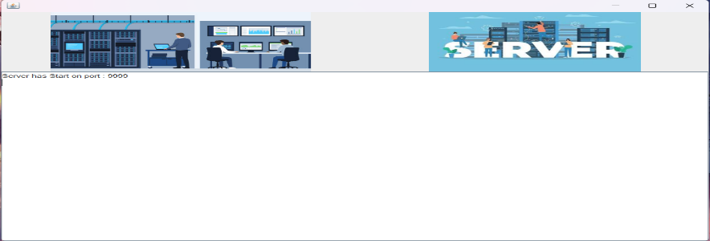
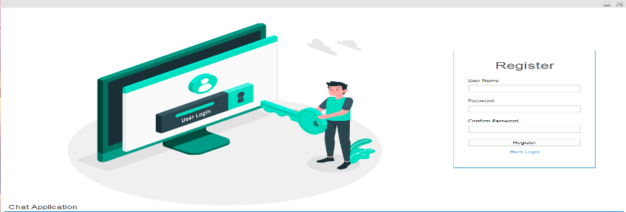
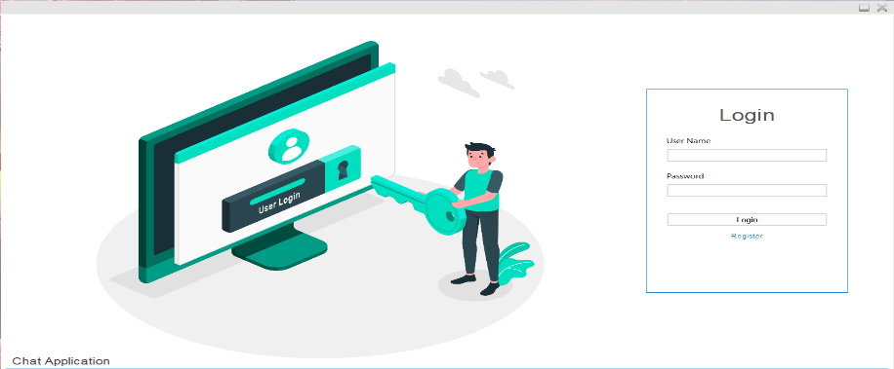
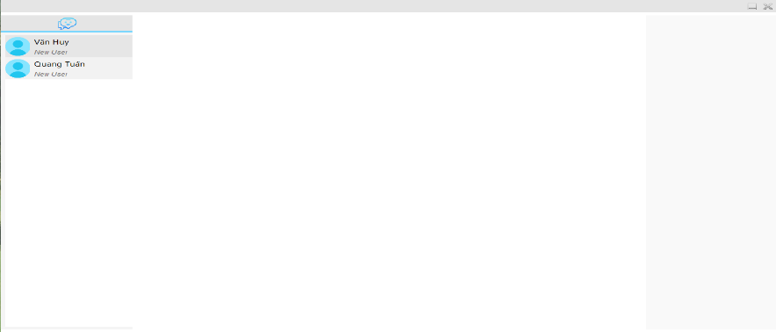
III
Demo Program
III.1
App interface :
Server interface
Registration interface
Login interface
Messaging interface
1980
1970
1960
1950

Slide 10
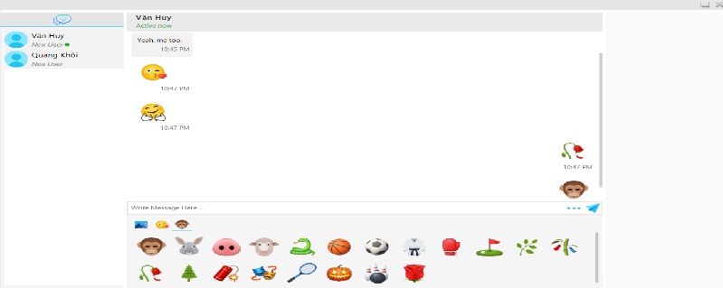
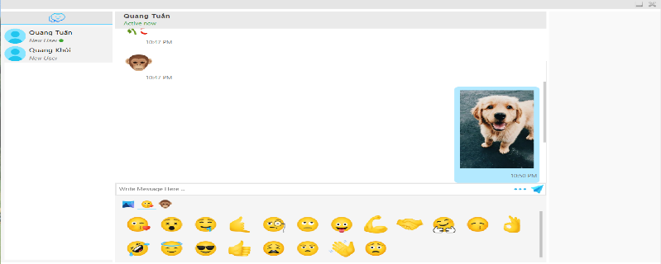
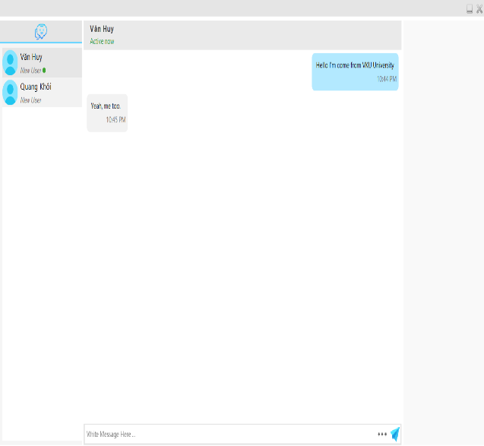
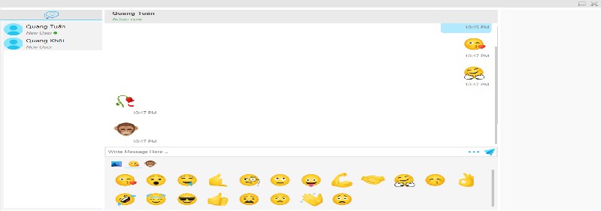
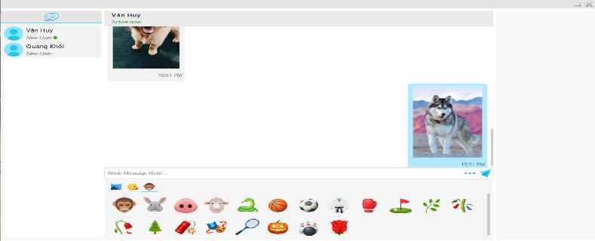
III
Demo Program
III.2
Functions of the application :
Send emotions
Send images
Chat messages
Receive emotions
Receive images
1980
1970
1960
1950

Slide 11
**
Conclusion and development direction
Conclusion
When implementing the program, we have a more intuitive view of the connection between Client through Server. Know how it works when a Client sends photos or messages via another Client.
Develop
Improved ability to send PDF and DOCX files
Add other features such as downloading photos to your device and video calling
Deploy on other platforms such as mobile and web
Ensure information security and safety for users

Slide 12
Thanks For Watching And Listening
Lê Nhật Huy makes slide

