Slide 1

Time-Lapse Video Synthesis from a Single Outdoor Image
Dao Quang Tung, Nguyen Duc Khoa
Samsung STP

Slide 2
Problem & Motivation
The Challenge
Time-lapse videos are visually appealing but difficult and costly to create
Require sophisticated hardware setup and time-consuming capture process
Goal: Synthesize time-lapse videos from a single outdoor image using deep neural networks (GAN)

Slide 3
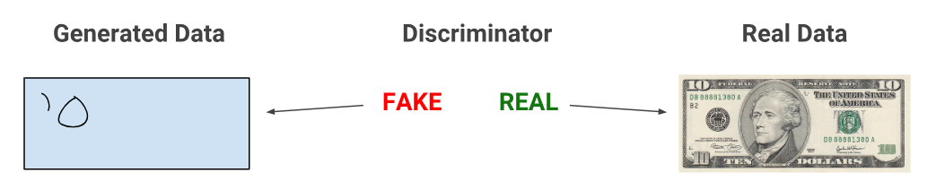
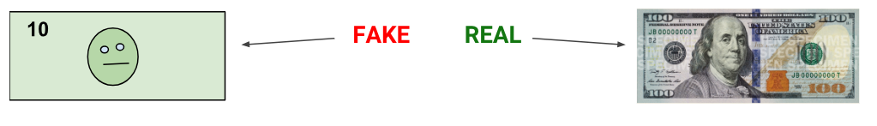
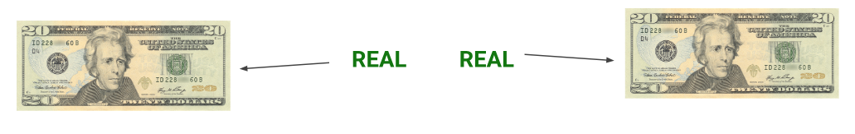
Problem & Motivation
GAN Structure
A generative adversarial network (GAN) has two parts:
The generator learns to generate plausible data
The discriminator learns to distinguish the generator's fake data from real data

Slide 4
Related work
Image & Video Stylization
Previous work: Focused on transferring an image from a source domain to a target domain (e.g., day to night, sketch to photo) while preserving the content.
Our approach: Instead of a discrete domain transfer, our method creates a continuous change in illumination.

Slide 5
Related work
Animation Still Images
Previous work: The most related method is a data-driven approach that creates time-lapses by finding a reference video in a large database to guide the color transfer.
Limitation: This requires storing an entire video database at runtime and may fail if no semantically similar reference video can be found.
Our approach: Only requires storing a compact model and needs no reference video at runtime, making our approach more robust and efficient

Slide 6
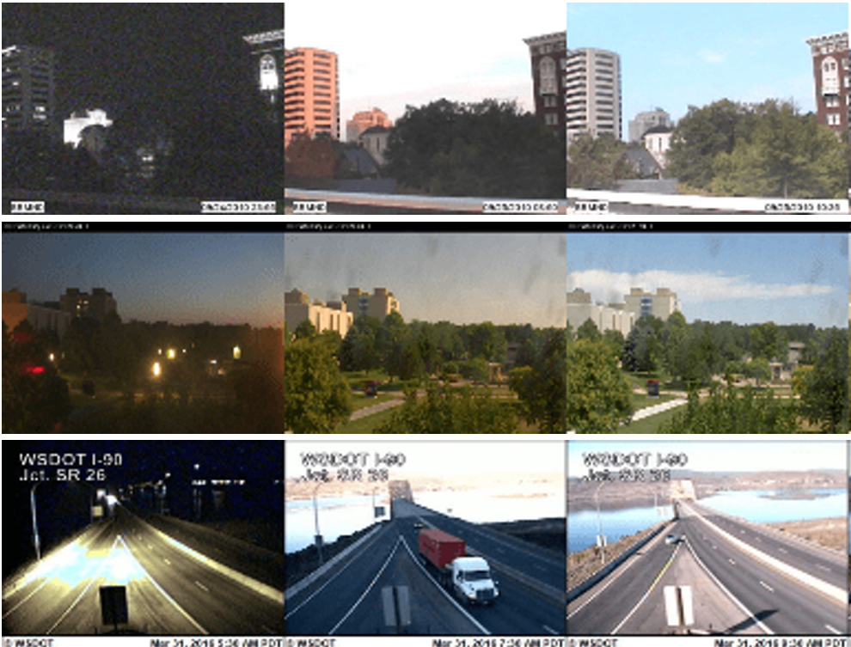
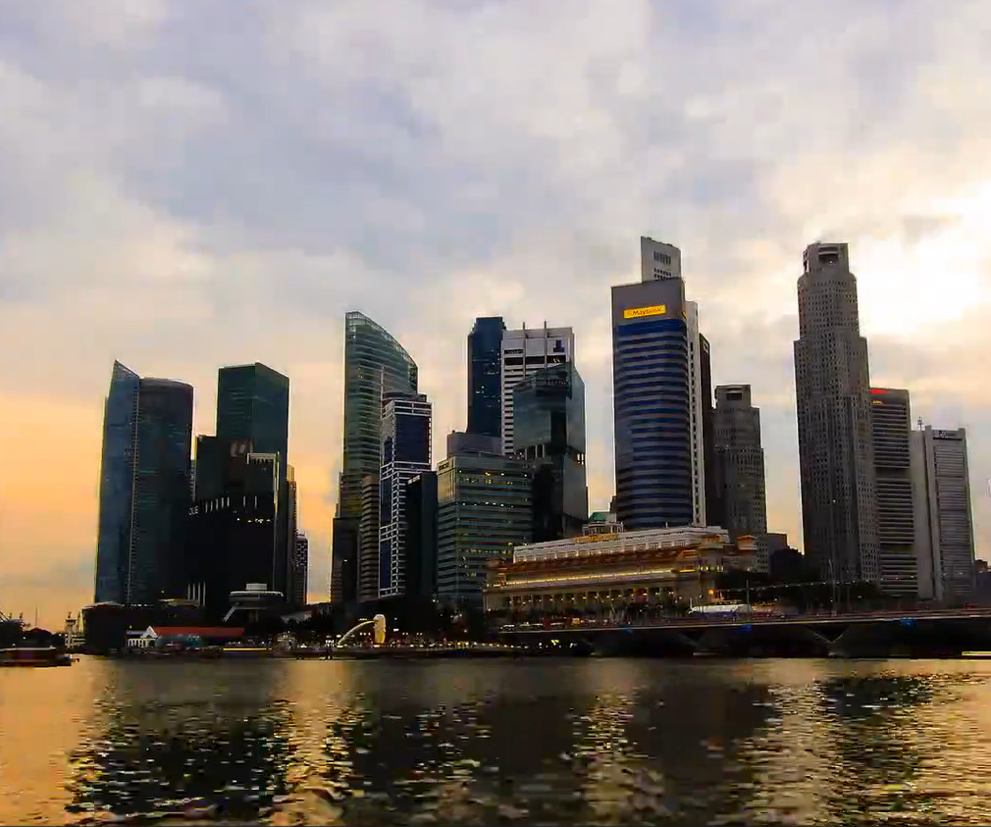
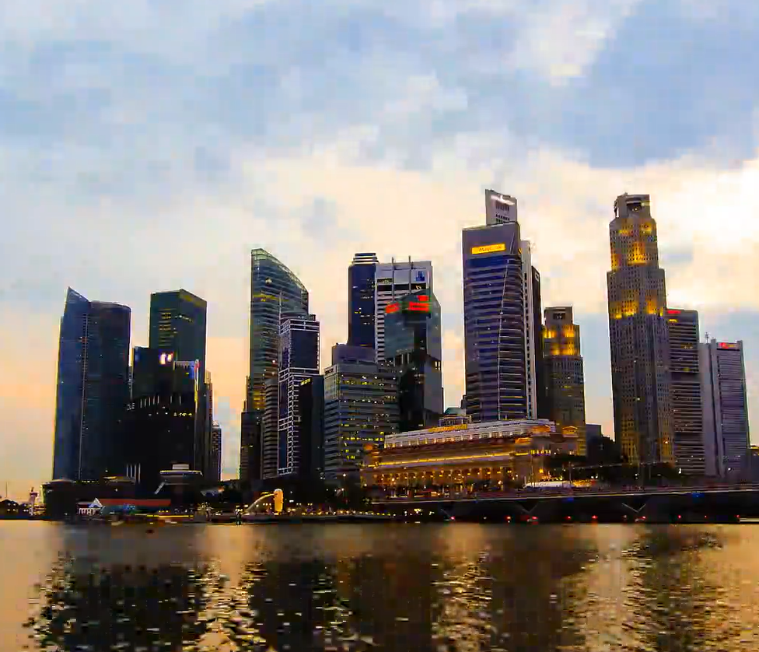
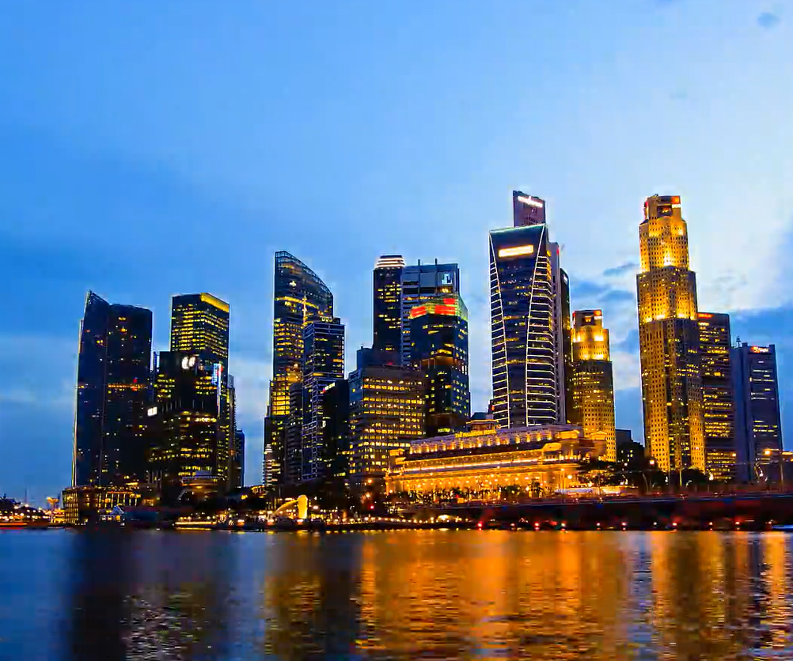
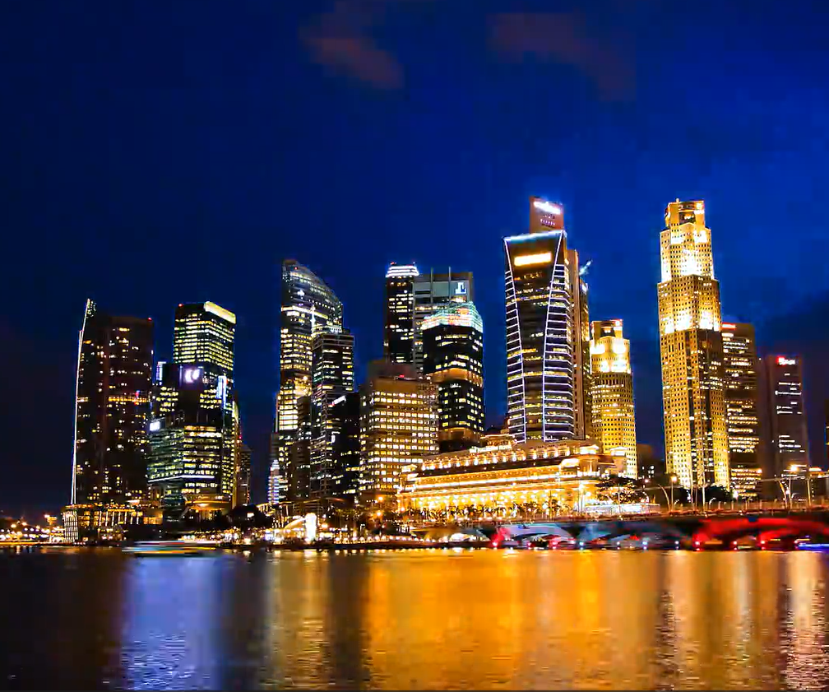
Dataset
2. TLVDB (Time-Lapse Video Database)
1. AMOS (Archive of Many Outdoor Scenes)
Image from webcam, has a timestamp label
Real time-lapse videos, do not have timestamp for each frames

Slide 7

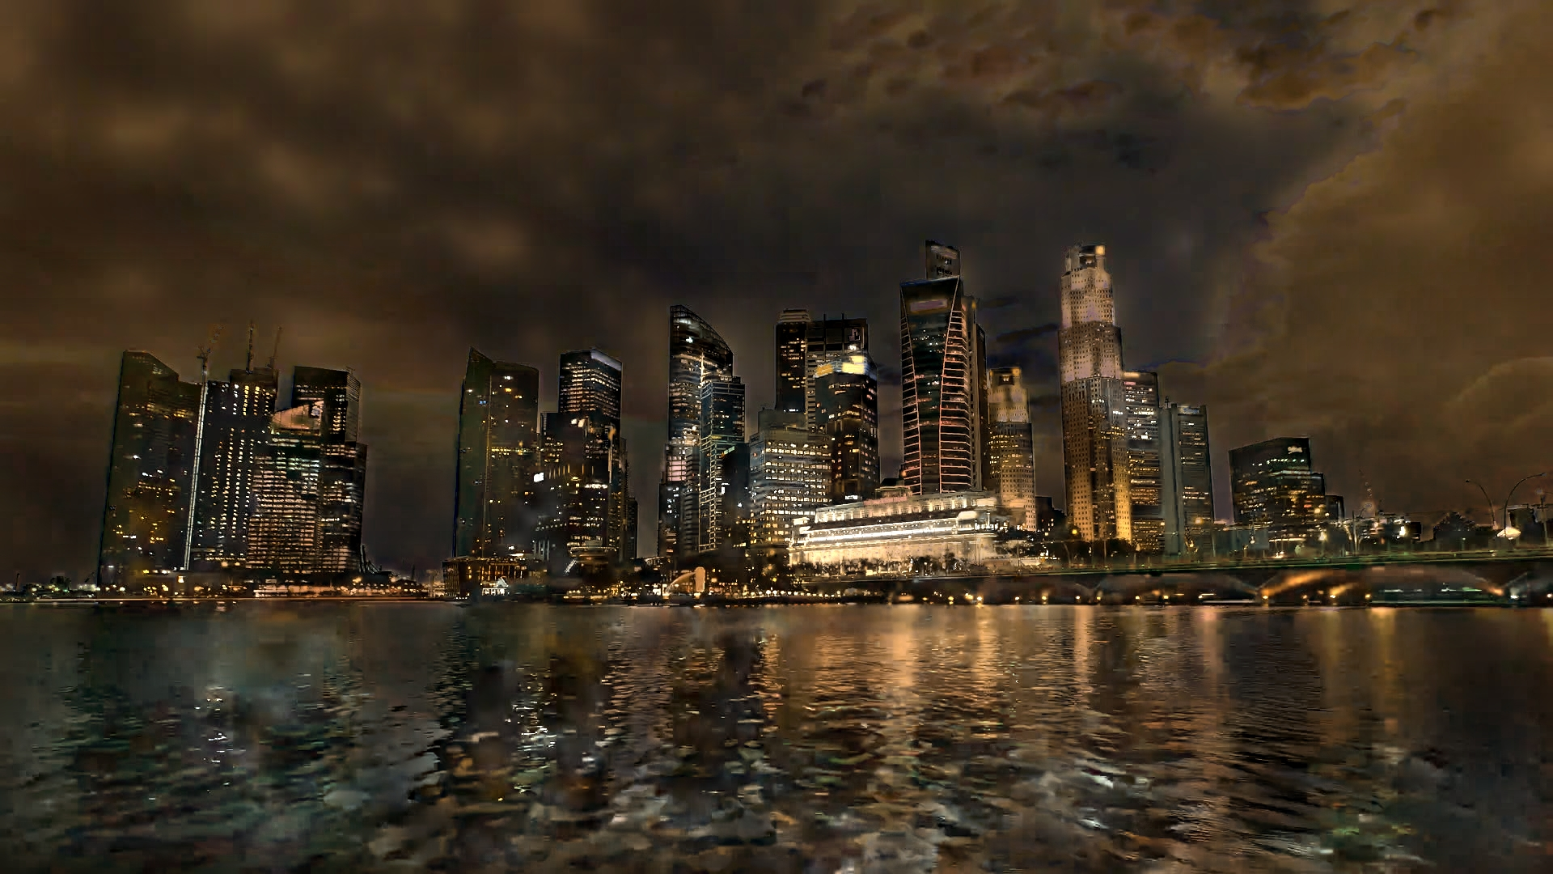
Method Overview
Conditional Image-to-Image Translation
Ît = G(I, t)
I: input image | t: timestamp | Ît: output at time t

Slide 8
Method Overview
Ĩ₀
Ĩ₁
I
G(I, t)
Aggregate
Ĩ₀
Ĩ₁
Ĩ_{n}
Video time-lapse
Ĩ_{n}

Slide 9
Method Overview
The problem of the naive approach
Problem 2: The Data Dilemma
Problem 1: Inconsistency
Training on independent frames fails to capture temporal consistency.
Domain A (AMOS): Has accurate time labels (timestamps) but low visual quality (surveillance cams, clipped colors)
The model lacks a shared "context" (like weather or season) for the entire sequence, leading to unrealistic color shifts
Domain B (TLVDB): Has high visual quality (rich, artistic illumination) but no time labels.
Key insight: Multi-Frame Joint Conditional Generation, Multi-Domain Training

Slide 10
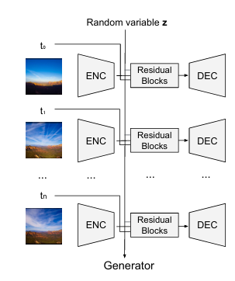
Multi-Frame Joint Conditional Generation
Generator
Goal: Enforce temporal consistency. Force the generator to learn the "context" of an entire sequence, not just a single frame.
Key idea 1: Shared latent z captures temporal context across different times of day

Slide 11
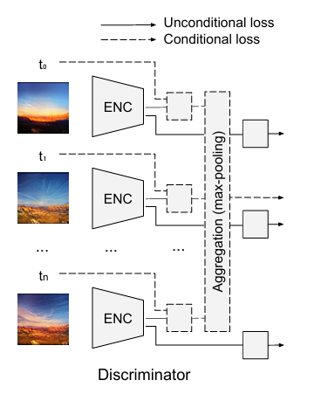
Multi-Frame Joint Conditional Generation
Discriminator Design
Two-Part Architecture
D: Unconditional - checks if each frame is real
D: Conditional - validates temporal consistency
Max-pooling aggregation for permutation invariance
Key idea 2: Sequence-Aware Discriminator

Slide 12
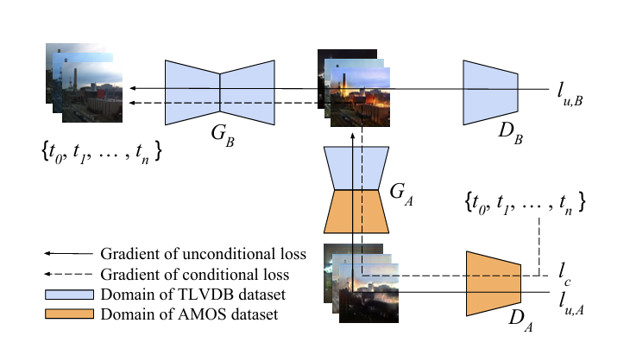
Multi-Domain Training

Slide 13
Implementation
Framework & Dataset
Hyperparameters
Framework: Pytorch
Iterations: 40000
AMOS: 85K images
Batch size: 4
TLVDB: 135K images
Sequences length: 16
Learning rate: 0.0002
Training Algorithm (per Iteration)
Update DA & DB
Update GA
Update GB

Slide 14
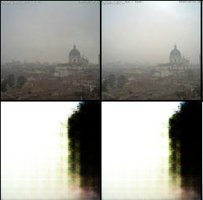
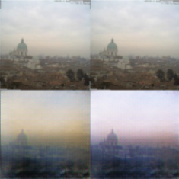
Implementation: Issues & Resolutions
Issues
Solutions
Generator (Gb) failed to preserve input structure
Integrated a VGG-based Perceptual Loss into the Gb training loss.
The generated images resembled noise and lost all content from the input image.
Rationale: This forces Gb to match high-level content features (extracted by VGG) of the input, rather than just optimizing for pixel values via the adversarial loss

Slide 15
Implementation: Issues & Resolutions
Issues
Solutions
Time condition (t) was ignored by the generator
Re-architected the conditioning mechanism. The latent context (z) and time embedding (t) are now concatenated at every block of the Gb Encoder
The model produced the same image regardless of the input timestamp (a form of mode collapse)
Rationale: This forces the network to process the time information at multiple feature scales, preventing the condition from being "lost" or "ignored" in deep layers

Slide 16
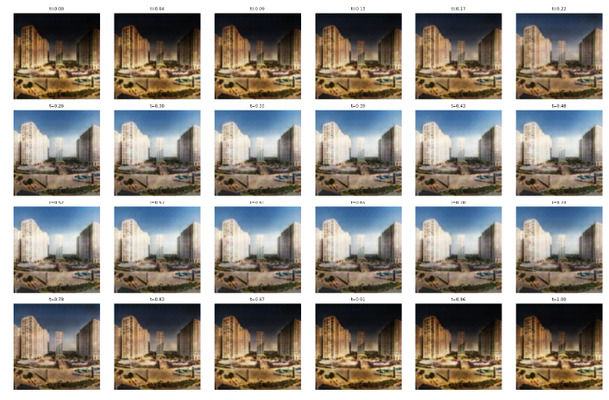
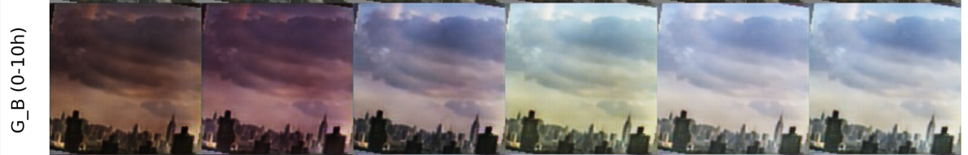
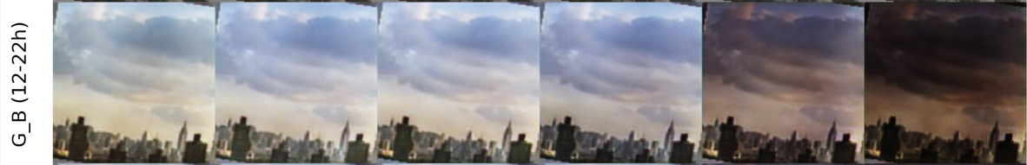
Implementation: Issues & Resolutions
Issues
Solutions
Poor differentiation between daytime timestamps
Switched from a continuous time variable t in [0, 1) to 48 discrete time classes (1 class per 30-minute interval)
Generated images for different daytime hours (e.g., 10:00 AM vs 2:00 PM) looked almost identical

Slide 17
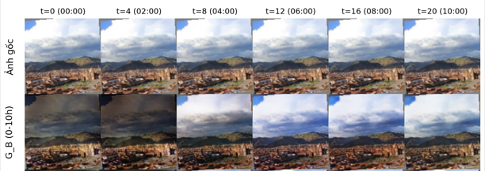
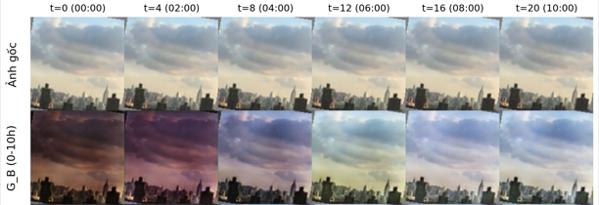
Result
Some output images during training

Slide 18
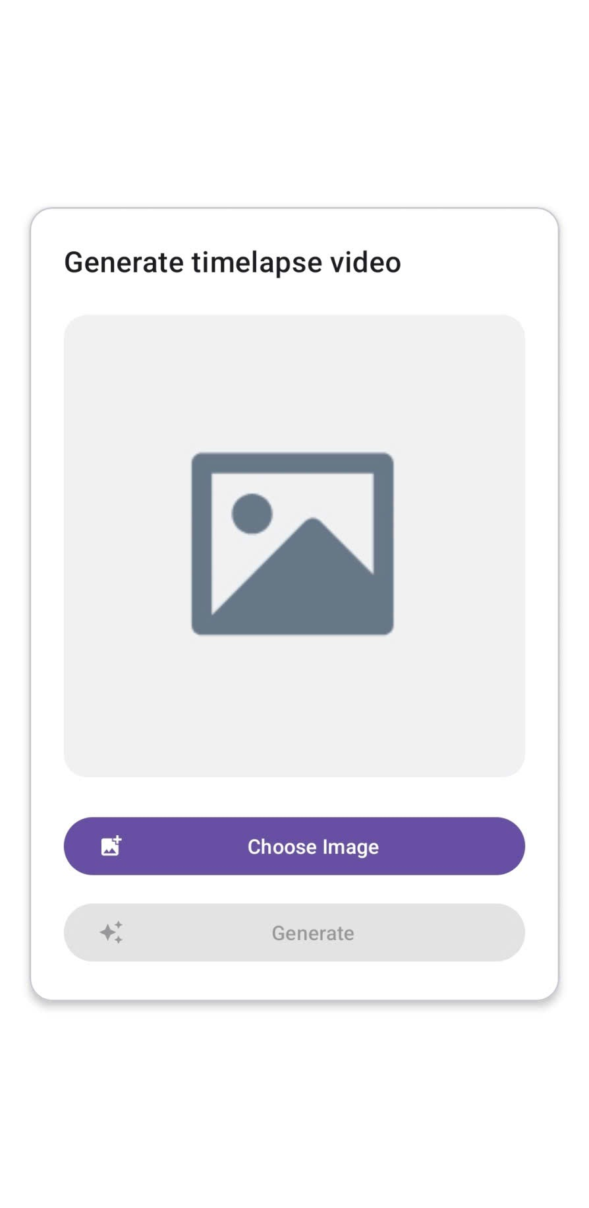
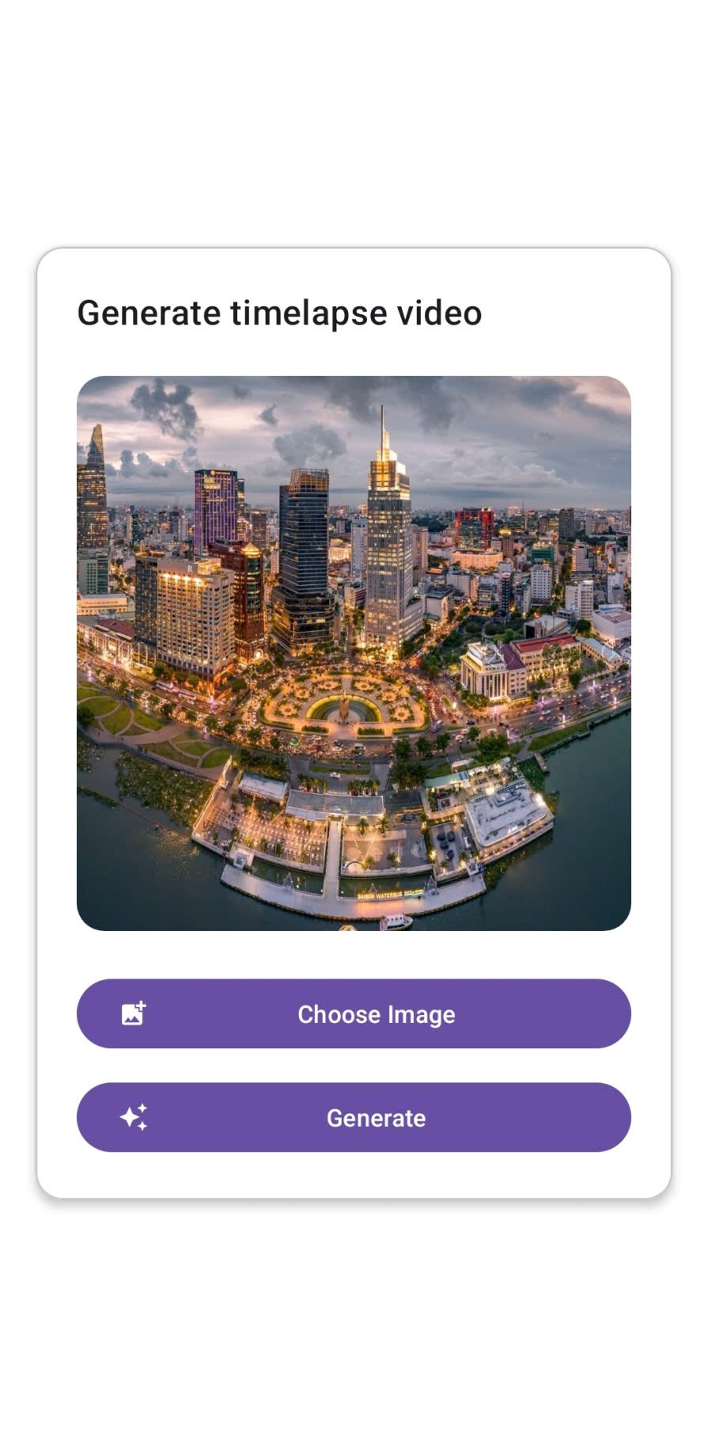
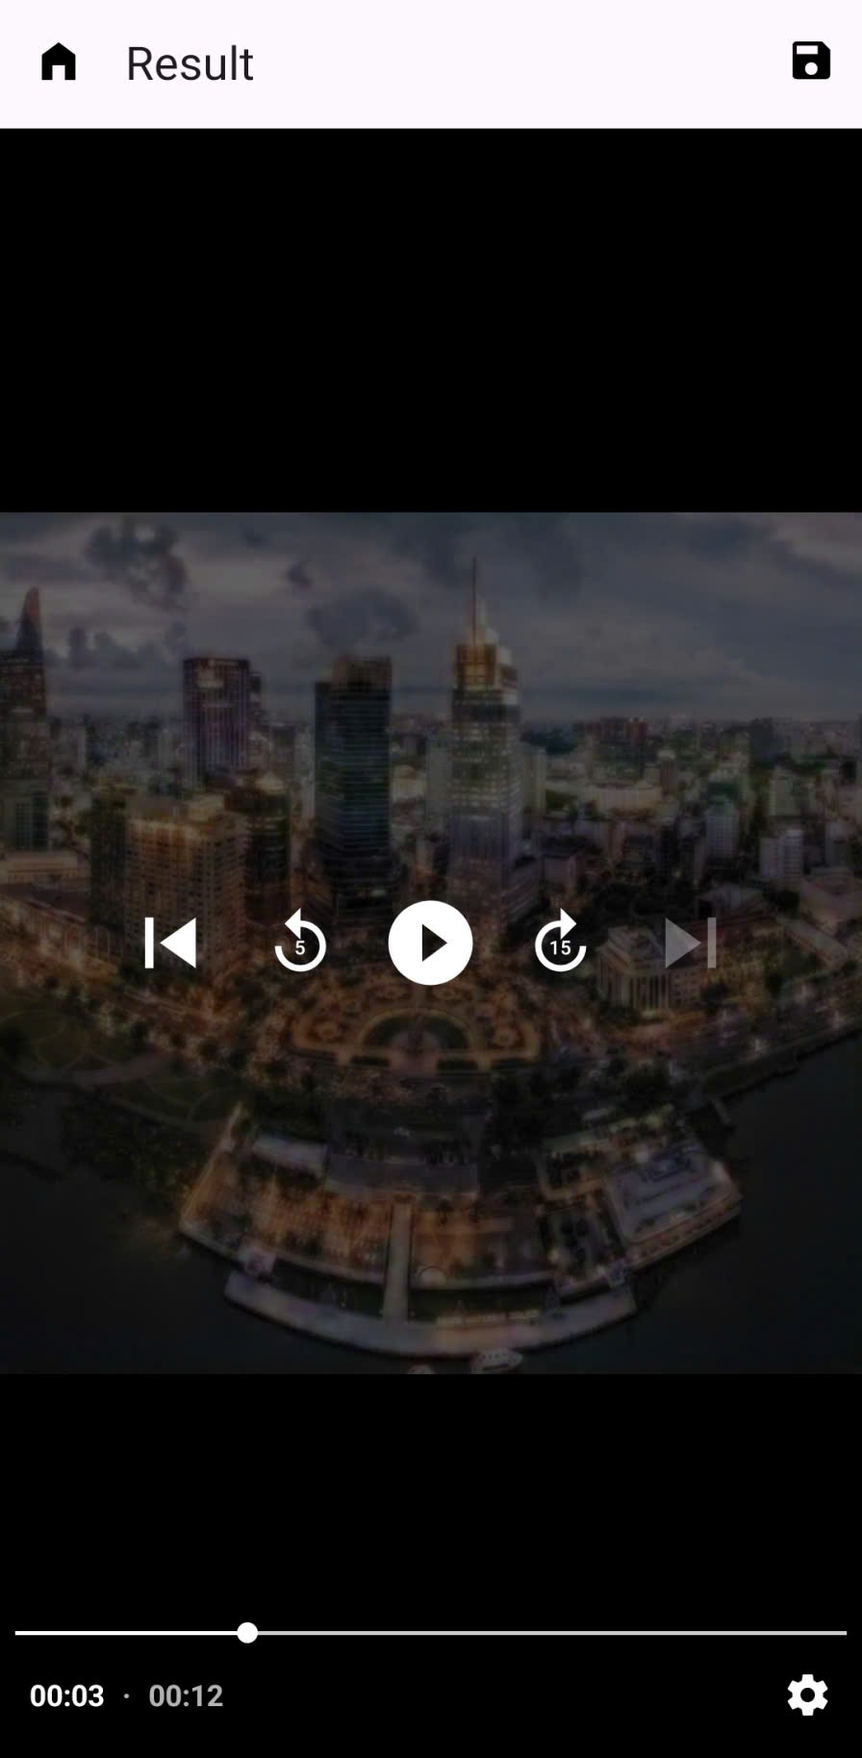
Android integration
Integrate model into Android app using TorchScript and Pytorch Android

Slide 19
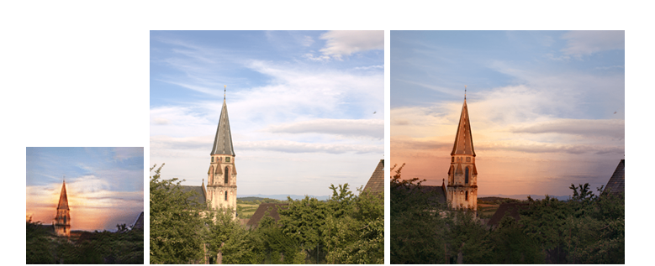
Android integration
Post-Processing: Guided Upsampling for High Resolution
It assumes the final image is a simple linear transform of the original:
Final_Image(p) = s(p) * Original_Image(p) + b(p)
The goal is to find the transformation maps s (scale) and b (bias) that "re-color" the original image to look like the GAN output.

Slide 20
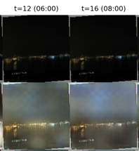
Conclusions
Limitations:
Struggles to hallucinate daytime image from very dark nighttime inputs
Fails to generate artificial lighting in regions like building windows
It only changes color tones and image quality is not really good
Runtime on android is not good, not really optimized

Slide 21
Conclusions
Future works
Improve the current approach: train on bigger and better dataset, better model architecture
Combine the current approach with motion synthesis techniques.
Improved to run better on mobile environment

Slide 22
Thank you for listening

