Slide 1
CHALLENGES 0

Slide 2

HELLO!
I am Vo Nguyen Quang Vinh
I am here because I love to give presentations.
You can find me at @voquangvinh333

Slide 3
TO DOWN APPROACH
1. What
2. When
3. How
4. Benefits
5. Example
6. Summary

Slide 4
TO DOWN APPROACH

Slide 5
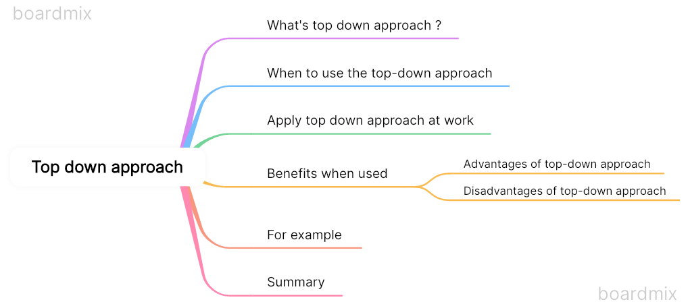

Slide 6
WHAT IS THE TO DOWN APPROACH ?
Approach to project management and development
Clear common goals
Divide into small pieces to make

Slide 7
WHEN TO USE THE TOP DOWN APPROACH
Overall goals and strategies before
Decompose for management
Not a lot of changes

Slide 8
HOW TO APPLY THE PROGRAM
Determine functional and non-functional requirements
Program modules based on requirements
Disassemble modules
Coding and deploy modules
Documentation

Slide 9
BENEFITS WHEN USED
Advantages of top-down approach :
Clear strategy
Effective management
Resource optimization
Easily evaluate progress
Create trust
Disadvantages of top-down approach :
Lack of flexibility
Lack of creativity
Risk is not guaranteed

Slide 10
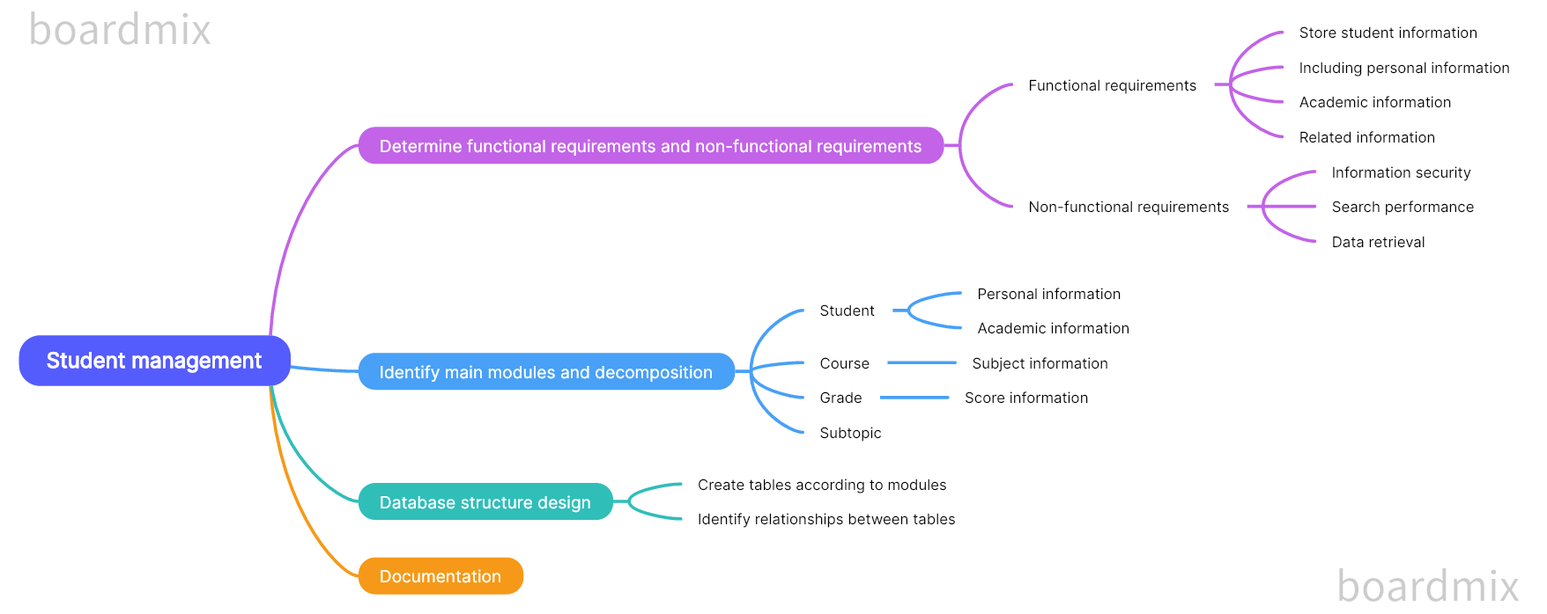
FOR EXAMPLE

Slide 11
DOCUMENT
Boardmix
Chat GPT
Monica

Slide 12
THANKS!
Any questions?
You can find me at
voquangvinh333@gmail.com

