Slide 1
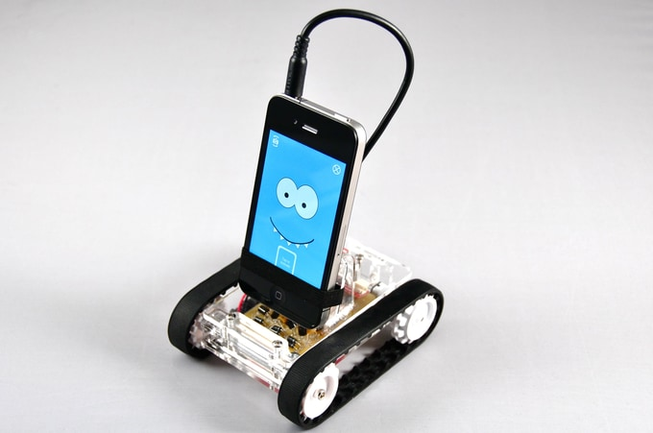
FriendBot
ANDROID & iOS PHONE MOBILE ROBOT
OpenBot 2WD · ESP32-S3 · Xiaozhi voice control
Project guide: firmware, app screens, mechanics, wiring and sensor connections
Reference imagery from FriendBot.pptx
The phone is the ears, mouth and brain. The ESP32-S3 is the muscle.
Vu Nguyen · November 2026

Slide 2
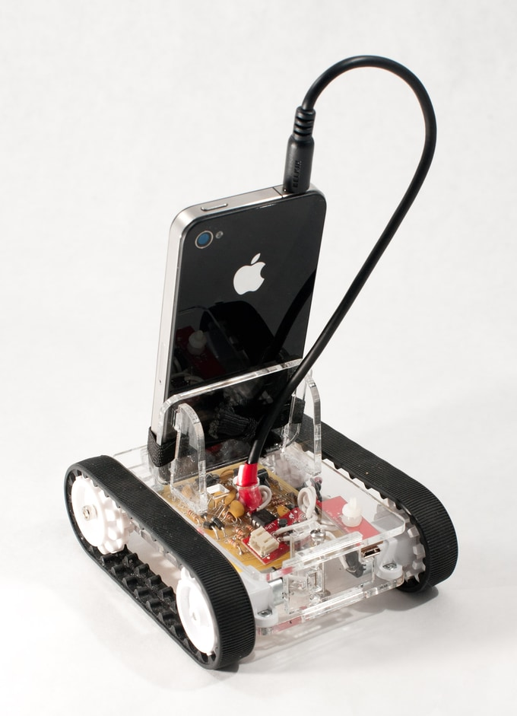
Project at a glance
A two-wheel robot car you drive by talking to it. You speak in English, Vietnamese or Chinese; the phone sends your voice to the Xiaozhi AI; the AI answers by voice and sends a move command; the phone passes the command to the ESP32-S3 over Bluetooth or USB.
01
Phone app (Android / iOS)
Microphone, speaker, screen and the link to the robot. Example: you say "tiến", the app plays Xiaozhi's reply.
02
Xiaozhi server (cloud AI)
Turns speech into text, decides what to do, replies in its own voice, issues tool calls like self.robot.move.
03
ESP32-S3 + L298N (robot)
Only drives the two motors. Example: "c192,192" = both wheels forward at 75 %.
2
20 kHz
1 s
3
gear motors
silent PWM
failsafe stop
languages
Reference imagery from FriendBot.pptx
Source: docs/ESP32S3_2WD_XIAOZHI_VOICE_GUIDE.md §1–3; firmware/openbot-esp32s3/openbot-esp32s3.cpp

Slide 3
System architecture
Phone app
Android · iOS
Voice Control screen
mic · speaker · transcript
voice
Xiaozhi server (xiaozhi.me)
WebSocket session · Opus audio both ways
speech-to-text → LLM → text-to-speech
MCP tool calls: self.robot.move / stop
You
speak in any
language
reply + tool call
Fallbacks keep the robot drivable: offline typed text → REST LLM → built-in keywords → quick buttons.
BLE or USB serial
"c<left>,<right>" every 250 ms
Left motor
RC receiver
optional · FlySky
iBUS on GPIO 42
ESP32-S3-DevKitC-1
N16R8 · 16 MB flash · 8 MB PSRAM
firmware: openbot-esp32s3
L298N
dual H-bridge
GPIO 13–18
PWM + direction
Right motor
2S Li-ion 7.4 V
Source: docs/ESP32S3_2WD_XIAOZHI_VOICE_GUIDE.md §1; firmware protocol comments (openbot-esp32s3.cpp)

Slide 4
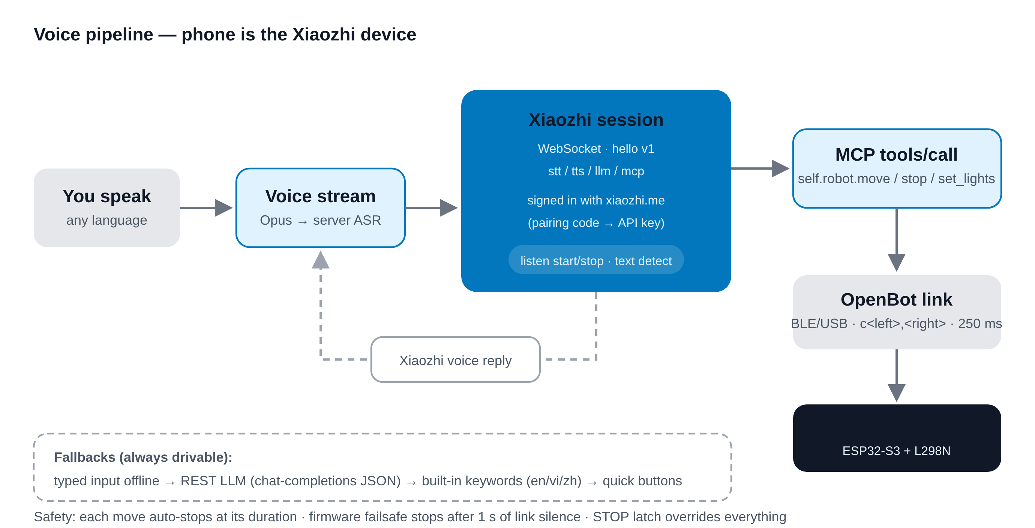
How one voice command travels
01
Pair once
App shows a code; you enter it on xiaozhi.me. Credentials are saved.
02
Speak
Hands-free by default. Example: "đi thẳng 3 giây".
03
Xiaozhi answers
Speech reply + MCP call self.robot.move(forward, 3000 ms).
04
App drives
Sends c<l>,<r> every 250 ms until the move ends, then c0,0.
Why it matters: the robot needs no microphone, speaker or Wi-Fi. All intelligence sits in the phone and the cloud, so the robot board stays cheap and simple. Example: upgrading the AI model needs no firmware change at all.
Source: docs/images/voice-flow.svg; guide §1 and §4 "How one utterance is handled"

Slide 5
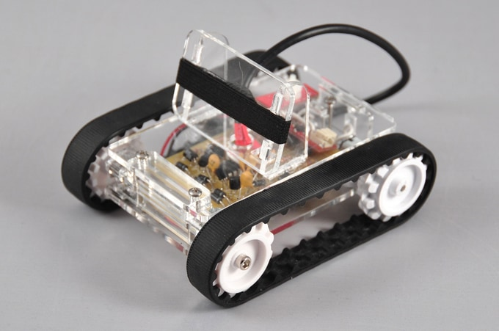
Mechanical design: 2WD differential base
Chassis
OpenBot DIY body, 3D-printed. Variants in body/diy/cad: regular, slim, glue and block bodies (STL + STEP).
Drive
Two DC gear motors with wheels plus a caster. Turning is done by speed difference: "turn left" = left wheel back, right wheel forward (spin in place).
Phone mount
Two-part mount (phone_mount_top / bottom .stl) keeps the camera clear and the screen visible.
Reference imagery from FriendBot.pptx
Layout
Battery low and central to reduce tipping; ESP32 and L298N inside the body; USB port reachable for flashing.
Mirror effect: the two motors face opposite ways, so one must be reversed for "forward". The firmware handles this with MOTOR_R_REVERSED = 1 — no rewiring needed.
Source: body/README.md, body/diy/cad/*, body/phone_mount/*.stl; image: FriendBot.pptx

Slide 6
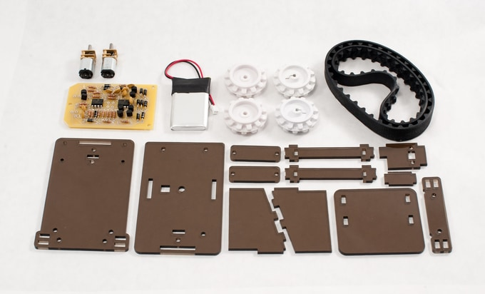
Bill of materials
Part | Specification | Role in the robot
Microcontroller | ESP32-S3-DevKitC-1, N16R8 (16 MB flash, 8 MB octal PSRAM) | Runs firmware, BLE link, PWM to motors
Motor driver | L298N dual H-bridge module | Switches battery current to the motors
Motors | 2 × DC gear motors + wheels | Differential drive
Battery | 2S Li-ion, 7.4 V | Motor supply → L298N +12V terminal
Phone | Android or iPhone with the OpenBot app | Voice, AI link, camera, GPS, screen
Body | 3D-printed OpenBot DIY body + phone mount | Holds everything together
Cable | USB-C data cable | Flashing, and optional wired control link
Optional | FlySky FS-i6B transmitter + FS-iA6B receiver | Manual / Auto / Hold mode switch
Prototype parts — reference imagery from FriendBot.pptx
Example cost logic: the robot side is only a dev board, a driver and two motors — the expensive "brain" is a phone you already own.
Source: guide §2 "Parts"; body/README.md

Slide 7
Wiring: ESP32-S3 → L298N → motors
ESP32-S3
DevKitC-1 N16R8
L298N
dual H-bridge
GPIO 13
left dir
IN1
M
Left motor
left dir
OUT1 / OUT2
GPIO 14
IN2
GPIO 15
left PWM*
ENA
GPIO 16
right dir
IN3
M
Right motor
right dir
OUT3 / OUT4
GPIO 17
IN4
GPIO 18
right PWM*
ENB
GND
common ground
GND
2S Li-ion 7.4 V
+12V
* remove the ENA / ENB jumper caps so the ESP32 can PWM them
battery − also to GND
USB-C: power + flashing + optional serial link to phone
Source: firmware/openbot-esp32s3/openbot-esp32s3.cpp SETTINGS §3 (pin defines); guide §2 "Wiring"

Slide 8
Power and wiring rules
01
Common ground
02
Remove ENA / ENB jumpers
Battery −, L298N GND and ESP32 GND must join. Without it, the PWM signal has no reference. Example symptom: motors twitch randomly.
With the caps on, the motors always run at full speed. Remove them so GPIO 15 and 18 can set speed.
03
Keep the 5 V jumper
04
Pins to avoid
Leave the L298N regulator jumper in place when logic power comes from the 7.4 V motor battery.
GPIO 26–37 (flash / octal PSRAM), 0, 3, 45, 46 (boot straps), 19, 20 (USB), 43, 44 (UART0). Wiring here can stop the board booting.
Direction check: if one side runs backward on "forward", either swap that motor's two wires or flip MOTOR_L_REVERSED / MOTOR_R_REVERSED in the firmware.
Source: guide §2 "Notes"; firmware SETTINGS §5 pin notes (ESP32-S3 datasheet v2.2 Table 2-14)

Slide 9
Sensor and input connections
On the robot
On the phone (the robot's real sensor pack)
Input | Connection | Status
RC receiver, iBUS (FS-iA6B) | SERVO port → GPIO 42 (UART2 RX) | Optional, HAS_RC
RC receiver, PWM (FS-iA6) | CH1 → 38, CH2 → 39, CH5 → 40 | Optional
Mode switch SwC on CH5 | 1000 / 1500 / 2000 µs | MANUAL / AUTO / HOLD
Sonar, LEDs, encoders, voltage | not fitted in this build | Off — feature reply "f2WD_S3:"
Microphone + speaker voice in, Xiaozhi voice out
Camera object detection, autopilot modes
IMU (tilt) Tilt drive mode, 4° dead zone
GPS phone GPS for navigation — no external module
Proximity data feeds the object-avoidance gate
RC mode logic (from rc_input.h)
MANUAL: sticks drive the motors, app commands ignored. AUTO: the phone drives. HOLD: motors stopped.
No receiver heard since power-on → behaves as if none is fitted. Receiver lost for 250 ms → failsafe hold. Example: switch SwC down and the robot stops even if Xiaozhi says "go".
Source: firmware SETTINGS §8 + rc_input.h; process_feature_msg(); guide §6 (tilt, object-avoidance)

Slide 10
Firmware: what loop() does every cycle
01
02
03
04
05
Keep BLE alive
Read messages
Who drives?
Failsafe
Drive motors
Re-advertise as "OpenBot" when the phone disconnects.
Bytes from BLE or USB serial; one line per message, first letter = type.
rcPoll() reads the RC switch: MANUAL, AUTO, HOLD or LOST.
No command for 1000 ms → left = right = 0.
Sign → IN pins, size → PWM duty on EN pins.
Speed mapping (drive_to_duty)
Motor truth table
duty = MIN_DUTY + |drive| × (1023 − MIN_DUTY) / 255
c128,128 → duty 220 + 128×803/255 ≈ 623 / 1023
Command | IN1 | IN2 | Result
value > 0 | HIGH | LOW | forward
value < 0 | LOW | HIGH | reverse
value = 0 | HIGH | HIGH | brake (default)
value = 0, coast | LOW | LOW | roll to stop
Why the minimum duty? A brushed motor at 5 % power only hums. Lifting every non-zero command to 220/1023 makes small commands actually move the wheels.
Source: firmware/openbot-esp32s3/openbot-esp32s3.cpp — loop(), update_vehicle(), write_motor_value(), drive_to_duty()

Slide 11
Phone ↔ robot protocol
Message | Direction | Meaning | Example
c<left>,<right> | phone → robot | Drive, each −255…255 | c192,192 = forward
t<text> | phone → robot | Plain-word command, EN / VI / ZH | tturn left · ttiến
h<ms> | phone → robot | Heartbeat (failsafe) timeout | h1000
f | phone → robot | Feature query | f
f<type>: | robot → phone | Feature reply | f2WD_S3:
m<mode> | robot → phone | RC mode: M / A / H / L | mA = AUTO
Excerpt — text command matching
if (contains_any(msg, STOP_WORDS)) {
left = 0; right = 0;
} else if (contains_any(msg, BACK_WORDS)) {
left = -speed; right = -speed;
} else if (contains_any(msg, LEFT_WORDS)) {
left = -speed; right = speed;
} ...
} else {
// unknown words: STOP
left = 0; right = 0;
}
Order matters: "stop" is checked first, so "don't go" stops. "back" is checked before "go", so "go back" reverses. Unknown words stop the robot — a bad recognition can never drive it away.
Simplified from process_text_msg(); real code also handles "faster" / "slower" (±64, range 64–255).
Source: openbot-esp32s3.cpp "Protocol" section, process_ctrl_msg(), process_text_msg(), process_feature_msg()

Slide 12
Settings, build and flash
Define | Default | What it does
MOTOR_L_REVERSED | 0 | 1 flips the left motor
MOTOR_R_REVERSED | 1 | 1 flips the right motor
MOTOR_PWM_FREQ / RES | 20000 / 10 | 20 kHz, 0–1023 (no whine)
MOTOR_MIN_DUTY | 220 | Lifts motors out of the dead band
MOTOR_BRAKE_ON_STOP | 1 | Brake instead of coast
CONTROL_TIMEOUT_MS | 1000 | Failsafe stop time
VOICE_SPEED_DEFAULT | 192 | Speed for text commands (of 255)
HAS_RC | 0 | Set 1 to enable the RC receiver
Build and upload (arduino-cli)
arduino-cli compile \
--fqbn esp32:esp32:esp32s3 \
--board-options PSRAM=opi,
FlashSize=16M \
firmware/openbot-esp32s3
arduino-cli upload --fqbn ... \
--port /dev/tty.usbserial-0001
Your own settings survive updates
Copy the SETTINGS block into openbot_settings.h next to the sketch. Git ignores it; the firmware uses it automatically.
Appears to the phone as
BLE name "OpenBot", service 61653dc3-…, RX 06386c14-…, TX 9bf1103b-… — or as a USB serial device.
Source: firmware SETTINGS section; guide §3 "Build and flash"

Slide 13
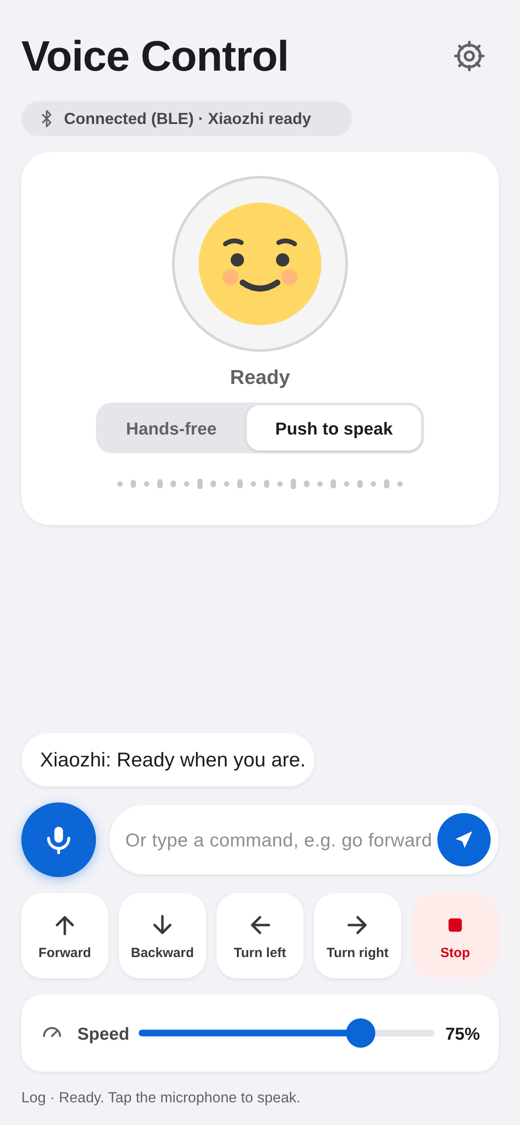
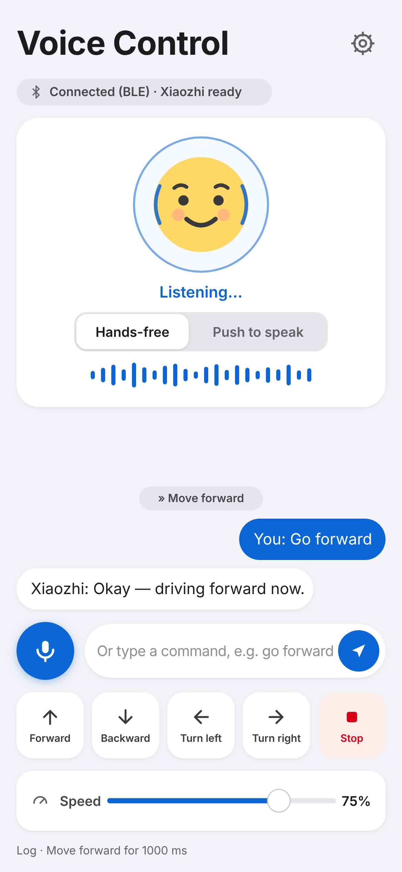
App screens: Voice Control on Android and iOS
Friendly face + state
Ready → Listening… → Thinking… → Speaking…
Hands-free by default
Just talk. "Push to speak" switches to tap-to-talk. Tap while it speaks = interrupt (barge-in).
Chat transcript
You on the right, Xiaozhi on the left; every action shown as a chip, e.g. "» Move forward".
Quick buttons + speed
Forward / Back / Left / Right / Stop; speed slider 25–100 %, default 75 %.
Multi-phone
The phone holding the robot link shares it over Wi-Fi; "Remote Mic" turns a 2nd phone into a microphone.
Android
iOS
Source: docs/images/voice-android.svg, voice-ios.svg; robot/android/.../robot/voice/, robot/ios/.../Controllers/VoiceControl/

Slide 14
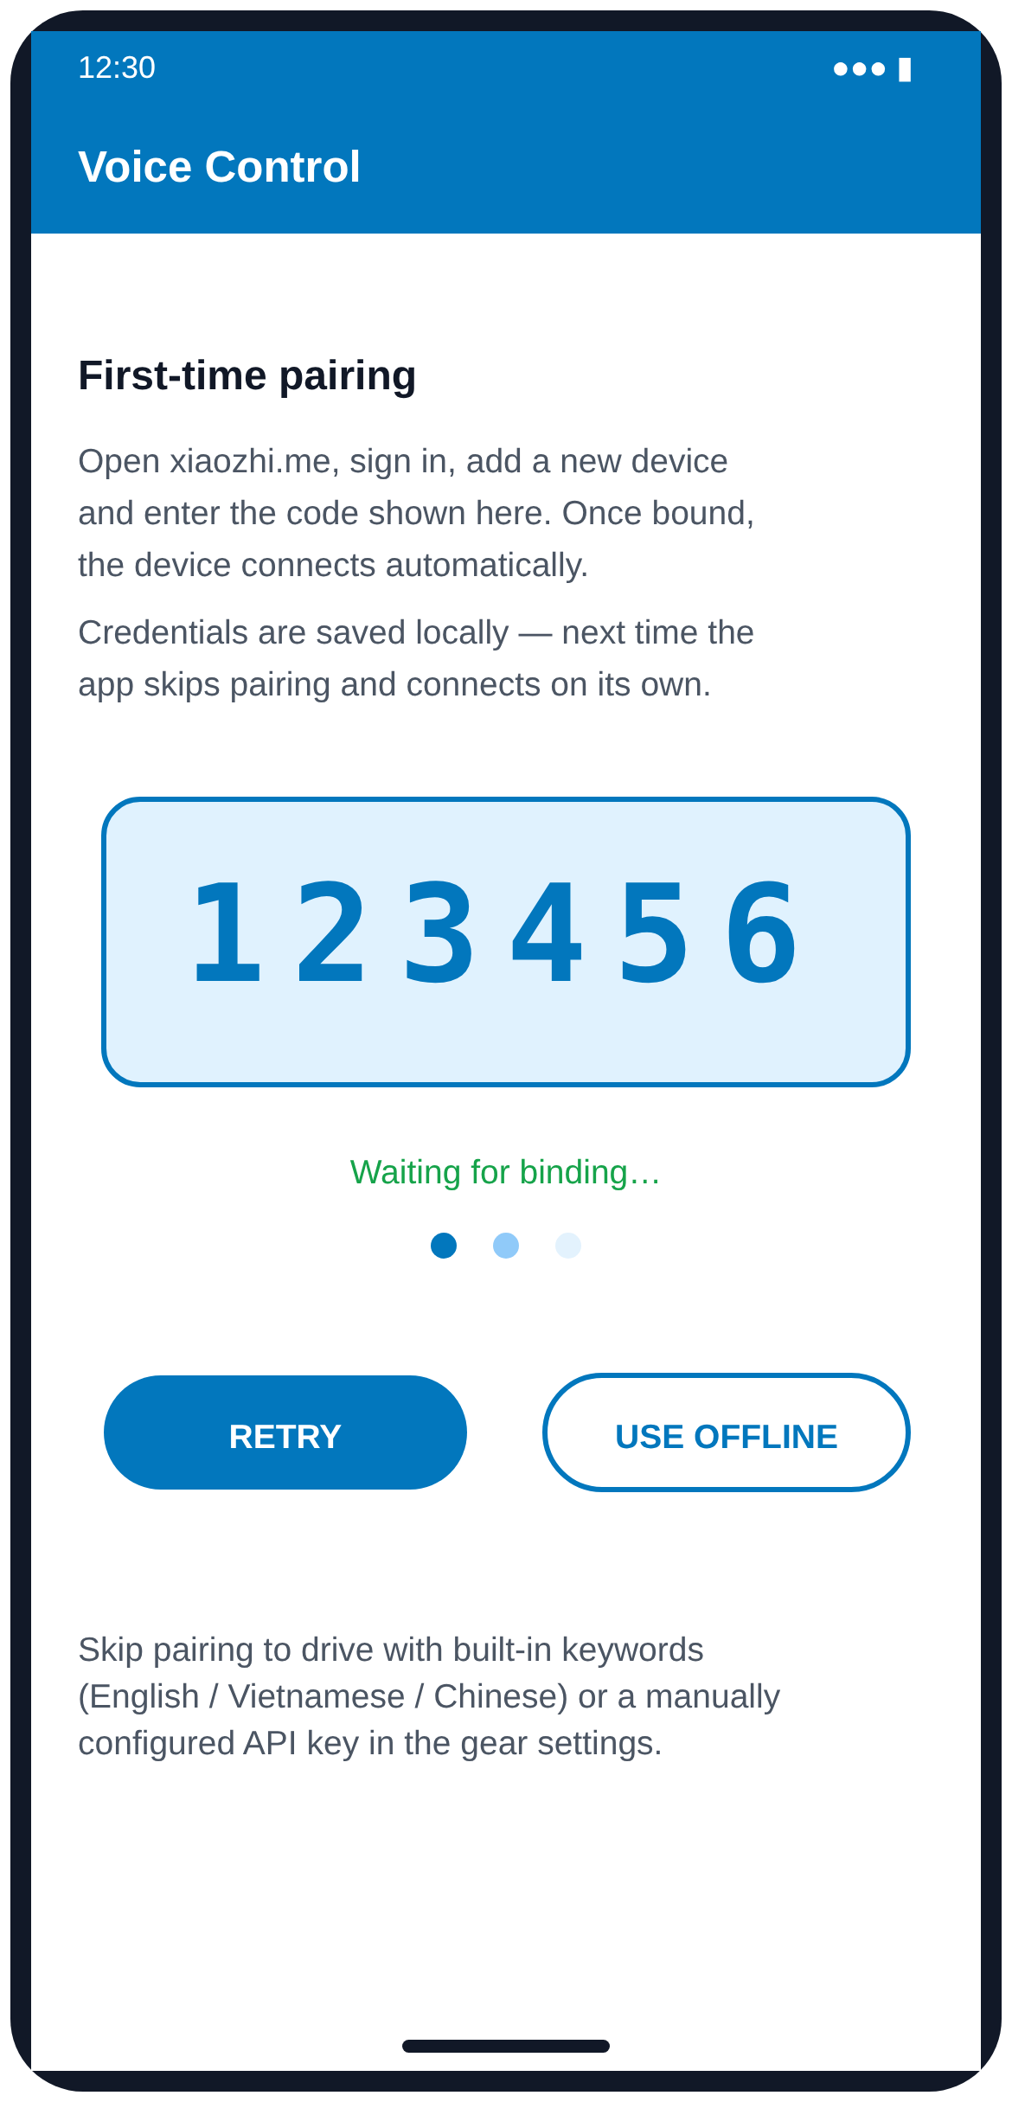

First launch: pairing and Xiaozhi settings
01
App shows a code
It registers with the Xiaozhi OTA endpoint (api.tenclass.net) as a new device.
02
Enter it on xiaozhi.me
Sign in, "add device", type the code, e.g. 123456.
03
Credentials saved
API key + WebSocket details stored locally; next launch connects by itself.
04
Or configure manually
Any OpenAI-compatible chat endpoint, token and model (default xz-lite).
Settings (gear button)
Pairing code
"Use offline" skips pairing and drives with built-in keywords only.
Source: docs/images/voice-pairing.svg, voice-settings.svg; guide §4 "First launch" and §5

Slide 15
Command vocabulary
English | Tiếng Việt | 中文 | Action | Motor values
forward, go, ahead | tiến, đi | 前进, 向前, 走 | Forward | c+S, +S
back, reverse, go back | lùi, lùi lại | 后退, 倒, 向后 | Backward | c−S, −S
left, turn left | trái, rẽ trái | 左, 左转 | Spin left | c−S, +S
right, turn right | phải, rẽ phải | 右, 右转 | Spin right | c+S, −S
stop, halt | dừng, dừng lại | 停, 停止 | Stop | c0,0
faster, speed up | nhanh, tăng tốc | 快, 加速 | Speed up | app +15 %
slower, slow down | chậm, giảm tốc | 慢, 减速 | Slow down | app −15 %
S = current voice speed (default 192 of 255).
With the Xiaozhi LLM, free speech works too. Example: "lùi chậm trong ba giây" → {"action":"backward","speed":0.3,"duration_ms":3000,"say":"Đang lùi chậm."}
Source: guide §4 "Command vocabulary"; firmware process_text_msg() word lists

Slide 16
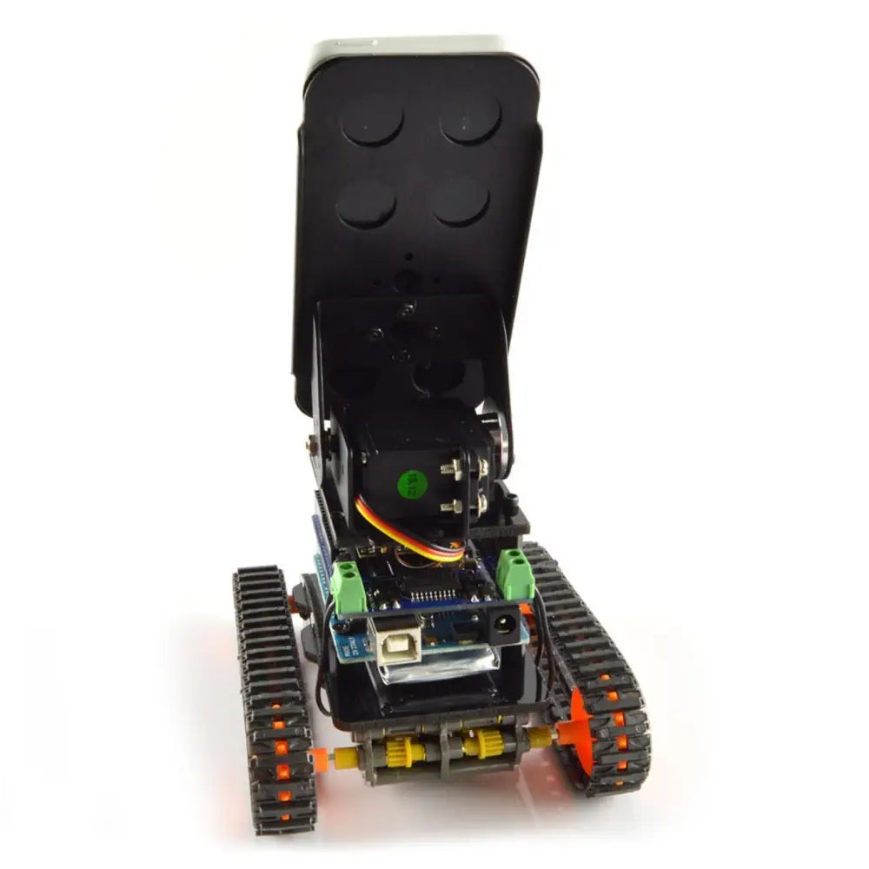
Layered safe-stop behavior
App
Firmware
App
Move timeout
Link failsafe
STOP latch
Every move ends by itself after its duration (default 1.2 s, max 8 s).
No command for 1 s → motors stop.
Red STOP button overrides every command until resumed.
App + firmware
App
Firmware
Unknown words stop
MCP check
RC override
Bad recognition or unsure LLM → stop, never guess.
Unknown or malformed tool calls are rejected.
HOLD switch or lost RC link stops the motors.
Physical cutoff and safe stop — reference imagery from FriendBot.pptx
Why so many layers? Each one covers a different failure: phone crash, Bluetooth drop, cloud mistake, wrong word, or a person who needs to stop it now.
Source: guide §1 and §6 "Safety behavior"; firmware CONTROL_TIMEOUT_MS, rc_input.h

Slide 17
Test plan and troubleshooting
Bring-up tests
Symptom | Fix
Motor hums, does not spin | Raise MOTOR_MIN_DUTY; check battery under load
Robot drives the wrong way | Flip MOTOR_*_REVERSED or swap that motor's wires
"Robot not connected" | Connect BLE "OpenBot" from the Bluetooth screen first
No answer to voice | Grant mic permission; phone needs Wi-Fi or data
"Xiaozhi ready" never appears | Credentials stale — sign in with xiaozhi.me again
Move stops early | STOP latch is on, or link dropped for > 1 s
01
Bench test
Wheels off the ground; send c150,150 then c-150,-150 from a serial console.
02
Failsafe test
Stop sending — motors must stop within 1 s.
03
Voice test
Say "go forward", "turn left", "stop" in each language.
04
RC test
Flip SwC: MANUAL, AUTO, HOLD; switch transmitter off.
Source: guide §7 "Troubleshooting"

Slide 18
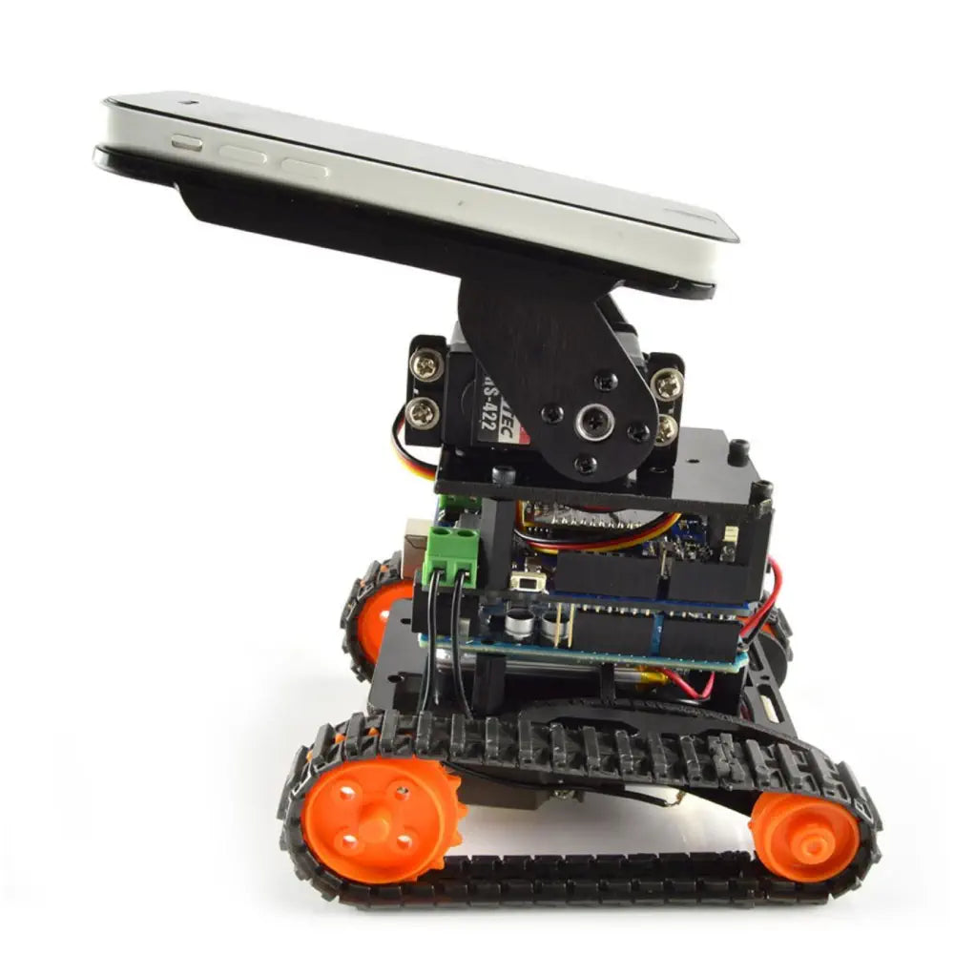
Next steps and questions to explore
Next steps
Deep questions for discussion
01
Add wheel encoders
Why keep the AI on the phone and cloud instead of on the ESP32-S3?
What should the robot do if the internet drops in the middle of a move?
Why does an unknown word stop the robot instead of repeating the last command?
How much delay (speech → wheels) is acceptable, and where is it spent?
When should the RC transmitter override the voice AI — and who decides?
Speed feedback so both wheels match — straighter driving.
02
Add a battery voltage divider
Report "v" to the app; warn before the pack runs low.
03
Enable the RC receiver
Set HAS_RC 1 and wire the FS-iA6B to GPIO 42.
04
Combine voice + camera
Reference imagery from FriendBot.pptx
e.g. "follow me" using the phone's person detection.
Source: Project status from the repo (firmware + Android/iOS voice screens done); questions are suggestions

