Slide 1

Notes:
Everyone in this room knows fundraising in Vietnam runs on introductions. We spent this hackathon building the introduction machine — and it's already live. I'll show you the problem, what we shipped, and why the way we built it matters.

Slide 2
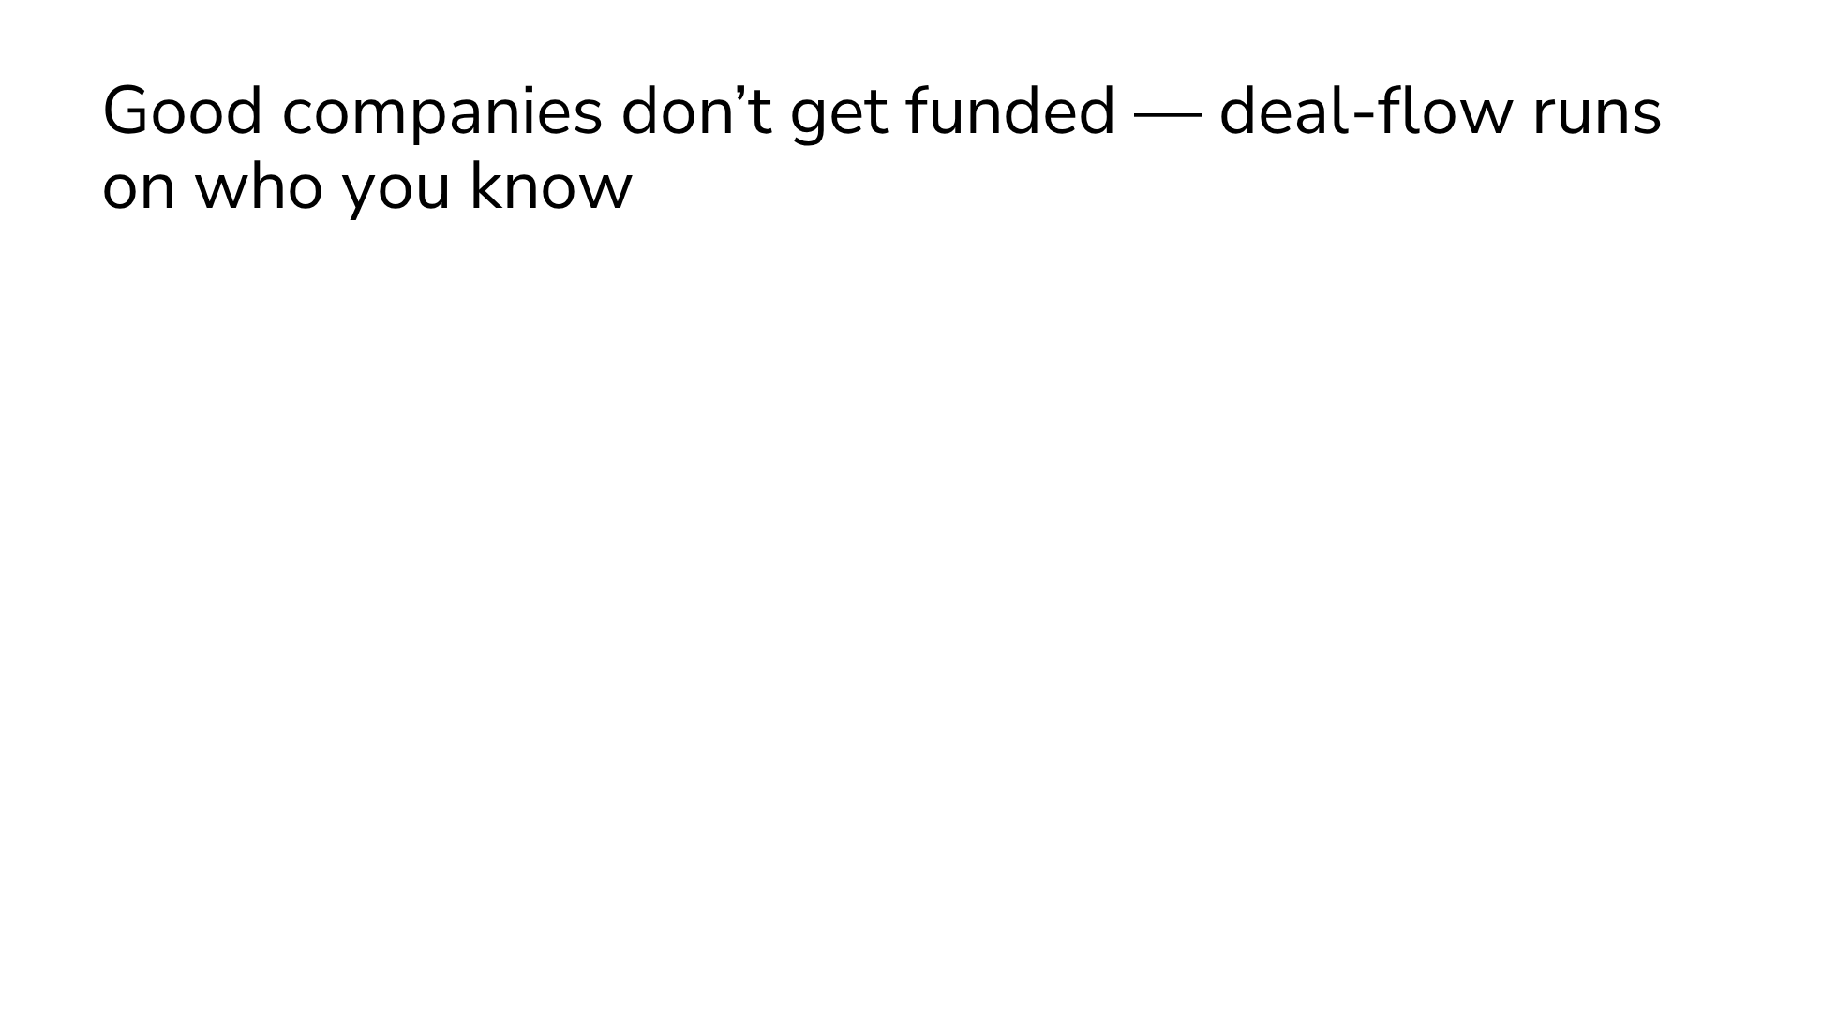
Notes:
Matching today is slow, manual, and network-bound. Founders can't tell which investors actually fit their industry, stage, and check size, so they blast everyone. Investors miss great companies that simply aren't in their circle. And a promising Vietnamese startup usually has no convincing English pitch, so international money never hears its story. Good companies don't get funded; good money doesn't reach them.

Slide 3
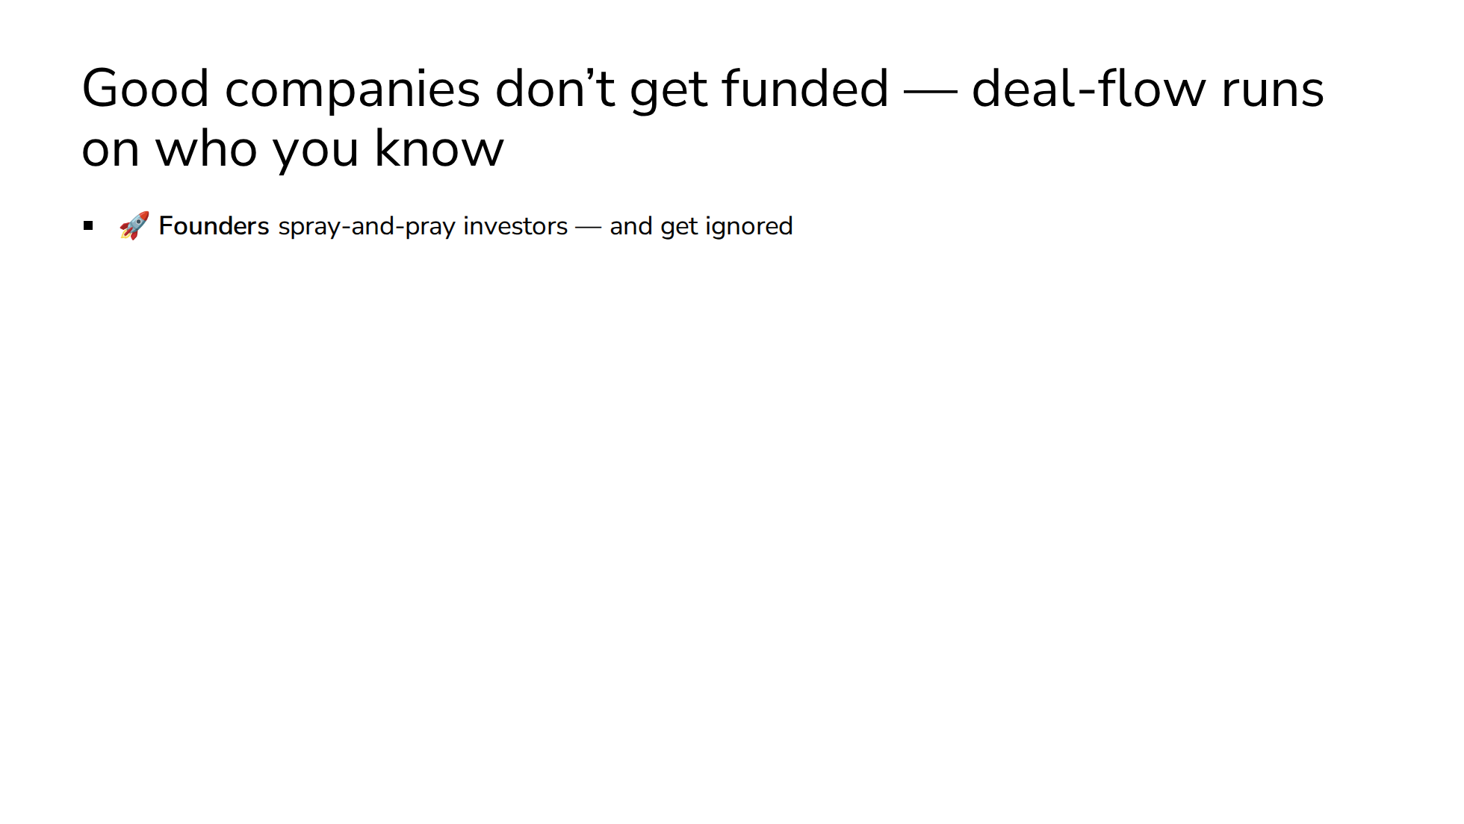
Notes:
Matching today is slow, manual, and network-bound. Founders can't tell which investors actually fit their industry, stage, and check size, so they blast everyone. Investors miss great companies that simply aren't in their circle. And a promising Vietnamese startup usually has no convincing English pitch, so international money never hears its story. Good companies don't get funded; good money doesn't reach them.

Slide 4
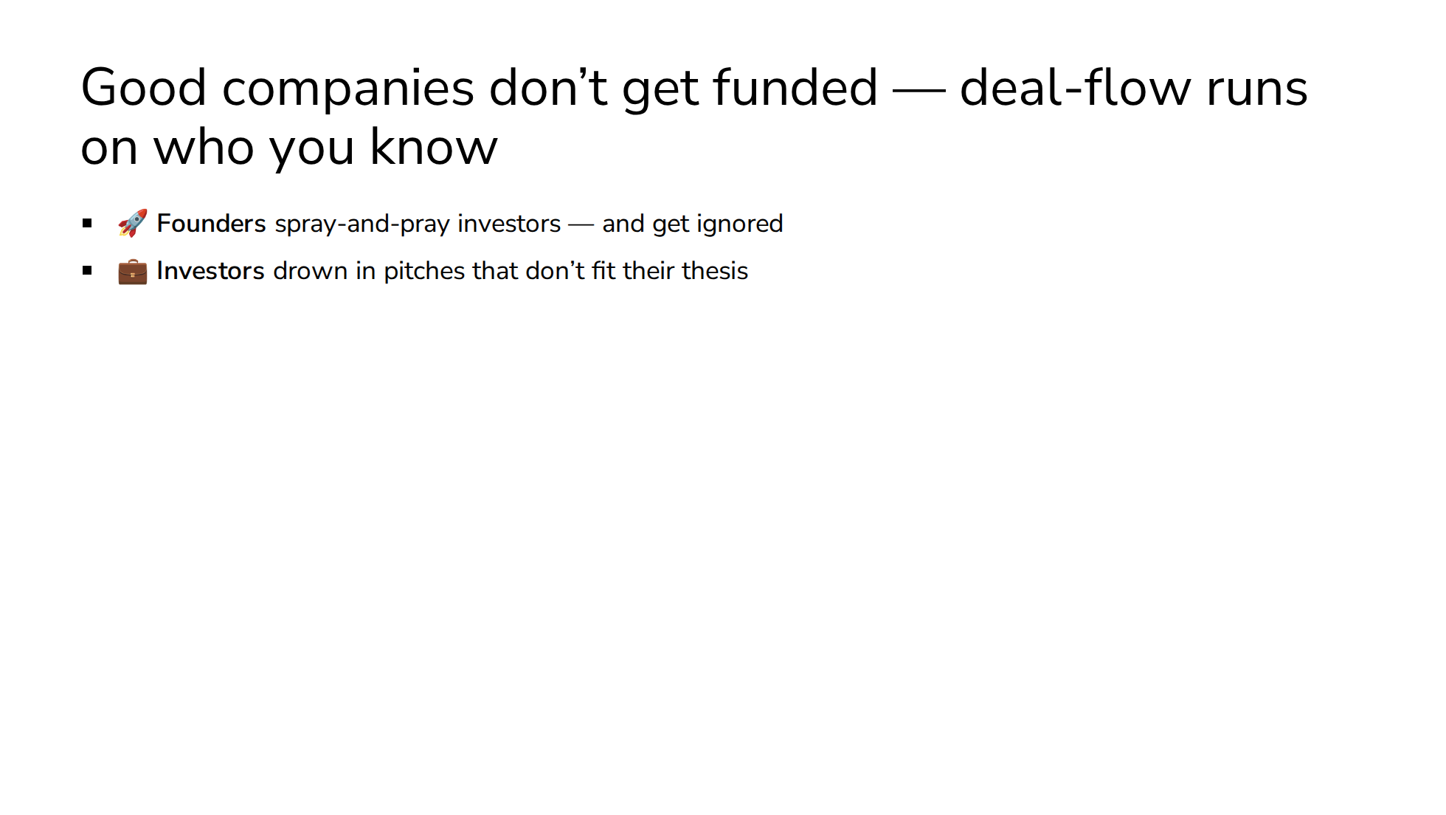
Notes:
Matching today is slow, manual, and network-bound. Founders can't tell which investors actually fit their industry, stage, and check size, so they blast everyone. Investors miss great companies that simply aren't in their circle. And a promising Vietnamese startup usually has no convincing English pitch, so international money never hears its story. Good companies don't get funded; good money doesn't reach them.

Slide 5
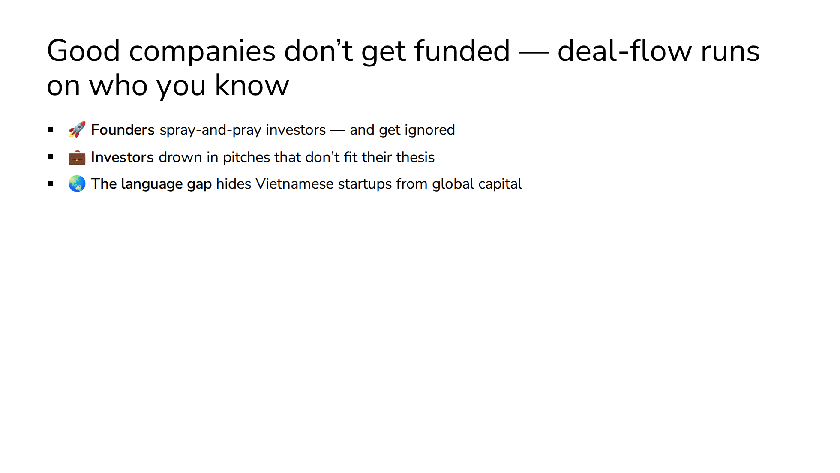
Notes:
Matching today is slow, manual, and network-bound. Founders can't tell which investors actually fit their industry, stage, and check size, so they blast everyone. Investors miss great companies that simply aren't in their circle. And a promising Vietnamese startup usually has no convincing English pitch, so international money never hears its story. Good companies don't get funded; good money doesn't reach them.

Slide 6
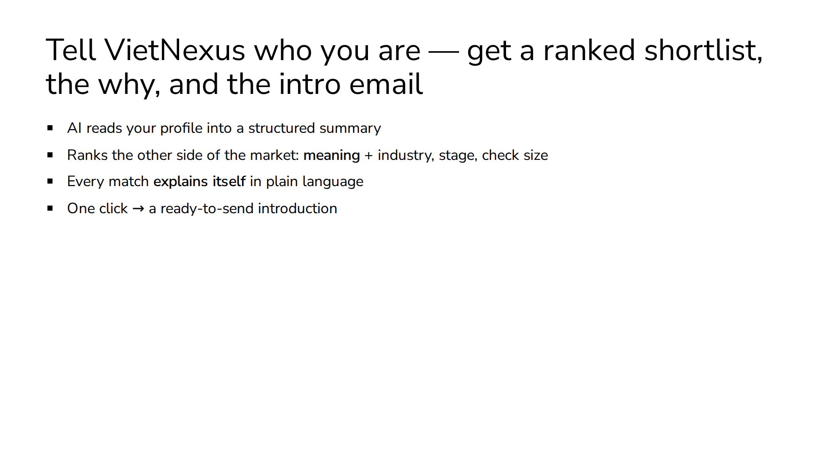
Notes:
The journey is five steps: sign up, the AI structures your profile, we rank everyone on the other side of the market, and every match comes with plain-language reasons — same industry, right stage, invests in your region — so you trust the list instead of guessing. Then one click gives you a ready-to-send intro. That's a cold-start problem turned into a warm introduction.

Slide 7
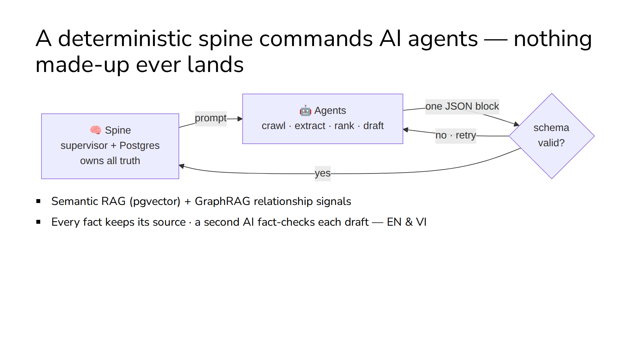
Notes:
The interesting part is how it's built. Deterministic code — the spine — owns all data and side effects. AI agents do only the judgment work: crawling the web, extracting, ranking, drafting. They meet at one guarded seam: an agent returns a single block of JSON, and the spine schema-validates it before anything lands. Matching runs on multilingual embeddings over a pgvector corpus plus graph relationships. And every intro email is drafted bilingually, then fact-checked by a second AI against sourced evidence. Judges hear "AI" all day — our answer to hallucination is architectural, not a prompt.

Slide 8
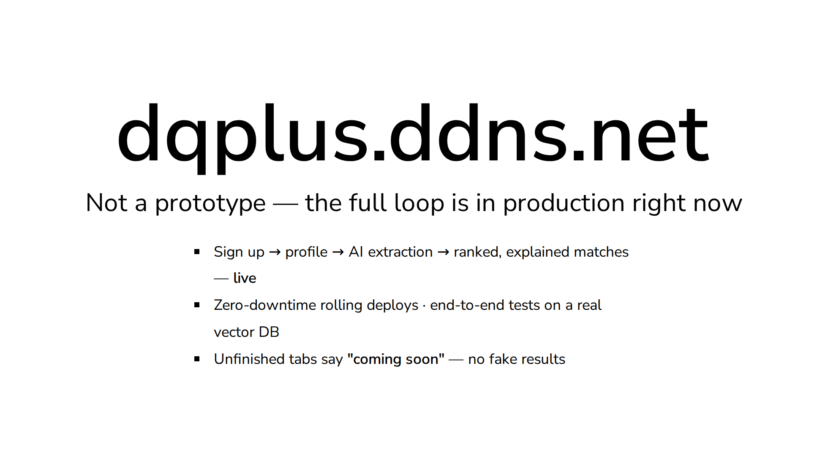
Notes:
This isn't a slideware demo. The whole loop — register, onboard, AI extraction, ranked matches with reasons, outreach draft — runs end-to-end on the public internet today. We deploy with zero downtime and test every service end-to-end against a real database, no mocks. And where the product isn't finished — customers, partners, talent matching — the app says so honestly instead of pretending. You can try it from your phone right now.

Slide 9
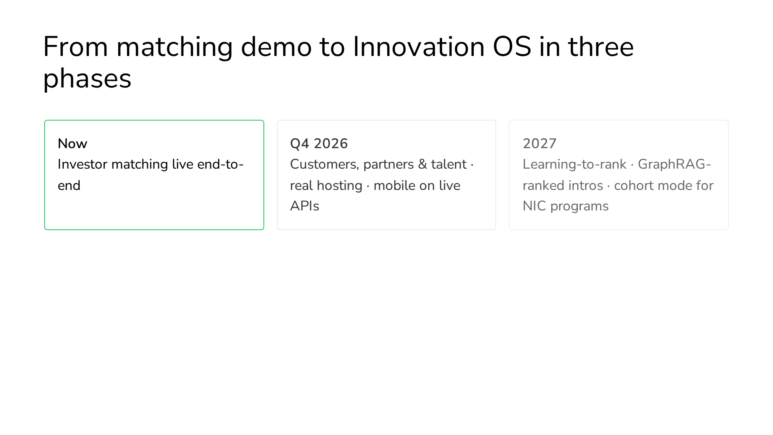
Notes:
We're deliberate about sequencing. First, demo-hard: wire the fact-checked bilingual drafts into the app and add CI. Next quarter, the other three connection types light up — the entity model already supports corporations, universities, and research institutes — plus real hosting. In 2027 the platform starts learning: match outcomes tune the ranking, relationship graphs feed the rationale, and accelerators or government programs run their own cohorts on the same spine. That's when it earns the name Innovation OS.

Slide 10
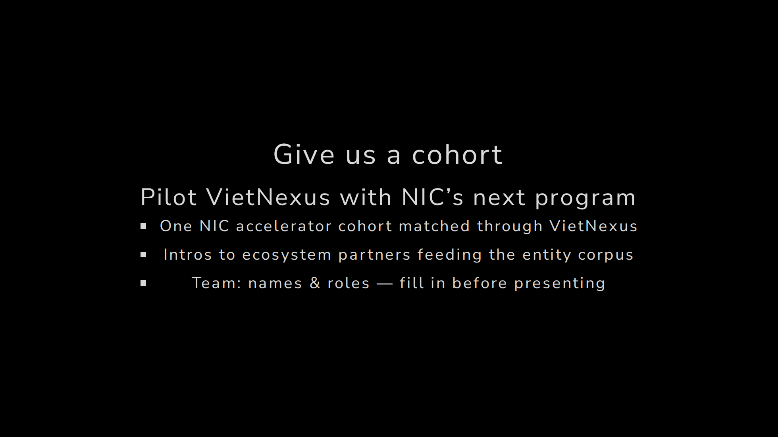
Notes:
Here's what we're asking for. Beyond the challenge itself: give us one real cohort. Put a NIC program's startups and partners through VietNexus and measure the introductions that convert. The platform is live, the architecture doesn't hallucinate, and the roadmap is honest. Vietnam's ecosystem doesn't need another directory — it needs a matchmaker that never sleeps. We built it. Thank you.

