Slide 1

Loan Classification
Notes:
Cho Phan

Slide 2
Problem
When the company receives a loan application, the company has to make a decision for loan approval based on the applicant’s profile.

Slide 3
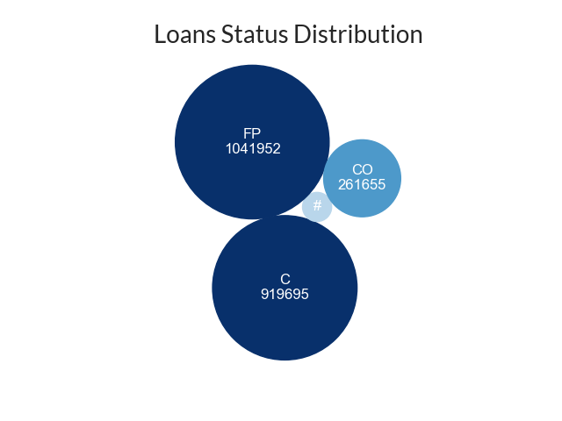
Loan Status
Fully Paid (FP): applicant has fully paid the loan.
Current (C): applicant is in the process of paying the installments, the tenure of the loan is not yet completed.
Charged Off (CO): applicant has not paid the installments in due time for a long period of time, they have defaulted on the loan.
#: Other

Slide 4
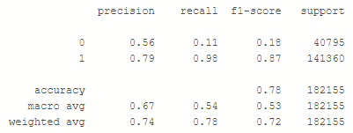
Classification Report

Slide 5
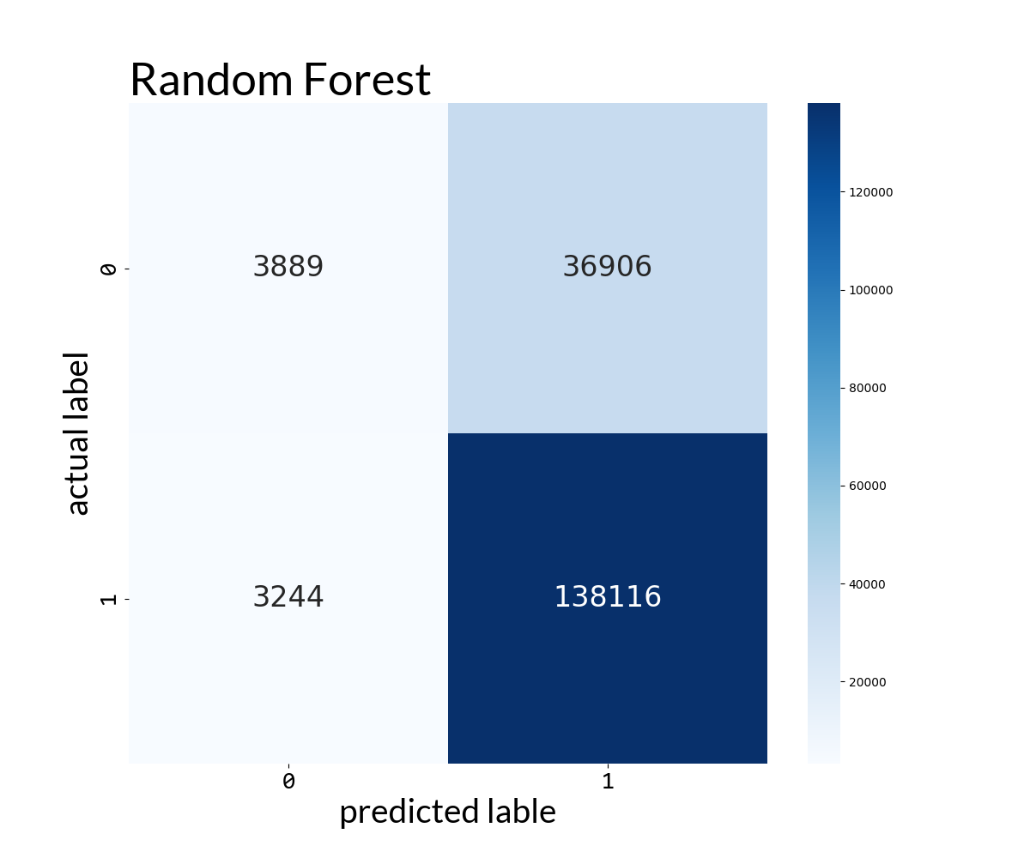
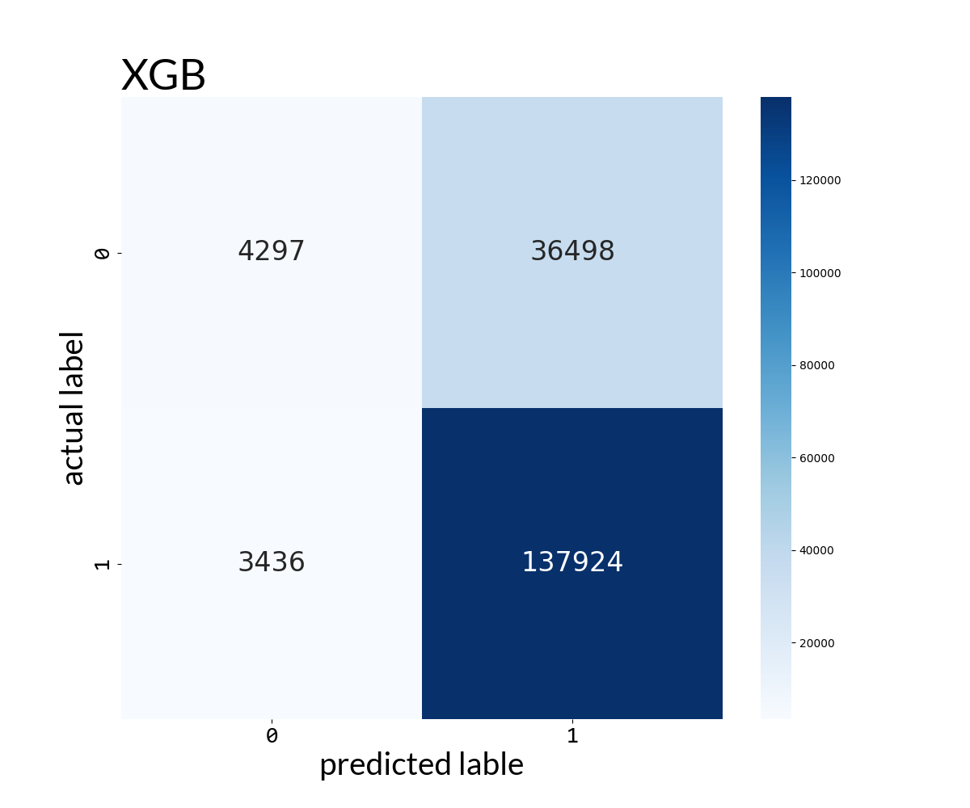
Confusion Matrix

Slide 6
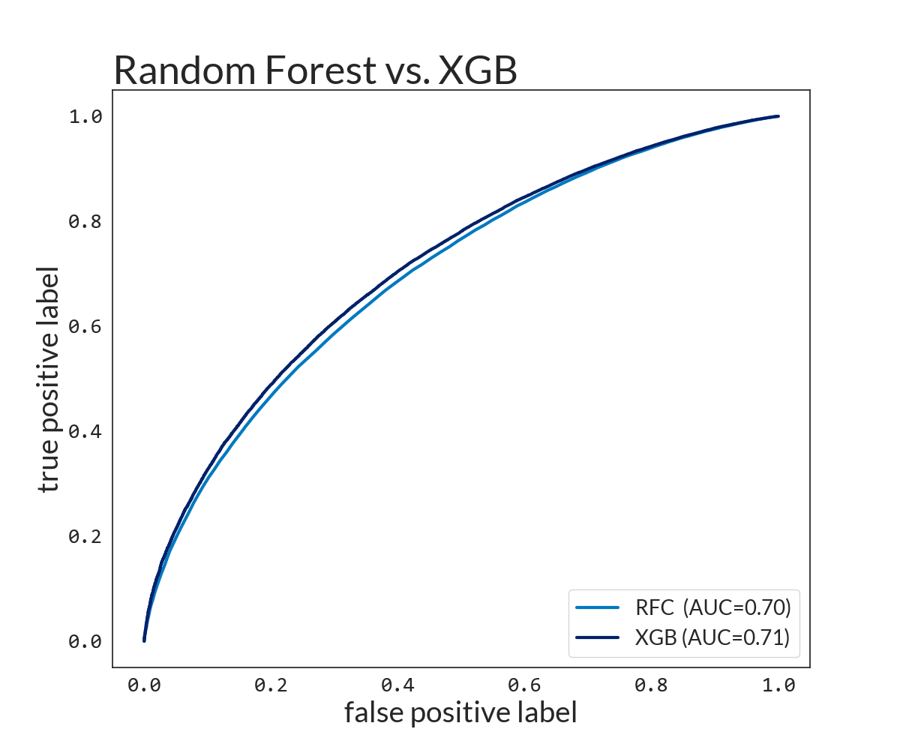
ROC Curve and AUC
An ROC curve (Receiver Operating Characteristic) is graph showing the performance of a classification model at an classification thresholds.
AUC (Area under the ROC curve) measures the entire two-dimensional area under the ROC curve.
AUC measures how well predictions.
Source: Google Developers

Slide 7
End.
Notes:
Cho Phan

