Slide 1
Marschner Model
A combination of three scattering modes on a dielectric cylinder
Primary specular peak to root
Strong forward scattering in light hair (very bright when lit from behind)
A secondary specular peak, a secondary colored highlight on top of the white highlights, that varies as a function of the azimuth
Currently have a paper summary
Watered down to basics
Psuedocode/plan for actual implementation

Slide 2
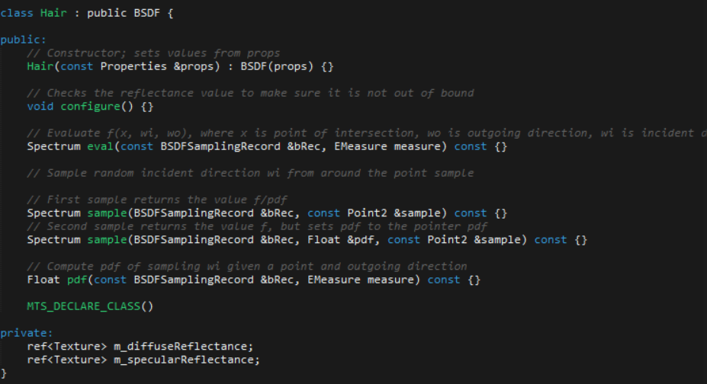
Code skeleton for Hair BSDF

