Slide 1
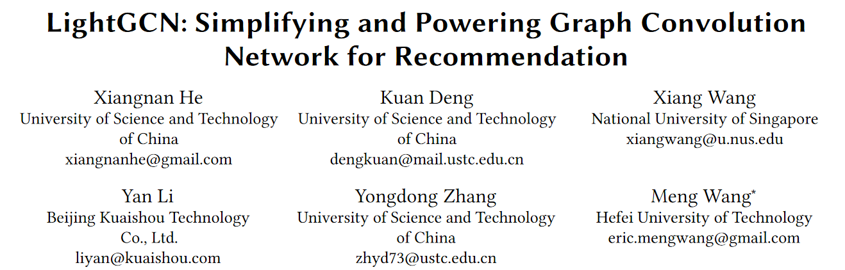
SIGIR 2020
董正
2022-6-27

Slide 2
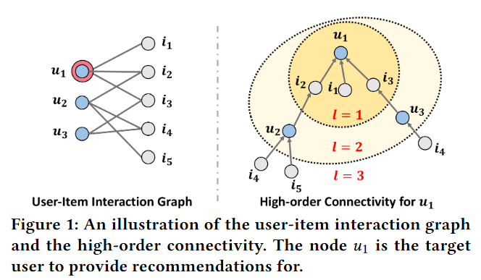


1 Introduction
推荐系统：预测user是否会和item交互
协同过滤(CF)：对每个user和item学习embedding来预测交互
behaviorally similar users would exhibit similar preference on items
Learn embeddings:
GCN on User-item Interaction Graph
(NGCF)
LightGCN: neighborhood aggregation
去掉σ和W

Slide 3
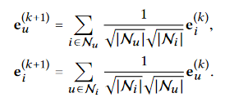
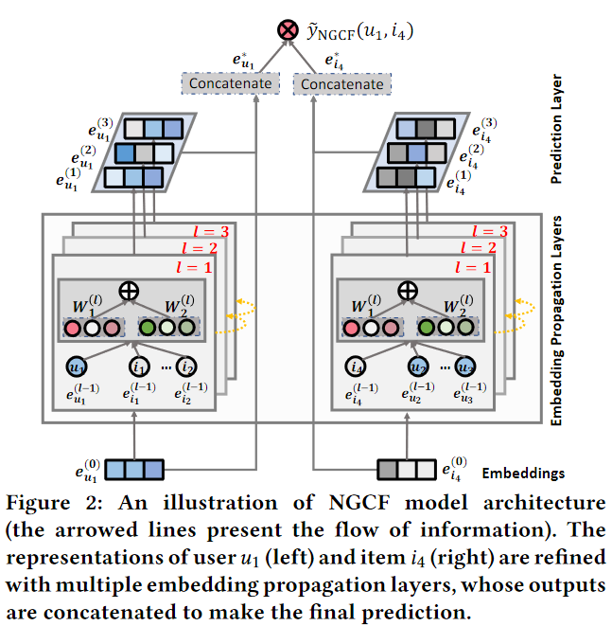
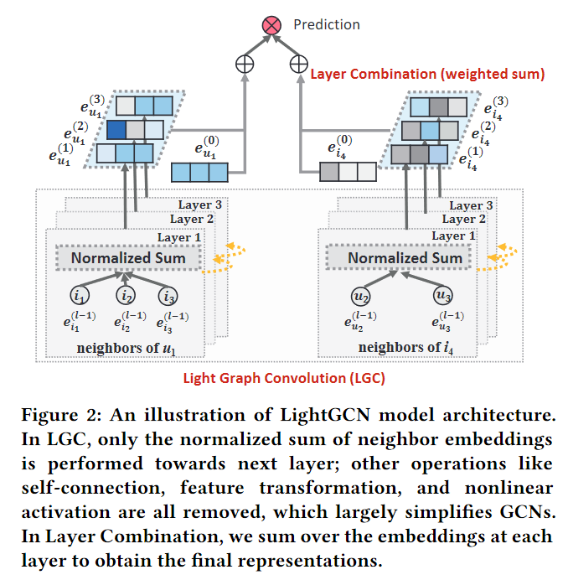
2 Method
实际应用：均值

Slide 4
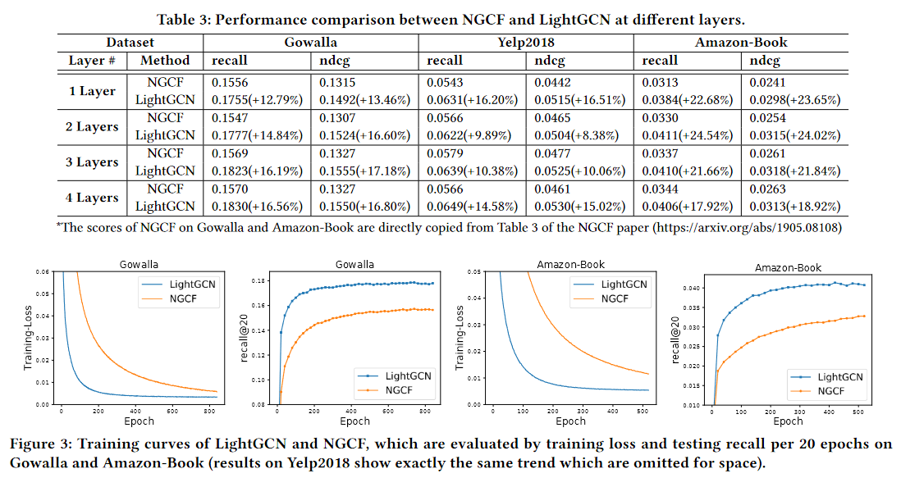
3 Experiments

Slide 5
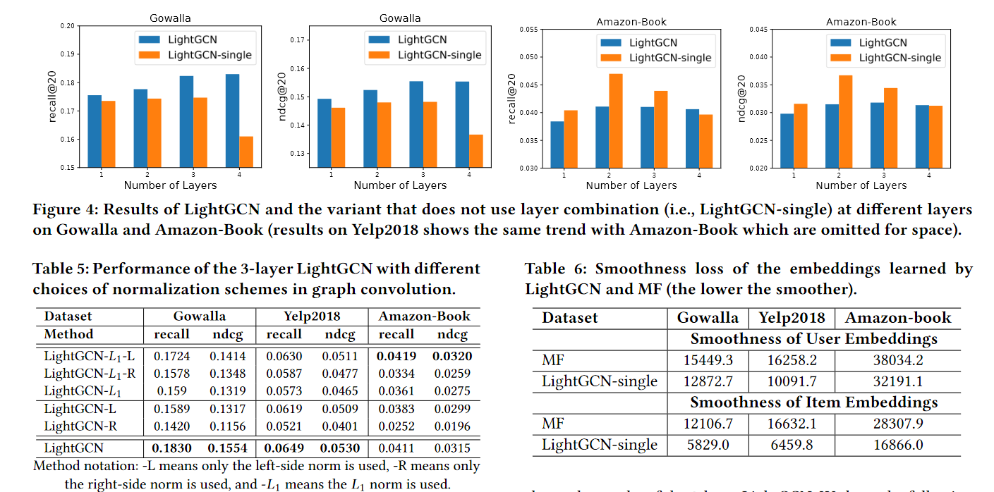
4 Ablation Study

Slide 6

















