Slide 1
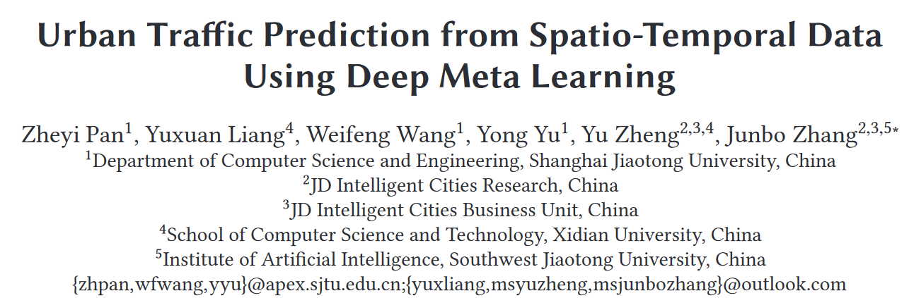
KDD 2019
董正
2022-10-10

Slide 2
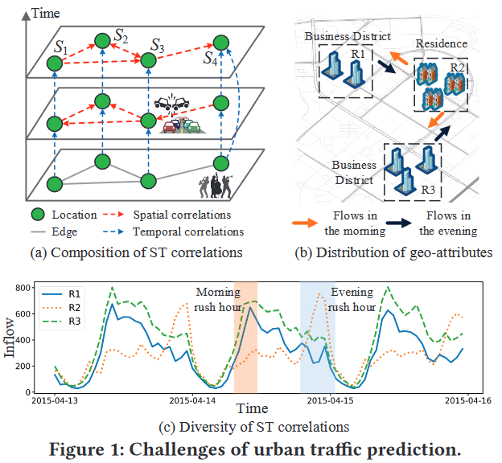
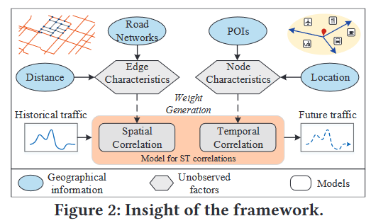
1 Introduction
目标：extract diverse ST correlations
创新点：
A meta-learning framework to learn meta knowledge from geo-graph attributes
A meta graph attention network to model spatial correlations
A meta gated recurrent neural network to model temporal correlations
A seq2seq framework for traffic prediction
Edge attributes -> spatial knowledge
Node attributes -> temporal knowledge
-> model parameters

Slide 3
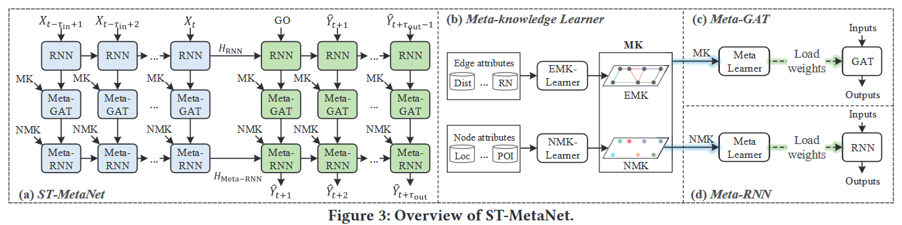
2 Framework
GRU
Meta-GRU

Slide 4
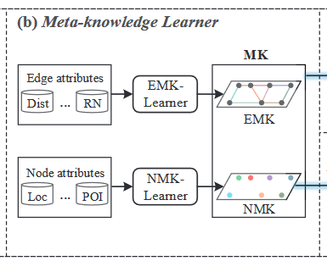
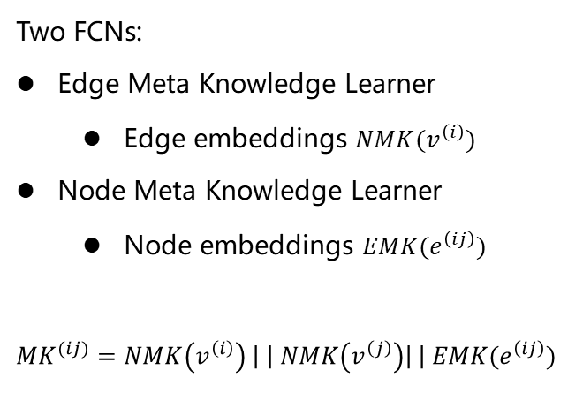
3 Meta-Knowledge Learner
Two FCNs:
Edge Meta Knowledge Learner
Edge embeddings $NMK(v^{\left(i\right)})$
Node Meta Knowledge Learner
Node embeddings $EMK(e^{\left(ij\right)})$
$$MK^{(ij)}=NMK\left(v^{\left(i\right)}\right) \left| \right| NMK\left(v^{\left(j\right)}\right)\left| \right| EMK(e^{\left(ij\right)})$$

Slide 5
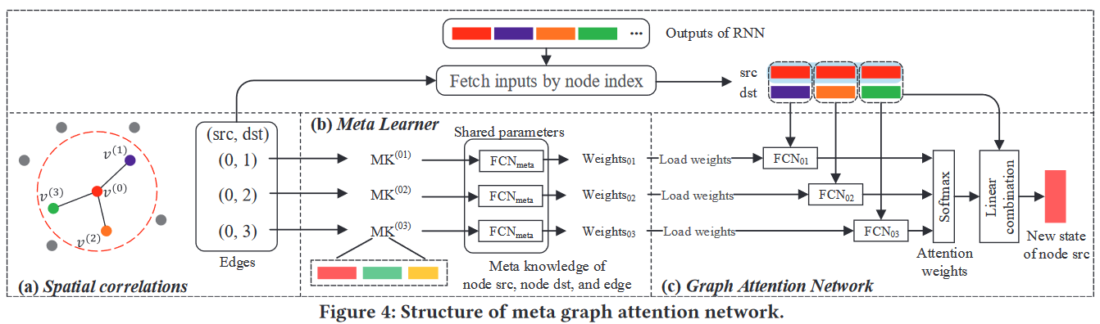
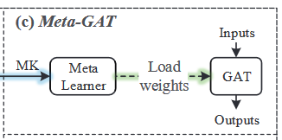


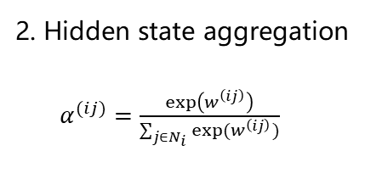
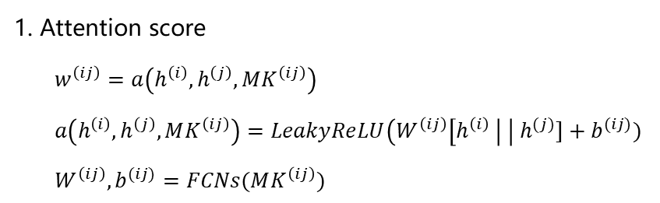

4 Meta-GAT
$$h^{(1)},h^{(2)},…,h^{(N_{l})}$$
1. Attention score
$w^{\left(ij\right)}=a\left(h^{\left(i\right)},h^{\left(j\right)},MK^{\left(ij\right)}\right)$
$a\left(h^{\left(i\right)},h^{\left(j\right)},MK^{\left(ij\right)}\right)=LeakyReLU\left(W^{\left(ij\right)}\left[h^{\left(i\right)} \right| \right| h^{(j)}]+b^{(ij)})$
$W^{\left(ij\right)},b^{(ij)}=FCNs(MK^{\left(ij\right)})$
2. Hidden state aggregation
$α^{(ij)}=\frac{exp\left(w^{\left(ij\right)}\right)}{\sum_{j∈N_{i}}{exp(w^{\left(ij\right)})}}$
$λ^{(i)}∈(0,1)$ 用来衡量邻居对其的影响力大小

Slide 6
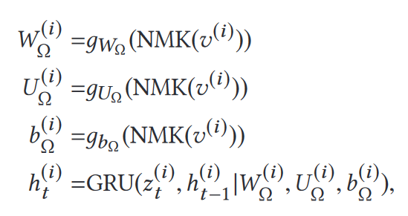
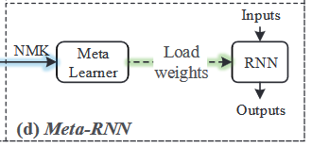
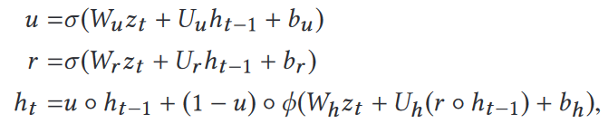
5 Meta-GRU

Slide 7
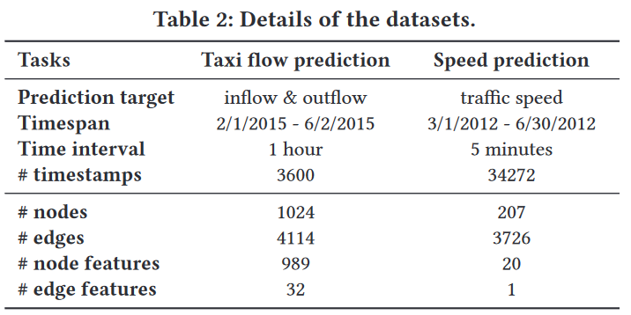
6 Experiments
Flow Prediction:
TDrive: 32*32 grids
Attributes:
· node: #POIs in each category, #roads and lanes, etc
· edge: #roads and lanes connecting two grids, etc
Speed Prediction:
METRLA: 207 sensors
Attributes: 2 directions
· node: GPS points of nodes, and road structure information for each node,
i.e., a vector reflecting the road distance between
the node and its k-nearest neighbors.
· edge: road distance between nodes

Slide 8
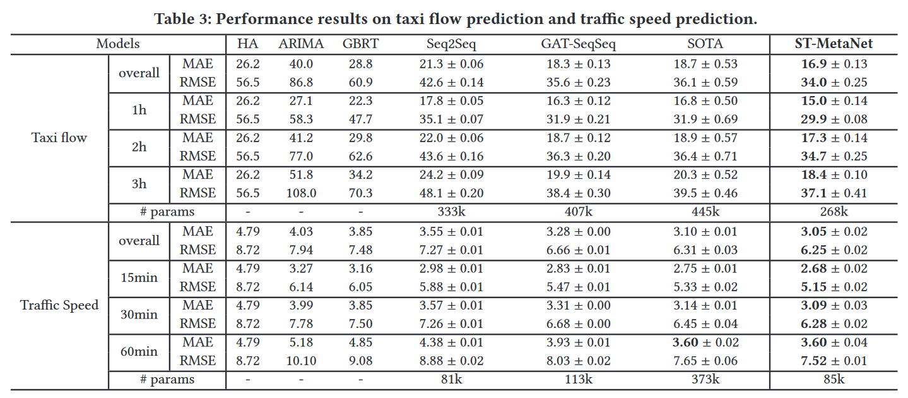
6 Experiments
ST-ResNet
DCRNN

Slide 9
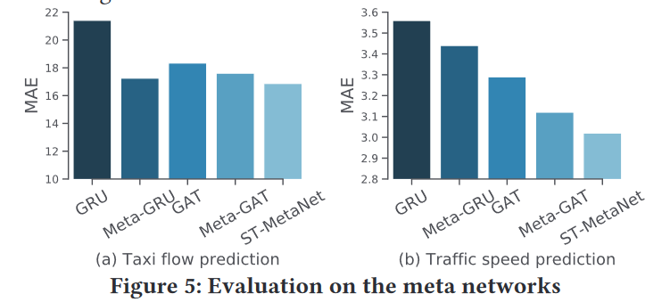
7 Ablation Study
GRU (two GRUs)
Meta-GRU (GRU and Meta-GRU)
GAT (GRU, GAT, and GRU)
MetaGAT (GRU, Meta-GAT, and GRU)
ST-MetaNet (GRU, Meta-GAT, and Meta-GRU)

Slide 10
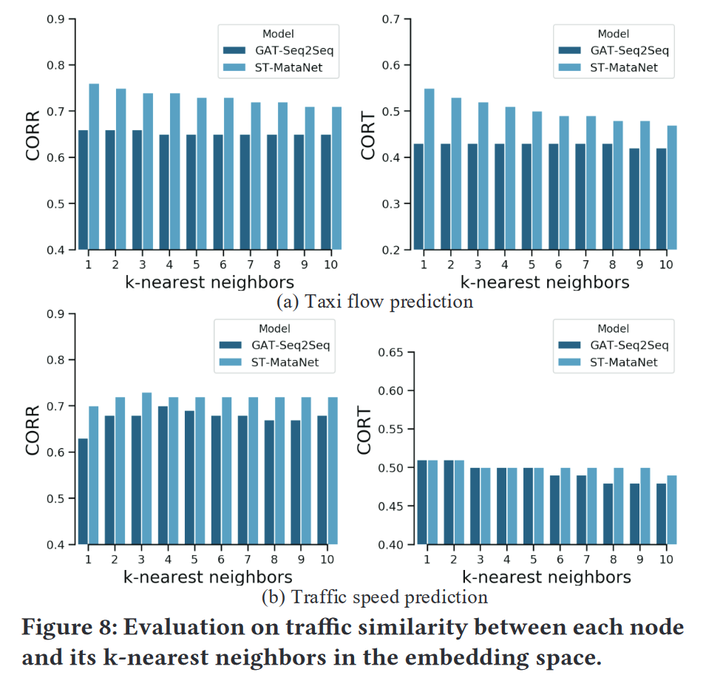
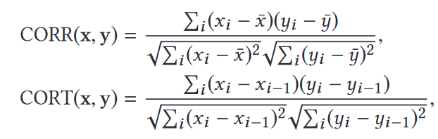
8 Interpretability

Slide 11
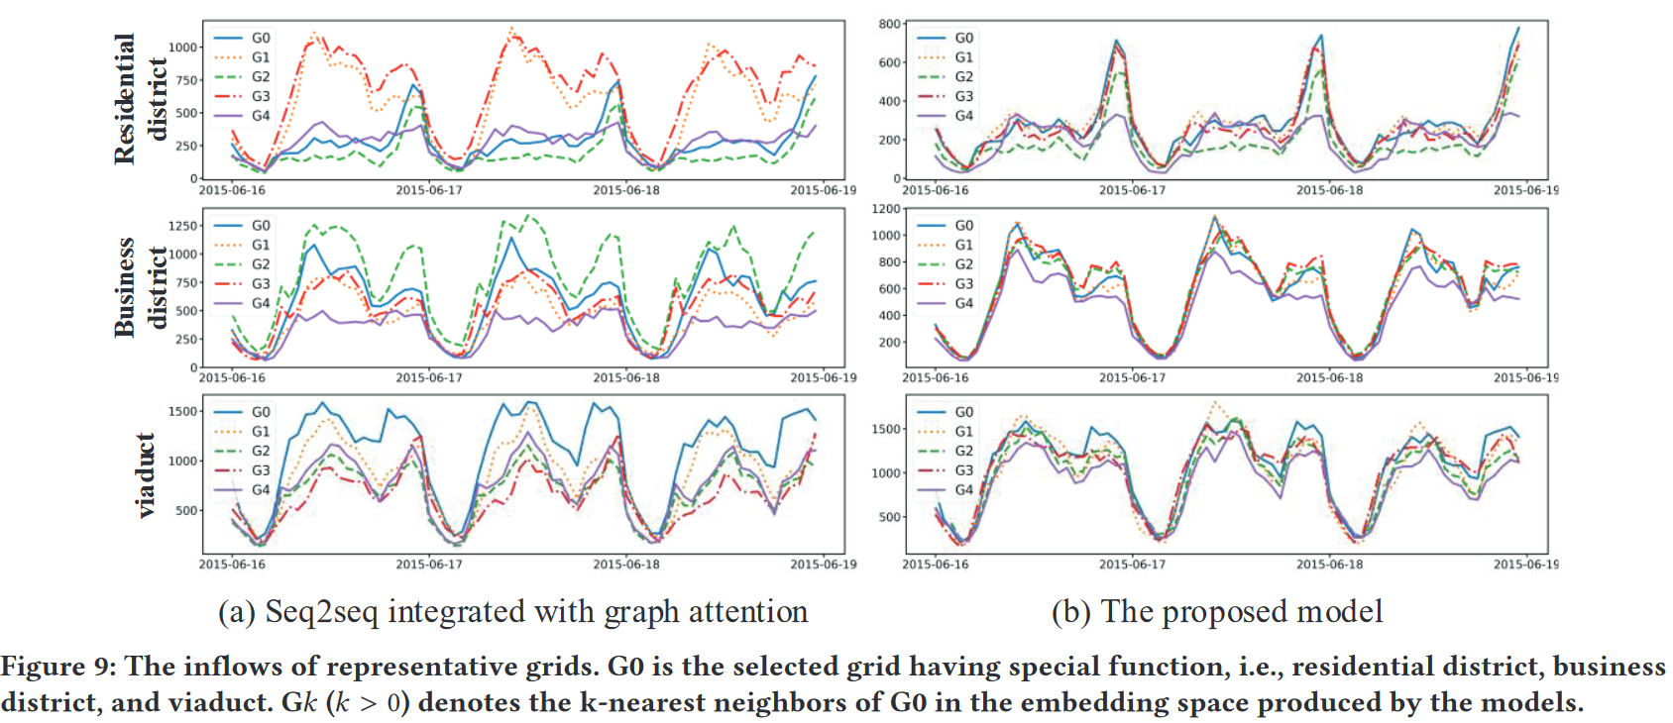
8 Interpretability

