Slide 1

GRADUATION THESIS
TOPIC: Laptop Sale Website
Student : Lê Thế Trung
Class : 17CE
Instructor : TS. Hoàng Hữu Đức

Slide 2
MAIN CONTENT
PURPOSE
CONTENT OF THE SUBJECT
RESULT,DEMO

Slide 3

PURPOSE OF CHOOSE TOPIC
Personal: With the knowledge I have learned, I feed suitable for web programming.
General: With the current epidemic situation, the solution to buy laptops online helps parents and students to buy goods easily without having to go directly to the store.

Slide 4
OBJECTIVES OF THE STUDY
Build a website to sell laptops.
Research on web programming.
Research on connecting the database to the website.
Research on laptop products.
Customer research and customer management.

Slide 5



TECHNOLOGY USED IN THE SUBJECT
FE languages: HTML,CSS,TS.
BE language: Java.
Framework: Spring boot, Angular.
Database: MySQL.

Slide 6
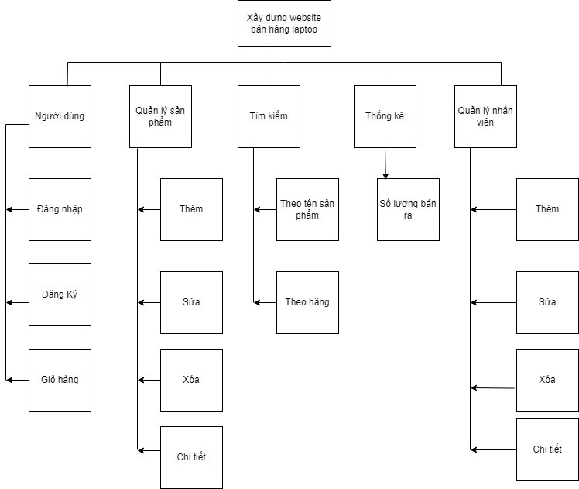
FUNCTIONAL HIGHLIGHTS DIAGRAM

Slide 7
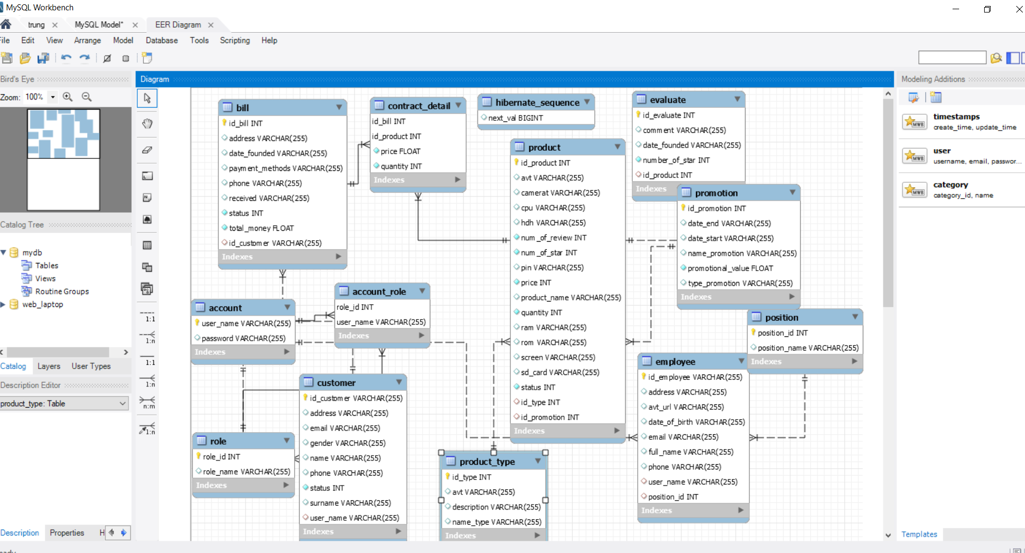
DATABASE

Slide 8
RESULT
Description:
Website selling laptops. Mainly serving two objects admin and user.
Admin: manage employees, manage products, orders, customers and profit statistics.
User: View product information, purchase products, make payments and invoices.

Slide 9
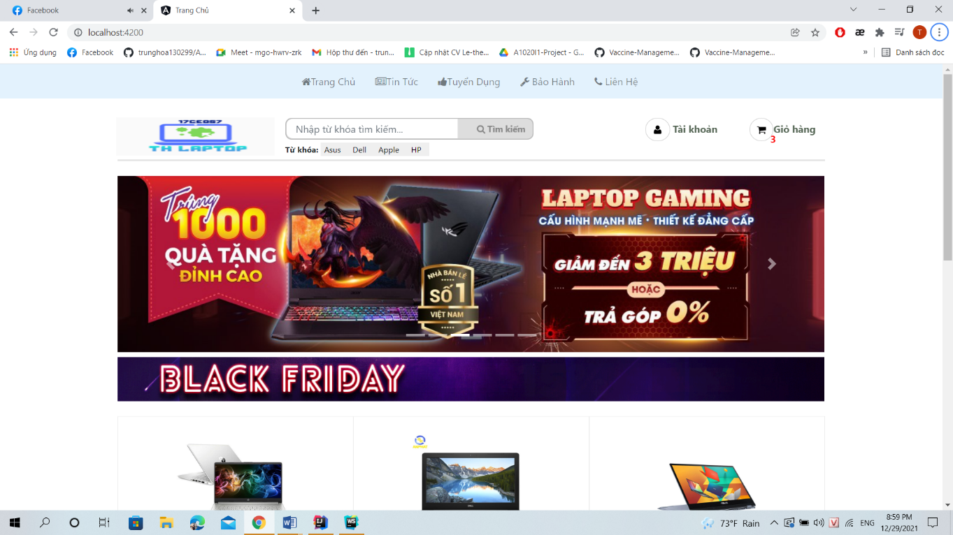
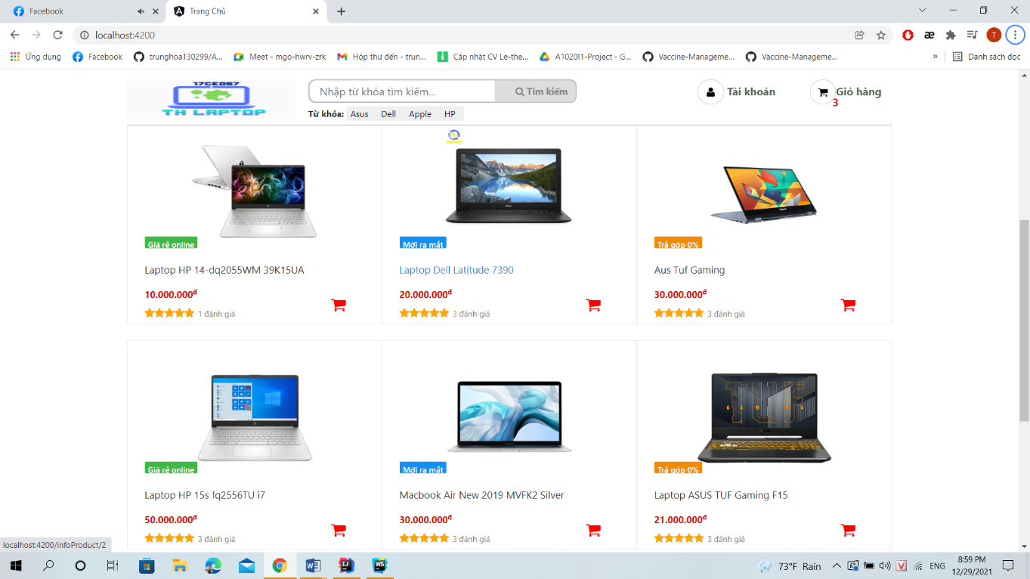
User page

Slide 10
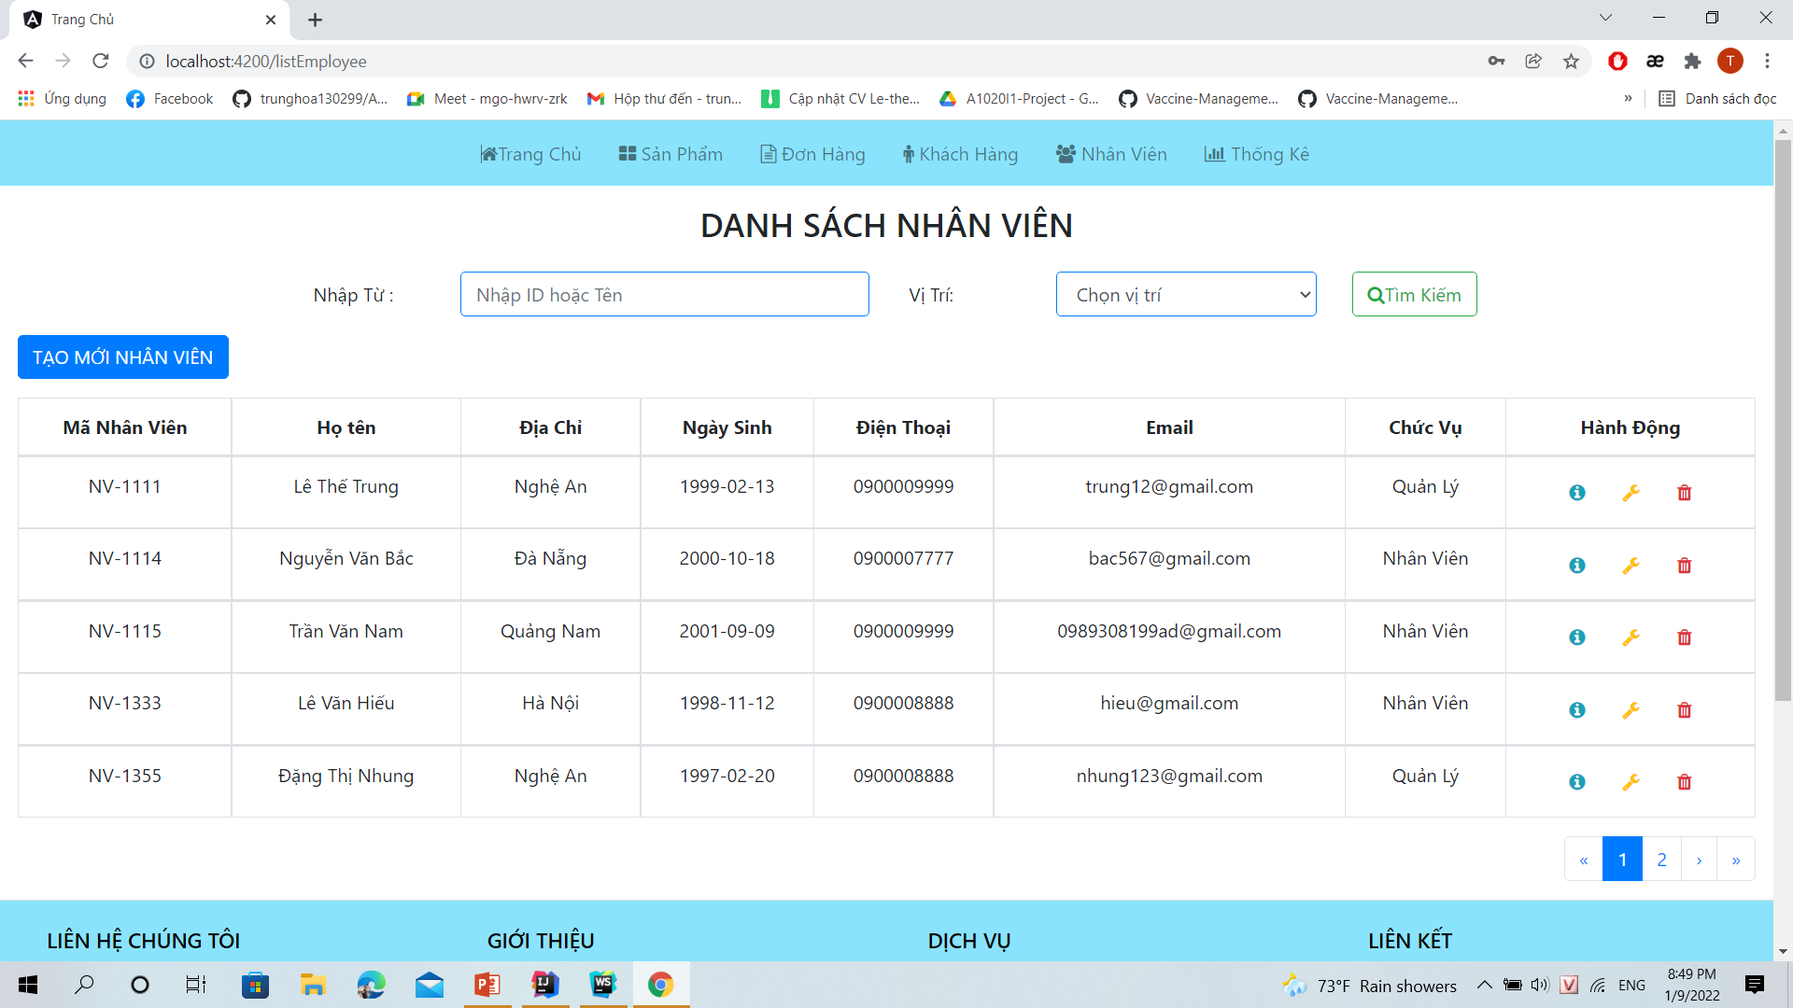
Admin page

Slide 11
ADVANTAGES AND LIMITATIONS
Advantages:
Design a friendly, easy-to-use website interface.
Ease of website maintenance.
Fast web page loading.
Limitations:
There is no domain for the website.
Some functions are incomplete.
Developing:
Supplement and complete the website.
Additional functions such as: pay by paypal.

Slide 12
DEMO

Slide 13


