Slide 1
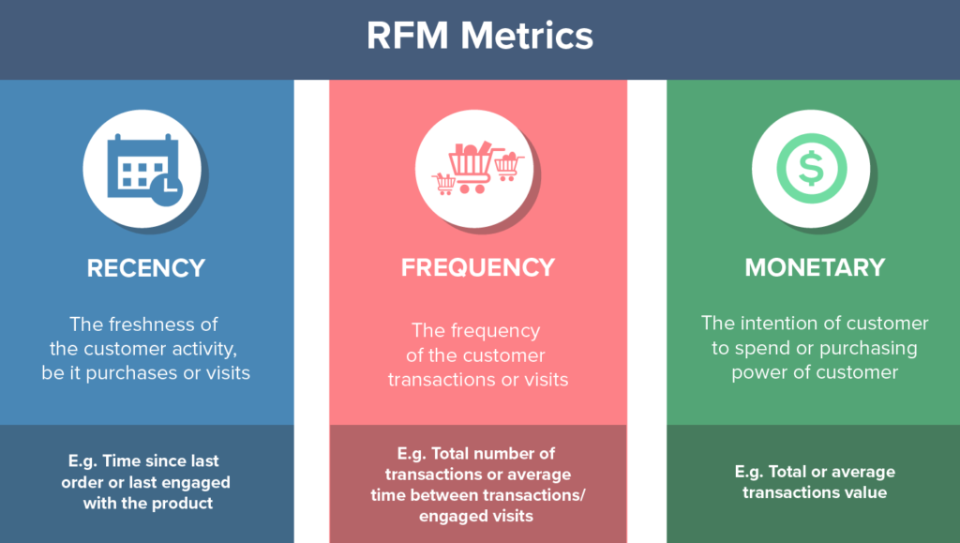
Video dùng SQL để transform data https://youtu.be/80uThxzE-ec
Video dùng PowerBI để transform data https://youtu.be/PQ_Uz_x8S9Q

Slide 2
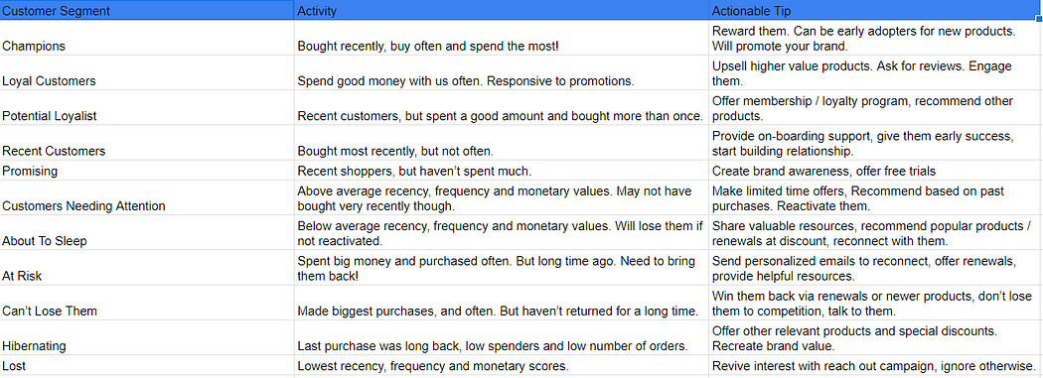

Slide 3
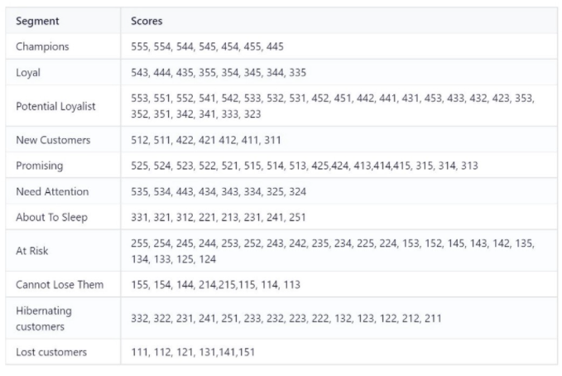

Slide 4
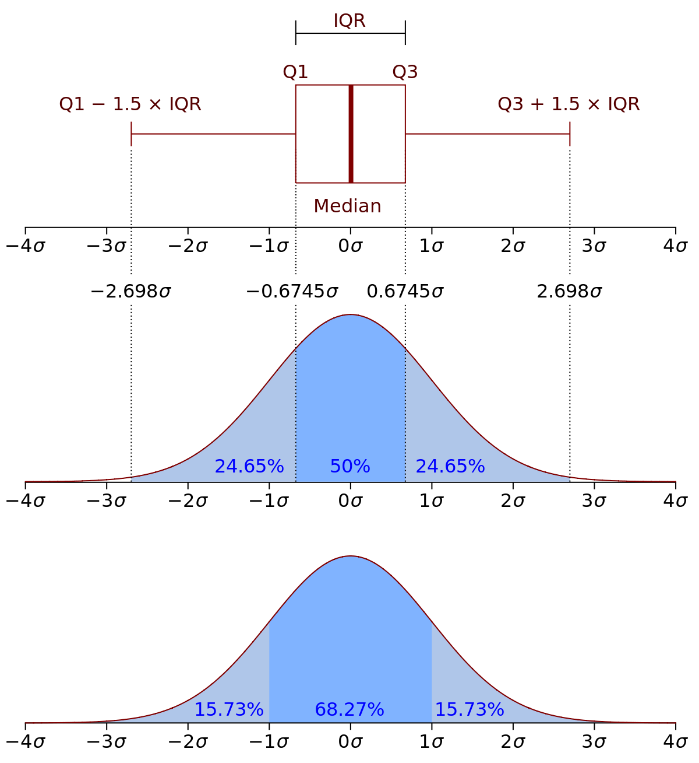

Slide 5
