Slide 1
Checkpoint 1
Team 17

Slide 2
Checkpoint 1 Objectives
• Load 64x64 Maze Environment
• Verify Agent-Environment Interaction
• Implement Naïve Navigation Strategy
• Demonstrate Basic Goal Reach

Slide 3
Environment Integration
• Successfully initialized MazeEnvironment
• Reset returns correct start position
• step() returns valid TurnResult
• Goal detection and death handling verified

Slide 4
Naïve Agent Strategy
Simple Greedy Movement Order:
1. MOVE_RIGHT
2. MOVE_DOWN
3. MOVE_LEFT
4. MOVE_UP
No hazard memory or map building yet.

Slide 5
Current Results
• Agent moves correctly within maze
• Detects walls using wall_hits
• Respawns after death
• Occasionally reaches goal

Slide 6
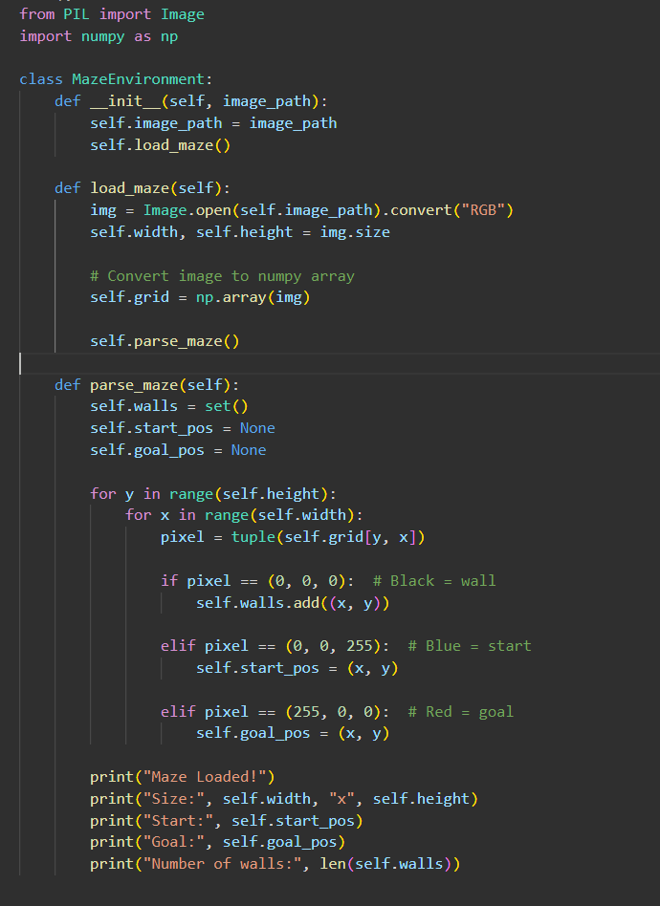

Slide 7
