Slide 1
IMP PROJECT RESEARCH DEFENSE
Evidence before leaderboard claims
EVIDENCE
ATLAS
A repaired evidence contract turns a contaminated benchmark and a failed hypothesis into defensible research.
MiT-B3 U-Net versus nnU-Net v2
Negative contour-channel ablation
Protected test remains sealed; this is not state of the art
research report | July 2026
Notes:
Open with the tension: a high Dice score is not useful when the evidence contract is broken.,State that this talk values what the evidence supports, including a negative result.,Do not describe the system as clinical or state of the art.
Release manifest SHA-256: 435606d5adc296be57405c65a9c725af3dff96c15f9aabf7ac0924d06387a264

Slide 2
WHY THE STUDY NEEDED REPAIR
Leakage changed the meaning of every favorable score
Three patient identities and 13 rows crossed legacy split boundaries, so the old leaderboard became historical evidence rather than a scientific ranking.
3
Patient overlap violates independent patient-level interpretation.
crossing patient IDs
Old test-v2 values remain visible only as contamination-aware history.
13
The repair starts with identity groups, not model tuning.
cross-boundary rows
legacy_patient_contaminated
02
Notes:
Explain that leakage is a scientific design defect, not a cosmetic caveat.,Do not compare legacy model scores as if they were independent test results.,Use this slide to motivate the evidence hierarchy.
Release manifest SHA-256: 435606d5adc296be57405c65a9c725af3dff96c15f9aabf7ac0924d06387a264

Slide 3
BOUNDED RESEARCH QUESTIONS
Two hypotheses, two evidence classes
The architecture comparison and the contour-channel ablation answer different questions and must not be collapsed into one ranking.
RQ1
RQ2
How do complete MiT-B3 and nnU-Net systems trade overlap, boundary quality, precision, and recall?
Does a saliency-constrained contour channel improve a matched MiT-B3 control?
System comparison
Single recorded run
Descriptive inference
Matched intervention
Three selected seeds
Conditional paired inference
adaptive development-validation + train_screen
03
Notes:
Keep the architecture comparison descriptive because it has one recorded run per system.,Describe Loop206 as a controlled train-screen ablation with three selected seeds.,Transition to the interactive pipeline as the map of the evidence flow.
Release manifest SHA-256: 435606d5adc296be57405c65a9c725af3dff96c15f9aabf7ac0924d06387a264

Slide 4
CLICK A MODULE TO INSPECT IT
The claim can only be as strong as its weakest evidence boundary
Every model output passes through data, protocol, metric, and claim gates before it reaches the paper or demo.
01
02
03
04
05
06
Data Audit
Preprocessing
Models
Robust Evaluation
Loop206 Ablation
Evidence-bound Demo
Select a module for its evidence detail. Every detail slide returns here.
interactive evidence pipeline
04
Notes:
Use this slide nonlinearly: select the module that best matches the audience question.,For the default talk, visit modules from left to right.,The pipeline is a navigation spine, not a decorative architecture diagram.
Release manifest SHA-256: 435606d5adc296be57405c65a9c725af3dff96c15f9aabf7ac0924d06387a264

Slide 5
MODULE 01 | DATA AUDIT
Clean-v3 repairs identity leakage before model comparison
The leakage-audited manifest contains 2,869 images with no detected cross-split identity-group overlap.
2,869
leakage-audited images
TRAIN
2,008
ADAPTIVE VALIDATION
431
SEALED TEST
430
IDENTITY / EXACT DUPLICATE / PERCEPTUAL DUPLICATE / SPLIT GROUP
Validation was opened adaptively. The 430-row test partition remains sealed.
Back to Pipeline
dataset audit | protected test sealed
05
Notes:
Say no detected overlap, not proof of no hidden biological relationship.,Clarify that validation was already opened and used adaptively.,The 430-row test partition remains sealed.
Release manifest SHA-256: 435606d5adc296be57405c65a9c725af3dff96c15f9aabf7ac0924d06387a264

Slide 6
MODULES 02-03 | PREPROCESSING + MODELS
The comparison is between complete systems, not isolated encoders
MiT-B3 uses a fixed preprocessing-aware 384x384 pipeline; nnU-Net v2 uses raw RGB and a self-configuring 256x256 system.
MiT-B3 U-Net
nnU-Net v2
384 × 384
LAB-luminance CLAHE
Percentile stretch + median filter
Fixed preprocessing-aware system
256 × 256
Raw RGB
Generated plans
Self-configuring 2D system
Different resolution, decoder, loss, augmentation, and policy: this is not an isolated encoder ablation.
Back to Pipeline
adaptive development-validation | older geometry contract
06
Notes:
Avoid calling this a controlled architecture ablation.,Explain that nnU-Net is a strong system-level baseline.,Mention the historical geometry mismatch as a limitation, not a hidden footnote.
Release manifest SHA-256: 435606d5adc296be57405c65a9c725af3dff96c15f9aabf7ac0924d06387a264

Slide 7
MODULE 04 | ROBUST EVALUATION
nnU-Net records higher point estimates, not statistical superiority
On adaptive development-validation, nnU-Net v2 has higher robust Dice and boundary F1 point estimates; MiT-B3 retains slightly higher precision.
Robust Dice
0.8959
Point estimates only
Single recorded run
No paired confidence interval
0.9019
Boundary F1
0.4145
0.4369
MiT-B3 retains slightly higher precision; metric trade-offs remain material.
MiT-B3 nnU-Net v2
Back to Pipeline
adaptive development-validation | single run | selection-optimistic
07
Notes:
Read the values as recorded point estimates.,Do not say statistically significant, superior, or test performance.,Use the precision direction to show that metric trade-offs matter.
Release manifest SHA-256: 435606d5adc296be57405c65a9c725af3dff96c15f9aabf7ac0924d06387a264

Slide 8
MODULE 05 | LOOP206 DESIGN
Loop206 isolates one intervention: the fourth input channel
Control and candidate share architecture, preprocessing, seeds, budget, and loss; only the zero versus contour channel changes.
CONTROL
zero fourth channel
SAME INPUT
SAME SEED
PAIRED GROUP BOOTSTRAP
seeds + views averaged first
CANDIDATE
contour fourth channel
308
76
3
fit groups
holdout groups
paired seeds
Back to Pipeline
train_screen | three selected seeds | 76 groups
08
Notes:
This is the stronger causal comparison because the arms are matched.,The interval is conditional on the selected seeds and does not estimate seed-selection uncertainty.,No protected image or mask participates in fitting, thresholding, selection, or evaluation.
Release manifest SHA-256: 435606d5adc296be57405c65a9c725af3dff96c15f9aabf7ac0924d06387a264

Slide 9
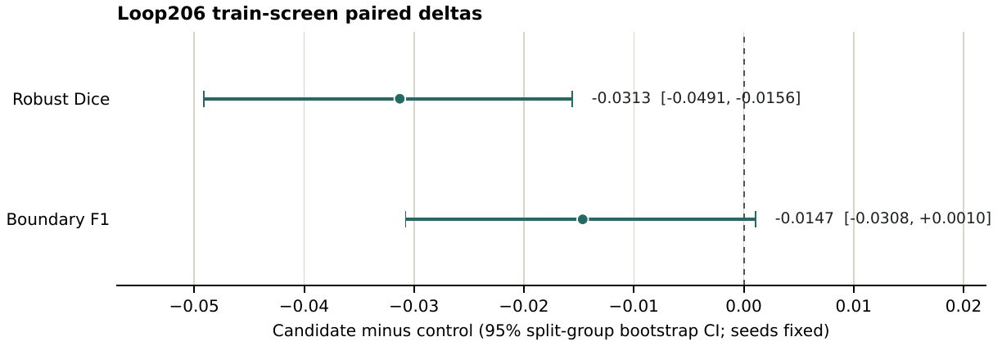
MODULE 05 | DECISION
The contour channel fails the primary gate
Seed-and-view-averaged robust Dice changes by -0.0313; its conditional 95% interval lies entirely below zero.
REJECT
Dice Δ -0.0313
95% CI [-0.0491, -0.0156]
BF1 Δ -0.0147
95% CI [-0.0308, 0.0010]
Candidate rejected before protected evaluation.
Back to Pipeline
train_screen | conditional on the selected seeds
09
Notes:
Pause on the negative result: it is the main controlled finding.,Do not generalize from this binary contour mechanism to all boundary methods.,Explain that a failed preregistered gate prevents expensive protected-test fishing.
Release manifest SHA-256: 435606d5adc296be57405c65a9c725af3dff96c15f9aabf7ac0924d06387a264

Slide 10
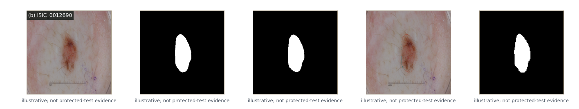
MODULE 06 | EVIDENCE-BOUND DEMO
Two demo lanes answer different questions
Live public/synthetic RGB runs L206-control-s206 then reconstructed L192 nnU-Net; audited fixed samples compare the two Loop206 arms. Live output is not paper RQ1.
AUDITED FIXED L206 LANE
LIVE PUBLIC/SYNTHETIC LANE
Fixed-cache sample: original + control mask + candidate mask
ISIC_0000050 | ISIC_0012690
SAME RGB, SEQUENTIAL
L206-control-s206
L192-nnUNet-v2-raw-100ep
2 public samples: illustrative masks + hash receipts
No ground truth. No accuracy. Not paper RQ1.
illustrative fixed-cache examples; not protected-test evidence
Non-clinical research demo; not a diagnosis.
Ground truth is authorized only in the audited fixed lane.
Back to Pipeline
live public/synthetic illustrative lane + audited fixed L206 lane | non-clinical
10
Notes:
Open the live dual lane only after local preflight passes; it chains L206 control and reconstructed L192 on the same public/synthetic RGB.,Two public samples are illustrative only: show masks, never ground truth, accuracy, or generalization; receipts are eligible only after a successful dual run, and no canonical live receipt is included.,Disclose asymmetric training exposure for both public samples: included in Clean-v3 L192 training, excluded from the L206 308-group fit, and in its 76-group train-screen holdout.,Keep audited fixed L206 zero-versus-contour evidence separate from the live lane; it is not paper RQ1.,Keep the non-clinical warning visible.
Release manifest SHA-256: 435606d5adc296be57405c65a9c725af3dff96c15f9aabf7ac0924d06387a264

Slide 11
CHALLENGE 01 | LEAKAGE
Can a clean score survive an invalid split?
A polished score cannot rescue a patient split whose identities cross evaluation boundaries.
PROBLEM
Leakage can make a validation split look more independent than it is.
RESPONSE
Audit identity groups and split assignments before interpreting model scores.
REMAINING LIMITATION
Audits reduce detectable leakage; they do not prove every hidden relationship is absent.
challenge | leakage and split validity
11
Notes:
Defense question: what evidence supports split validity before any model comparison?,Keep the distinction between detectable overlap and proof of no hidden relationship explicit.
Release manifest SHA-256: 435606d5adc296be57405c65a9c725af3dff96c15f9aabf7ac0924d06387a264

Slide 12
CHALLENGE 02 | FAIRNESS
What makes a comparison fair enough to interpret?
A fair comparison needs its system differences and geometry contract stated before its ranking is discussed.
PROBLEM
Complete systems can differ in preprocessing, resolution, geometry, loss, and inference policy.
RESPONSE
Describe the comparison as system-level, then use matched arms for a causal geometry-preserving test.
REMAINING LIMITATION
A system comparison cannot identify which individual component caused a difference.
challenge | fair comparison and geometry
12
Notes:
Defense question: which comparison is descriptive, and which isolates one intervention?,Do not turn a system-level comparison into an encoder-only conclusion.
Release manifest SHA-256: 435606d5adc296be57405c65a9c725af3dff96c15f9aabf7ac0924d06387a264

Slide 13
CHALLENGE 03 | UNCERTAINTY
How much certainty can adaptive validation support?
Adaptive validation supports development decisions, not a certainty claim about unseen performance.
PROBLEM
Repeated development choices can make validation point estimates selection-optimistic.
RESPONSE
Label uncertainty, report the available interval, and keep the protected test sealed.
REMAINING LIMITATION
Recorded evidence has no paired confidence interval for the architecture comparison.
challenge | uncertainty and adaptive validation
13
Notes:
Defense question: why is the architecture result descriptive rather than a superiority claim?,Separate selected-seed uncertainty from the conditional Loop206 interval.
Release manifest SHA-256: 435606d5adc296be57405c65a9c725af3dff96c15f9aabf7ac0924d06387a264

Slide 14
CHALLENGE 04 | DEMO TRUST
When should an interactive demo be trusted?
A demo earns trust by showing only the lane, inputs, and claims its evidence contract authorizes.
PROBLEM
A convincing visual demo can be mistaken for accuracy or generalization evidence.
RESPONSE
Keep illustrative live outputs separate from audited fixed comparisons and state their scope.
REMAINING LIMITATION
The demo does not establish paper RQ1 or a canonical live receipt.
challenge | demo trust
14
Notes:
Defense question: which lane is illustrative, and which lane is audited fixed evidence?,Keep the non-clinical notice and no-generalization boundary visible.
Release manifest SHA-256: 435606d5adc296be57405c65a9c725af3dff96c15f9aabf7ac0924d06387a264

Slide 15
CHALLENGE 05 | REPRODUCIBILITY
What can a reproducible deployment actually prove?
Reproducibility is strongest when deployment checks distinguish verified artifacts from unavailable historical experiments.
PROBLEM
Hash-bound release artifacts do not make incomplete historical training runs clone-runnable.
RESPONSE
Verify available source bytes in the strict local audit and document deployment boundaries.
REMAINING LIMITATION
Missing code, configurations, and predictions prevent full experiment reproduction.
challenge | reproducibility and deployment
15
Notes:
Defense question: what is hash-bound, and what remains unavailable for a clone-runnable experiment?,Describe deployment verification separately from original-runtime equivalence.
Release manifest SHA-256: 435606d5adc296be57405c65a9c725af3dff96c15f9aabf7ac0924d06387a264

Slide 16
REPRODUCIBILITY + LIMITS
Artifacts are hash-bound; full experiments are not clone-runnable
Recorded claims are digest-recorded; source bytes are verified only in the strict local audit, while missing historical training artifacts keep full experiments from being clone-runnable.
HASH-BOUND
RECONSTRUCTED RUNTIME
NOT CLONE-RUNNABLE
Recorded claims
Tables + figures
Compiled PDF
Model IDs
Source reports
L192 runtime identity
Startup verification
No original equivalence
No full E2E proof
Historical training code
Loop191/192 configs
Paired predictions
RQ1-v2 pending until P1
Protected test remains sealed.
hash-bound release | protected test remains sealed
16
Notes:
Separate digest-recorded claims from source-byte verification, which is available only in the strict local audit, and from reproduction of complete historical experiments.,Name the reconstructed Loop192 runtime; do not imply original-runtime equivalence or E2E validation.,RQ1-v2 is pending/unverified until P1. Keep protected test and non-clinical limits explicit.
Release manifest SHA-256: 435606d5adc296be57405c65a9c725af3dff96c15f9aabf7ac0924d06387a264

Slide 17
DEFENSIBLE TAKEAWAY
A narrower conclusion is the stronger scientific result
nnU-Net records higher development-validation point estimates, the hard contour prior fails its matched train-screen gate, and no protected-test or state-of-the-art claim is authorized.
01
Repair leakage before optimizing models.
02
Use strong baselines without hiding contract differences.
03
Publish negative ablations when they reject a mechanism.
NEXT DEFENSIBLE EXPERIMENT
Reproduce both systems under one geometry contract before any protected test.
scientific_sota_status = not_established
17
Notes:
Resolve the opening tension: evidence discipline prevented a false leaderboard claim.,End on the next defensible experiment, not a generic thank-you slide.,Invite questions about evidence boundaries, the matched ablation, or the demo.
Release manifest SHA-256: 435606d5adc296be57405c65a9c725af3dff96c15f9aabf7ac0924d06387a264

