Slide 1
Android Overview

Slide 2
Contents
Android operating system
Android platform architecture
Android versions

Slide 3
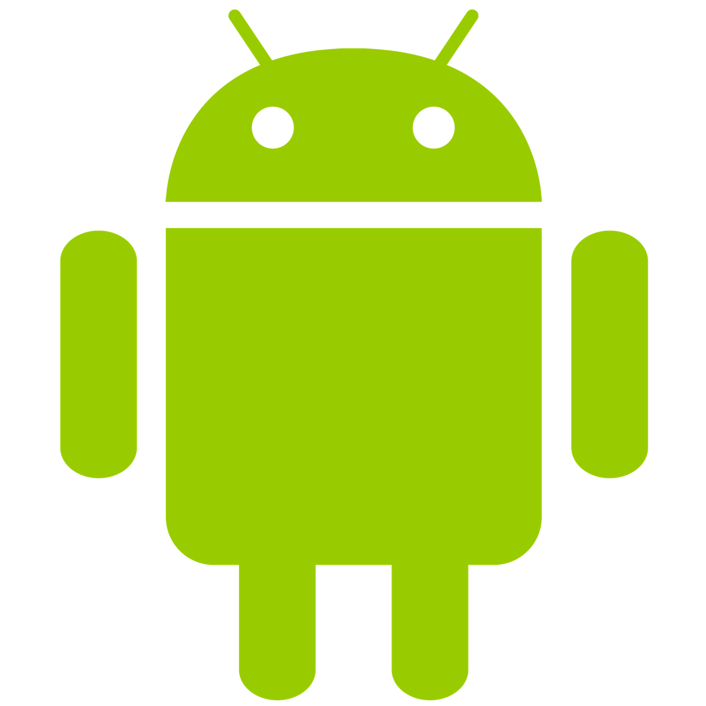
Android operating system
Android is a Linux-based operating system
Open source
https://source.android.com/
Just the OS, not the Play store or Google play services
User Interface for touch screens
Highly customizable for devices / by vendors

Slide 4
Android Ecosystem
Android - phones and tablets
Android wear - smartwatch
Extended notification center
Android TV - televisions, consoles
Native TV app experience for IPTV
Android auto - cars
Connecting phone with the car
Android things
Platform for IoT
Google glass

Slide 5
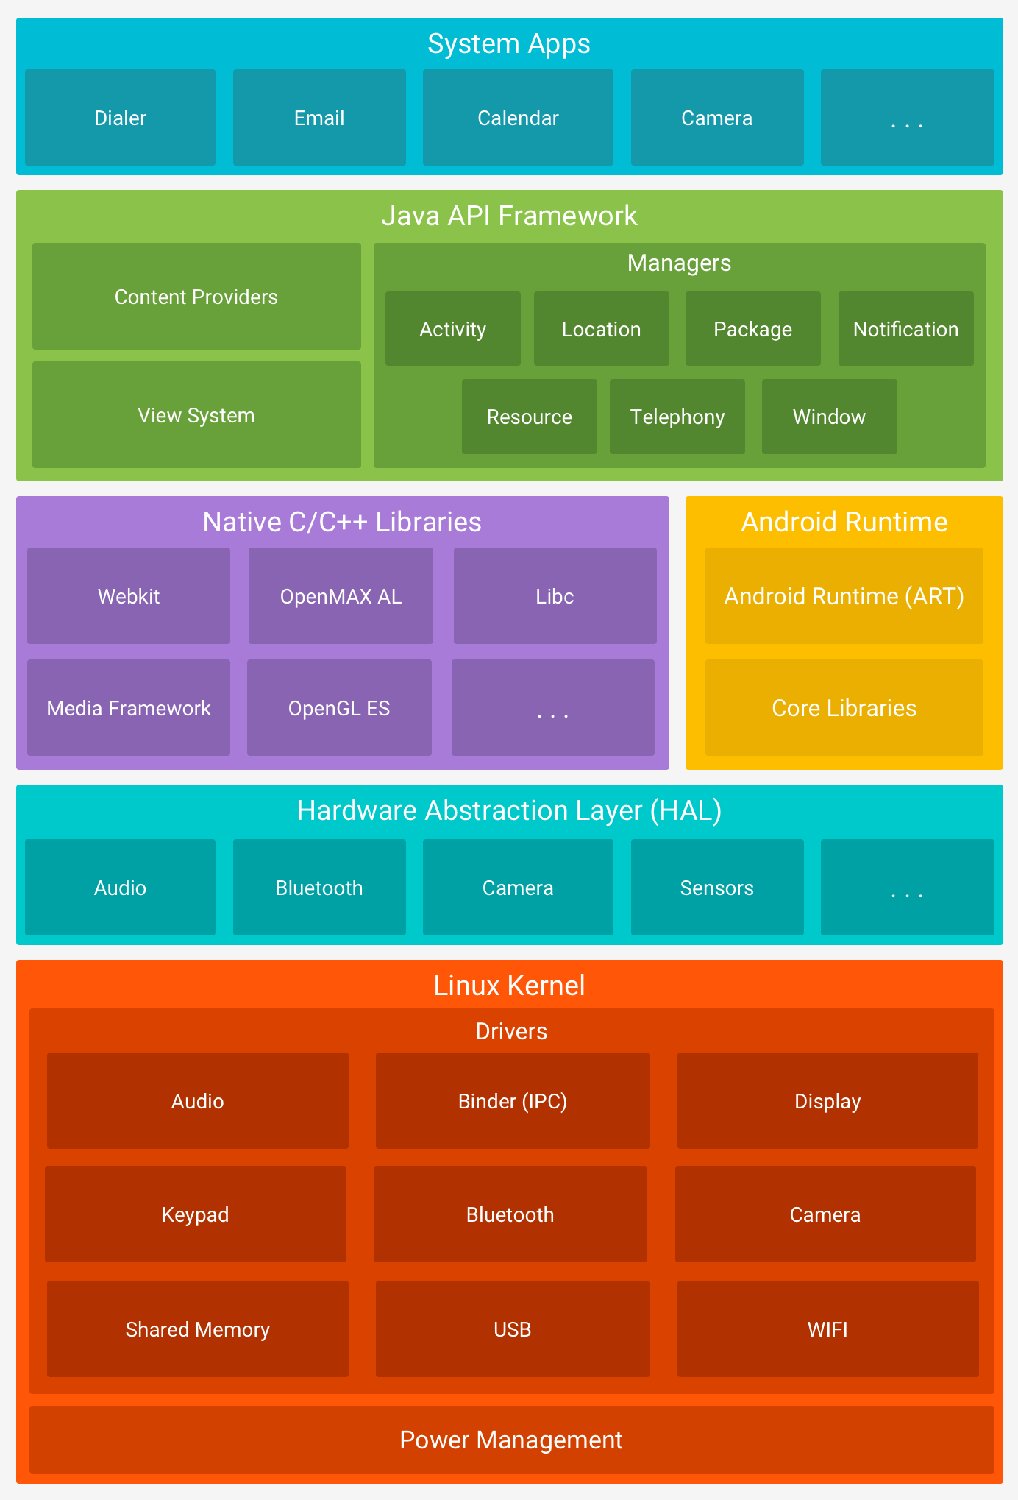
Android Platform Architecture
5
4
Linux Kernel
HAL: Expose device hardware capabilities
Expose native APIs; run apps
Java API Framework: Android OS API in Java framework
System and user apps
3
2
1

Slide 6
Android Platform Architecture
1. Linux Kernel
Threading and low-level memory management
Security features
Drivers

Slide 7
Android Platform Architecture
2. Hardware Abstraction Layer (HAL): Standard interfaces that expose device hardware capabilities as libraries
Examples: Camera, bluetooth module
3.1 C/C++ libraries: give access to core native Android system components and services.
3.2. Android runtime: Each app runs in its own process with its own instance of the Android Runtime.

Slide 8
Android Platform Architecture
4. Java API Framework:
The entire feature-set of the Android OS is available to you through APIs written in the Java language.
View class hierarchy to create UI screens
Notification manager
Activity manager for life cycles and navigation

Slide 9
Android Platform Architecture
5. System and user apps
System apps have no special status
System apps provide key capabilities to app developers
Example:
Your app can use a system app to deliver a SMS message.

Slide 10
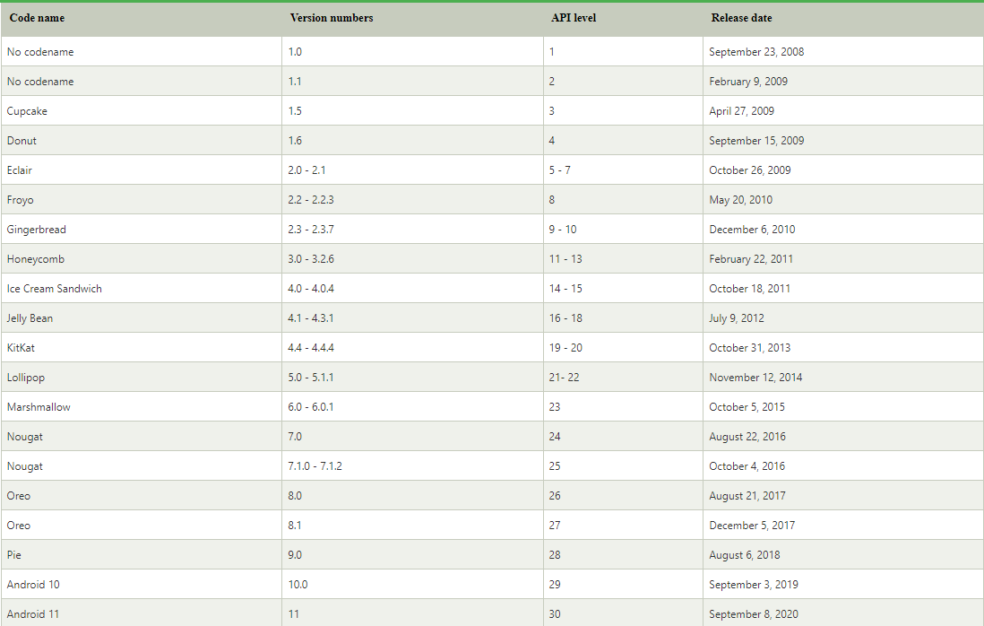
Android versions

Slide 11
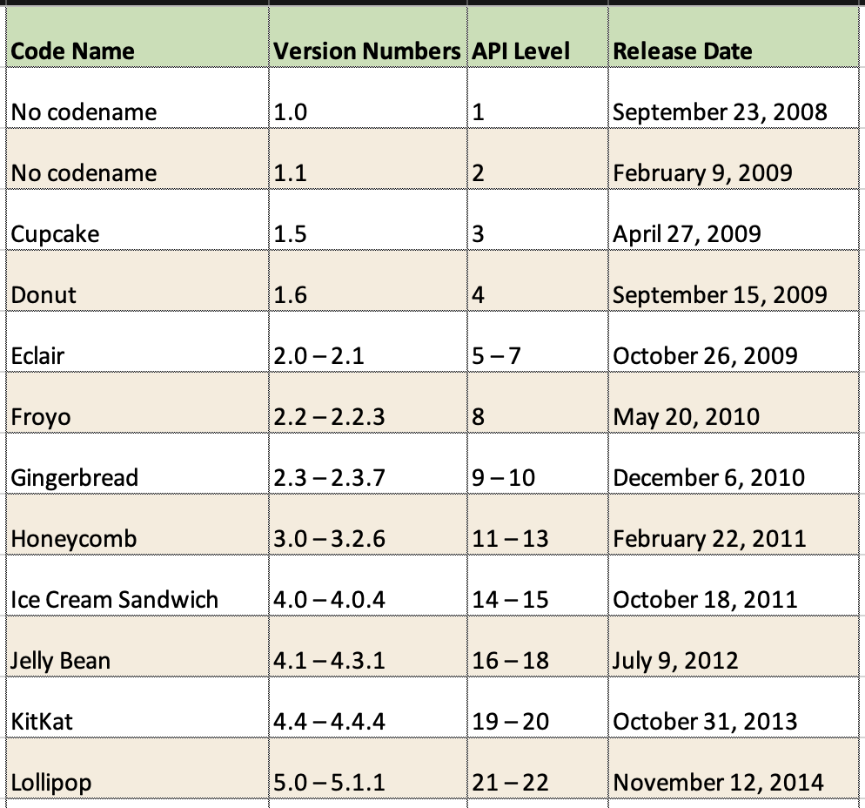
Android versions

Slide 12
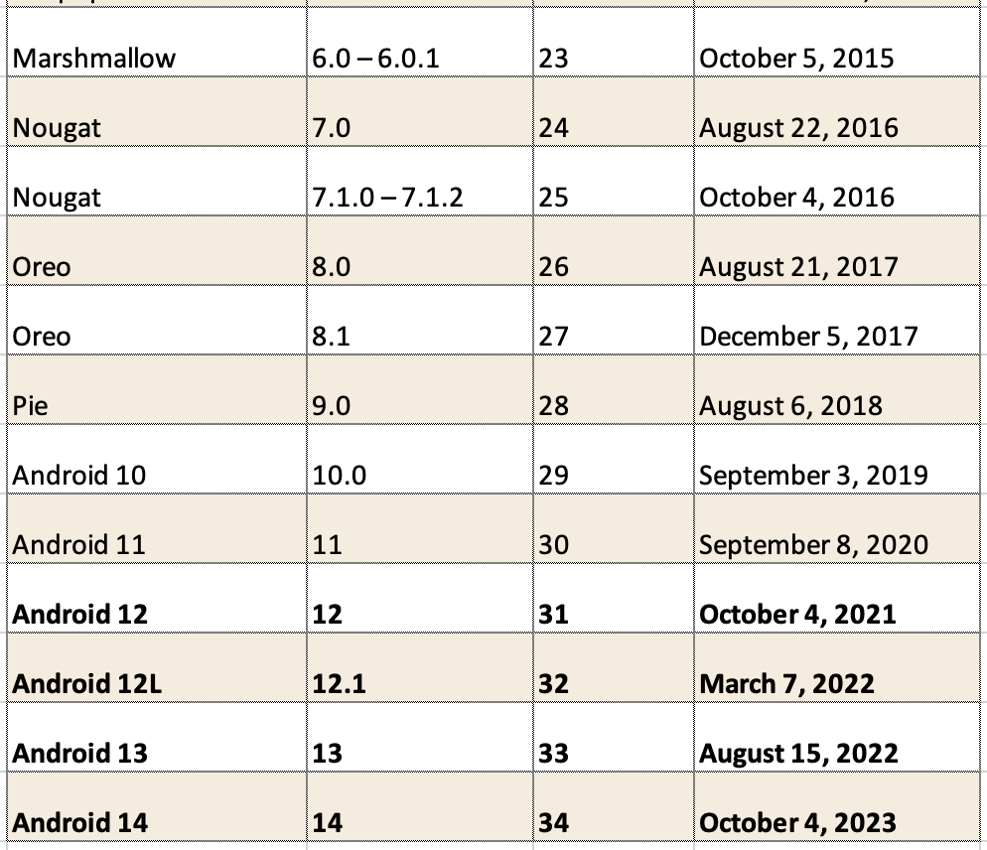
Android versions

Slide 13
Challenges of Android development
Multiple screen sizes and resolutions
Performance: make your apps responsive and smooth
Security: keep source code and user data safe
Compatibility: run well on older platform versions

Slide 14
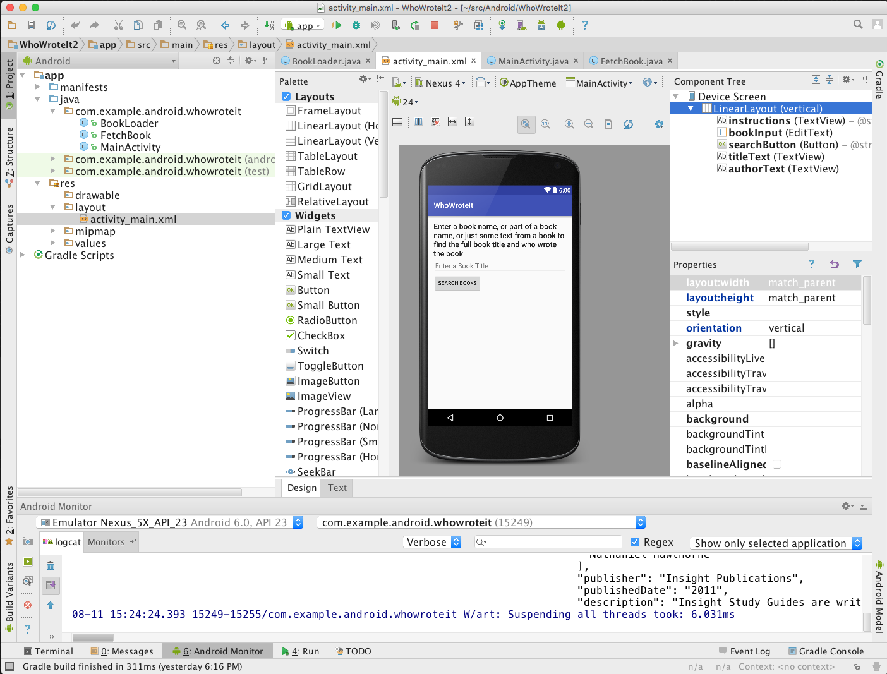
Android application development
Android Studio
Develop, run, debug, test, and package apps
Monitors and performance tools
Virtual devices
Project views
Visual layout editor

Slide 15
Android application development
Android Software Developer Kit (SDK)
Development tools (debugger, monitors, editors)
Libraries (maps, wearables)
Virtual devices (emulators)
Documentation (developers.android.com)
Sample code

Slide 16
References
https://google-developer-training.github.io/android-developer-fundamentals-course-concepts-v2/

Slide 17
Practice Project samples for groups (5 members)
Describe: Develop an Android application for Products Sale
Database: Using MySQL/SQLServer (using Restful API) or database on Firebase cloud
Functions:
Sign Up/Login screen: manage users
List of Products screen: show list of products
Product details screen: show information of a product
Product Cart screen: show products that user selects to buy
Billing screen: process payment of user
Show a notification if Cart has products when opening the application
Map screen: show Store’s location
Chat screen: customers can chat with Store

Slide 18
Other apps
Task management
Expense management
Story reading app
Music app
Video app
Weather app
Some games
Etc.

Slide 19
Requirement for project
Each member at least 3-4 screen (medium)
Submit source code & Document
Present the result.

