Slide 1
Android Permission

Slide 2
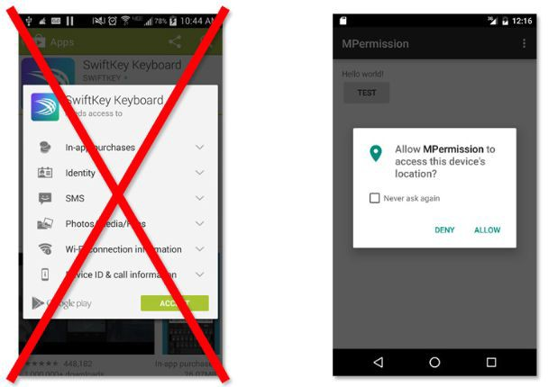
Android Permission
In Android 6.0 Marshmallow, application will not be granted any permission at installation time. Instead, application has to ask user for a permission one-by-one at runtime.

Slide 3
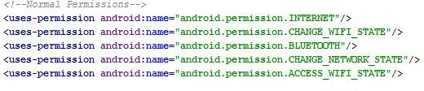
Normal Permissions

Slide 4
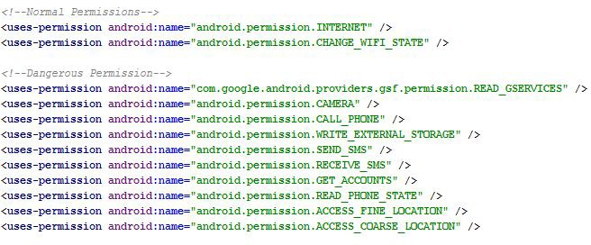
Dangerous Permissions

Slide 5
Permission Groups
Android 6.0 Marshmallow has nine main groups of permissions:
Calendar: Read and/or write to the calendar.
Camera: Give the application the ability to access the camera. Location: Access fine or coarse location.
Microphone: The ability to record audio.
Phone: Includes phone state; the ability to make calls, read, and write to the call log; and voicemail. Sensor: The ability to use various sensors in the device, like a gyroscope.
SMS: Similar to how the phone is handled including sending and receiving texts. MMS and cell broadcasts. Storage: Read and write to device’s external storage.

Slide 6
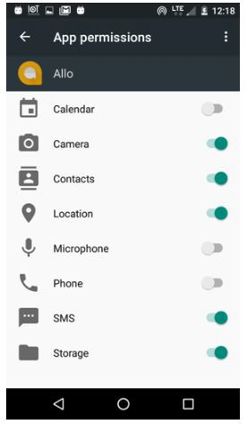
Manually Enabling and Disabling Runtime Permissions
Open your device’s Settings app.
Tap apps and find an app that you want to work with. Select it.
Tap applications permissions on the App Info screen.
You will see the list of permissions the app requests. Tap on the switch to turn it on or off.

Slide 7
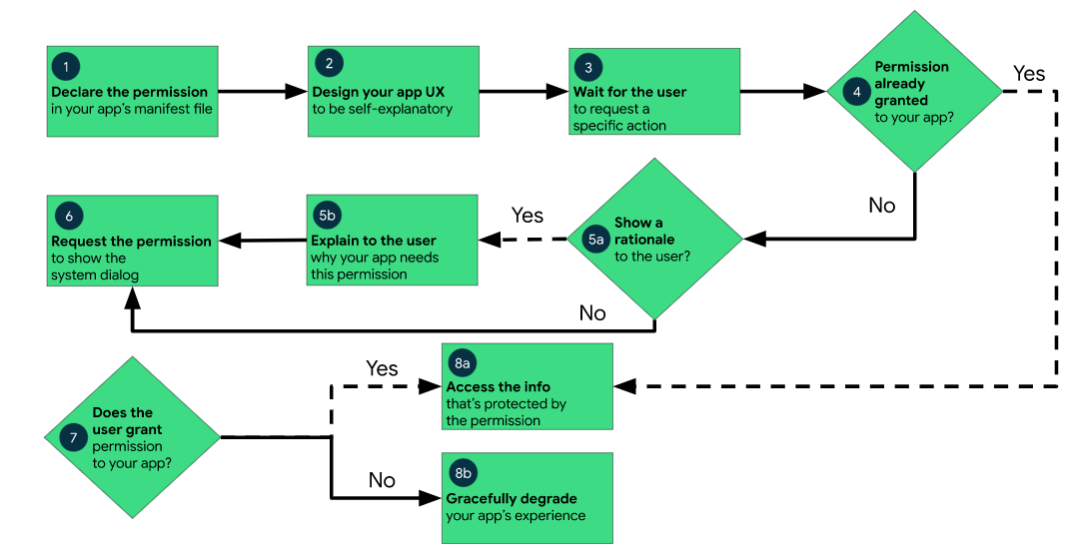
Workflow for handling android permission

Slide 8

How to Check for Runtime Permissions
Check the Target SDK Version
Check if Permission Is Granted

Slide 9
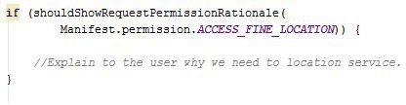
Handle "Never Ask Again"

Slide 10
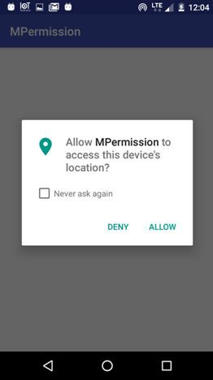
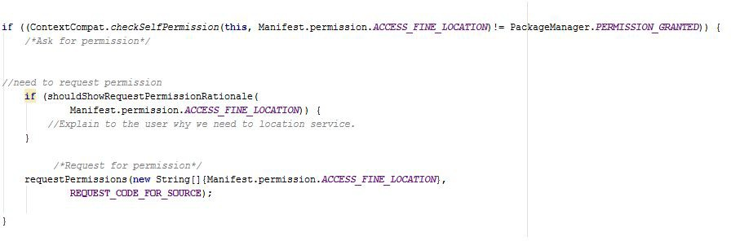
Request for Permission

Slide 11
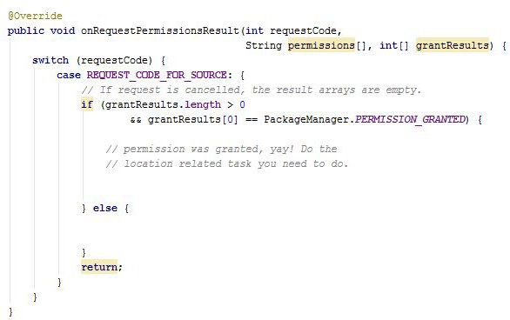
Handle the Permissions Request Response

Slide 12
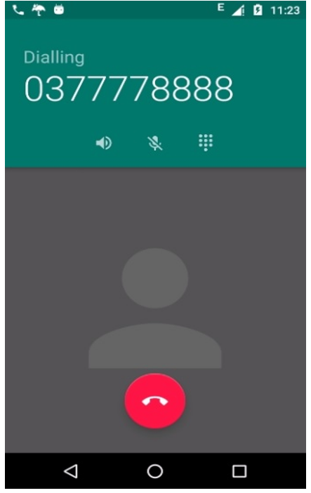
Classwork
In Product Details screen, add phone number of Store
Click Phone number, call the Store

Slide 13
References
https://developer.android.com/training/permissions/requesting
https://dzone.com/articles/android-runtime-permissions
https://inthecheesefactory.com/blog/things-you-need-to-know-about-android-m-permission-develope r-edition/en

