Slide 1
Android Notification

Slide 2
Contents
What are notifications?
Notification channels
Creating a notification channel
Creating notifications
Handling notification actions

Slide 3
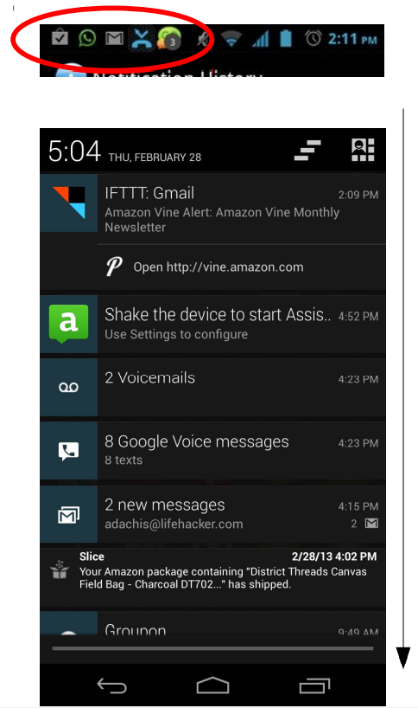
What are notifications
Notification: A message displayed to the user outside of any app's UI in a top notification drawer area.
– used to indicate system events, status of service tasks, etc.

Slide 4
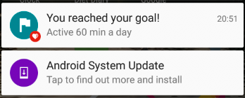
What are notifications
Notifications can have:
icons (small, large)
a title
a detailed description
one or more associated actions that will occur when clicked
..

Slide 5
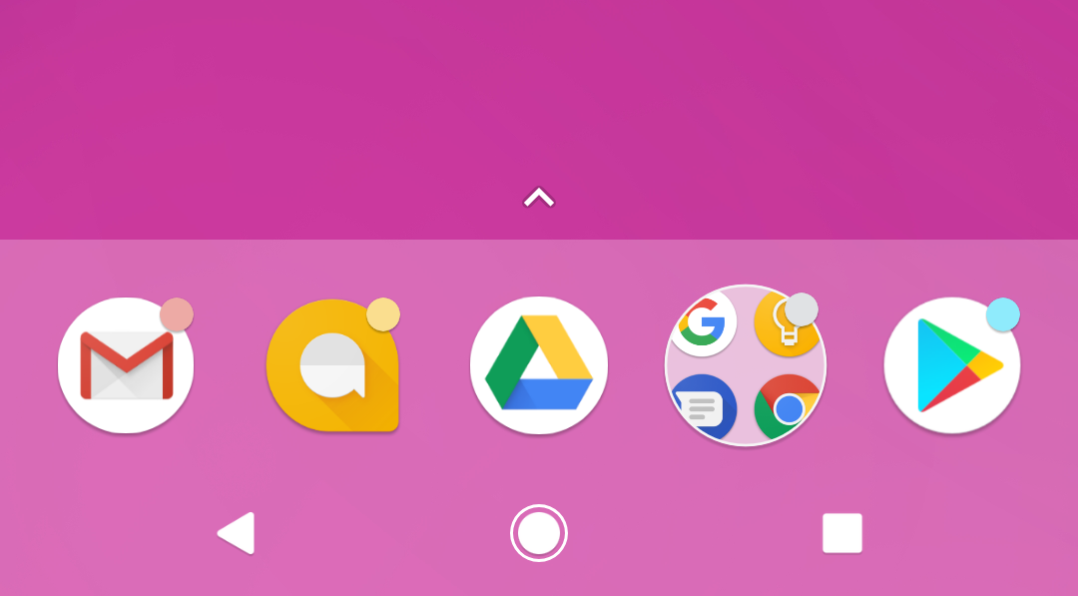
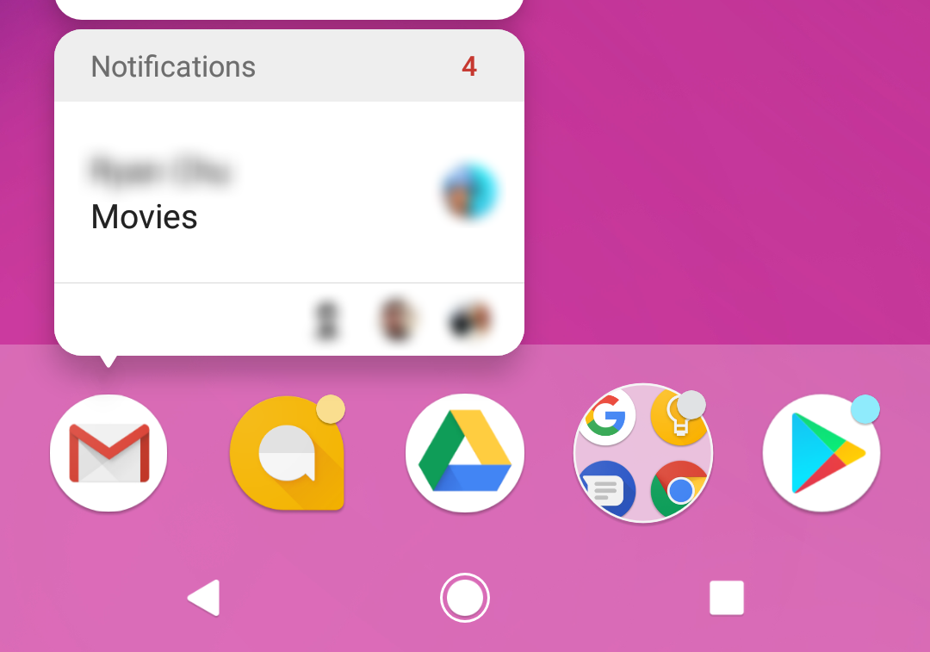
App icon badge
- Available only on the devices running Android 8.0 (API level 26) and higher.
New notifications are displayed as a colored "badge" (also known as a "notification dot") on the app icon.
Users can long-press on an app icon to see the notifications for that app. Similar to the notification drawer.

Slide 6
Notification channels
Used to create a user-customizable channel for each type of notification to be displayed.
More than one notification can be grouped in to a channel.
Set notification behavior like sound, light, vibrate and so on, applied to all the notifications in that channel.

Slide 7
Notification channels are mandatory
Notification channels are introduced in Android 8.0 (API level 26)
All notifications must be assigned to a channel starting from Android 8.0 (API level 26), else your notifications will not be displayed.
For the apps targeting lower than Android 8.0 (API level 26), no need to implement notification channels.

Slide 8
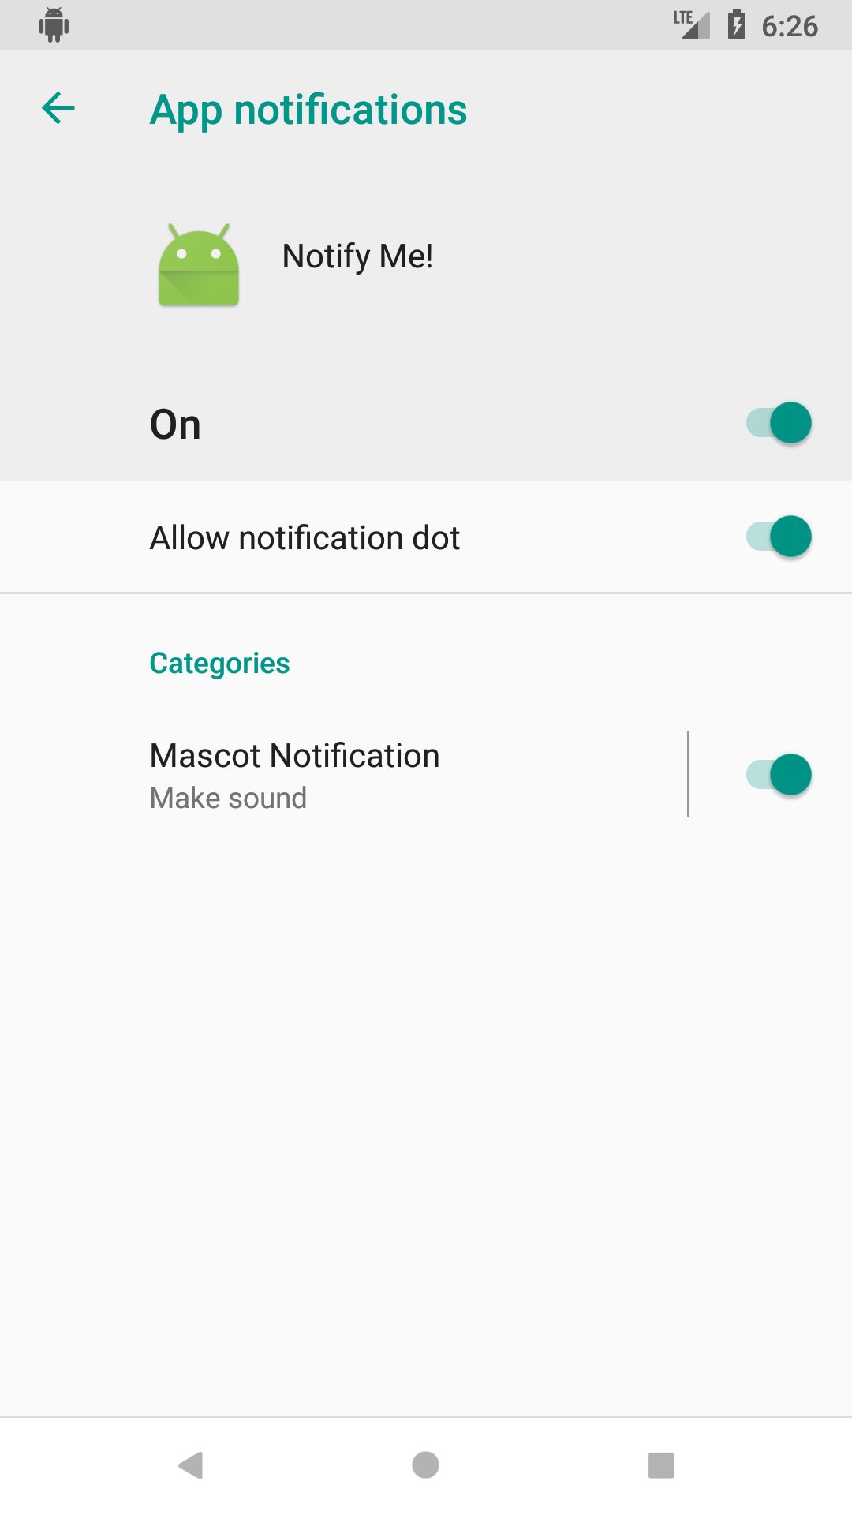
Notification channels in Settings
Notification channels appear as Categories under App notifications in the device Settings.

Slide 9
Create a Notification channel
Notification channel instance is created using NotificationChannel constructor.
You must specify:
An ID that's unique within your package.
User visible name of the channel.
The importance level for the channel.
if (Build.VERSION.SDK_INT >= Build.VERSION_CODES.O) {
NotificationChannel notificationChannel =
new NotificationChannel(CHANNEL_ID, "Mascot Notification",
NotificationManager.IMPORTANCE_DEFAULT);
}

Slide 10
Importance level
Available in Android 8.0 (API level 26) and higher.
Sets the intrusion level, like the sound and visibility for all notifications posted in the channel.
Range from IMPORTANCE_NONE(0) to IMPORTANCE_HIGH(4).
To support earlier versions of Android (Lower than API level 26), set the priority.

Slide 11
Notification priority
Determines how the system displays the notification with respect to other notifications, in Android version Lower than API level 26.
Set using the setPriority() method for each notification.
Range from PRIORITY_MIN to PRIORITY_MAX.
setPriority(NotificationCompat.PRIORITY_HIGH)

Slide 12
Importance level and priority constants
User-visible importance level | Importance (Android 8.0 and higher) | Priority (Android 7.1 and lower)
Urgent Makes a sound and appears as a heads-up notification | IMPORTANCE_HIGH | PRIORITY_HIGH or PRIORITY_MAX
High Makes a sound | IMPORTANCE_DEFAULT | PRIORITY_DEFAULT
Medium No sound | IMPORTANCE_LOW | PRIORITY_LOW
Low No sound and doesn't appear in the status bar | IMPORTANCE_MIN | PRIORITY_MIN

Slide 13
Creating notifications
Notification is created using NotificationCompat.Builder class.
Pass the application context and notification channel ID to the constructor.
The NotificationCompat.Builder constructor takes the notification channel ID, this is only used by Android 8.0 (API level 26) and higher, but this parameter is ignored by the older versions.
NotificationCompat.Builder mBuilder = new
NotificationCompat.Builder(this, CHANNEL_ID);

Slide 14
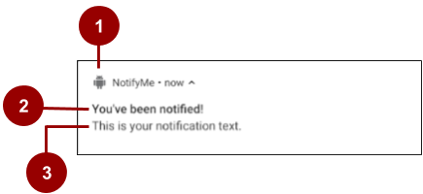
Setting notification contents
A small icon, set by setSmallIcon().
This is the only content that's required.
A title, set by setContentTitle().
The body text, set by setContentText(). This is the notification message.

Slide 15
Setting notification contents
NotificationCompat.Builder mBuilder =
new NotificationCompat.Builder(this, CHANNEL_ID)
.setSmallIcon(R.drawable.android_icon)
.setContentTitle("You've been notified!")
.setContentText("This is your notification text.");

Slide 16
Delivering notifications
Notification notification = mBuilder.build();
NotificationManager manager = (NotificationManager) getSystemService(Context.NOTIFICATION_SERVICE);
manager.notify(ID, notification)

Slide 17
Updating notifications
Update a notification by changing and or adding some of its content.
Issue notification with updated parameters using builder.
Call notify() passing in the same notification ID.
If previous notification is still visible, system updates.
If previous notification has been dismissed, new notification is delivered.

Slide 18
Canceling notifications
Notifications remain visible until:
User dismisses it by swiping or by using "Clear All".
Calling setAutoCancel() when creating the notification, removes it from the status bar when the user clicks on it.
App calls cancel() or cancelAll() on NotificationManager.
mNotifyManager.cancel(NOTIFICATION_ID);

Slide 19
Handling notification actions
Normally when the user clicks on a notification, an action should occur. (direct the user to a particular app / activity, etc.)
– To achieve this, use an intent inside your notification.
– Must wrap it inside a "pending intent" object.
Notification.Builder builder = ...;
Intent intent = new Intent(this, ActivityClassName.class);
intent.putExtra("key1", "value1");
...
PendingIntent pending = PendingIntent.getActivity(
this, 0, intent, 0);
builder.setContentIntent(pending);
Notification notification = builder.build();

Slide 20
Classwork
When opening the app, if there is product in the cart
Show a notification on status bar to remind user about selected products
When clicking on the notification, open a Cart screen

Slide 21
References
https://google-developer-training.github.io/android-developer-fundamentals-course-concepts-v2/

