Slide 1
Android Service

Slide 2
Contents
What is Service?
Types of Services
Service Lifecycle
How to use Service
Intent Service

Slide 3
What is Service?
A Service is an application component that can perform long-running operations in the background and does not provide a user interface.
Started with an Intent.
Can stay running when user switches applications.
Lifecycle—which you must manage.
Other apps can use the service—manage permissions.
Runs in the main thread of its hosting process.

Slide 4
What is Service?
Service is good for:
Network transactions.
Play music.
Perform file I/O.
Interact with a database.

Slide 5
Types of Services
Started Service
Started with startService()
Runs indefinitely until it stops itself or called stopService() from outside
Usually does not update the UI
Bound Service
Offers a client-server interface that allows components to interact with the service
Clients send requests and get results
Started with bindService()
Ends when all clients unbind

Slide 6
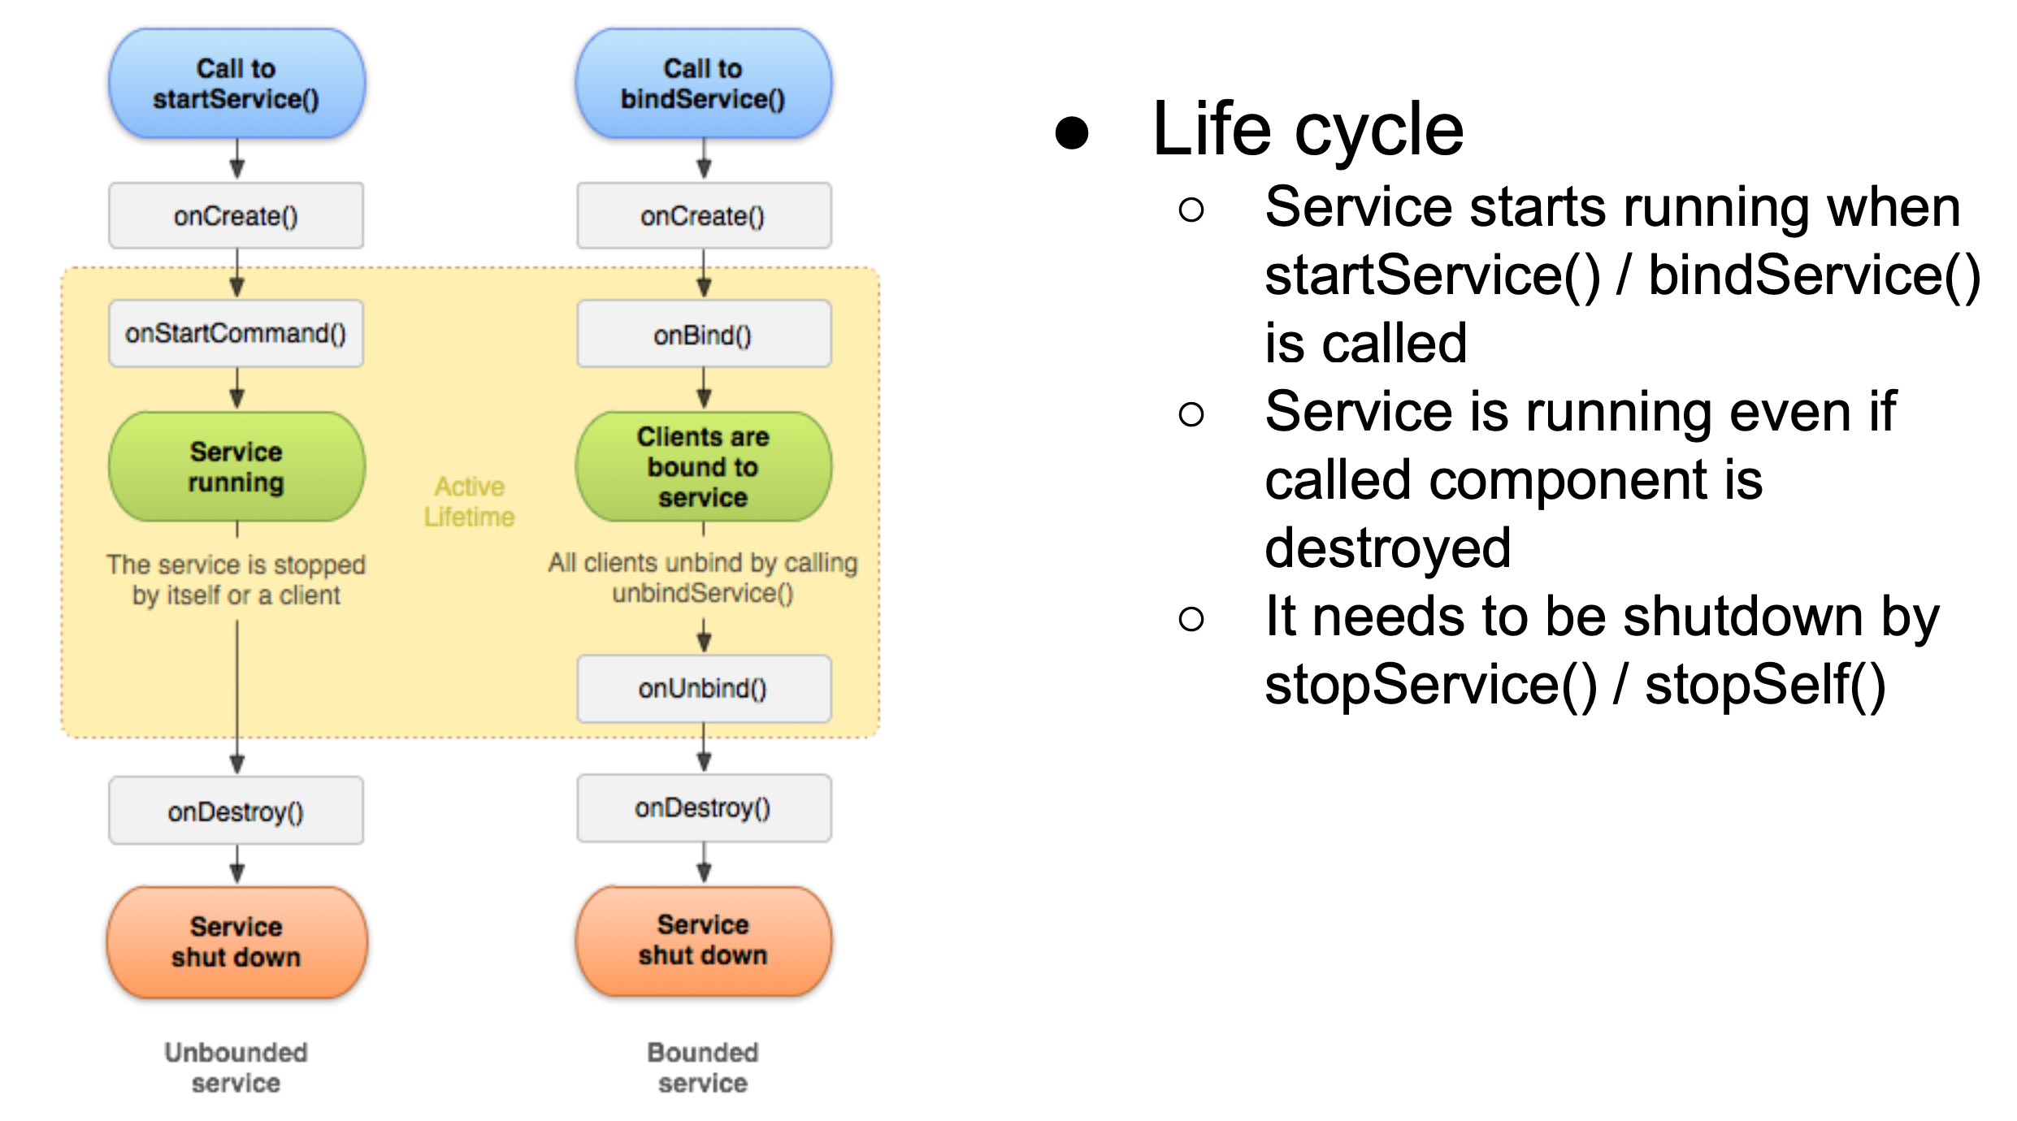
Service Lifecycle

Slide 7
Service Lifecycle
onCreate()
Called when the service is being created (after first call of startService() or bindService())
onStartCommand()
Called when startService() is called, delivers starting intent
Returned value specify behaviour when it’s killed by system
START_STICKY - don’t retain intent, later when system recreate service null intent is delivered (explicitly started/stopped services)
START_NOT_STICKY - if there is no start intent, take service out of the started state. Service is not recreated.
START_REDELIVER_INTENT - last delivered intent will be redelivered, pending intent delivered at the point of restart

Slide 8
Service Lifecycle
onBind()
When another component binds to service
Returns Binder object for communication
onUnbind()
When all clients disconnected from interface published by service
Returns true when onRebind should be called when new clients bind to service,
otherwise onBind will be called

Slide 9
Service Lifecycle
onRebind()
Called when new clients are connected, after notification about disconnecting all client
in its onUnbind
onDestroy()
Called by system to notify a Service that it is no longer used and is being removed.
Cleanup receivers, threads.

Slide 10
Foreground services
Runs in the background but requires that the user is actively aware it exists—e.g. music player using music service
Higher priority than background services since user will notice its absence—unlikely to be killed by the system
Must provide a notification which the user cannot dismiss while the service is running

Slide 11
Background services limitations
Starting from API 26, background app is not allowed to create a background service.
A foreground app, can create and run both foreground and background services.
When an app goes into the background, the system stops the app's background services.
The startService() method now throws an IllegalStateException if an app is targeting API 26.
These limitations don't affect foreground services or bound services.

Slide 12
Creating a service
<service android:name=".ExampleService" />
Manage permissions.
Subclass IntentService or Service class.
Implement lifecycle methods.
Start service from Activity.
Make sure service is stoppable.

Slide 13
Stopping a service
A started service must manage its own lifecycle
If not stopped, will keep running and consuming resources
The service must stop itself by calling stopSelf()
Another component can stop it by calling stopService()
Bound service is destroyed when all clients unbound
IntentService is destroyed after onHandleIntent() returns

Slide 14
Intent Service
Subclass of Service
Simple service with simplified lifecycle
Uses worker thread to handle requests
Handle only one request at one time
Creates work queue
Stops when it run out of work
Override onHandleIntent(Intent) for processing requests, runs on worker thread

Slide 15
IntentService Limitations
Cannot interact with the UI
Can only run one request at a time
Cannot be interrupted

Slide 16
IntentService Implementation
public class HelloIntentService extends IntentService {
public HelloIntentService() { super("HelloIntentService");}
@Override
protected void onHandleIntent(Intent intent) {
try {
// Do some work
} catch (InterruptedException e) {
Thread.currentThread().interrupt();
}
} // When this method returns, IntentService stops the service, as appropriate.
}

Slide 17
Classwork
Create a play music service
Start playing music in the background when we start the service and that music will play continuously until we stop the service in the android application.

Slide 18
References
https://google-developer-training.github.io/android-developer-fundamentals-course-concepts-v2/

