Slide 1
Multithread

Slide 2
Contents
Main thread
Worker thread
Some multithread methods

Slide 3
Main thread
Independent path of execution in a running program
Code is executed line by line
App runs on Java thread called "main" or "UI thread"
Draws UI on the screen
Responds to user actions by handling UI events

Slide 4
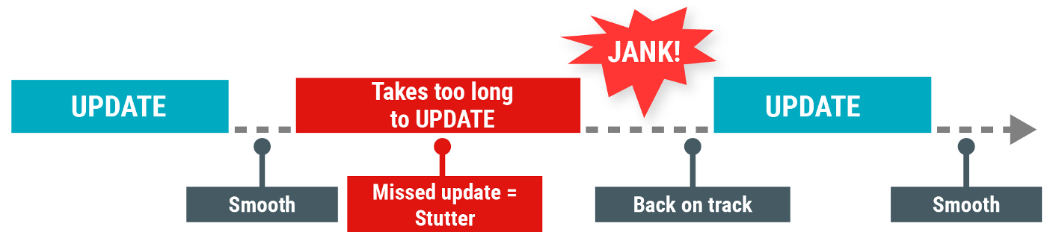
Main thread
Hardware updates screen every 16 milliseconds
UI thread has 16 ms to do all its work
If it takes too long, app stutters or hangs
WAIT

Slide 5
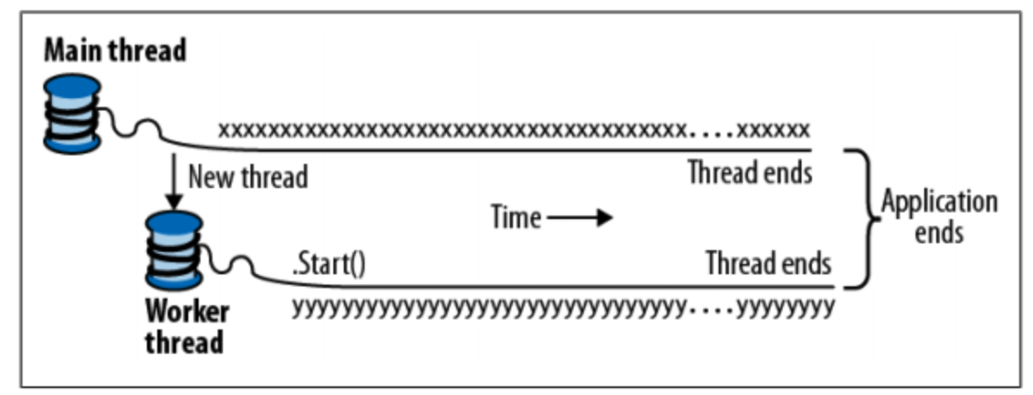
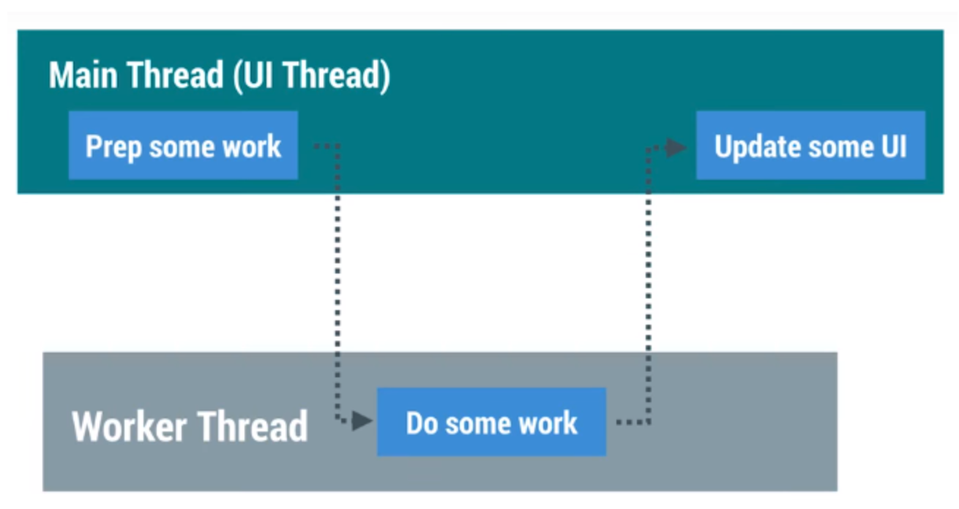
Worker thread

Slide 6
Worker threads do:
Network operations
Long calculations
Downloading/uploading files
Processing images
Loading data

Slide 7
Two rules for Android threads
Do not block the UI thread
Complete all work in less than 16 ms for each screen
Run slow non-UI work on a non-UI thread
Do not access the Android UI toolkit from outside the UI thread
Do UI work only on the UI thread

Slide 8
Some methods to create worker thread and update UI
Using thread and runOnUiThread method: used to execute a piece of code on the main thread, also known as the UI thread
Using Executor: Provides a flexible and robust way to handle background tasks, especially with ExecutorService and Handler for updating the UI.

Slide 9
Using thread and runOnUiThread method
//TODO: Prepare some works Thread t = new Thread(new Runnable() { @Override public void run() { //TODO: do some long task runOnUiThread(new Runnable() { @Override public void run() { //TODO: update UI here } }); } }); t.start();

Slide 10
Using Executor
// 1. Create an Executor ExecutorService executorService = Executors.newSingleThreadExecutor(); // 2. Create a Handler to post results back to the UI thread Handler handler = new Handler(Looper.getMainLooper()); // 3. Execute the task using Executor executorService.execute(new Runnable() { @Override public void run() { // Background task String result = "Kết quả từ Executor"; // Post the result back to the UI thread handler.post(new Runnable() { @Override public void run() { // Update UI textView.setText(result); } }); } });

Slide 11
Classwork
Using runOnUiThead or Executor to download 1 image from Url into an ImageView

Slide 12
Code to load an image from url
URL url = new URL(str); HttpsURLConnection connection = (HttpsURLConnection) url.openConnection(); connection.setDoInput(true); connection.connect(); InputStream inputstream = connection.getInputStream(); BufferedInputStream buffer = new BufferedInputStream(inputstream); Bitmap bitmap = BitmapFactory.decodeStream(buffer); return bitmap;

Slide 13
References
https://google-developer-training.github.io/android-developer-fundamentals-course-concepts-v2/

