Slide 1
Fragment

Slide 2
Contents
What is Fragment
Create Fragment
Interact with Activity

Slide 3
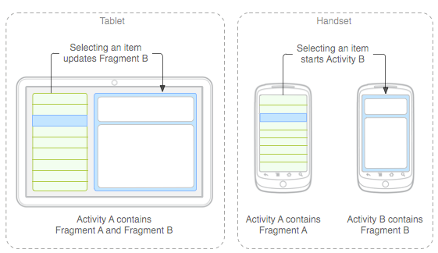
Fragment
Fragment: A reusable segment of Android UI that can appear in an activity.
can help handle different devices and screen sizes
can reuse a common fragment across multiple activities

Slide 4
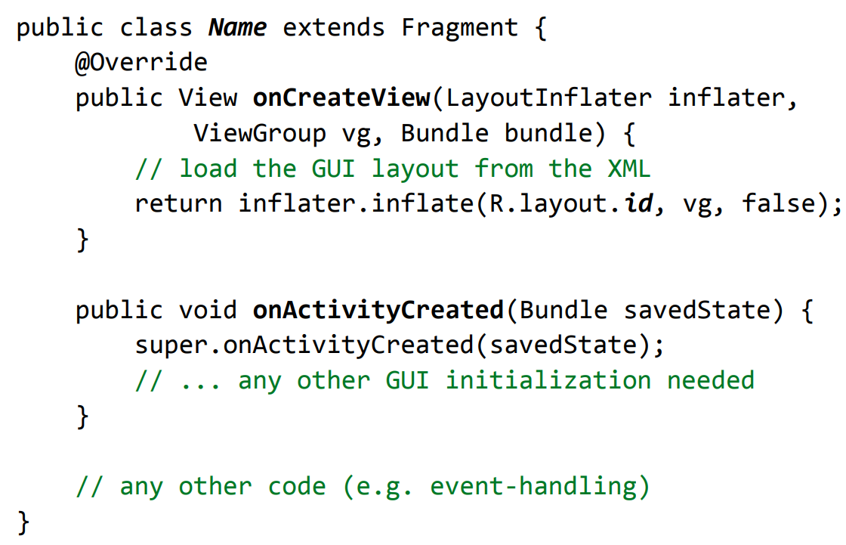
Create Fragment

Slide 5
Add Fragment to Activity
Static way:
<LinearLayout
android:layout_width="match_parent"
android:layout_height="match_parent">
<fragment android:name="com.example.news.ArticleListFragment"
android:layout_width="match_parent"
android:layout_height="match_parent" />
</LinearLayout>

Slide 6
Add Fragment to Activity
Dynamic way:
FragmentManager fragmentManager = getFragmentManager();
FragmentTransaction fragmentTransaction =
fragmentManager.beginTransaction();
ExampleFragment fragment = new ExampleFragment();
fragmentTransaction.add(R.id.fragment_container, fragment);
transaction.addToBackStack(null);
fragmentTransaction.commit();

Slide 7
Communicate with Activity
From Activity to Fragment:
keep fragment instance in Activity and call fragment methods directly
From Fragment to Activity
Pass a callback when the Fragment is created
public static class MainActivity extends Activity implements OnHeadlineListener {
@Override
public void onAttachFragment(Fragment fragment) {
if (fragment instanceof HeadlinesFragment) {
HeadlinesFragment headlinesFragment =
(HeadlinesFragment) fragment;
headlinesFragment.setOnHeadlineListener(this);
}
}
}
public class HeadlinesFragment extends Fragment {
OnHeadlineListener callback;
public void setOnHeadlineListener(OnHeadlineListener callback)
{
this.callback = callback;
}
public interface OnHeadlineListener {
public void onArticleSelected(int position);
}
}

Slide 8
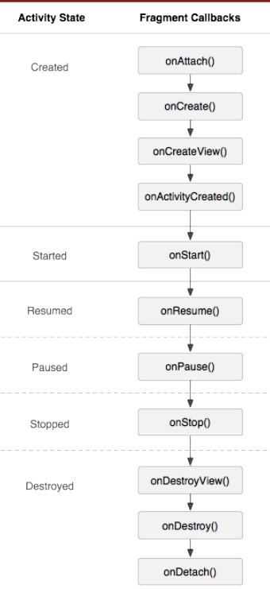
Fragment lifecycle
Fragments have a similar life cycle and events as activities.
Important methods:
onAttach to glue fragment to its surrounding activity
onCreate when fragment is loading
onCreateView method that must return fragment's root UI view
onActivityCreated method that indicates the enclosing activity is ready
onPause when fragment is being left/exited
onDetach just as fragment is being deleted

Slide 9
Fragment lifecycle
Fragment in an Activity---Activity Lifecyle influences
Activity paused -> all its fragments paused
Activity destroyed -> all its fragments destroyed
Activity running -> manipulate each fragment independently.
Fragment transaction: add, remove, etc.
adds it to a back stack that's managed by the activity—each back stack entry in the activity is a record of the fragment transaction that occurred.
The back stack allows the user to reverse a fragment transaction (navigate backwards), by pressing the Back button

Slide 10
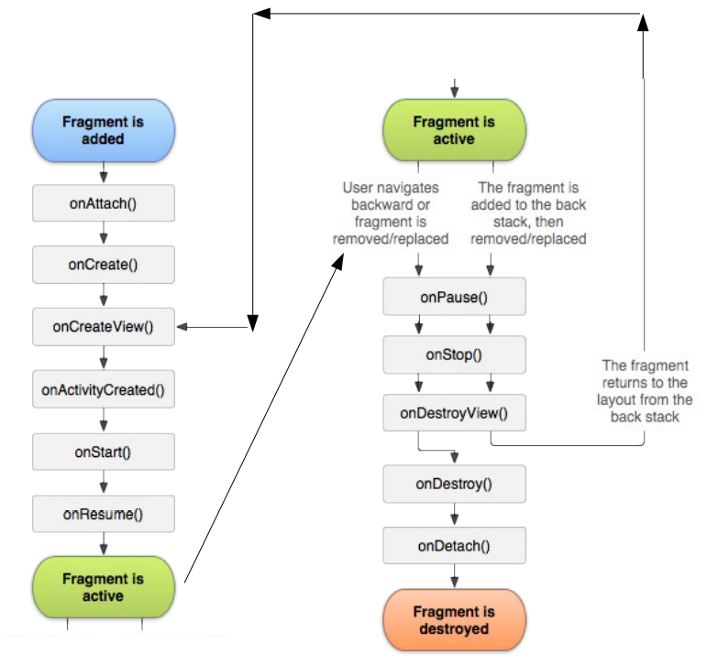
Fragment lifecycle

Slide 11
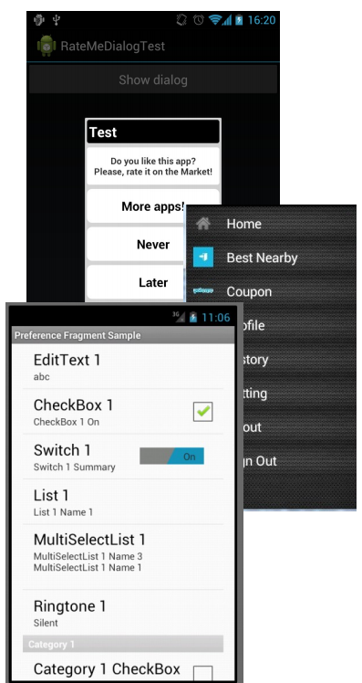
Fragment subclasses
DialogFragment - a fragment meant to be shown as a dialog box that pops up on top of the current activity.
ListFragment - a fragment that shows a list of items as its main content.
PreferenceFragment - a fragment whose main content is meant to allow the user to change settings for the app

Slide 12
Classwork
Using Fragment to make:
A ListProduct Fragment
A DetailedProduct Fragment
Click an Item in ListProject Fragment, show DetailedProduct Fragment

Slide 13
References
https://google-developer-training.github.io/android-developer-fundamentals-course-concepts-v2/

